Slide 1
.NET
CREATED BY:
Tech Titans

Slide 2
WHAT IS .NET
Microsoft .NET is a software development framework and a collection of technologies created by microsoft to help developers easily build applications and connect information, people, systems, and devices.
It provides:
A runtime to execute programs
A huge library of ready-made functionalities
Support for multiple programming languages
Tools to build web, desktop, mobile, cloud, iot, and gaming applications
.Net is all about creation, consumption and delivery of services

Slide 3
HISTORY
Before .NET, windows applications were built using:
Win32 API, VB6 (visual basic 6), C++
These technologies were:
Hard to maintain, not consistent, missing features like garbage collection, complex for beginners
2000 – .Net announced - microsoft introduced the .Net framework, c#, and clr to simplify development and compete with java.
2002 – .Net framework 1.0 - released with CLR 1.0, base class library, ASP.NET, windows forms, and support for C# & VB.Net.
2016 – .Net core - cross-platform, open-source, fast, and lightweight—runs on windows, linux, and macos.
2020 – .Net 5 - unified .Net framework, .Net core, and xamarin into one modern platform.
Today - a unified, cross-platform, high-performance framework for web, mobile, desktop, cloud, and ai apps.

Slide 4
MICROSOFT C#
C# (pronounced c-sharp) is a modern, object-oriented programming language created by Microsoft for building powerful, safe, and high-performance applications on the .NET platform.
It is designed to be easy to learn, clean, and structured while offering advanced features for real-world software development.
C# is widely used to create web apps, desktop software, mobile apps, cloud services, apis, and even games using unity.
C# provides:
A runtime to run your code
A library of ready-made functions
Tools to make development fast and easy

Slide 5
IMPACT’S
PROBLEM | HOW .NET SOLVED IT
Hard to build apps in older Windows technologies | Provided unified library and runtime
No built-in memory management | Introduced Garbage Collection
No consistent language model | Introduced CLS, CTS, CLR
Windows-only limitations | Introduced .NET Core → Cross platform
Poor security | Introduced Code Access Security
Need for fast, scalable apps | Modern JIT compiler, optimized runtime

Slide 6
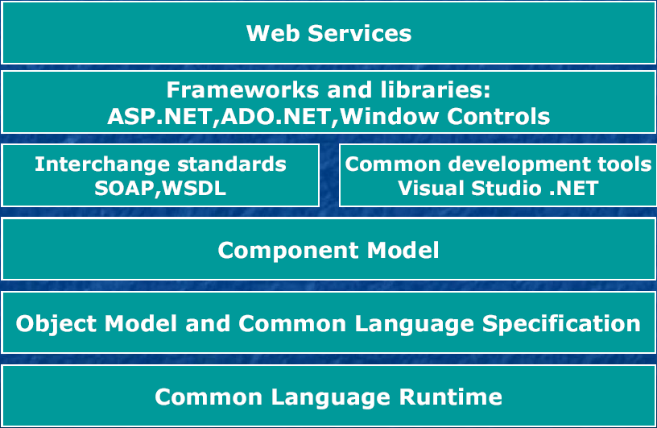
.NET ARCHITECTURE

Slide 7
.NET ARCHITECTURE COMPONENTS
CLR (Common Language Runtime)
The heart of .NET
Executes code
Manages memory
Handles security
Performs garbage collection

Slide 8
.NET ARCHITECTURE COMPONENTS
2. BCL (Base Class Library)
A collection of ready-to-use features:
A collection of ready-to-use features:
Networking
Encryption
Collections (List, Dictionary)
Math & UI controls

Slide 9
.NET ARCHITECTURE COMPONENTS
3. Languages
All languages compile into MSIL/IL and run on CLR.
WHY ONLY THESE LANGUAGES SUPPORT .NET?
They follow CLS (Common Language Specification) Rules for all .NET languages.
They compile to IL (Intermediate Language) Then CLR executes it.
They follow CTS (Common Type System) So a class written in C# can be used in VB.NET and vice versa.
C#
VB.NET
F#
Powershell
IronPython & IronRuby

Slide 10
.NET FRAMEWORK
ASP.NET
Windows Forms
Web Services
Web Forms
Controls
Drawing
ASP.NET Application Services
Windows Application Services
Framework Class Library
ADO.NET
XML
Threading
IO
Network
Security
Diagnostics
Etc.
Common Language Runtime
Memory Management
Common Type System
Lifecycle Monitoring

Slide 11
.NET SECURITY
.Net security = protecting your app + protecting your data + protecting your users + protecting your machine.
The .NET security framework architecture consists of the following five core elements:
Evidence Based Security
Code Access Security
Verification
Role Based Security
Cryptography

Slide 12
BENCHMARK
NVC BBD

Slide 13
APPLICATION OF .NET
NVC BBD

Slide 14
SUMMARY
.Net is a powerful, secure, and flexible development platform that allows developers to build any type of application using modern tools and languages like c#.
Its continuous upgrades, strong performance, and cross-platform support make it one of the most reliable and future-ready technologies in the software industry.
Whether it's web, mobile, desktop, cloud, or gaming — .NET provides a complete ecosystem to create fast, scalable, and high-quality applications.

Slide 15
THANK YOU

