Slide 1


Third Ear
Real-Time AI Audio Description for Live Video.

Slide 2

The Problem: Left in the Dark
A massive audience: Over 2.2 billion people worldwide live with visual impairment.
Completely manual: Traditional audio description relies entirely on human writers and voice actors.
Too slow for today: Because it's manual, it’s expensive and restricted only to pre-recorded media like Netflix.
The blind spot: This leaves live streams, breaking news, and interactive broadcasts with zero accessibility.

Slide 3

The Solution: Third Ear
100% Automated & Real-Time
Dynamic Scene Analysis
"Smart Injection" Technology
Non-Disruptive
Instantly translates live on-screen action into accurate text.
Continuously monitors the native audio track for silence.
Seamlessly injects spoken AI descriptions only during natural dialogue pauses.
Zero human scripting or voice acting required.

Slide 4
Under the Hood: The Tech Stack
Fishjam: Low-latency real-time video/audio streaming infrastructure.
Gemini Live API: Multimodal vision engine analyzing video frames for context.
PyAV / FFmpeg: Real-time media processor intercepting the live stream.
Torch & Torchaudio: High-speed audio data transformation.
VAD (Voice Activity Detection): Neural network analyzing the audio track to identify silence gaps.

Slide 5

Demo: Third Ear in Action

Slide 6
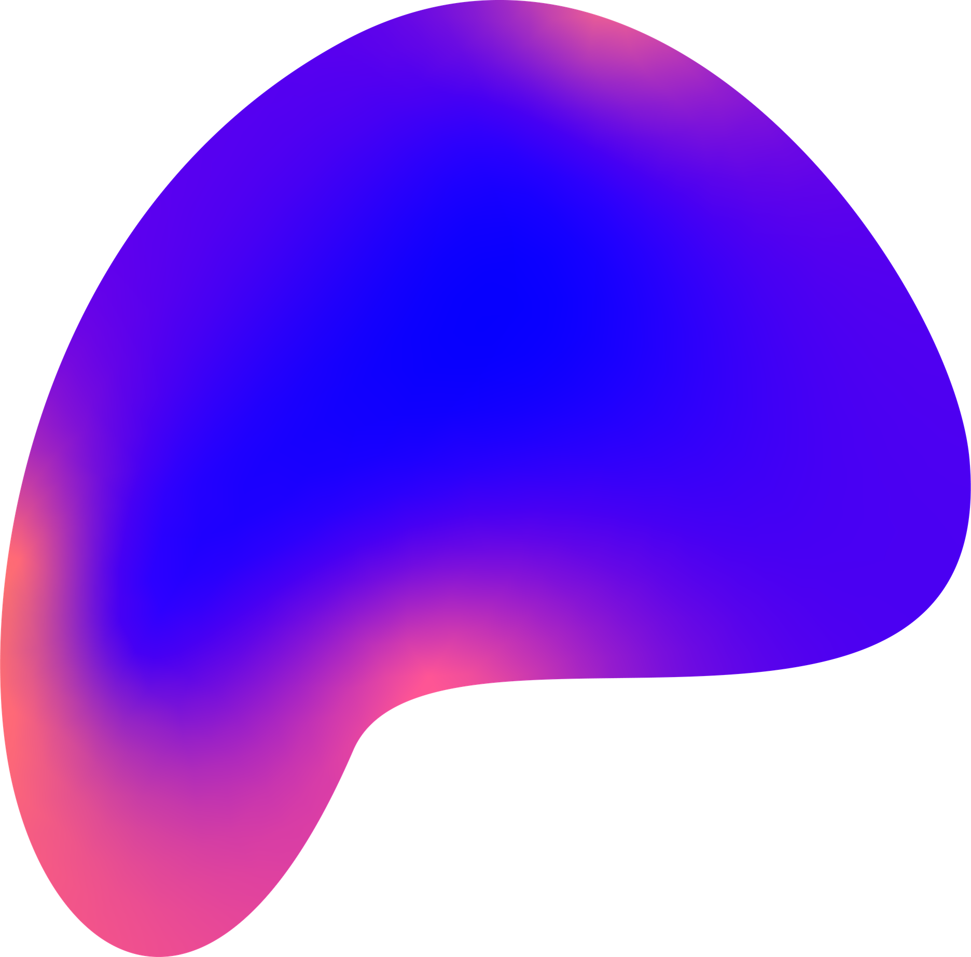
Future Roadmap & Impact
Multi-User Personalization: Individual users in a Fishjam room can select their preferred description detail.
Global Reach: Real-time, on-the-fly translation into multiple languages.
Broad Application: Expanding to live educational webinars, e-sports, and breaking news.
The Vision: Making the live internet 100% accessible.

