Slide 1


Introduction to Networking
and the Wireless Edge
AI-Edge summer REU program
Jim Kurose
University of Massachusetts, Amherst

Slide 2
Overview of today’s REU seminar
Networking 101 - in 10 minutes
Wireless networks: motivation, applications
Architectural components of a wireless network
5G: architectural overview
5G: selected topics for REU
For more information:
Networking: http://gaia.cs.umass.edu/kurose_ross
Wireless Networking: https://gaia.cs.umass.edu/wireless_and_mobile_networking

Slide 3
















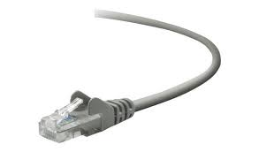
The Internet: a “nuts and bolts” view
Billions of connected computing devices:
running Internet applications
clients, servers
5.3 B Internet users (2024)
mobile network
national or global ISP
Packet switches: forward packets (chunks of data)
routers, switches
local or regional ISP
Internet
Communication links
fiber, copper, radio, satellite
transmission rate: bandwidth
home network
content
provider
network
datacenter
network
Networks
collection of devices, routers, links: managed by an organization
enterprise
network

Slide 4
What is the Internet: a “nuts and bolts” view
mobile network
Network edge:
user devices at network edge: clients
servers often in data centers
national or global ISP
local or regional ISP
home network
content
provider
network
datacenter
network
enterprise
network

Slide 5
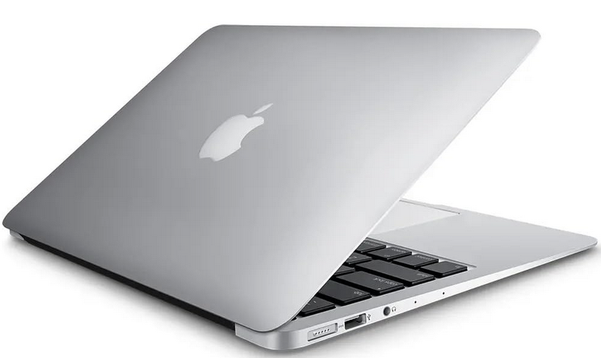



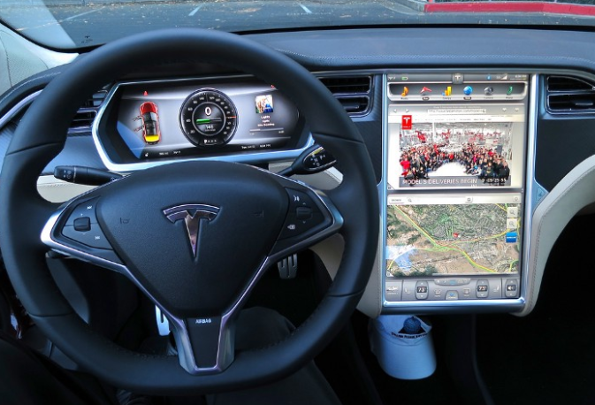



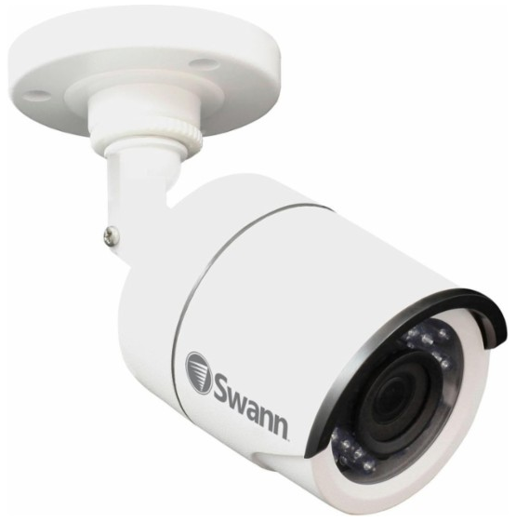
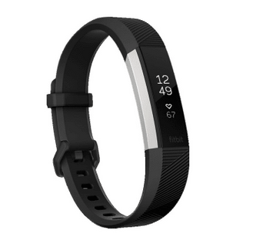

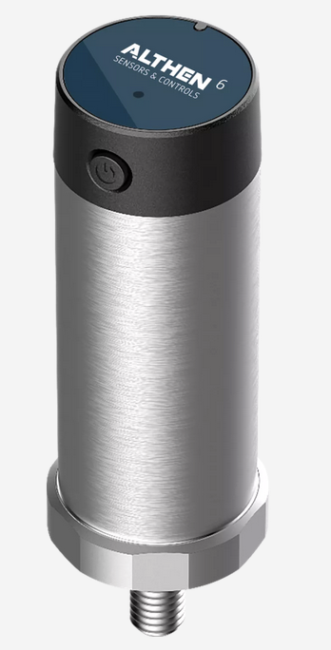


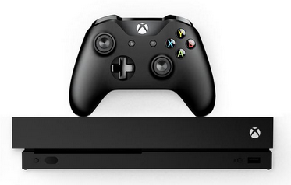
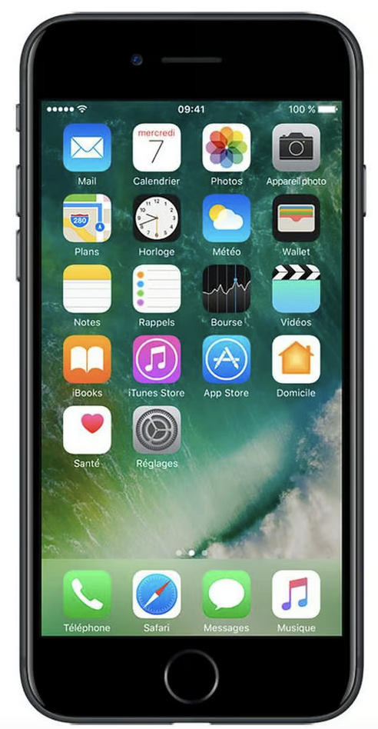

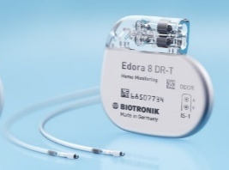

Internet-connected devices (not just computers)
Tweet-a-watt:
monitor energy use
laptop
bikes
Web-enabled toaster +
weather forecaster
Amazon Echo
IP picture frame
wireless and mobile devices
Internet
refrigerator
cars
Slingbox: remote
control cable TV
sensor
Security Camera
scooters
Fitbit
AR devices
Gaming devices
diapers
Internet phones
Pacemaker & Monitor

Slide 6
What is the Internet: a “nuts and bolts” view
Network devices:
user devices: aka “clients”
servers often in data centers
mobile network
national or global ISP
Network edge:
devices, servers connect directly to access networks: (Comcast, Verizon, UMass, company networks)
local or regional ISP
home network
content
provider
network
Network core:
interconnected regional, national, global Internet Service Providers (ISPs): AT&T, Sprint, Level-3, NTT
interconnected global company networks (e.g., Google, Facebook)
datacenter
network
enterprise
network

Slide 7


Packet switching
mobile network
hosts break application-layer messages into packets
network forwards packets from one router to the next, across links on path from source to destination
destination re-assembles packets into application message
national or global ISP
local or regional ISP
4 3 2 1
home network
content
provider
network
datacenter
network
enterprise
network

Slide 8
Wireless and Mobile Networks: context
more mobile-broadband-connected (cellular) devices than fixed-broadband-connected devices devices (5-1 in 2025)!
wireless connectivity even great when WiFi users considered (80% of broadband homes use WiFi)
8000
7000
6000
5000
Mobile broadband subscribers (M)
4000
Broadband subscribers (M)
3000
2000
Fixed (wired) broadband subscribers (M)
1000
2007
2008
2009
2010
2011
2012
2013
2014
2015
2016
2017
2018
2019
2020
2021
2022
2023
Data source: www.statista.com (1/25)

Slide 9
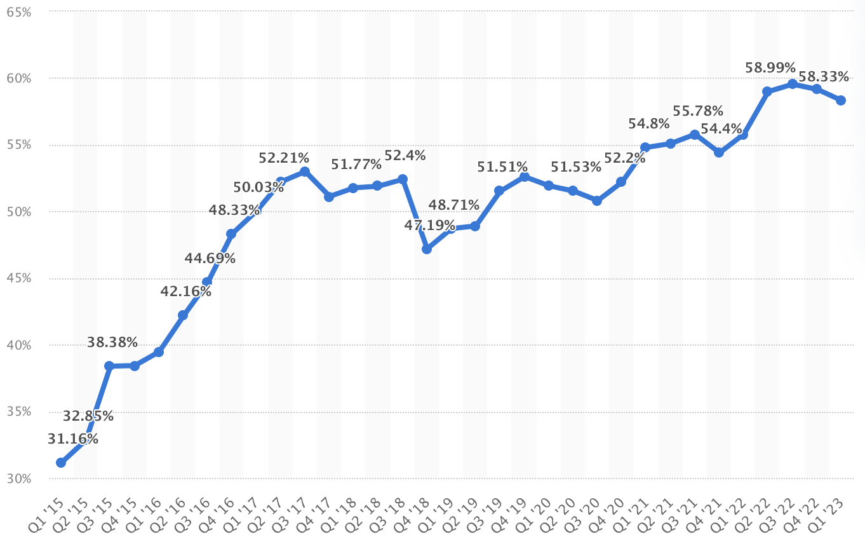
Wireless and Mobile Networks: context
Majority of Internet web site traffic directed to mobile (rather than fixed) devices
% global website traffic generated by mobile devices (excluding tablets)
Image source: www.statista.com (11/23)

Slide 10
Wireless applications their needs
Six application areas :
Application needs:
Wide-area Mobile Wireless Internet Access
Local-area Mobile Wireless Internet Access
Fixed Wireless Internet Access
Satellite Networks for Internet Access and Sensing
Cable replacement
Internet of Things (IoT)
high importance
user data rate
mobility
user data rate
mobility
medium
low
energy efficiency
area traffic capacity
energy
efficiency
area traffic capacity
latency
device density
latency
device density

Slide 11

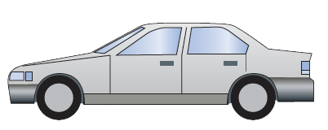
Wide-area Mobile Wireless Internet Access
Q: two high importance, 1 medium/low importance
device ranges over tens or hundreds of miles while maintaining continuous Internet connectivity (e.g., VoIP, streaming, ongoing TCP connection)
only provided by cellular networks
mobility
high importance
user data rate
medium
low
area traffic capacity
latency
device density
energy
efficiency
wide-area mobile Internet access

Slide 12






Internet-of-Things
Q: two high importance, 1 medium/low importance
connecting devices (often small, energy-constrained) to computation that senses, monitors, reports, and controls phenomena in the physical world
Bluetooth, WiFi, cellular, LoRaWAN
mobility
high importance
user data rate
medium
low
area traffic capacity
latency
device density
energy
efficiency
Internet of Things

Slide 13
Overview of today’s REU seminar
Networking 101 - in 10 minutes
Wireless networks: motivation, applications
Elements of a wireless network
5G: architectural overview
5G: selected topics for REU
For more information:
Networking: http://gaia.cs.umass.edu/kurose_ross
Wireless Networking: https://gaia.cs.umass.edu/wireless_and_mobile_networking

Slide 14

















Elements of a wireless network
wired network
infrastructure

Slide 15



Elements of a wireless network
wireless hosts
laptop, smartphone, IoT
run applications
may be stationary (non-mobile) or mobile
wireless does not always mean mobility!
wired network
infrastructure

Slide 16

Elements of a wireless network
base station
typically connected to wired network
relay - responsible for sending packets between wired network and wireless host(s) in its “area”
e.g., 4G/5G cell towers, 802.11 (WiFi) access points (APs)
wired network
infrastructure

Slide 17

Elements of a wireless network
wireless link
typically used to connect device(s) to base station, also used as backbone link
multiple access protocol coordinates link access (random access, FDMA, TDMA, CDMA, polling)
various transmission rates and distances, frequency bands
wired network
infrastructure
Ad hoc networks: not all wireless networks are connected into a larger network

Slide 18

Elements of a wireless network
wireless device radio
wireless device has different radios for different networks
iPhone16: has ~11 different radios, many antennae
5 different cellular radios, WiFi, Bluetooth, UWB, satellite NFC, GPS
wired network
infrastructure
Notes:
5G NR (New Radio): Supports both Non-Standalone (NSA) and Standalone (SA) modes, encompassing sub-6 GHz and mmWave frequencies for high-speed data transmission.
LTE (Long-Term Evolution): Includes support for both Frequency Division Duplexing (FDD) and Time Division Duplexing (TDD) variants, facilitating widespread 4G connectivity.
WCDMA (Wideband Code Division Multiple Access): Provides compatibility with 3G networks, ensuring service continuity in areas where newer technologies are unavailable.
HSPA+ (Evolved High-Speed Packet Access): Enhances 3G network performance, offering faster data rates and improved efficiency.
GSM (Global System for Mobile Communications): Ensures basic voice and data services, particularly in regions where GSM remains prevalent.

Slide 19
Wireless networks: radio
Wireless radio
signal carried in various “bands” in electromagnetic spectrum
no physical “wire”
broadcast, “half-duplex” (sender to receiver)
propagation environment effects
reflection
obstruction by objects
interference/noise
Radio link types:
Wireless LAN (WiFi)
10-1000’s Mbps; 10’-100s of meters
wide-area (e.g., 4G/5G cellular)
10’s Mbps over ~10 Km
Gbps over short distances (mmwave)
Bluetooth: cable replacement
short distances, limited rates
satellite
geostationary: < 45 Mbps per channel, 270 msec e-e delay
LEOS: 50-100 Mbps downlink (Starlink), 46 msec LEOS
Notes:
Recent Starlink speeds: https://arstechnica.com/tech-policy/2022/09/ookla-starlinks-median-us-download-speed-fell-nearly-30mbps-in-q2-2022/

Slide 20
Characteristics of selected wireless links
14 Gbps
802.11ax
10 Gbps
5G
3.5 Gbps
802.11ac
802.11 af,ah
600 Mbps
802.11n
4G LTE, 5G eMBB
54 Mbps
802.11g
LEOS
11 Mbps
802.11b
2 Mbps
Bluetooth
Indoor
Outdoor
Midrange
outdoor
Long range
outdoor
Space (100’s of Km)
10-30m
50-200m
200m-4Km
4Km-15Km

Slide 21




802.11 (WiFi) LAN architecture (overview)
wireless host communicates with base station
Basic Service Set (BSS) (aka “cell”) in infrastructure mode contains:
wireless hosts
wireless channel
access point (AP): base station
other network services (identity management, IP addressing and routing, DHCP) handled by institutional IP infrastructure: WiFi is a layer-2 (only) network!
institutional
network,
Internet
switch
or router
BSS 1
BSS 2

Slide 22
Overview of today’s REU seminar
Networking 101 - in 10 minutes
Wireless networks: motivation, applications
Architectural components of a wireless network
5G: architectural overview
5G: selected topics for REU
For more information:
Networking: http://gaia.cs.umass.edu/kurose_ross
Wireless Networking: https://gaia.cs.umass.edu/wireless_and_mobile_networking

Slide 23
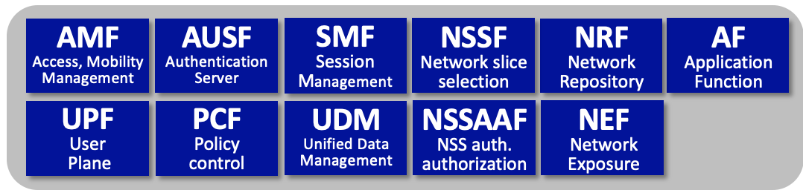
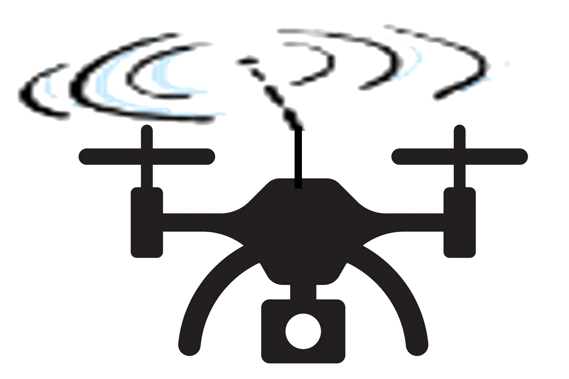
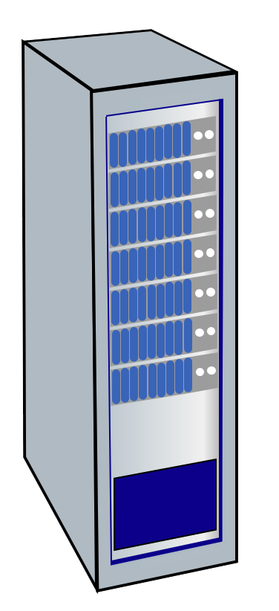



Architectural Elements of 5G
Core Network Functions
User equipment
(UEs)
gNodeB
to
Internet
radio access
Network (RAN)
5G core network

Slide 24
5G Radio Access Network (RAN)
5G RAN: edge network connecting devices (UEs) to base station (gNodeB)
provides link-layer service, as first hop between devices and larger network
limited geographic scope
under control of a single service provider
somewhat analogous to WiFi LAN
RAN components:
many devices (User Equipment: UE)
radio channel (New Radio: NR)
one base station (Next Generation Node B: gNodeB, gNB)
User equipment
(UEs)
gNodeB

Slide 25
5G RAN components
5G User Equipment (UE):
smartphone, tablet, laptop, IoT device
UEs host, run applications
devices attached in RAN
may or may not be mobile
User equipment
(UEs)
gNodeB

Slide 26
5G RAN components
Radio Channel (aka New Radio, NR, in 5G)
Physical (PHY) layer: OFDMA
UEs only communicate with base station
via uplink, downlink channels
UEs do not communicate directly with each other
various uplink/downlink physical and logical channel defined
User equipment
(UEs)
gNodeB

Slide 27
5G RAN components
Base station (aka Next Generation Node B (gNodeB or gNB in 5G):
central control point for RAN, role somewhat analogous to that of WiFi AP
computing, storage may be located at gNB
all communication between UEs and other endpoints (other UEs, 5G Core, Internet) go through gNB
aka Extended Node B (eNB) in 4G
User equipment
(UEs)
gNodeB

Slide 28
5G Core Network
Core situated between RAN and other endpoints (Core, larger Internet)
single Core; multiple RANs
consist of links, routers, servers, providing services to UEs and gNBs
“all Internet” Core, but very different services than traditional Internet apps
clear logical separation between control-plane, user plane:
CUPS: Control-Plane and User-Plane Separation
Core Network Functions
to
Internet

Slide 29
5G control- and user- plane separation (CUPS)
AUSF
Authentication
Server
UDM
Unified Data Management
AF
Application Function
control plane
emphasis on functions and services
well-defined interfaces defines between services
N13
N12
N8
N10
N5
N1
AMF
Access, Mobility
Management
SMF
Session
Management
PCF
Policy control
N11
N7
N2
N3
N5
gNB, RAN
UPF
User
Plane
N3
N6
N6
data plane
5-layer Internet data plane
base station
(gNB)
IP datagrams
extensive use of tunneling
S-GW
IP tunnel

Slide 30


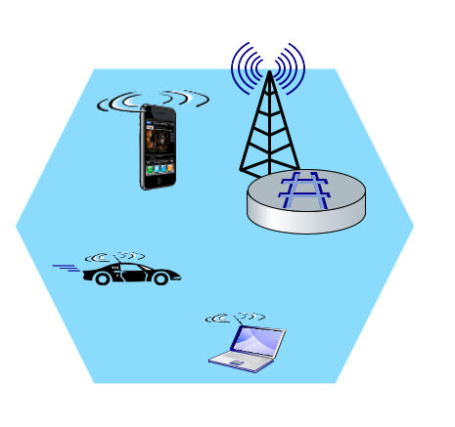
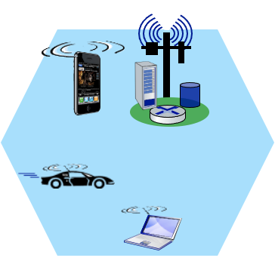
5G: Local application breakout, slicing
IoT app
Video app
IoT
Multimedia
Mobility Management Entity (MME)
Mobile device
(UE)
Mobile device
(UE)
Base station
(gNode-B)
local breakout: enables direct communication between devices, applications without traffic leaving mobile core
Base station
(eNode-B)
to
Internet
to
Internet
PDN gateway
(P-GW) and Serving Gateway (S-GW)
…
…
network slices: allocate resources end-end, segregate traffic to deliver different QoS to a collection of devices, apps

Slide 31
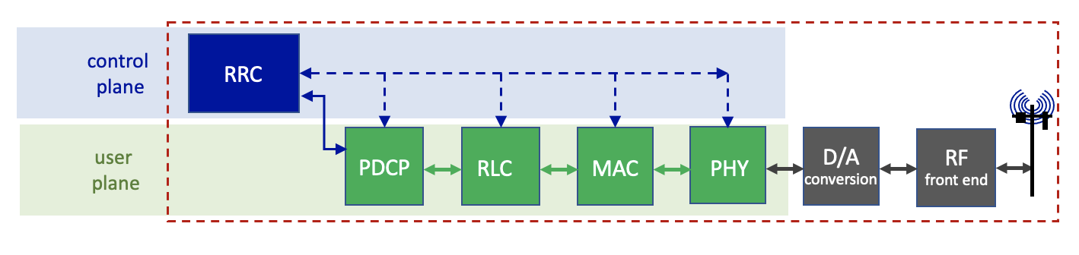
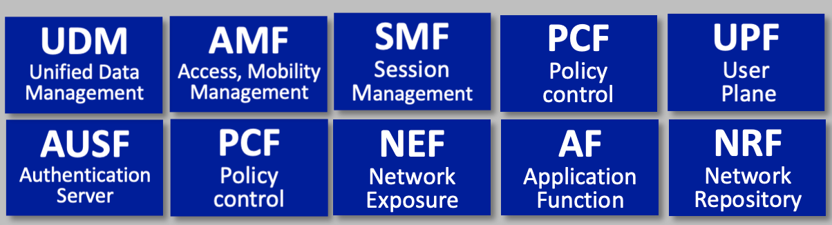

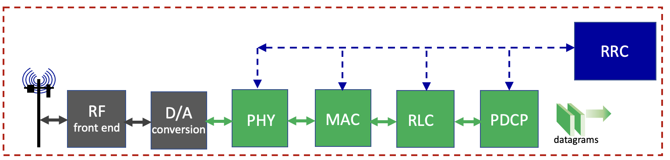
RAN packet processing pipeline: context
RAN: transfers datagrams between mobile core and UEs
datagrams
IP datagrams
Base station
(gNode-B)
UE
protocol processing pipeline in UE

Slide 32
RAN packet processing pipeline
base station
control
plane
RRC
mobile
core
user
plane
PDCP
RLC
MAC
PHY
D/A
conversion
RF
front end
datagrams
traditional 3GPP view
RRC (Radio Resource Control)
configures coarse-grained, policy-related aspects of pipeline (e.g., scheduling prioritization, security)
this implements the RAN’s control plane
does not process user plane packets

Slide 33
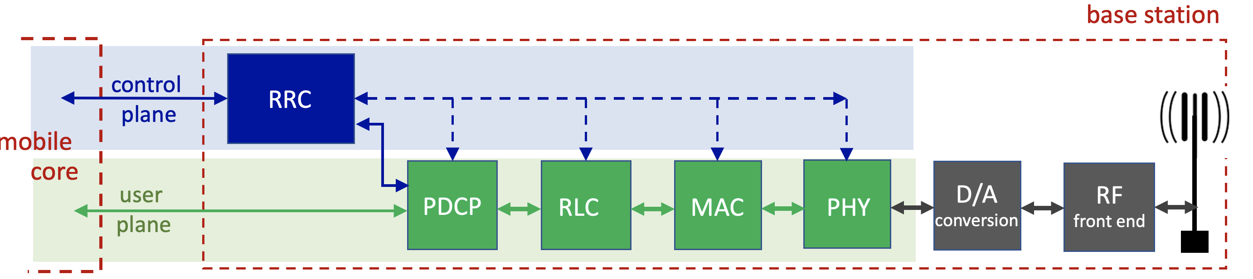
Software-defined RAN
Recall our earlier description of traditional RAN base station (below)
tightly coupled control and data planes
let’s focus on control / management: RRC implementation

Slide 34

Software-defined RAN
SD-RAN: implementing RAN using SDN approach
3GPP-compliant interface between RAN and Mobile Core control plane
New programmatic API for exerting software-based control over pipeline that implements RAN user plane
control
plane
Control plane proxy
Real-Time Intelligent Controller (RIC)
Re-factored RRC
user
plane
PDCP
RLC
MAC
PHY
D/A
conversion
RF
front end
SDN-controlled switches

Slide 35
Software-defined RAN
SD-RAN: implementing RAN using SDN approach
Near-real time network control applications implemented as “xApps”
RAN Network Information Base (R-NIB)
common set of information consumed by numerous control apps, e.g., longer time-scale CQI (channel Quality Indicator) values, other per-session state
load
balancing
…
…
handover
QoS
control
plane
Control plane proxy
Real-Time Intelligent Controller (RIC)
R-NIB
Re-factored RRC
user
plane
PDCP
RLC
MAC
PHY
D/A
conversion
RF
front end
SDN-controlled switches

Slide 36
Mobility in 5G networks: major mobility tasks
3
1
association:
covered earlier
mobile provides IMSI – identifying itself, home network
SMF
UDM
1
AMF
SEPP
PCF
AUSF
1
2
SMF
UDM
SEPP
AMF
4
2
control-plane configuration:
AMF, visited UDM, home UDM establish control-plane state: mobile in visited network
Home
network
PCF
AUSF
Internet
Visited network
Streaming server
3
data-plane configuration:
AMF, SMF configures forwarding tunnels
visited, home network establish tunnels from home to mobile, only if home-routed
4
mobile handover:
mobile device changes its point of attachment to visited network

Slide 37


