Slide 1
Probability and Information Theory
From the book "Deep Learning“ and Course ECE6001
Notes:
let's start with some basic knowledge in probability and IT

Slide 2
Random Experiments
Single fair coin flip
Outcomes: Heads, Tails
Discrete
Probability of head and probability of tail
Bus arrival within 9:00 – 10:00 am
Continuous: bus can arrive at any time between 9:00 – 10:00 am
Probability of bus arrives before 9:30 am with uniform distribution
H
T
9:00 am
10:00 am
Notes:
Random and outcomes

Slide 3
Random variables
Random experiment: fair coin flip
Sample Space Random variable Probability
A random variable X is a function that assigns real values to outcomes of a random experiment.
X: the number of heads in the outcomes.
Heads
Tails
1
0
1/2
Notes:
Sample space a set of all possible outcomes

Slide 4
Probability Distributions
Probability mass functions (PMFs): a probability distribution over discrete variables.
Fair coin flips
Bernoulli distribution
Probability density functions (PDFs): a probability distribution over continuous variables.
Bus arrival
Gaussian Distribution

Slide 5
Bernoulli distribution
The Bernoulli distribution is a distribution over a single binary random variable.
Controlled by a single parameter ϕ∈[0,1]
P(X=1)=ϕ
P(X=0)=1−ϕ
Heads
Tails
1
0
1/2

Slide 6
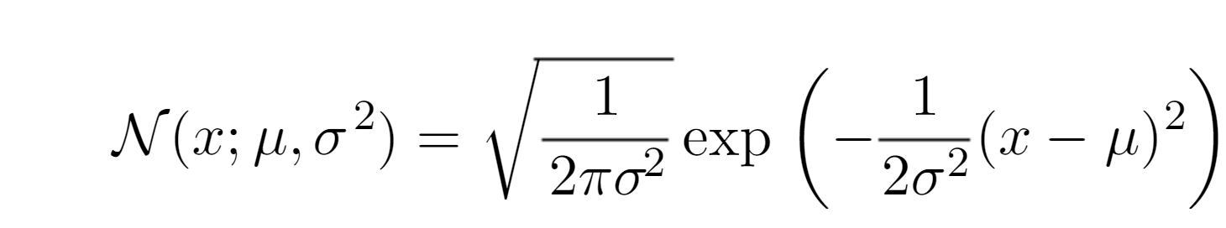
Gaussian Distribution
Gaussian Distribution

Slide 7
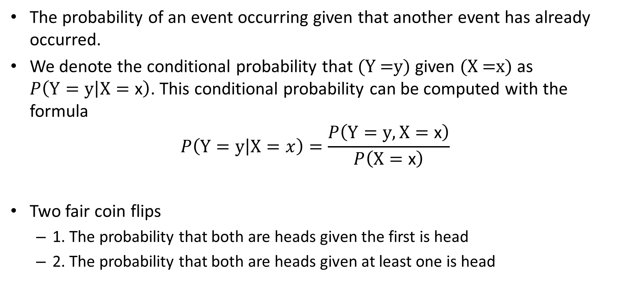
Conditional Probability
The probability of an event occurring given that another event has already occurred.
We denote the conditional probability that (Y =y) given (X =x) as $P\left(Y=\left.y\right|X=\text{x}\right)$. This conditional probability can be computed with the formula
$$P\left(Y=\left.y\right|X=x\right)=\frac{P\left(Y=y,X=\text{x}\right)}{P\left(X=\text{x}\right)}$$
Two fair coin flips
1. The probability that both are heads given the first is head
2. The probability that both are heads given at least one is head

Slide 8
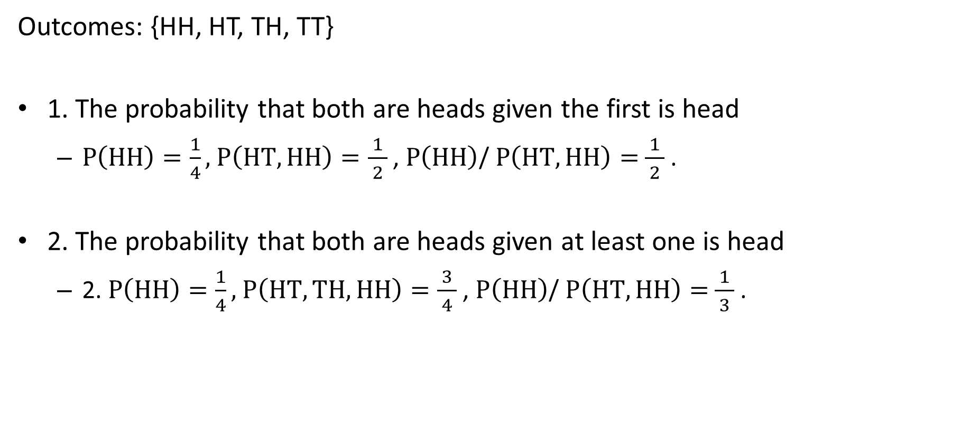
Conditional Probability
Outcomes: {HH, HT, TH, TT}
1. The probability that both are heads given the first is head
$P\left(HH\right)=\frac{1}{4},$ $P\left(HT,HH\right)=\frac{1}{ 2 }$ , $P\left(HH\right)$/ $P\left(HT,HH\right)=$ $\frac{1}{ 2 }$ .
2. The probability that both are heads given at least one is head
2. $P\left(HH\right)=\frac{1}{4},$ $P\left(HT,TH,HH\right)=\frac{3}{ 4 }$ , $P\left(HH\right)$/ $P\left(HT,HH\right)=$ $\frac{1}{ 3 }$ .

Slide 9
Conditional Probability in LLMs
The capital of France is ___
conditional probability
Next token | Probability
Paris | 0.96
Columbus | 0.02
France | 0.01
other | 0.01
P(xt​∣x1​,…,xt−1​)
Conditional probability is not merely a textbook concept. It is the basic mechanism behind modern language models.
Suppose an AI assigns 70% probability to answer A and 30% to answer B. Does this mean answer A is correct?
GPT may assign high probability to a citation that looks academically plausible, even when the paper does not exist.

Slide 10
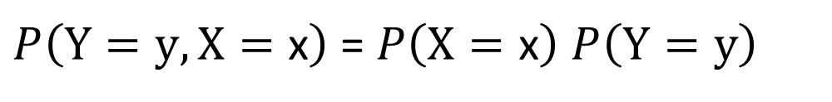
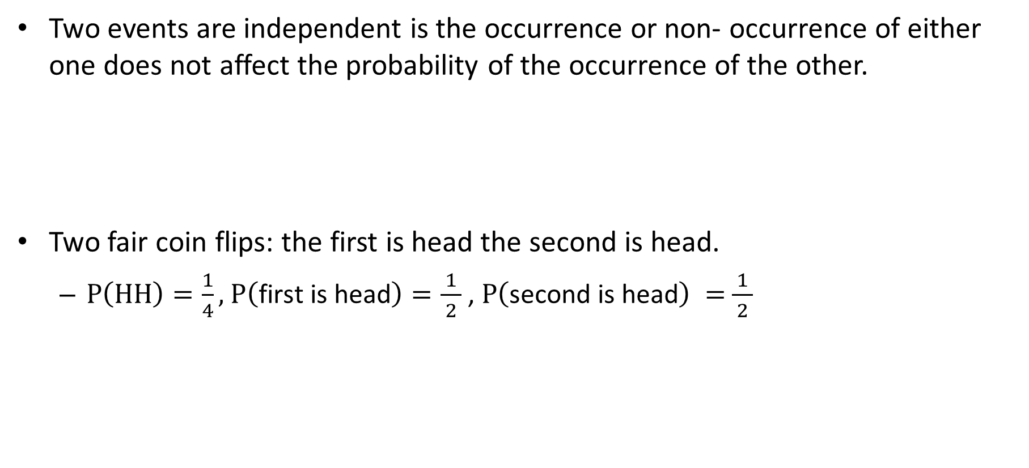
Independence of Two Events
Two events are independent is the occurrence or non- occurrence of either one does not affect the probability of the occurrence of the other.
Two fair coin flips: the first is head the second is head.
$P\left(HH\right)=\frac{1}{4},$ $P\left(\text{first} \text{is} \text{head}\right)=\frac{1}{ 2 }$ , $P\left(\text{second} \text{is} \text{head}\right) =$ $\frac{1}{ 2 }$
$P\left(Y=y,X=\text{x}\right)$ = $P\left(X=\text{x}\right)$ $P\left(Y=y\right)$

Slide 11
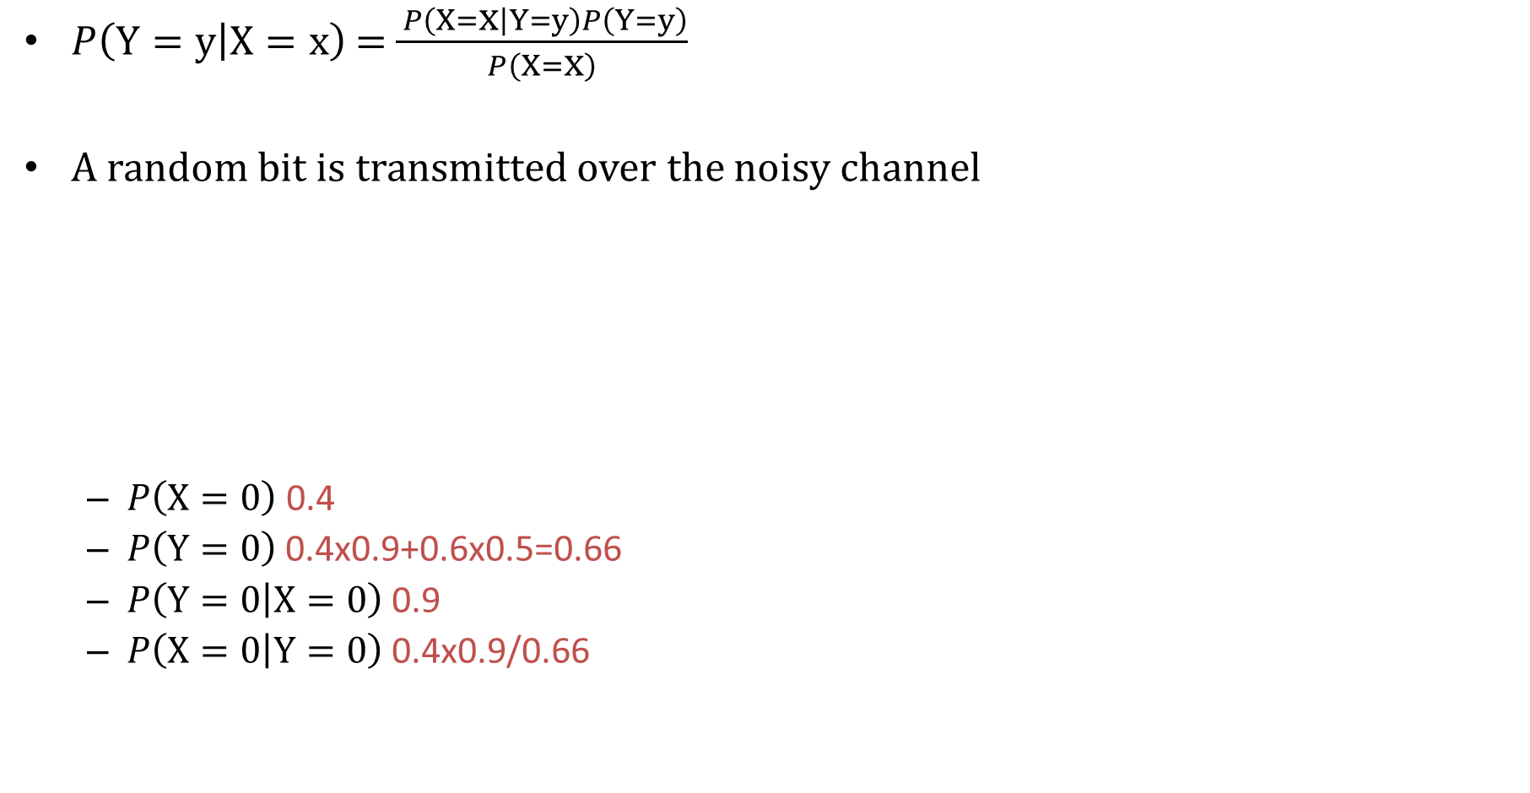
Bayes’ Rule
$P\left(Y=\left.y\right|X=\text{x}\right)$ = $\frac{ P\left(X=\text{x}\left|Y=y\right.\right)P\left(Y=y\right)}{P\left(X=\text{x}\right)}$
A random bit is transmitted over the noisy channel
$P\left(X=\text{0}\right)$ 0.4
$P\left(Y=\text{0}\right)$ 0.4x0.9+0.6x0.5=0.66
$P\left(Y=\left.0\right|X=\text{0}\right)$ 0.9
$P\left(X=\left.0\right|Y=\text{0}\right)$ 0.4x0.9/0.66
X
Y
0.9
0
0
0.4
0.1
0.5
0.6
1
1
0.5
Notes:
1. 0.4
2. 0.4x0.9+0.6x0.5=0.66
3. 0.9
4. 0.4x0.9/0.66 0.55

Slide 12
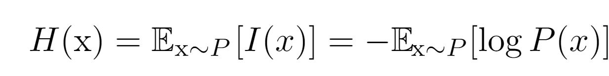

Entropy and Information Theory
We define the self-information of an event $X=\text{x}$to be
$I\left(\text{x}\right)=−\log{P\left(\text{x}\right) }$
Shannon entropy use base-2 logarithms
One-time fair coin flip
Heads
Tails
1
0
1/2

Slide 13
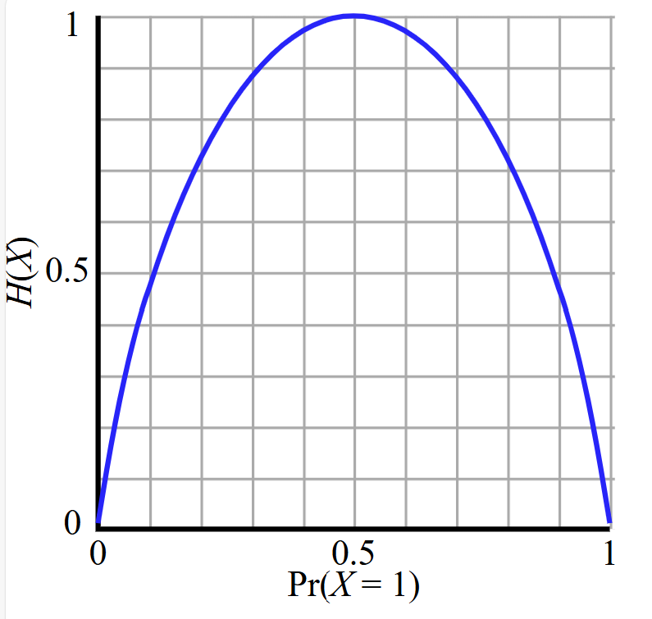

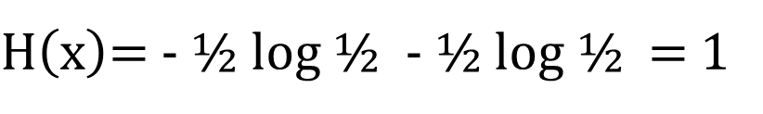
Entropy and Information Theory
We define the self-information of an event $X=\text{x}$to be
$I\left(\text{x}\right)=−\log{P\left(\text{x}\right) }$
Shannon entropy use base-2 logarithms
Heads
Tails
1
0
1/2
$H\left(\text{x}\right)$= - ½ log ½ - ½ log ½ = 1

Slide 14
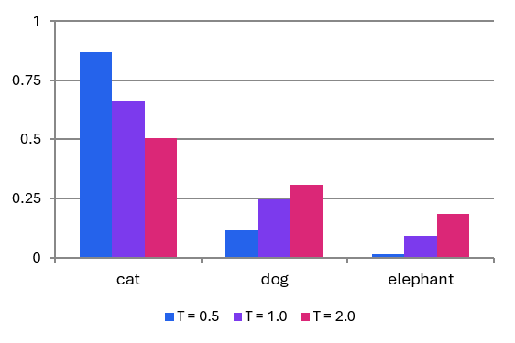
Temperature in LLMs
Token | Relative score
cat | 3
dog | 2
elephant | 1
pᵢ(T) = exp(zᵢ / T) / Σⱼ exp(zⱼ / T)
For writing Python code, should temperature be high or low? For generating creative story ideas, should it be high or low?

Slide 15
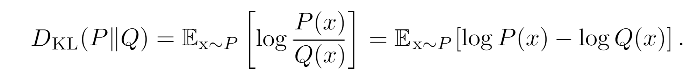
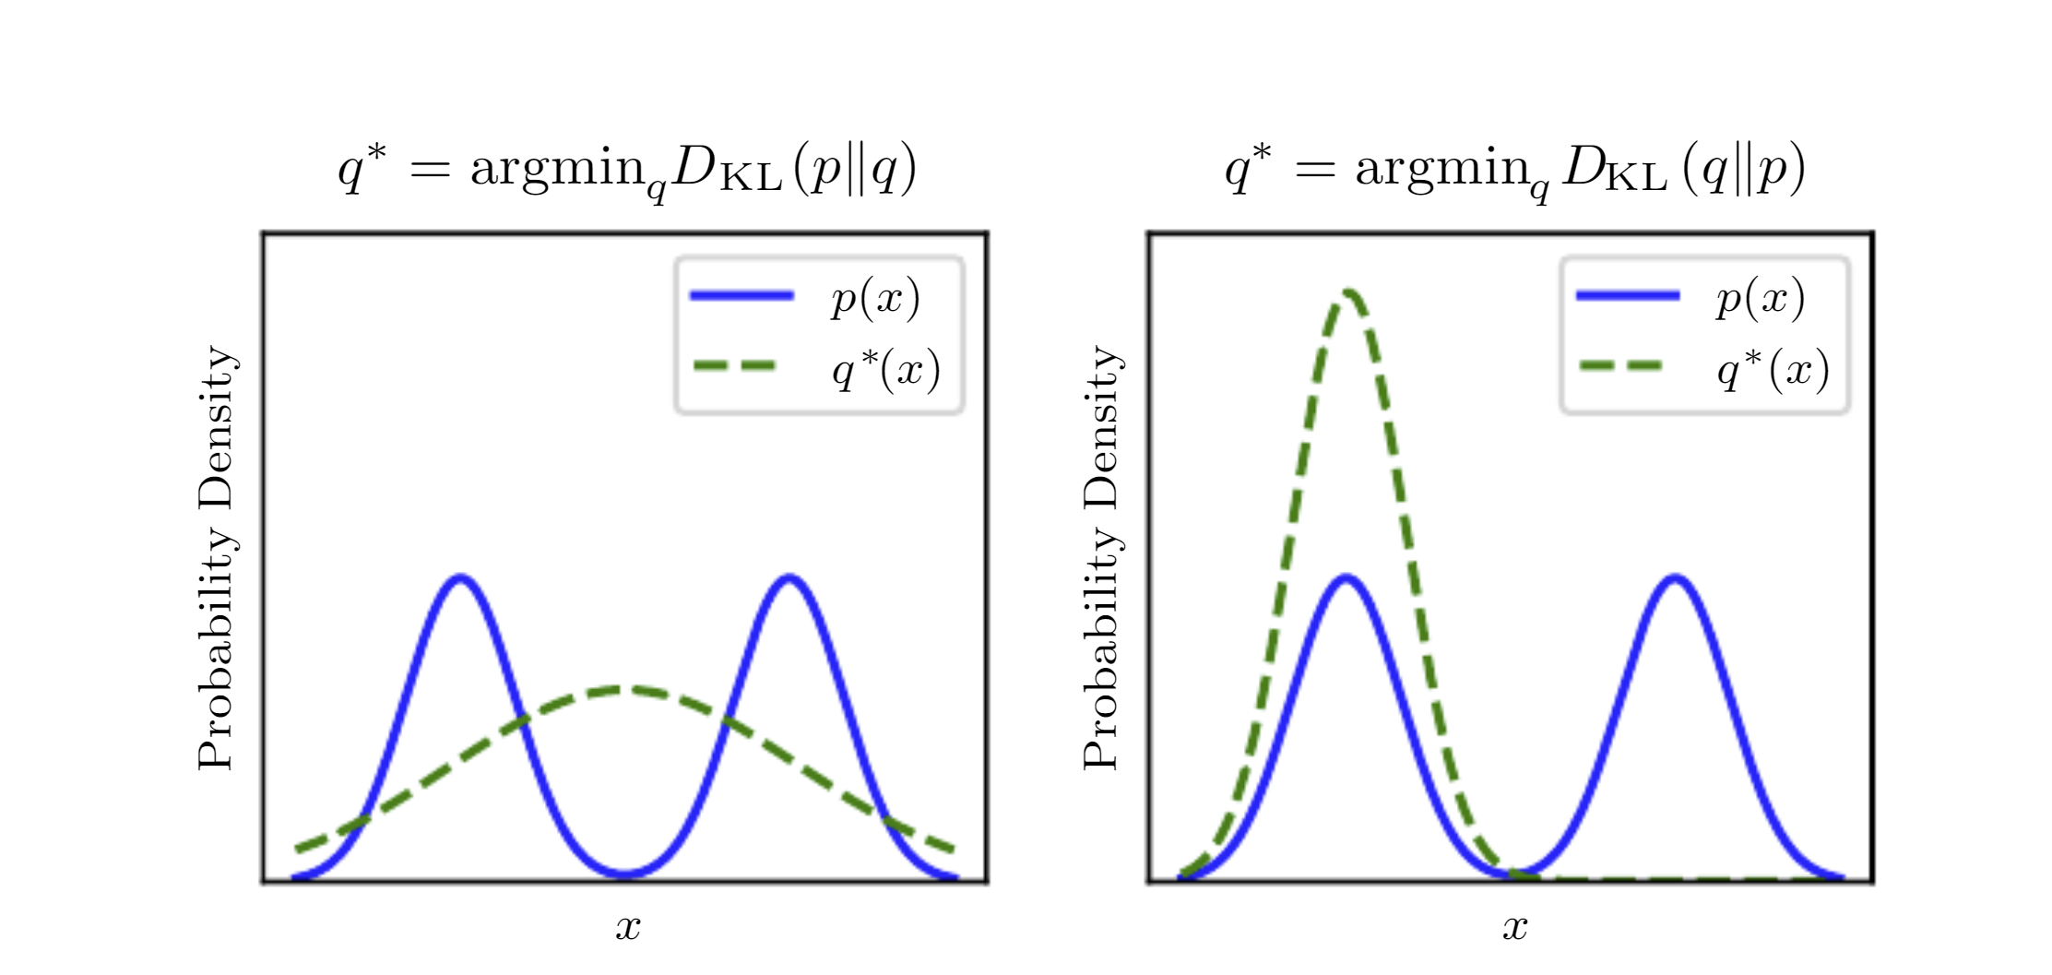
Kullback-Leibler (KL) divergence
Diﬀerence of two distributions
Asymmetric

