Slide 1


Software-i-zation and AI
at the wireless edge
AI-Edge summer REU program
Jim Kurose
University of Massachusetts, Amherst

Slide 2
Overview of today’s REU seminar
wireless (5G, nG) networks: review
network software-i-zation
three 5G/nG network control/management challenges
... and opportunities for AI/ML
For more information:
Networking: http://gaia.cs.umass.edu/kurose_ross
Wireless Networking: https://gaia.cs.umass.edu/wireless_and_mobile_networking

Slide 3
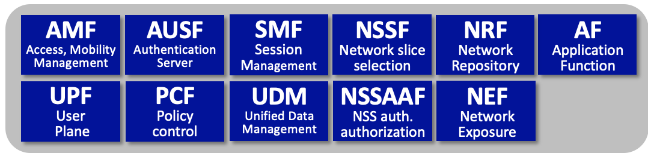
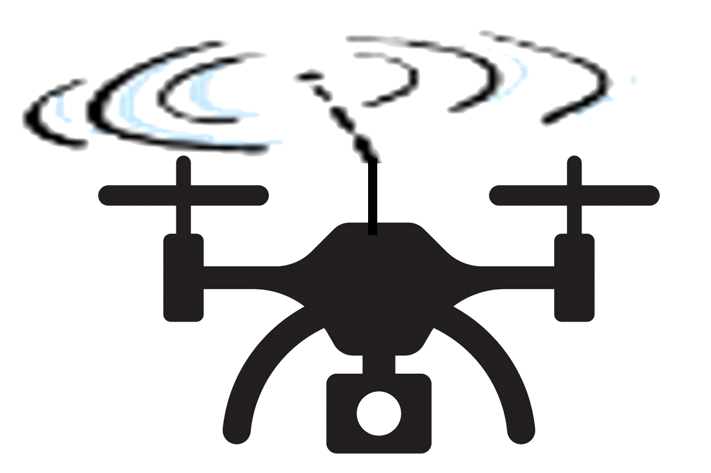

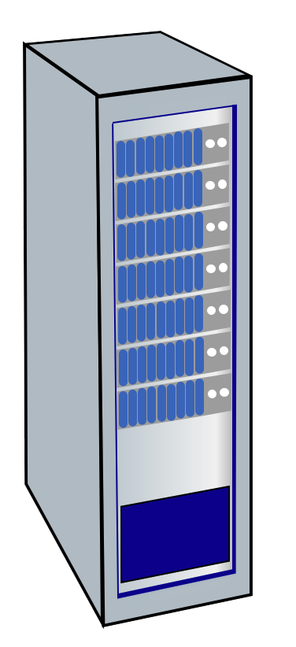





Architectural Elements of 5G
Core Network Functions
User equipment
(UEs)
gNodeB
to
Internet
radio access
Network (RAN)
5G core network

Slide 4
5G Radio Access Network (RAN)
5G RAN: edge network connecting devices (UEs) to base station (gNodeB)
provides link-layer service, as first hop between devices and larger network
limited geographic scope
under control of a single service provider
somewhat analogous to WiFi LAN
RAN components:
many devices (User Equipment: UE)
radio channel (New Radio: NR)
one base station (Next Generation Node B: gNodeB, gNB)
User equipment
(UEs)
gNodeB

Slide 5
5G RAN components
5G User Equipment (UE):
smartphone, tablet, laptop, IoT device
UEs host, run applications
devices attached in RAN
may or may not be mobile
User equipment
(UEs)
gNodeB

Slide 6
5G RAN components
Radio Channel (aka New Radio, NR, in 5G)
Physical (PHY) layer: OFDMA
UEs only communicate with base station
via uplink, downlink channels
UEs do not communicate directly with each other
various uplink/downlink physical and logical channel defined
User equipment
(UEs)
gNodeB

Slide 7
5G RAN components
Base station (aka Next Generation Node B (gNodeB or gNB in 5G):
central control point for RAN, role somewhat analogous to that of WiFi AP
computing, storage may be located at gNB
all communication between UEs and other endpoints (other UEs, 5G Core, Internet) go through gNB
aka Extended Node B (eNB) in 4G
User equipment
(UEs)
gNodeB

Slide 8
5G Core Network
Core situated between RAN and other endpoints (Core, larger Internet)
single Core; multiple RANs
consist of links, routers, servers, providing services to UEs and gNBs
“all Internet” Core, but very different services than traditional Internet apps
clear logical separation between control-plane, user plane:
CUPS: Control-Plane and User-Plane Separation
Core Network Functions
to
Internet

Slide 9
5G Core Network
Core situated between RAN and other endpoints (Core, larger Internet)
single Core; multiple RANs
consist of links, routers, servers, providing services to UEs and gNBs
“all Internet” Core, but very different services than traditional Internet apps
Core Network Functions
to
Internet

Slide 10
Architectural Elements of 5G
Core Network Functions
AMF (Access, Mobility Management Function)
connection management, access authorization
mobility management
User equipment
(UEs)
gNodeB
to
Internet
radio access
Network (RAN)
5G core network

Slide 11

Mobility in 5G networks: major mobility tasks
3
1
association:
mobile provides IMSI – identifying itself, home network
SMF
UDM
1
AMF
SEPP
PCF
AUSF
1
2
SMF
UDM
2
control-plane configuration:
AMF, visited UDM, home UDM establish control-plane state: mobile in visited network
SEPP
AMF
4
Home
network
PCF
AUSF
Internet
Visited network
Streaming server
3
data-plane configuration:
AMF, SMF configures forwarding tunnels
visited, home network establish tunnels from home to mobile, only if home-routed
4
mobile handover:
mobile device changes its point of attachment to visited network

Slide 12
Overview of today’s REU seminar
Wireless (5G, nG) networks: review
network software-i-zation
Three 5G/nG network control/management challenges
... and opportunities for AI/ML

Slide 13
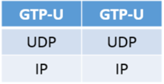
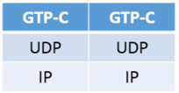


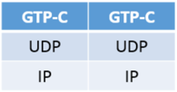
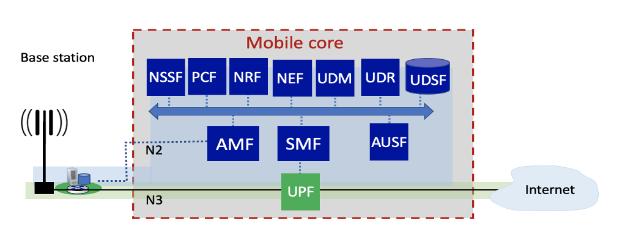
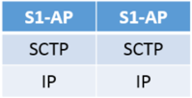

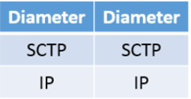
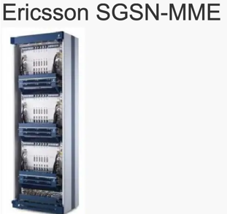
5G: migration away from “protocols” is underway!
Serving gateway (S-GW)
PDN gateway (P-GW)
public Internet
and
inter-carrier IPX
4G mobile core:
boxes and protocols
Mobility Management Entity (MME)
Home Subscriber Service (HSS)
public Internet
and
inter-carrier IPX
5G: microservice-like architecture
SDN 13
Notes:
a clear migration away from protocols is also clear in the transition from 4G to 5G
I like to think of 4G in terms of boxes and protocols. The green path here is the user plane (IP packets flow to/from the UE device from/to Internet), and the blue interactions are the control and management plane in 4G that control and configure the user-plane devices. 4G: boxes and protocols.
This 5G figure is from the 2018 ITU-T spec Y.3102, which describes the first key feature of an IMT-2020 network as
“distributed architecture based on softwarize-d network functions”
ITU specs discuss the mobile core in terms of software functions. And while it doesn’t mandate a cloud-based SDN-like solution, this diagram is certainly evocative of that. So in some sense we have the 5G physical network infrastructure, and then
we have the management and control of these
SEGUE: Those of you who watch this space commercially probably saw the

Slide 14
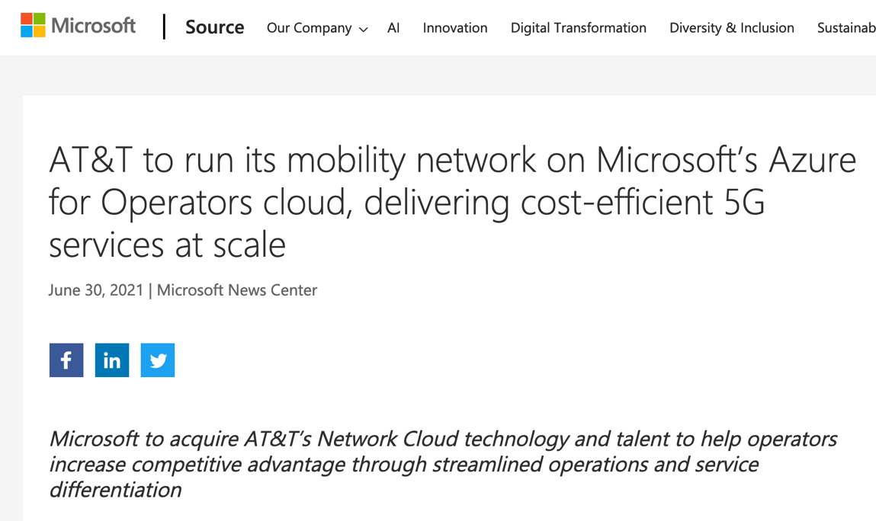
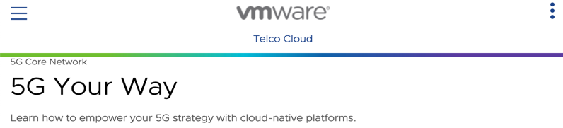
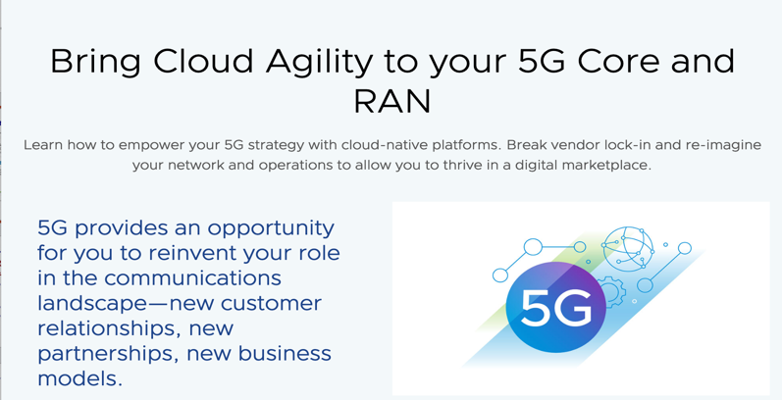
5G: migration away from “protocols” is underway!
public Internet
and
inter-carrier IPX
5G: microservice-like architecture
Note: 4G/5G operators manage intradomain services in their mobile network
SDN 14
Notes:
Software companies and operators coming together
Segue: SO ... given these changes are underway in SD_WAN, in 4G-5G, does this mean protocols are dead?
Here are the insights that I’ve drawn when thinking about this question “Are protocols dead”?

Slide 15
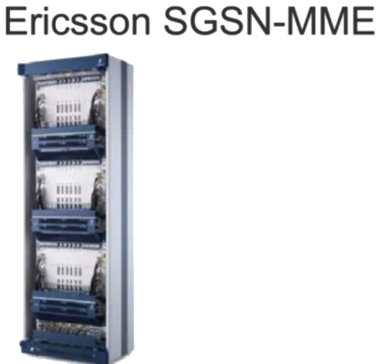




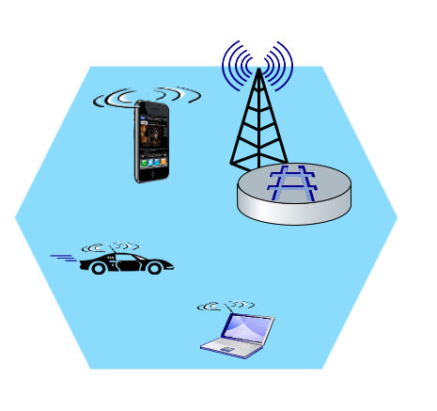
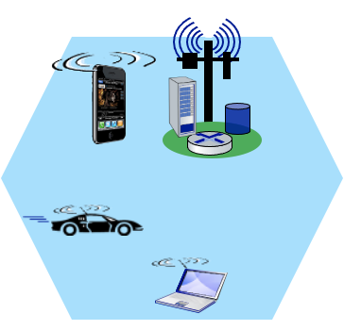
5G: software-i-zation: Core
NEF
Network Exposure
AF
Application Function
NRF
Network Repository
from 4G boxes
to 5G
functions and services
AMF
Access, Mobility
Management
UDM
Unified Data Management
AMF
Access, Mobility
Management
cloud infrastructure within the mobile 5G network
PCF
Policy control
Mobility Management Entity (MME)
Mobile device
(UE)
Mobile device
(UE)
Base station
(gNode-B)
SMF
Session
Management
Base station
(eNode-B)
AUSF
Authentication
Server
software defined networking (SDN): 5G microservices can be implemented in data centers
PCF
Policy control
to
Internet
to
Internet
UPF
User
Plane
PDN gateway
(P-GW) and Serving Gateway (S-GW)
…
…

Slide 16
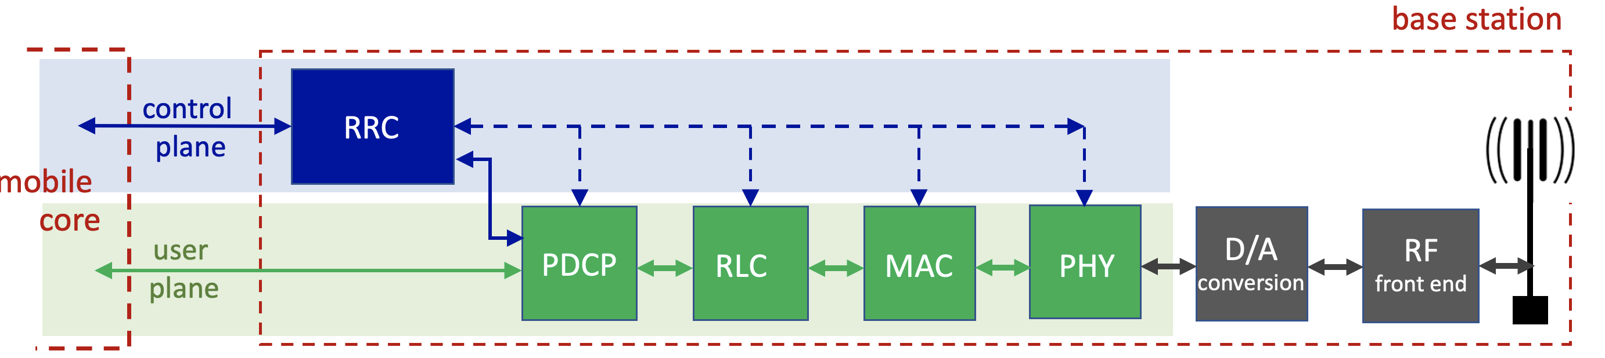
5G: software-i-zation: RAN
RAN: transfers datagrams between mobile core and devices
Recall our earlier description of traditional RAN base station (below)
tightly coupled control and data planes
let’s focus on control / management: RRC implementation

Slide 17

Software-defined RAN
SD-RAN: implementing RAN using SDN approach
3GPP-compliant interface between RAN and Mobile Core control plane
New programmatic API for exerting software-based control over pipeline that implements RAN user plane
control
plane
Control plane proxy
Real-Time Intelligent Controller (RIC)
Re-factored RRC
user
plane
PDCP
RLC
MAC
PHY
D/A
conversion
RF
front end
SDN-controlled switches

Slide 18
Software-defined RAN
SD-RAN: implementing RAN using SDN approach
Near-real time network control applications implemented as “xApps”
RAN Network Information Base (R-NIB)
common set of information consumed by numerous control apps, e.g., longer time-scale CQI (channel Quality Indicator) values, other per-session state
load
balancing
…
…
handover
QoS
control
plane
Control plane proxy
Real-Time Intelligent Controller (RIC)
R-NIB
Re-factored RRC
user
plane
PDCP
RLC
MAC
PHY
D/A
conversion
RF
front end
SDN-controlled switches

Slide 19
Overview of today’s REU seminar
Wireless (5G, nG) networks: review
network software-i-zation
Three 5G/nG network control/management challenges
... and opportunities for AI/ML

Slide 20
AI for networking
(and networking for AI)
AI/ML in network control:
ML: predict future, trained on past data
devices: have predictable mobility, power use, communication (traffic)patterns
radio environment: has predictable evolution given current conditions
Network infrastructure as a platform for AI/ML
computation: CPUs, GPUs
networking: communication between AI “pieces”
edge-based real-time AI applications: “close” to users
low latency, local (on prem) resources

Slide 21

AI-RAN
GPU
CPU
GPU
CPU
Industry initiative integrating AI/RAN to:
optimize RAN control using ML
run AI workloads (user applications) at RAN
AI-enabled RAN control xApps
AI-enabled user Apps
ML-enabled
energy management
…
ML-enabled mobility
management
…
video analytics
AR/VR
GPU
RIC
CPU
GPU
using common infrastructure (GPU/CPU computing, data, network):
CU
DU
RU
GPU
GPU
CPU
GPU

Slide 22
Challenge 1: Mobility in 5G networks: handover
Handover:
mobile device changes is point of attachment to the network
data flow to device changes from source base station to target base station
before
handover
AMF
Access, Mobility
Management
SMF
Session
Management
UPF
User Plane Function
after
handover
Why perform handover?
stronger signal from target base station
target base station has less devices, less traffic

Slide 23
Challenge 1: Mobility in 5G networks: handover
source BS
1
current (source) BS selects target BS, sends Handover Request message to target BS
data path before handover
3
1
4
UPF
User Plane Function
2
2
target BS pre-allocates radio time slots, responds with HR ACK with info for mobile
data path after
handover
target BS
3
source BS informs mobile of new BS
mobile can now send via new BS - handover looks complete to mobile
4
source BS stops sending datagrams to mobile, instead forwards to new BS (who forwards to mobile over radio channel)

Slide 24
Challenge 1: Mobility in 5G networks: handover
5
target BS informs AMF, SMF that it is new BS for mobile
SMF instructs UPF to change tunnel endpoint to be (new) target BS
source BS
6
UPF
User Plane Function
UPF
User Plane Function
5
AMF
Access, Mobility
Management
6
target BS ACKs back to source BS: handover complete, source BS can release resources
SMF
Session
Management
5
target BS
7
mobile’s datagrams now flow through new tunnel from target BS to UPF

Slide 25
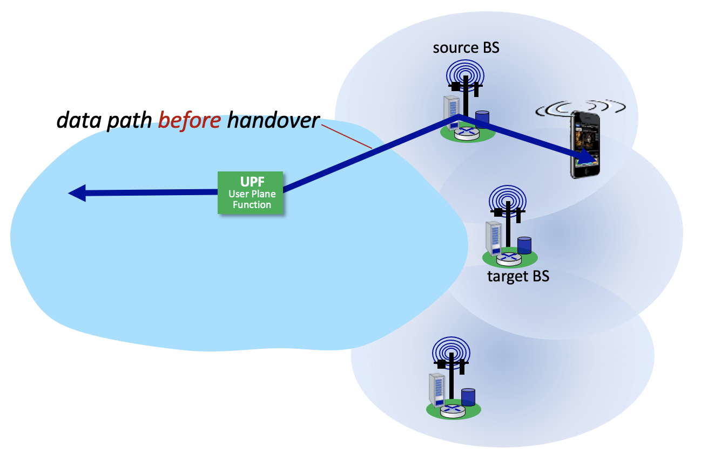
Handover in 5G networks: how AI/ML can help
User behavioral patterns can be learned/predicted:
where are users likely to move in future
future communication (bandwidth) requirements
per-RAN predictions of bandwidth requirements of users in aggregate
These predictions can be used in
handover: where/when to perform handover?
load balancing: which RAN to place users/load?
quality of service (QoS): what near-term-future quality of service guarantees can be made to a user
?

Slide 26

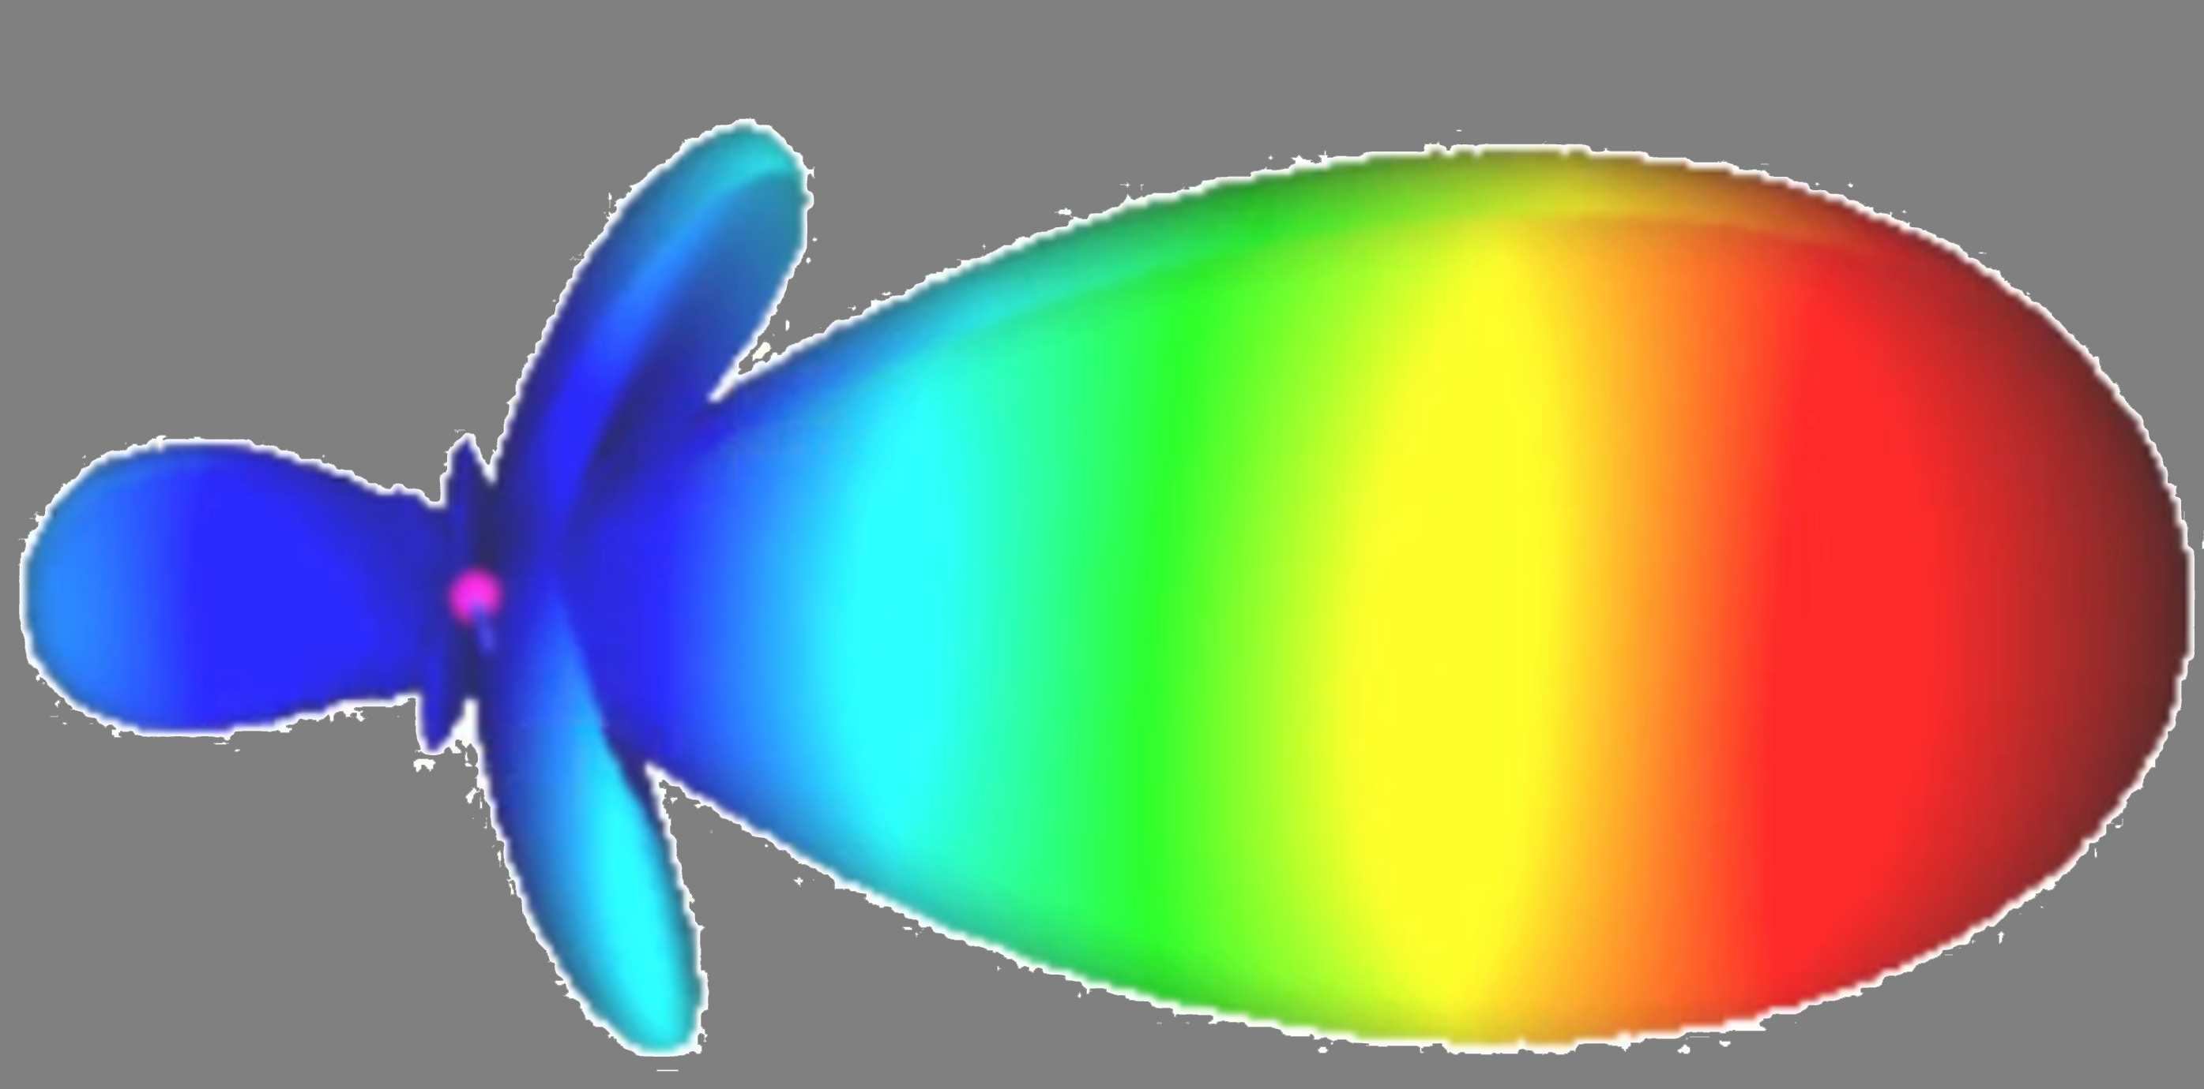

Challenge 2: beam (antenna) allocation/steering
antenna performance to a given location is a complex, time-varying quantity due to
reflections (multipath)
Interference
MIMO: multiple antennas
How AMI/ML can help:
antenna performance can be measured, future antenna performance predicted
outputs from ML prediction model used to steer antennas to optimize performance
single user MIMO
multi-user MIMO

Slide 27
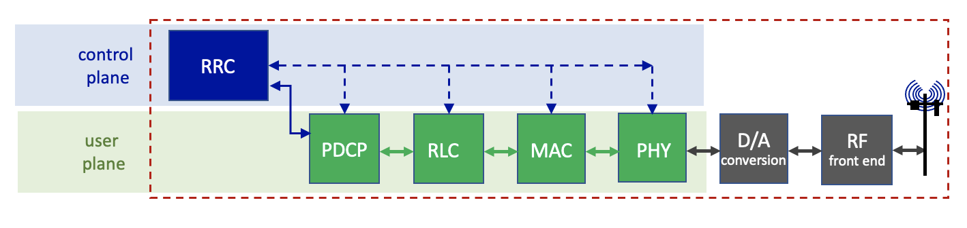
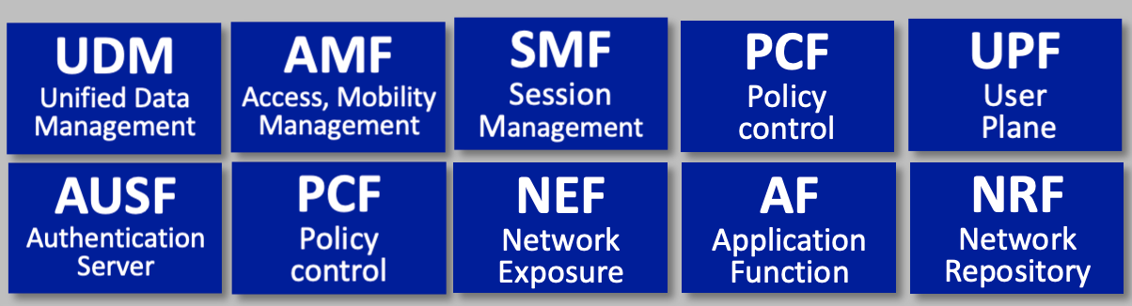

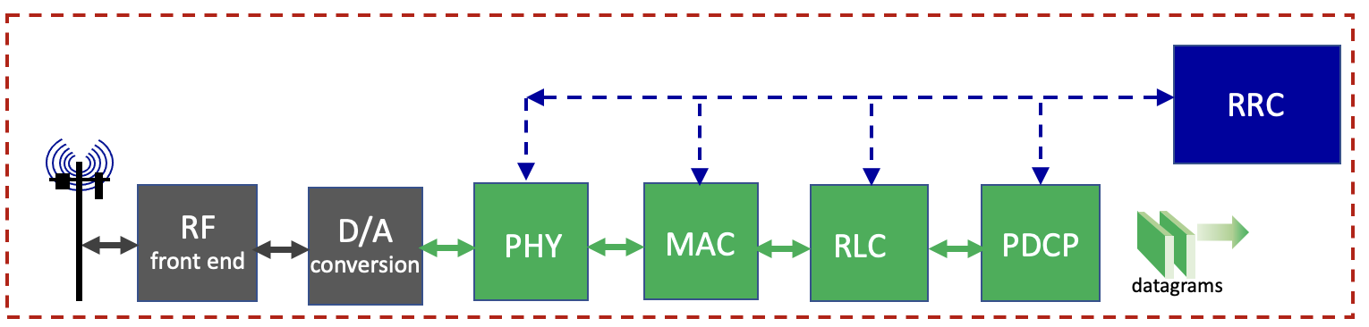
Challenge 3: packet scheduling in RAN
RAN: transfers datagrams between mobile core and UEs
datagrams
datagrams
Base station
(gNode-B)
UE
protocol processing pipeline in UE

Slide 28
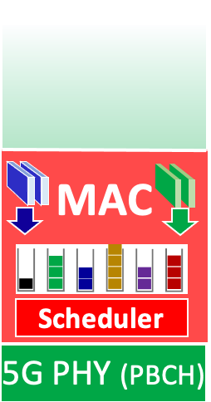
5G RAN scheduling: Channel Quality Indicator
Channel Quality Indicator (CQI):
device measures quality of received reference signals reports quality to base station
4-bit CQI value tells base station how fast it can transmit (bad channel: transmit slow)
CQI
“We are all equally important”
Notes:
Well, I’ve just said that a MAC scheduler may take the quality of the channel between the bases station and UE into account when making a scheduling discipline. In the next lesson of this module, we’ll look at how a UE and base station actually determine the quality of the channel.
<ANIMATE 1> But for now, I’ll just point out that the UE is going to periodically send a 4-bit Channel Quality Indicator - CQI – to the gNodeB. The gNB, in turn, uses the CQI to determine which modulation scheme to use.
<ANIMATE 2> Indeed, here’s the 4-bit CQI table from the standards that maps a CQI value onto a modulation scheme.
Different modulation schemes mean different numbers of bits per second that are being transmitted. Different throughput. Higher order QAM means higher throughput.
As we’ll see there are MAC scheduling disciplines that use this CQI in determining frame transmission order.

Slide 29
5G RAN scheduling: QoS Class Indicator
QCI: QoS Class Indicator
QoS: network wants to provide to a particular device (e.g., delay, guaranteed bit rate QoS guarantees)
scheduler determines channel allocation to ensure all devicesmeet their QoS requirements
QCI
CQI
Priority | QCI | Max delay | Max loss | Application
2 | 1 | 100ms | .01 | Voice
3 | 4 | 50 ms | .001 | Real-time gaming
6 | 7 | 300 ms | .000001 | Streaming video
8 | 8 | 600 | .000001 | Web browsing, TCP
Notes:
There is a second piece of information that is also sometimes used by MAC scheduling disciplines. It’s called the
the Quality of Service Class indicator – which unfortunately has an acronym (QCI) which is easily confused with CQI that we just studioed
<ANIMATE 1> In some cases, the network may promise a certain quality of service (QOS) to a UE. We’ll study QOS in later module. But the basic idea is that a UE may need a certain level of performance in order for the network to be useful for a given application. For example, for real-time interactive voice, you need short delays. In such cases, the network can make a quality of service guarantee to the UE that it, the network, will need to meet through it’s allocation of resources, allocation of RBs.
<ANIMATE 2> But, for now, we only need know that a MAC scheduler can also take the QOS Class indicator into account when making scheduling disciplines.
Again, the standards don’t say how the scheduler should make QoS-sensitive decisions,
<ANIMATE 3> but it does standardize that there is a 3bit QCI
which has the semantics shown here

Slide 30
5G MAC scheduling disciplines
Link-layer frame data awaiting transmission
Scheduling: which frame(s) to schedule for transmission
performance will depend on channel conditions, user device
QCI
Scheduler
CQI
Channel blocks that will carry frame data destined to specific devices
Q: what algorithm does scheduler use to choose frame data to be sent into N blocks?
Notes:
Here’s the common framework for all of the scheduling disciplines we’ll study.
<ANIMATE 1>. At each scheduling instant, we’re given a group of frames that are queued at the base station, awaiting transmission to the UEs. The frames can contain all different types of traffic. There can be data, control and management frames. There can be all sorts of application-layer data: voice, video, web browsing. You name it!
Note that we’ve shown 6 different queues here, each in a different color. Perhaps these are queues for 6 different UE’s (that’s the easiest way to think about it), but it could be queues for six different classes of traffic. The standards don’t say – this whole discussion is beyond the standards. But let’s just think of these as per-UE queues.
To simplify things, let’s also assume that each of these colored squares have just enough data to fill a resource block. We know that’s not true since we know that the number of bits that fill an RB will depend on the modulation scheme being used. But it’ll be good enough for explaining scheduling disciplines.
<ANIMATE 2>. Then we have the scheduler, which may have per-UE channel quality information (QCI) and per-frame Quality of Service Class Indications (QCIs)
<ANIMATE 3> And then we have the set of resource blocks that will be used between now and the next scheduling instant; these are the RBs to be scheduled and that will carry frame data destined to the UE’s.
And here’s the million dollar question: what algorithm does scheduler use to choose frame data to be packed into say N resource blocks?

Slide 31
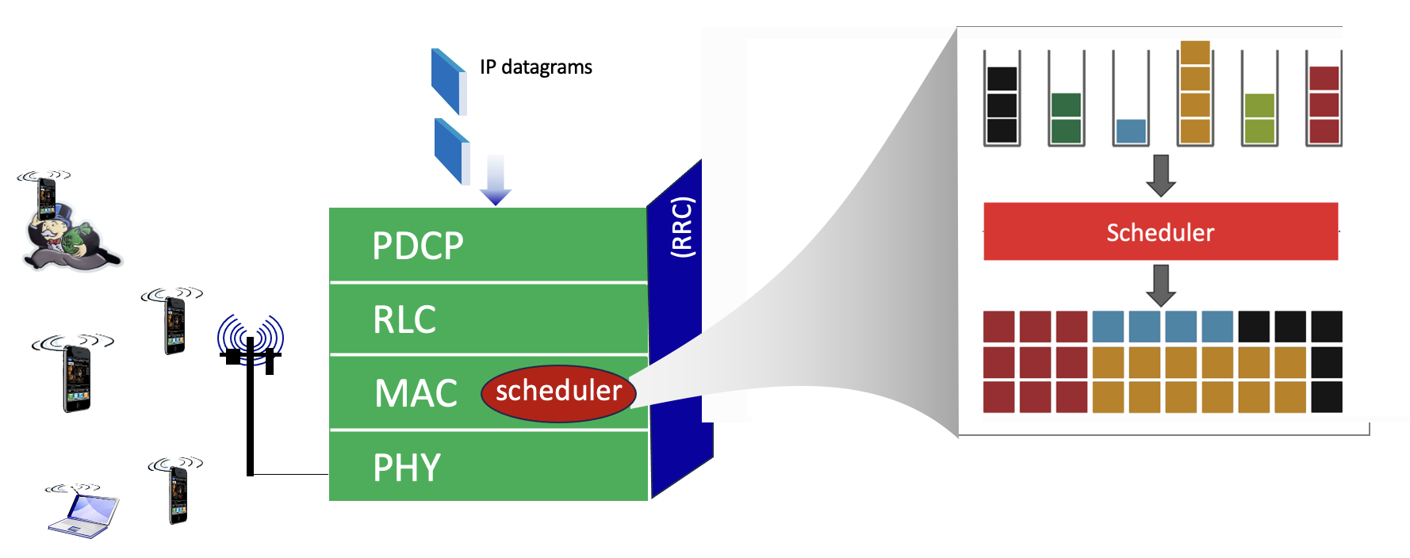
Packet scheduling in RAN: how AI/ML can help
Transmission performance can be learned / predicted for each packet, depending on:
channel conditions
UE mobility
These predictions can be used to determine expected per-packet transmission performance
actual packet selected depends on many factors: performance, fairness, quality of service

Slide 32
AI/ML in RAN control, management
many applications of AI/ML in RAN control, management:
channel state information (CSI) and feedback
power control
MIMO antennae optimization
scheduling
anomaly detection, fault prediction, and mitigation
slice SLA management
cell energy savings
load balancing and traffic steering
mobility prediction/management
localization (noisy environments)
AI-RAN Alliance, “State-of-the-Art AI/ML Applications for Improvements in RAN Performance,” 2026

Slide 33
Summary/Conclusions
Last week:
Networking 101 - in 20 minutes
Wireless networks: motivation, applications
Architectural components of a wireless network
5G: architectural overview
5G: selected topics for REU
This week:
wireless (5G, nG) networks: review
network software-i-zation
three 5G/nG network control/management challenges
... and opportunities for AI/ML
Enjoy this summer REU!
For more information:
Networking: http://gaia.cs.umass.edu/kurose_ross
Wireless Networking: https://gaia.cs.umass.edu/wireless_and_mobile_networking

Slide 34


