Slide 1


NNDL PROJECT-
MEDICAL CHATBOT USING LLAMA 2 LLM
Syed Maaz ahmed - R21EK040 Revanth Anvekar - R21EK031 Mohammed Zain - R22EK812

Slide 2
LLaMa-2
LLaMA (Large Language Model Meta AI) is a family of autoregressive large language models, released by Meta AI starting in February 2023.
Four model sizes were trained for the first version of LLaMA: 7, 13, 33, and 65 billion parameters. LLaMA's developers reported that the 13B parameter model's performance on most NLP benchmarks exceeded that of the much larger GPT-3 (with 175B parameters)

Slide 3
RLHF - Reinforcement learning from human feedback
Reinforcement learning from human feedback (RLHF) is a machine learning (ML) technique that uses human feedback to optimize ML models to self-learn more efficiently. Reinforcement learning (RL) techniques train software to make decisions that maximize rewards, making their outcomes more accurate. RLHF incorporates human feedback in the rewards function, so the ML model can perform tasks more aligned with human goals, wants, and needs. RLHF is used throughout generative artificial intelligence (generative AI) applications, including in large language models (LLM).
The core of RLHF is training a separate AI reward model based on human feedback, and then using this model as a reward function to optimize policy through RL.

Slide 4
Architecture of LLaMa-2
LLaMA uses the transformer architecture, the standard architecture for language modeling since 2018.
There are minor architectural differences.
-Compared to GPT-3, LLaMA uses SwiGLU activation function instead of GeLU(gated linear unit)
-Uses rotary positional embeddings instead of absolute positional embedding
-Uses root-mean-squared layer-normalization instead of standard layer-normalization

Slide 5
Using LLAMA-2 To make a medical chatbot
- Advanced Toolkit Selection:
- PyPDF, Langchain, Torch, and Hugging Face's Hub facilitate seamless processing of medical literature from diverse sources.
- Llama 2 7b quantized model from Hugging Face Model Hub chosen for efficient natural language understanding within limited computing resources.
- Strategic Technology Fusion:
- Integration of Faiss CPU for efficient vector storage and retrieval, Sentence Transformers for contextual embeddings, and Chainlit for streamlined model integration.
- Utilization of accelerative technologies like Accelerate and CTransformers ensures optimal performance on resource-constrained devices.

Slide 6
Using LLAMA-2 To make a medical chatbot
- Focused Development Approach:
- Crafting an intuitive medical conversational agent capable of comprehending nuanced queries and extracting insights from the Gale Encyclopedia.
- Emphasis on efficiency and reliability through components like Bitsandbytes for efficient data handling.
- Transformational Impact:
- Aim to revolutionize medical information access and support within educational institutions and beyond.
- Delivering a transformative solution poised to enhance medical education and research.

Slide 7
Tech Stack and Libraries Used:
1. PyPDF and Langchain: These libraries enable us to efficiently process and extract text from medical documents stored in PDF format, ensuring that our system can access and utilize valuable information from diverse sources.
2. Torch and Accelerate: Leveraging the power of Torch and Accelerate, our system efficiently performs complex computations and deep learning tasks, including natural language processing (NLP) and model inference, optimizing performance even on resource-constrained devices.
3. Bitsandbytes and CTransformers: These libraries provide essential utilities and tools for handling data efficiently and effectively, ensuring smooth data processing pipelines and optimal performance of our system.
4. Sentence Transformers: By incorporating Sentence Transformers, our system enhances the representation and understanding of textual data, enabling accurate and contextually relevant responses to user queries and requests.
.

Slide 8
Tech Stack and Libraries Used:
5. Faiss_cpu: Faiss_cpu facilitates efficient vector storage and retrieval, enabling fast and scalable similarity search operations on the vast amount of textual data processed by our system.
6. Chainlit: Chainlit plays a pivotal role in streamlining the integration of various components and modules within our system, ensuring seamless communication and interaction between different parts of the system architecture.
7. Hugging Face Hub: Utilizing the resources available on the Hugging Face Hub, including pre-trained language models like Llama 2 7b, our system enhances its natural language understanding capabilities, enabling it to comprehend and process complex medical queries with high accuracy and efficiency.

Slide 9
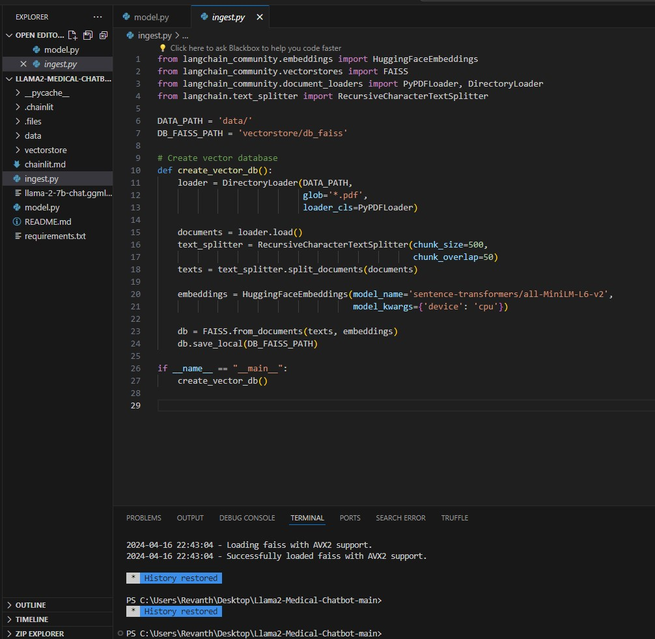
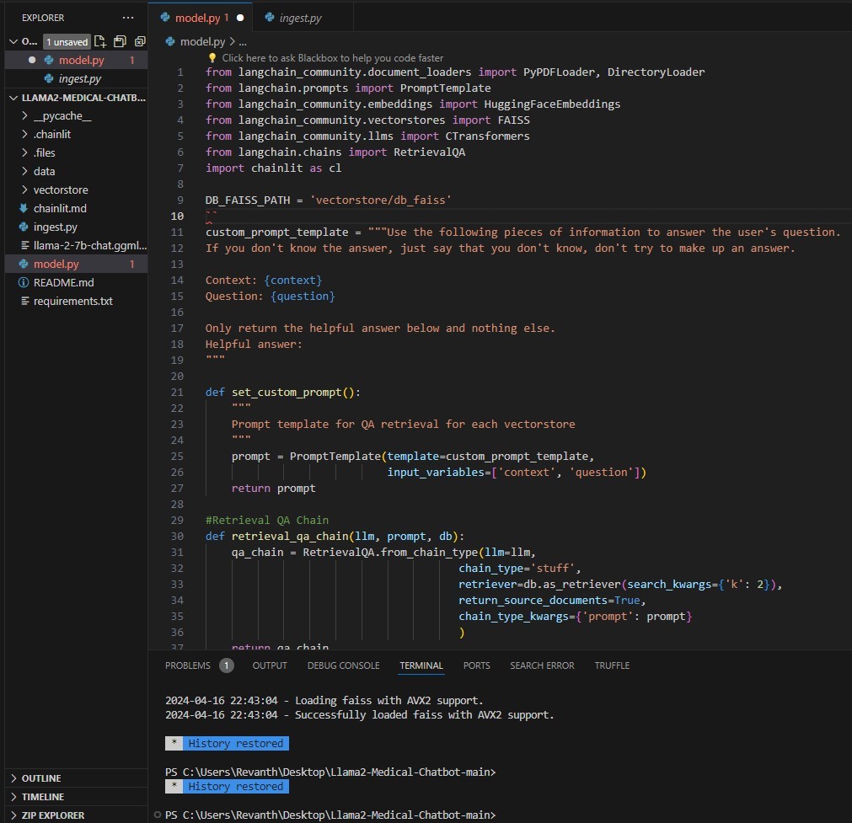
Code Snippet :
Ingest.py
Model.py

Slide 10
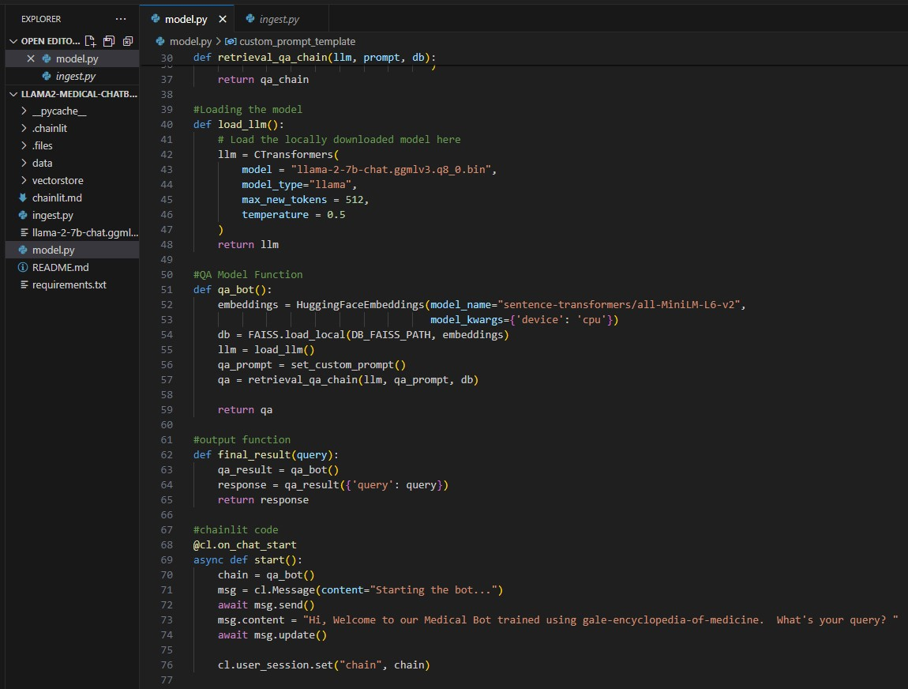
Code Snippet :
Chainlit asynchronous functions
(model.py)

Slide 11
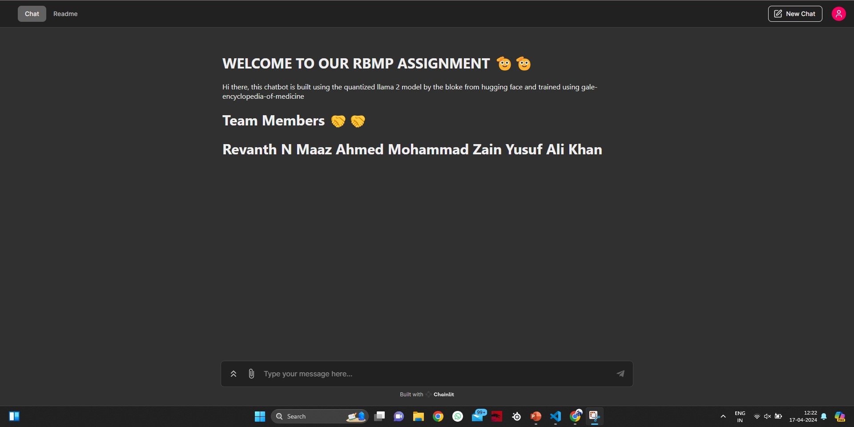
Project Output Snippets

Slide 12
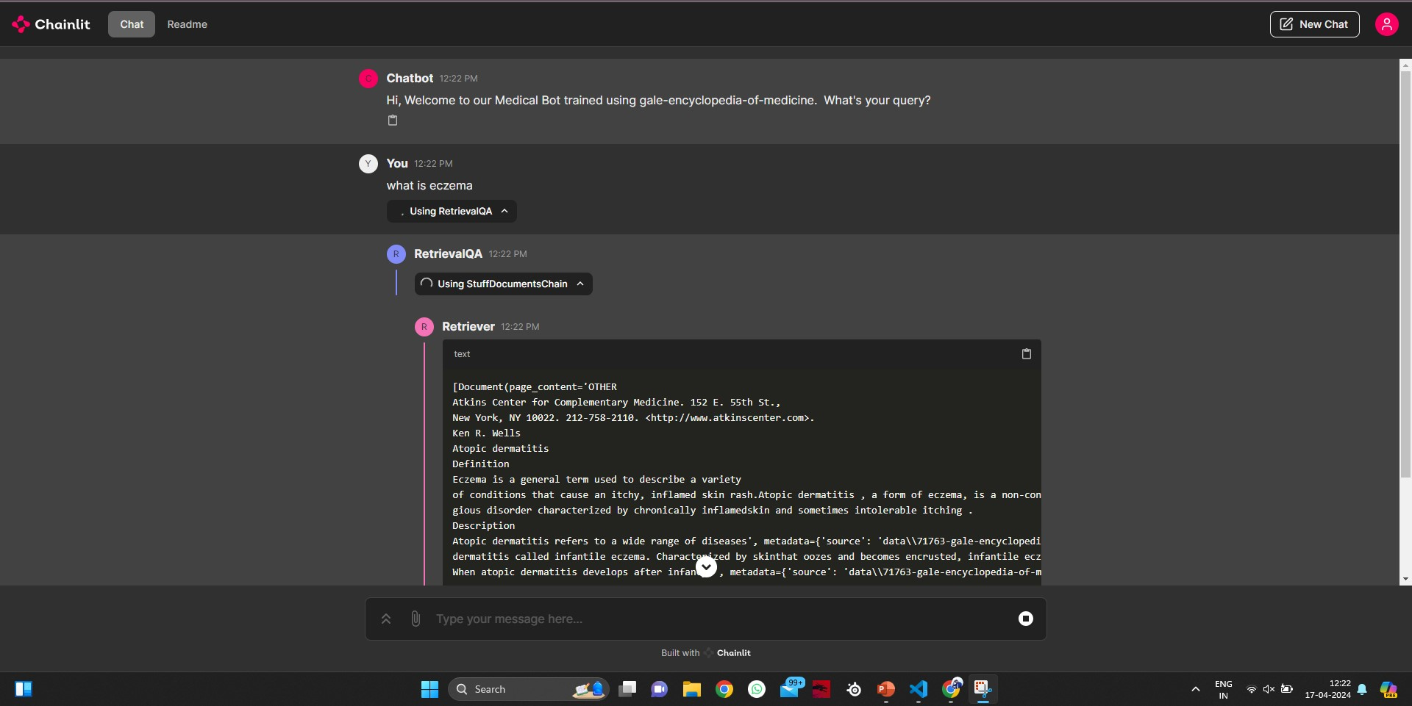
Project Output Snippets

Slide 13
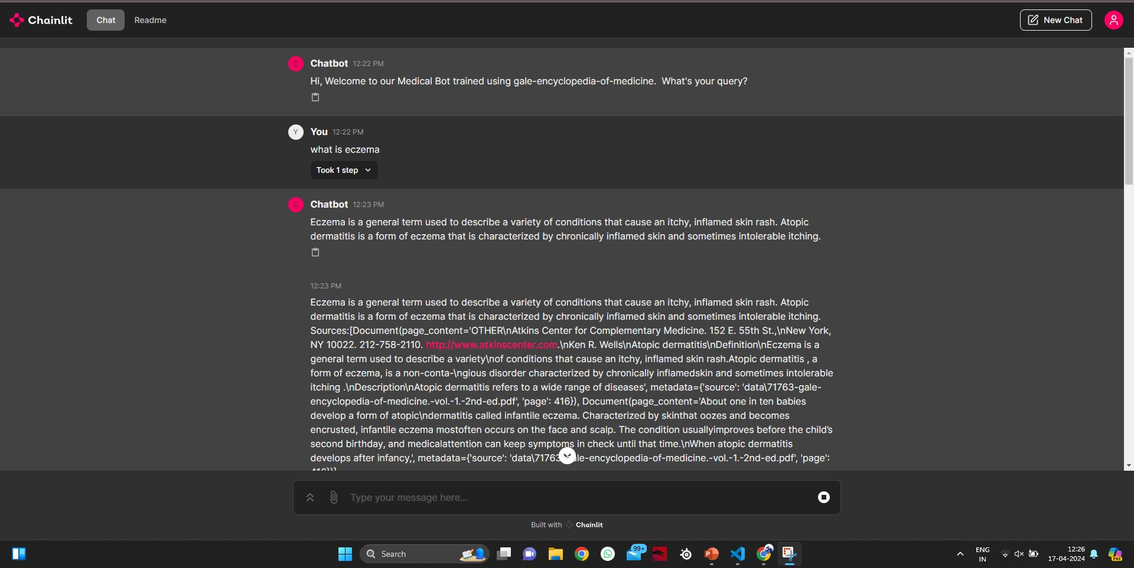
Project Output Snippets

Slide 14
USECASES
1. Medical information retrieval from Gale Encyclopedia
2. Support for medical education and learning
3. Patient education and engagement
4. Research assistance for literature review and data collection
5. Symptom checking and initial triage
6. Community health outreach and public health awareness

