Slide 1




Coffee Shop Sales Dashboard
"Coffee is more than a drink; it's a magical moment that brings us together, sip by sip.
" FIVE STEPS :
Stage 1: Collecting Sales Data
Stage 2: Organizing the Data
Stage 3: Creating the Dashboard
Stage 4: Analyzing the Data
Stage 5: Sharing the Results

Slide 2
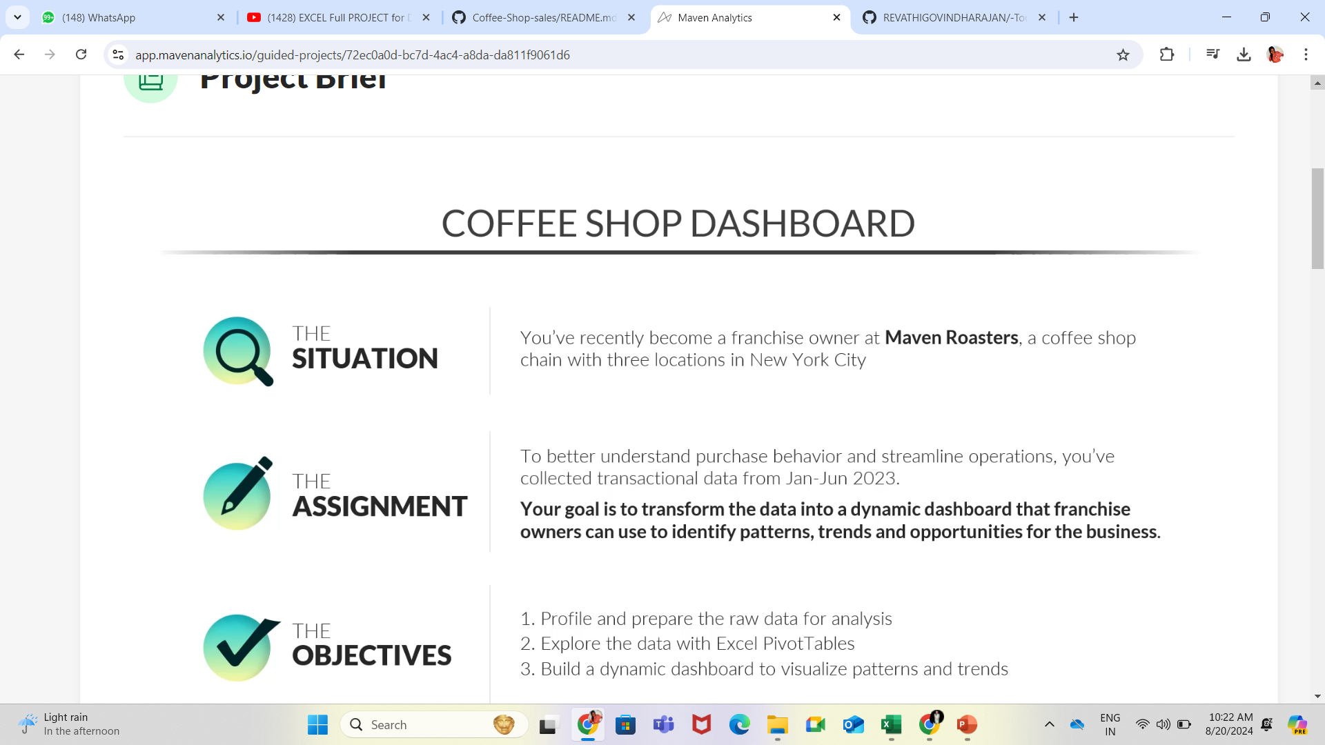

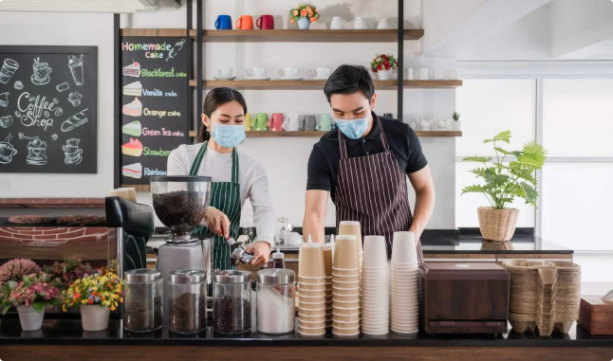
Optimizing Operations
1
Inventory Management
2
Staffing Efficiency
Streamline ordering and stocking processes to minimize waste and maximize profitability.
Utilize data-driven insights to optimize employee scheduling and reduce labor costs.
3
Supply Chain Optimization
Identify opportunities to optimize supplier relationships and logistics for key ingredients.

Slide 3
Overview of 3 NYC Locations
Midtown
Downtown
Uptown
Our flagship location in the heart of Manhattan, serving the bustling business district.
A cozy shop in the trendy SoHo neighborhood, attracting a stylish clientele.
A neighborhood cafe catering to the local residential community uptown.

Slide 4

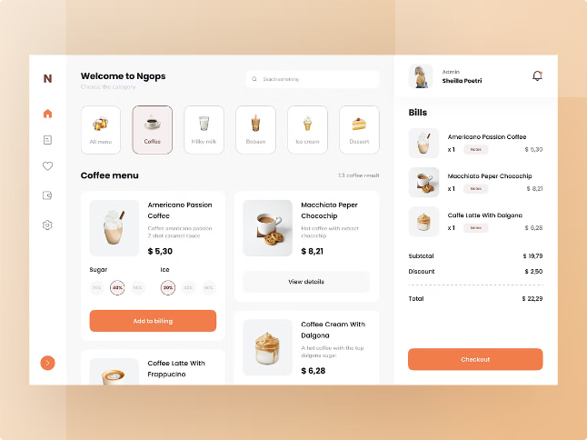
Real-Time Sales Insights
1
Hourly Trends
Monitor peak hours and lull periods to optimize staffing and inventory.
2
Daily Performance
Analyze daily sales figures and identify patterns across the week.
3
Weekly Reports
Review comprehensive weekly summaries to spot growth opportunities.

Slide 5
Analyzing Performance Trends
Revenue Growth
Customer Insights
Product Performance
Track monthly and yearly revenue trends to measure overall business growth.
Analyze customer visit frequency and average ticket size to understand buying habits.
Identify top-selling items and understand which offerings drive the most profits.

Slide 6

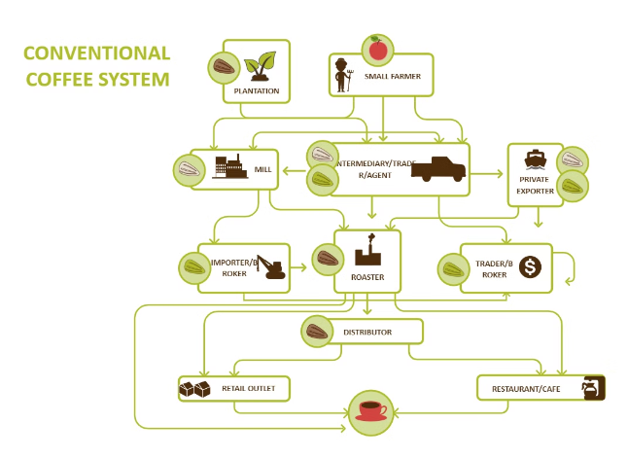
Visualizing Customer Behavior
1
Order Flow
Understand the customer journey from entry to checkout to optimize efficiency.
2
Foot Traffic
Monitor in-store traffic patterns to ensure adequate staffing and seating.
3
Loyalty Trends
Identify regular customers and target them with personalized offers and rewards.

Slide 7

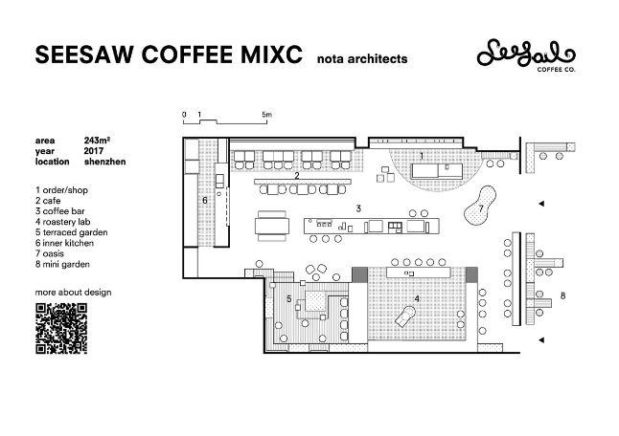
Identifying Growth Opportunities
New Menu Items
Catering Services
Analyze customer feedback and market trends to introduce innovative new offerings.
Expand into the corporate catering market to drive additional revenue streams.
Franchise Expansion
Online Orders
Leverage the successful brand and operating model to open new locations.
Develop a seamless online ordering platform to capture more convenience-driven customers.

Slide 8

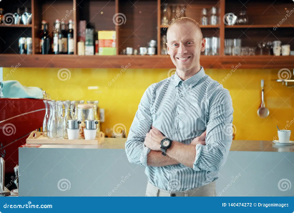



Driving Business Success
Scalable Growth
Customer Loyalty
Operational Excellence
Leverage data-driven insights to expand the coffee shop brand and capture new markets.
Deliver exceptional experiences that keep customers coming back time and time again.
Optimize every aspect of the business to maximize profitability and sustainability.

