Slide 1




LIFE-LINE BLOOD-BANK DATABASE MANAGEMENT SYSTEM
GROUP MEMBERS:
01
CHIRAG TANK (20075021)
02
PUNIT KUMAR MEENA
(20075069)

Slide 2
FEATURES :
BLOOD BANKS AND CAMPS
CHARTS
LISTS
MAP VIEW THAT IS LOCATION OF NEARBY BANKS/CAMPS CAN BE VIEWED ON THE MAPS
CHARTS FOR BLOOD DONORS AND AVAILABLE UNITS OF BLOOD IS MADE AVAILABLE.
DONOR AND REQUEST LIST ARE MADE TO STORE DONOR AND REQUEST DATAS.
-

Slide 3
FRONT END IN BRIEF :
MAP-VIEW HAS BEEN GENERATED WITH THE HELP OF GOOGLE MAP LINKS, IMPLEMENTED IN THE BACK-END PART OF THE WEBSITE.
SIMPLICITY HAS BEEN MAINTAINED TO MAKE IT USER FRIENDLY AND BRIGHT COLORS ARE USED TO MAKE IT ATTRACTIVE.
THE TEMPLATE FOR THE PAGES HAS BEEN FORMATTED ACCORDINGLY TO SERVE THE PURPOSE OF THE WEBSITE.
-

Slide 4
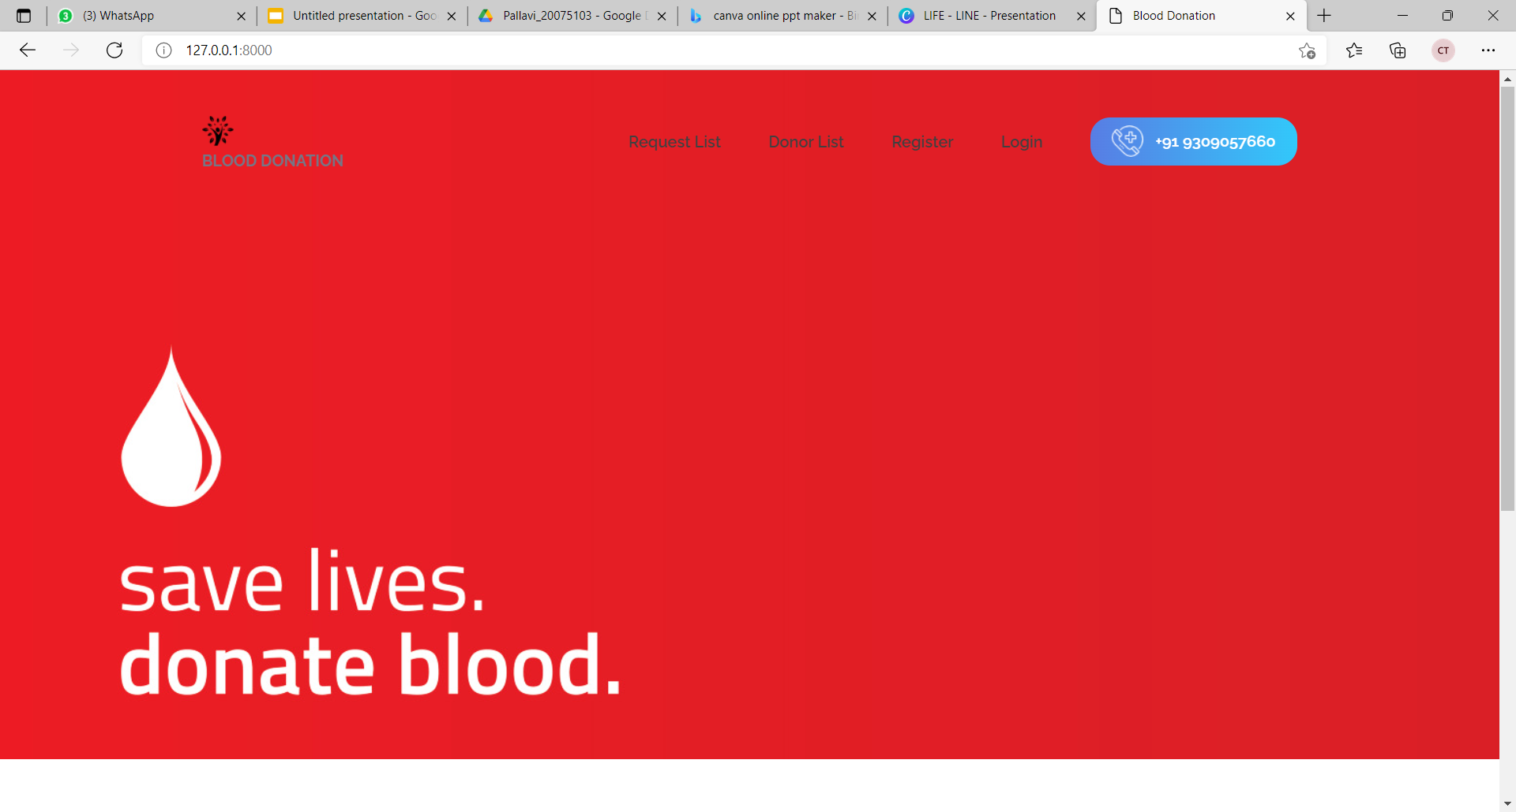
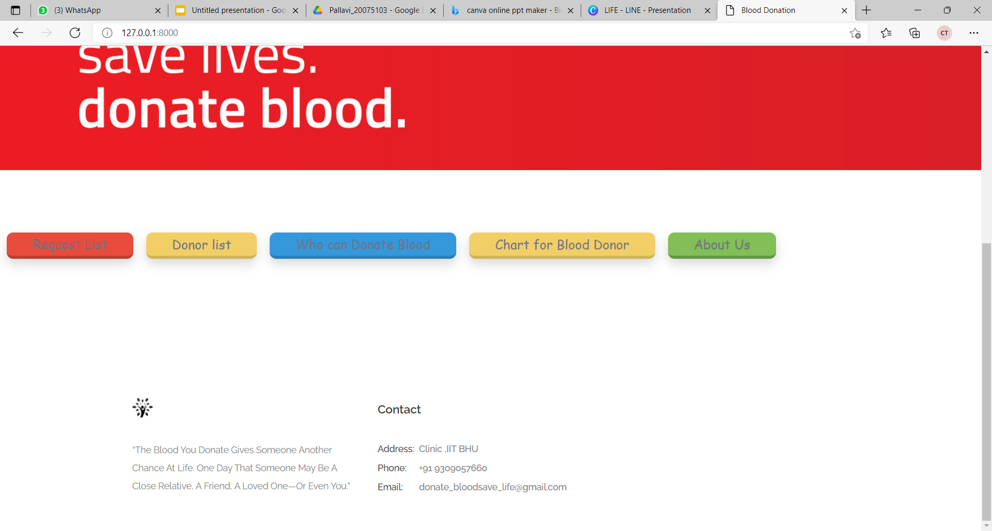
HOME PAGE VIEW OF WEBSITE

Slide 5
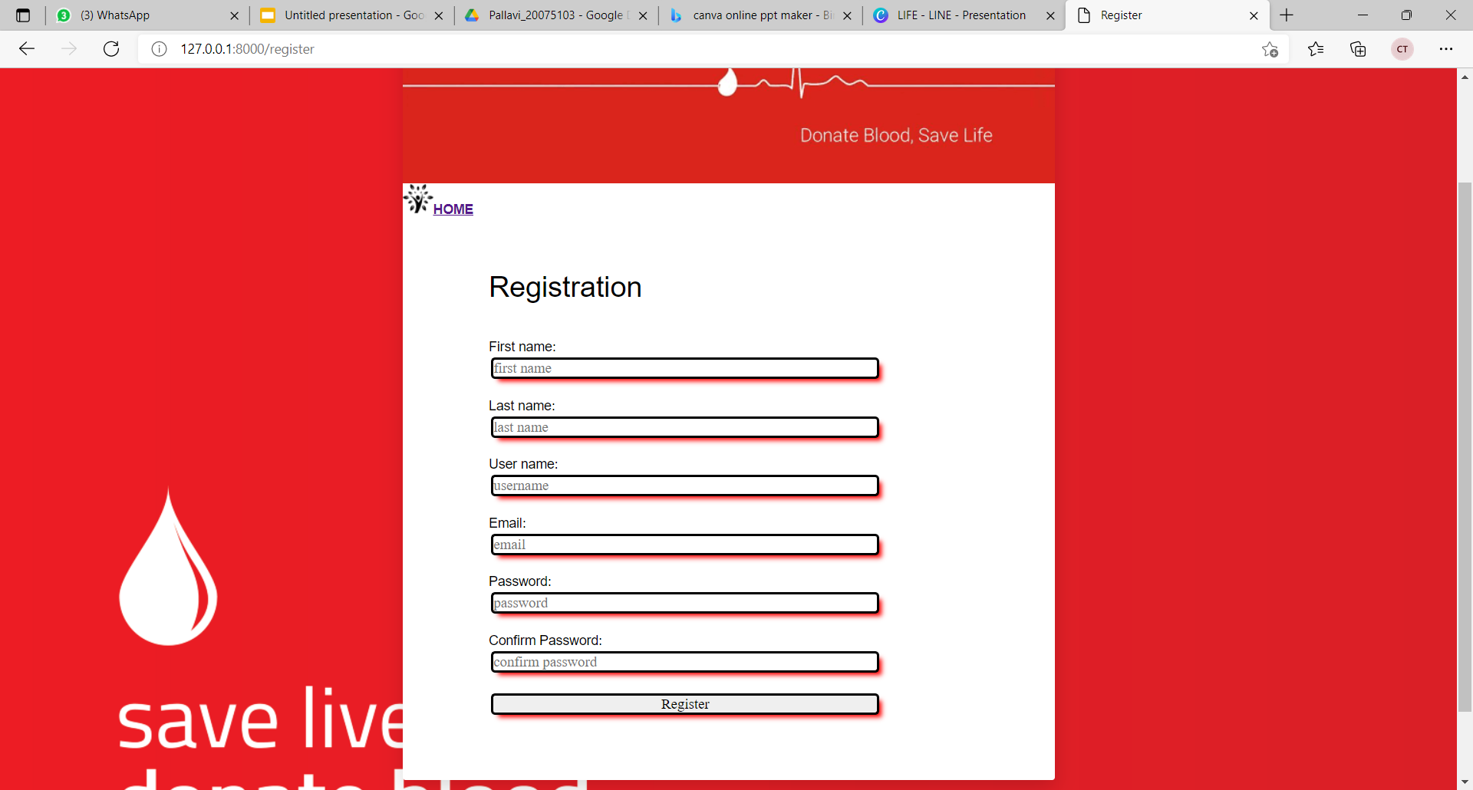
USER REGISTRATION PAGE

Slide 6

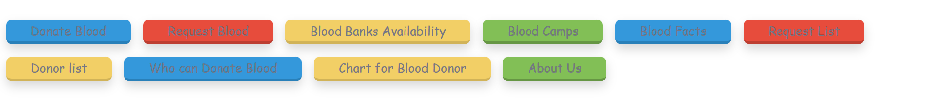
REGISTERED USER LOGIN PAGE

Slide 7
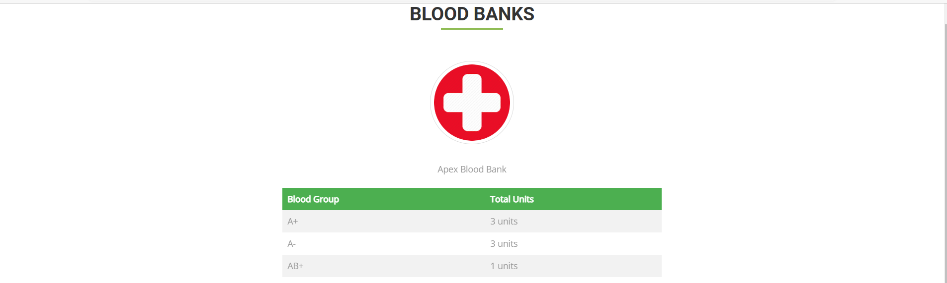
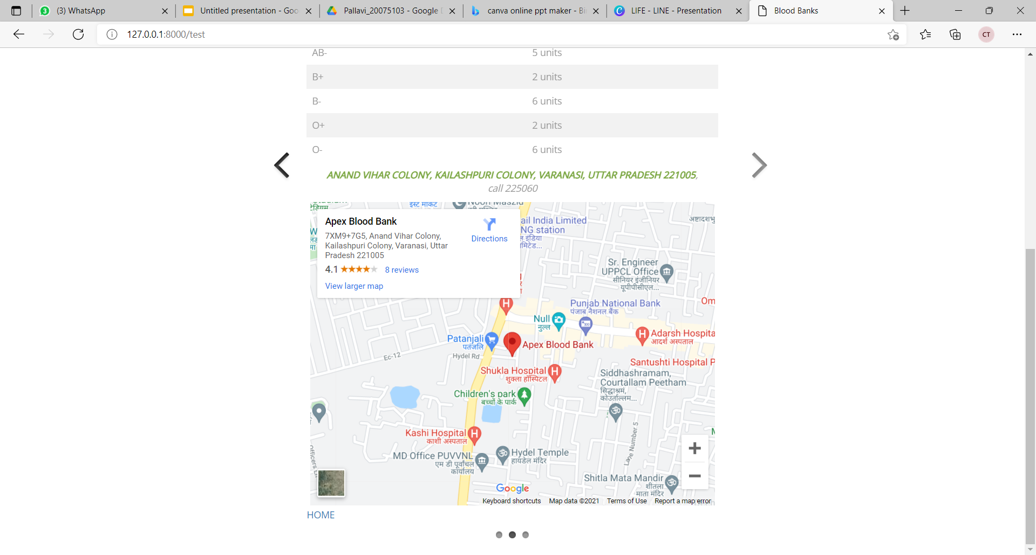
MAP VIEW FOR A LISTED BLOOD BANK

Slide 8
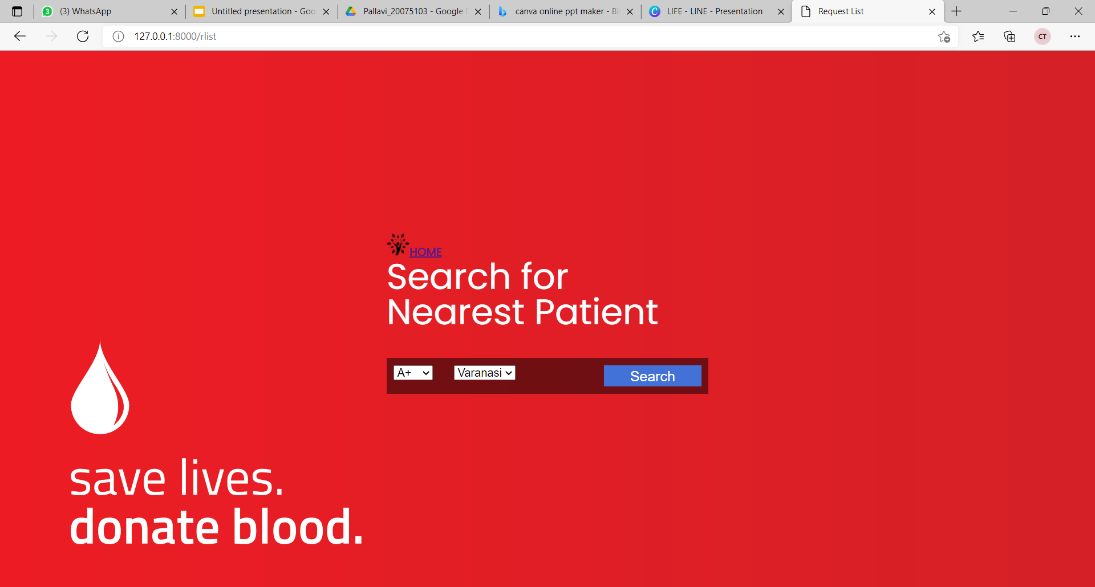
SEARCH FOR PATIENT PAGE
(WE HAVE A SIMILAR PAGE FOR DONOR)

Slide 9
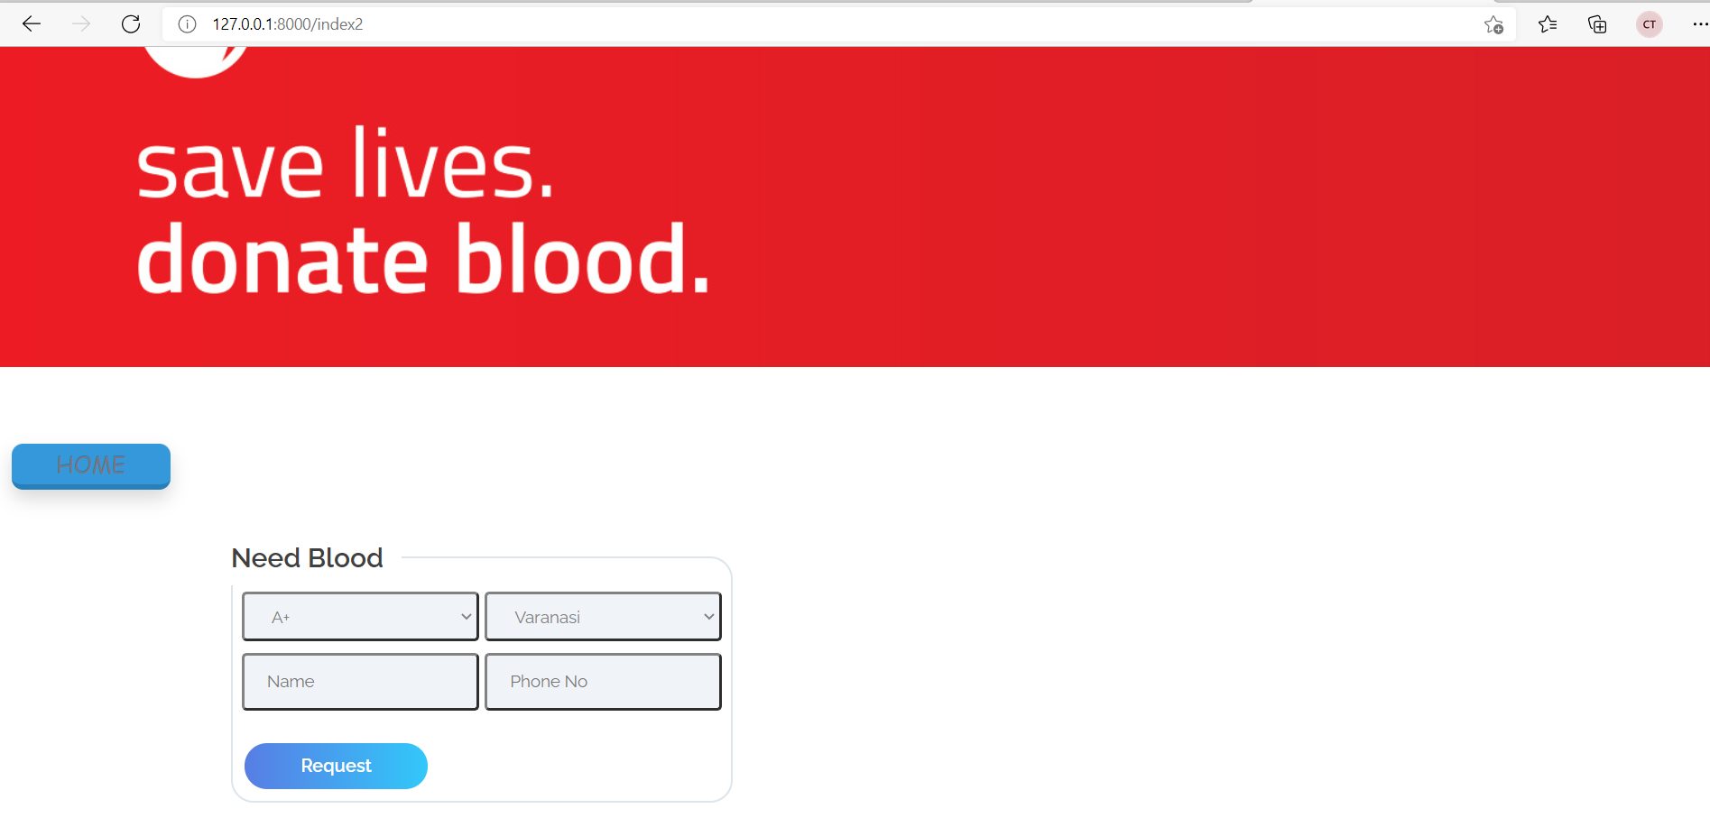
PAGE TO MAKE A REQUEST
(WE HAVE A SIMILAR PAGE FOR DONATION)

Slide 10
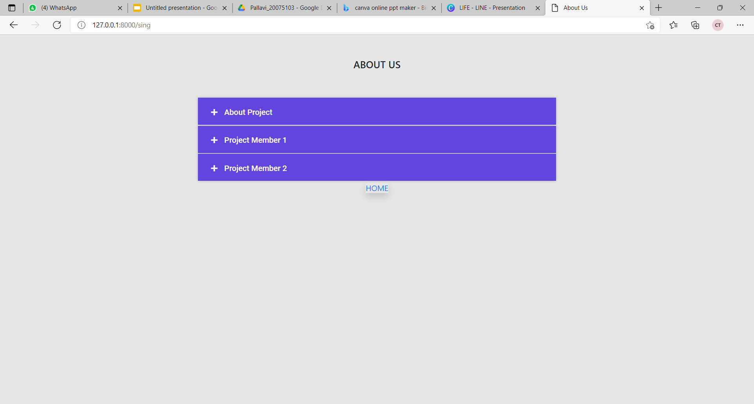
ABOUT US PAGE

Slide 11
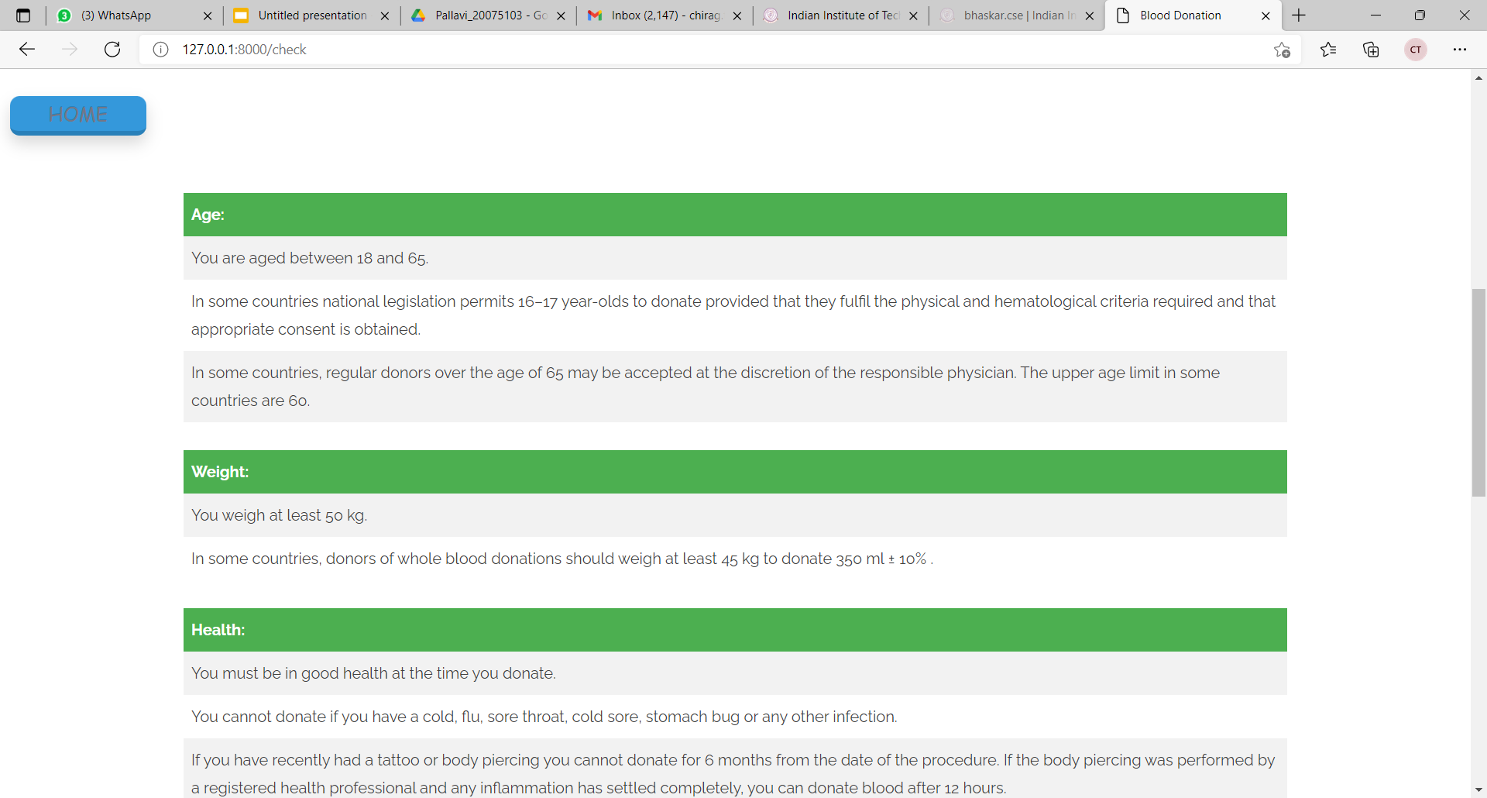
WHO CAN DONATE BLOOD (PAGE)

Slide 12
BACK-END INFORMATION IN BRIEF :
IN VIEWS.PY FILE, WE HAVE CODED VIEW FUNCTION FOR HOME PAGE VIEW, REGISTERED USER LOGGED IN VIEW, BLOOD BANK MAP VIEW, FACTS ABOUT BLOOD VIEW, ABOUT US VIEW,ETC.
IN URLS.PY FILE, WE HAVE MAPPED VARIOUS URLS FOR CORRESPONDING VIEWS SO THAT USER CAN ACCESS ALL WEB PAGES SMOOTHLY. THERE IS A TAB TO SWITCH BACK TO HOMEPAGE IN EVERY WEB PAGE.
SOME HTML FILES HAVE BEEN CREATED FOR CREATING FORMS, BASIC FORMATTING AND CREATING THE DESIRED VIEW.
SIMILARLY, SETTINGS.PY HAS BEEN MODIFIED IN ACCORDANCE WITH THE DESIRED PURPOSE.
MODELS.PY STORES VARIOUS MODELS FOR FETCHING INFORMATION FROM THE PAGE AND STORING IN THE MYSQL DATABASE.

Slide 13

THANK YOU !

