Slide 1
CS449 Lab 5/12/20
These slides will be available online:
https://github.com/kc13/CS449
Agenda for today
Overview of recitation / other class details
Overview of Lab #0

Slide 2
Basic info
TA: Karin Cox (also the recitation TA for CS447)
Email: kmc51@pitt.edu
The repository from the previous slide:
https://github.com/kc13/CS449
Slides will always be posted there.
Accessing these is optional.

Slide 3
Basic info
Zoom URL:
https://pitt.zoom.us/my/kmc51
Meeting ID # 8361144966
This will be used for all recitations
And also for office hours
Office hours:
Optional Doodle poll to determine what times work best: https://doodle.com/poll/za9d9akdem9w9qsm
If you choose to respond, please try to do so within the next few days.
Office hours will use the same Zoom URL.
These will be used for both general questions and “check-off” meetings (see website: https://sites.google.com/view/cs449su20/home); more information will be provided in the future (no check-offs will be required for this week’s lab).

Slide 4
Lab #0 (“Hello Lab”)
The instructions can be downloaded from Gradescope.
The first several pages discuss background information.
Pages 9-10 discuss the lab assignment itself.
These slides will provide a quick walk-through of this document.

Slide 5
Lab #0 (“Hello Lab”)
Summary: The main goal of this lab is to make sure you are able to edit, compile, and execute C programs on a linux machine.
If you are not able to access thoth with your Pitt username/password, contact Prof. Sherif Khattab at skhattab@cs.pitt.edu.

Slide 6
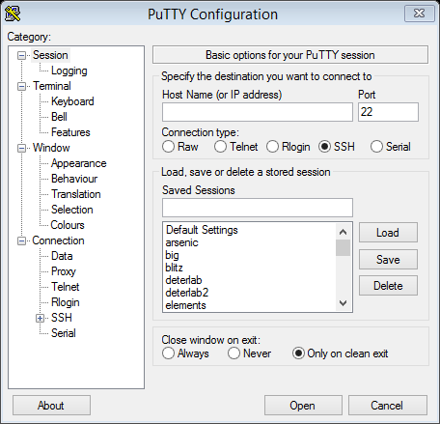
Lab #0 (“Hello Lab”): Accessing thoth using ssh (secure shell protocol)
PuTTY is a popular choice for SSH on Windows.
Note that you can save the Host Name (along with any other settings) for future use; just type a name under “Saved Sessions” and click “Save”.

Slide 7
Lab #0 page 2: Other ssh options for Windows
In Windows 10, you also have the option of accessing ssh through Windows’ own applications.
For the second option (enabling Bash), see https://blogs.windows.com/windowsdeveloper/2016/03/30/run-bash-on-ubuntu-on-windows/
If you prefer to stick with PuTTY, that is also OK.

Slide 8
Lab #0 page 2: Mac/Linux ssh

Slide 9
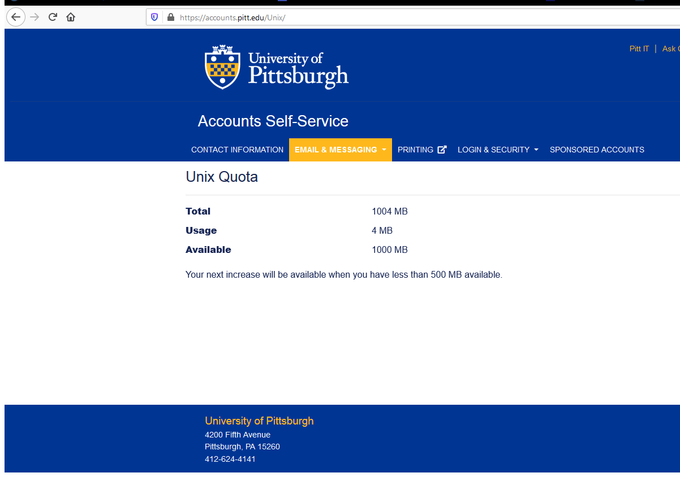
Lab #0 page 2: increase space on thoth
The default available storage space will be tiny; this is how you correct for that.
Result:

Slide 10
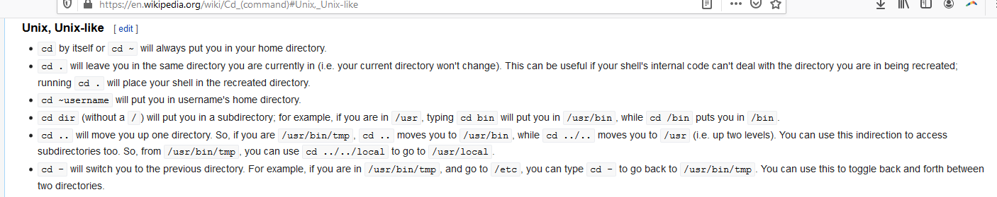
Lab #0 page 2: Linux navigation
This section refers to commands for specifying filepaths in Linux.
To move around to different filepaths, use cd (change directory), see Wikipedia info below:

Slide 11
Lab #0 page 3: Linux commands
This summarizes many of the most useful Linux commands to know.
Note that documentation for most commands can be accessed by typing “man <command>” on thoth (e.g., try “man ls”, or “man cat”). Man = short for manual. It’s also easy to find this info online.
You must be careful with commands that delete (like ‘rm’), since that will get rid of your file for good – you can’t count on a backup or a copy in a recycle/trash bin.

Slide 12
Lab #0 page 3: SCP (Secure Copy Protocol)
Can be used to copy files between your computer and thoth.
These commands should work on Linux and Mac OS.
For Windows, you may need to download an outside tool (which in most cases will make use of a graphical interface).
Example: WinSCP
https://winscp.net/eng/index.php

Slide 13
Lab #0 pages 3-4: Text Editors
It can be useful to be able to use a simple command-line interface text editor that you can open directly in a shell on thoth; some options are listed here.
nano is the most intuitive. Type “nano <filename>” to edit a file; ctrl-O to save, ctrl-X to exit.

Slide 14
Lab #0 page 4: GUI Text Editors
These are some editors you can use on your own computer, and the methods you can use to get your files on to thoth.
Another option not listed in the instructions: ‘gedit’ is a simple GUI-based editor that is installed on thoth. To view graphics from thoth on your own machine takes some setup (if interested, do a Google search for ‘X forwarding’; generally you have to install a program for X graphics and adjust your ssh configuration).

Slide 15
Lab #0 pages 4-5: C programming
Comment regarding textbooks:
For C, another good reference (in addition to the Kernighan & Ritchie book listed on the website) is Practical C Programming by Steve Oualline (which should be available online though the Pitt library system).

Slide 16
Lab #0 pages 4-5: C programming – Hello World

Slide 17
Lab #0 page 5: printf
Reference for format specifiers:
https://www.tutorialspoint.com/format-specifiers-in-c

Slide 18
Lab #0 page 5: Compilation/execution
For many of the examples in this lab, you will be asked to download a file from the Internet using wget, which is a command line utility that can perform these retrievals. For more info type ‘wget --help’. ‘-O’ tells wget to write the retrieved contents to a file named hello.c in your current working directory.

Slide 19
Lab #0 page 6: Compilation/execution
Note: Although you might not always need to use all the flags listed here, for this lab, it will be helpful to include them all.

Slide 20
Lab #0 pages 6-7: gdb – debugging tool
GDB won’t be used in this lab, but keep this around for reference for future labs.
GDB can do things like show you the underlying assembly instructions, and set breakpoints in execution.

Slide 21
Lab #0 page 7-8: Valgrind
The functionality of this program will be easier to understand after covering some concepts that will come later in the course.
It is relevant for this lab assignment, however, so a brief introduction is provided here.

Slide 22
Lab #0 page 7-8: Valgrind
Valgrind helps in identifying issues with memory management.
This initial exercise (not part of the assignment you will submit) asks you to first compile and run two small C programs, only one of which causes a “segmentation fault” error (which happens when you try to access an illegal memory address).

Slide 23
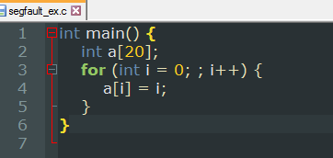
Lab #0 page 7-8: Valgrind
The program which does cause a segmentation fault (segfault_ex.c) does not include a termination condition in the for loop, so the program attempts to access memory locations beyond those allocated to the original integer array.
We can also use Valgrind to simulate the execution of this program, and provide information regarding memory issues.

Slide 24
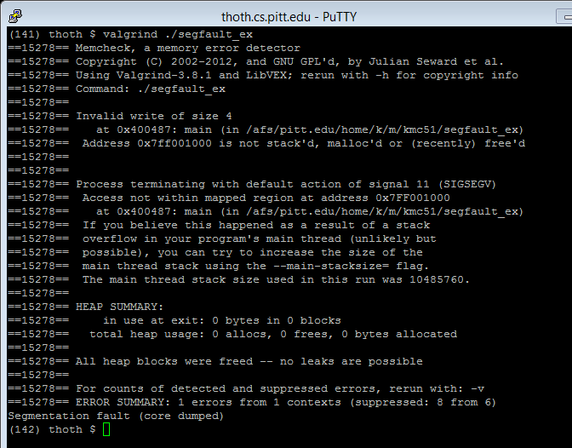
Lab #0 page 7-8: Valgrind output on segfault_ex

Slide 25
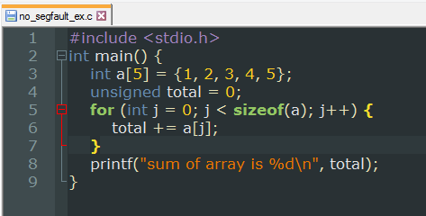
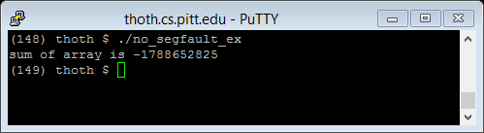
Lab #0 page 7-8: Program with an issue that does not cause segmentation fault

Slide 26
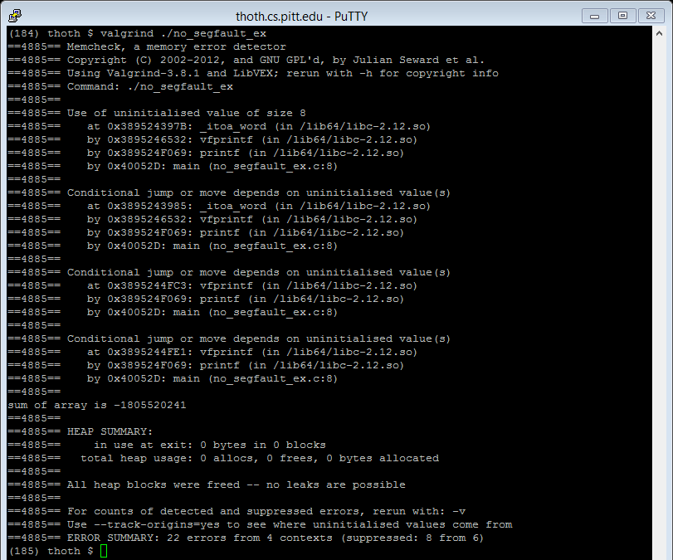
Lab #0 page 7-8: same program in valgrind
The issue is that sizeof(a) will return the number of bytes in the array (20) rather than the number of integer elements (5). So the loop runs too many times (resulting in overflow, which creates the negative output).
Valgrind does not tell us this exactly but does give us some hints.

Slide 27
Lab #0: Pages 9-10: Lab Assignment
This part will involve making edits to source code that is provided to you, and using the output of the modified program to answer questions on the quiz in Gradescope. Don’t worry if some things don’t make complete sense yet!

Slide 28
Lab #0: Pages 9-10: Lab Assignment
This part will involve making edits to source code that is provided to you, and using the output of the modified program to answer questions on the quiz in Gradescope. Don’t worry if some things don’t make complete sense yet!

Slide 29
Lab #0: Pages 9-10: Lab Assignment
This section tells you how to access the lab0.c file using wget, and reminds you how to compile a program with gcc.

Slide 30
Lab #0: Pages 9-10: Lab Assignment
This shows you how to execute the program.
Arguments 1-4 run different sections, which correspond to different parts of the Gradescope quiz.

Slide 31
Lab #0: Pages 9-10: Lab Assignment

Slide 32
Lab #0: Gradescope questions – a few comments
For Q1:
This is a multipart question. For each part, you’ll be asked to add some statements to designated sections in the part1 function in the code. As you add new statements for each subpart, you should leave (and not delete) the new lines that you have already added.
For Q3:
The line you need to uncomment and modify is :
// assert( student == 8 );
The correct answer will add some text both before and after ‘student’. Nothing is deleted. Read the preceding comments in part3, and think about how the technique demonstrated on “fillArray” could apply here. Also keep in mind that Gradescope should ultimately reveal the correct answer.

