Slide 1
Grid Flexibility Optimization
Nuclear Plants and Data Centers
EECE 6370 – Report02
Roberto Avila

Slide 2
Overview
  Nuclear power plants
  Modern Grid Flexibility
  Data Centers
  Nuclear-data center interaction
  Data Center Study
  Grid flexibility Optimization model

Slide 3

Nuclear Power Plants
  Baseload generation
  Limited ramping capability
  Typical output: 70–80 GW

Slide 4
Modern Grid Flexibility
  Daily demand swing ~91,123 MWh
  Need for dynamic balancing
  Increasing variable loads

Slide 5
Data Centers
  Growing AI-driven demand
  Large flexible load potential

Slide 6
Nuclear + Data Centers
  Nuclear = stable but inflexible
  Data centers = highly variable
  Mismatch challenges

Slide 7
Flexibility Strategies
  Load shifting
  Virtual energy storage
    Thermal
    UPS
    Generators
  Delay-tolerant workloads
  From:
  “Data Centres as a Source of Flexibility for
  Power Systems”

Slide 8
Optimization Model
  Flexible load band ±α
  Ramp constraints
  Energy neutrality
  Objective: balance

Slide 9
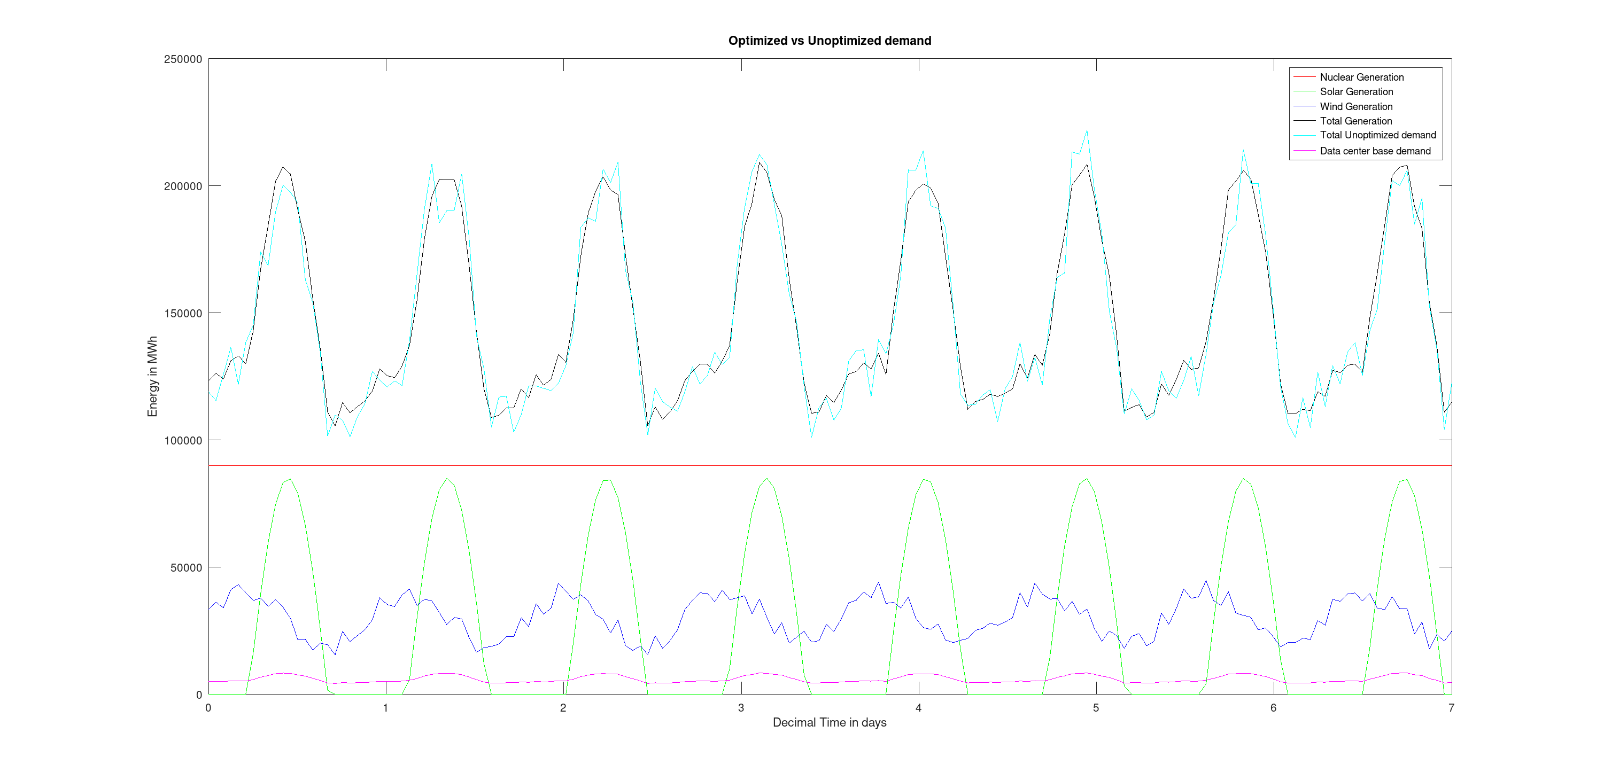

Slide 10
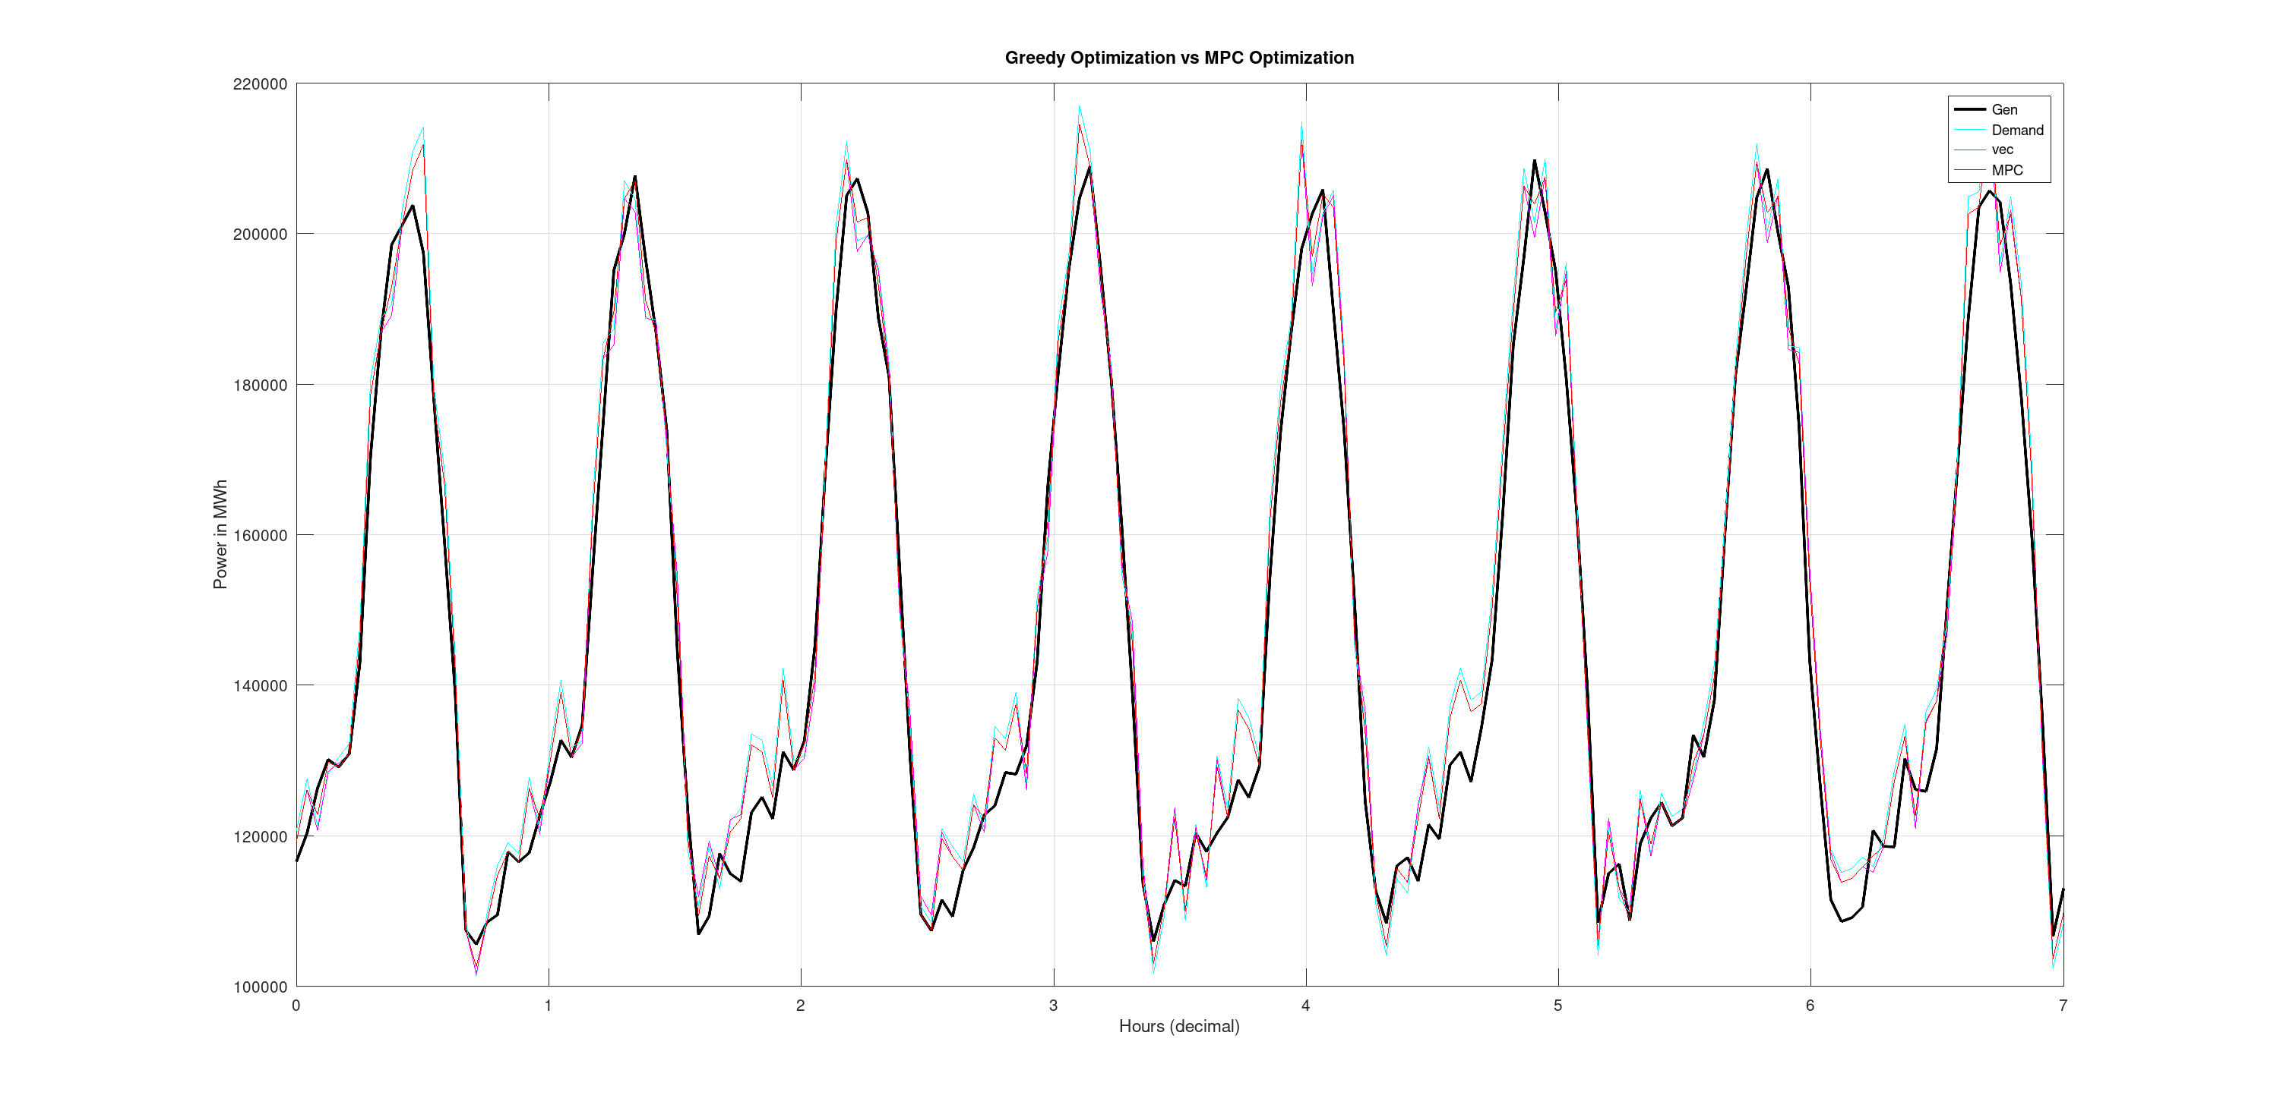
Results
  RMSE: None = 7194.1 MWh
  Greedy = 6455.8 MWh
  Model Predictive control (MPC) = 5713.5 MWh
  Data centers reduce mismatch

Slide 11
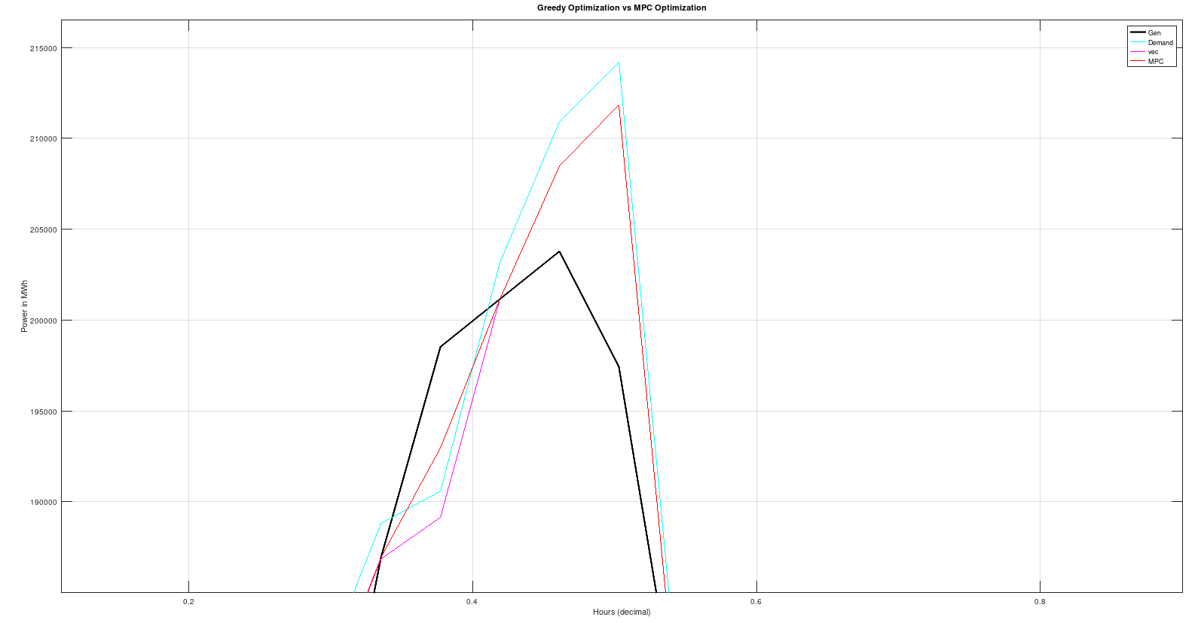

Slide 12
Conclusion
  Data centers as flexible grid assets
  Nuclear as stable baseload
  Flexibility improves grid stability

Slide 13

Code & Data on Github

