Slide 1
DiaLOG Chat
Chat Group Application

Slide 2
DiaLOG Chat
Team Members:
Robert Holden
Michael Harris
Nick Guzak
Tonja Jean
Dara: “Wow, it’s raining in Toronto!”
BigTiny: “Any good recommendations for pizza?”
Charlie: “Hey, What time is the game?”

Slide 3
Welcome to DiaLOG
Users send and receive chat messages in real time!
Allows users to create groups.
Each group has separate channels for chatting.
Each user creates a unique username.
Try it yourself!!!!!

Slide 4
Target Market
Groups
Colleagues
Friends/Family
Event Planning
General Recreation

Slide 5
Demo/Technology
Web Sockets
Bcrypt
Pug
Session Storage

Slide 6
Challenges / Bugs
Web Sockets –socket.io ws-express
Socket time out due to idle time
Added keep alive
Messages were not sorted

Slide 7
About: Web Sockets
Full-duplex (bi-directional) communication protocol.
Low-latency pushes between Server and Client.
Low overhead upon session set up.
Notes:
“Abstract
The WebSocket Protocol enables two-way communication between a client
running untrusted code in a controlled environment to a remote host
that has opted-in to communications from that code. The security
model used for this is the origin-based security model commonly used
by web browsers. The protocol consists of an opening handshake
followed by basic message framing, layered over TCP. The goal of
this technology is to provide a mechanism for browser-based
applications that need two-way communication with servers that does
not rely on opening multiple HTTP connections (e.g., using
XMLHttpRequest or <iframe>s and long polling).
Once the client and server have both sent their handshakes, and if
the handshake was successful, then the data transfer part starts.
This is a two-way communication channel where each side can,
independently from the other, send data at will.
After a successful handshake, clients and servers transfer data back
and forth in conceptual units referred to in this specification as
"messages". “
Reference:
https://tools.ietf.org/html/rfc6455

Slide 8
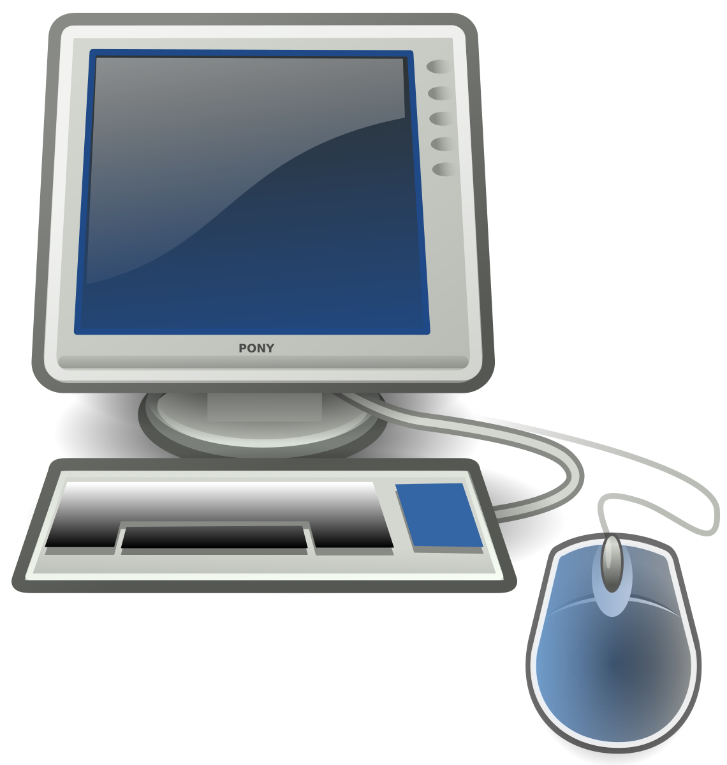
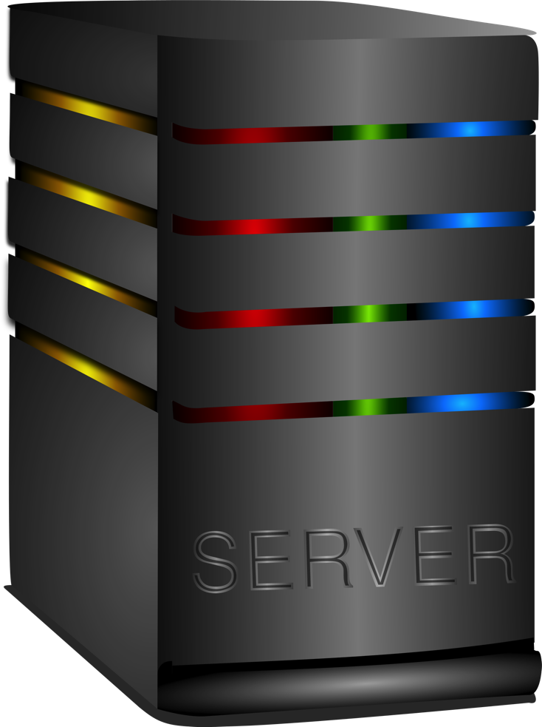
About: Web Sockets
Initial Request
Client
Server
Response Conf
Open Socket Bi-Directional
Close Socket Operation
Notes:
“Abstract
The WebSocket Protocol enables two-way communication between a client
running untrusted code in a controlled environment to a remote host
that has opted-in to communications from that code. The security
model used for this is the origin-based security model commonly used
by web browsers. The protocol consists of an opening handshake
followed by basic message framing, layered over TCP. The goal of
this technology is to provide a mechanism for browser-based
applications that need two-way communication with servers that does
not rely on opening multiple HTTP connections (e.g., using
XMLHttpRequest or <iframe>s and long polling).
Once the client and server have both sent their handshakes, and if
the handshake was successful, then the data transfer part starts.
This is a two-way communication channel where each side can,
independently from the other, send data at will.
After a successful handshake, clients and servers transfer data back
and forth in conceptual units referred to in this specification as
"messages". “
Reference:
https://tools.ietf.org/html/rfc6455

Slide 9
IceBox Features
Edit functionality for groups and channels
Upload documents/images
Add Voice
Group Admins
Email verification of users/ captcha/ google sign On
Private Messages
Friends List
Invite links
UX/UI enhancement

Slide 10
Thank you!

