Slide 1
The Aftereffect of complexity
A use case for advanced data architecture and multi-input models with neural networks

Slide 2
Table of contents
Thesis (data science problem)
Data sources
Proposed data architecture
Modelling
Results
Next steps and future iterations

Slide 3
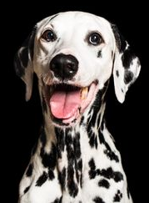

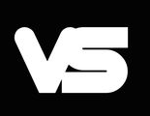
Data sources
In the wild, data is less friendly and useful than what we are accustomed to
Thesis
(data science problem)
While Convolutional Neural Networks (CNN's) are typically used for image recognition problems, this project explores the use of CNN's on an unconventional data architecture.
We believe that on situations where data is limited, adding layers of complexity will increase accuracy.
(the world famous “Iris” dataset) author’s representation
(the “real world” data) author’s representation

Slide 4
This poses the following question:
What can be done when data is uninformative relative to our question?
Engineering complexity…

Slide 5
Data sources
(Academic Yelp Dataset)
To engineer our way through this problem we chose the Yelp academic dataset to
Classify businesses as
“permanently closed” or “open”
based on soley on user reviews,

Slide 6
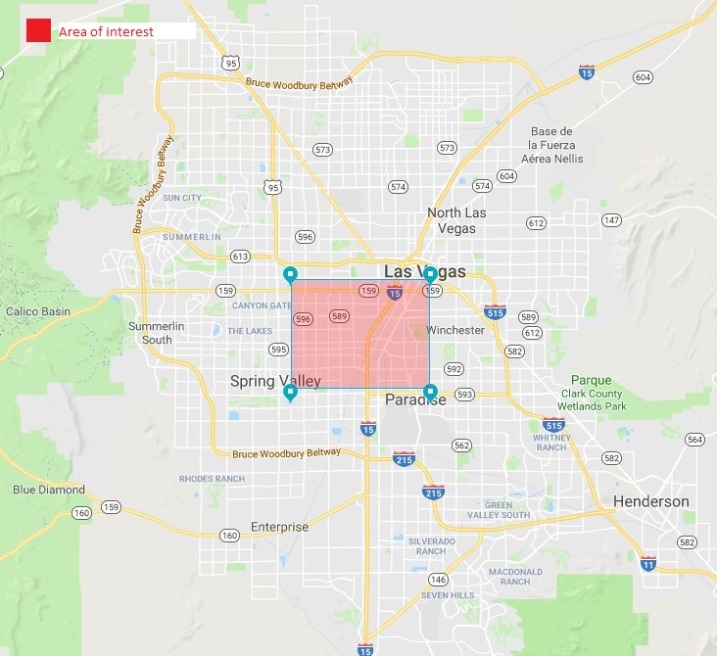
Data sources
(Academic Yelp Dataset)
6,000,000 user reviews
192,000 businesses
Due to computing limitations we reduced the scope to an area of interest comprised of
8,500 businesses
summarized reviews and ratings by business

Slide 7
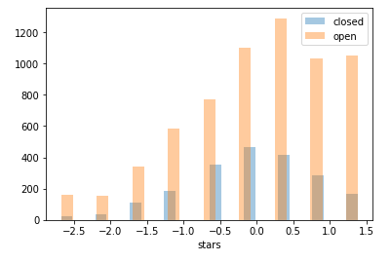
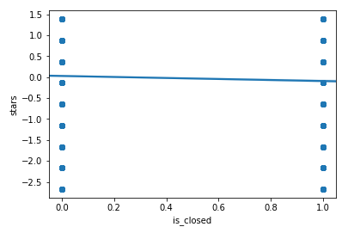
Visuals of simplified 2D model
Histograms (stars) | by “open” and “closed” businesses in “Las Vegas”
Regression plot | open vs. closed categories and stars
Proposed data architecture
The 2D data frame extracted directly from Yelp provides an oversimplified view of the problem.
A simple model does not beat baseline accuracy (naive estimation)
Baseline accuracy : 69%
Model performance : 69%

Slide 8
Typical image architecture
(a) pixel horizontal axis
(b) pixel vertical axis
0.5
4D tensor shape = (num images, a, b, pixel value)

Slide 9
Proposed data
architecture
A reasonable workaround to this limitation is to compare a given business against its neighboring competitors, under the assumption that low performing businesses relative to surrounding businesses are more likely to close.
We call it “benchmarking”

Slide 10
Proposed data architecture
(a) Business categories (from most to least similar for a given business)
others | C(-8) | C(-7) | C(-6) | C(-5) | C(-4) | C(-3) | C(-2) | C1 | C2 | C3 | C4 | C5 | C6 | C7 | C8 | others
5k | max
2.5k | 5k
1k | 2.5k
500 | 1k
250 | 500
100 | 250
50 | 100
0 | 50
-50 | 0
-100 | -50
-250 | -100
-500 | -250
-1k | -500
-2.5k | -1k
-5k | -2.5k
min | -5k
North
South
Features = difference between target business and the average of all businesses of the same category on a 50mts radius. Business location based on lat and long coordinates, distance calculated with Euclidean distance on UTM.

Slide 11
Model pipeline
2d dataframe
4d tensor
Modelling
Feed forward
neural network
Convolutional neural network
The advantage of this approach is to add layers of complexity to the data structure and hope that the model picks up in dimensional patters that 2D data architectures would not.
For example, the use of Deep learning techniques with multi input.
Dense layer
Final output

Slide 12
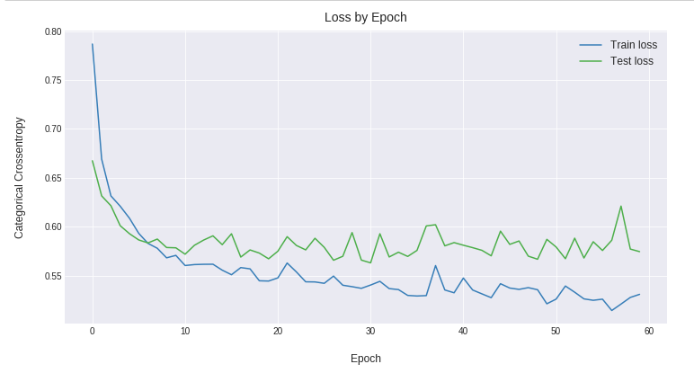
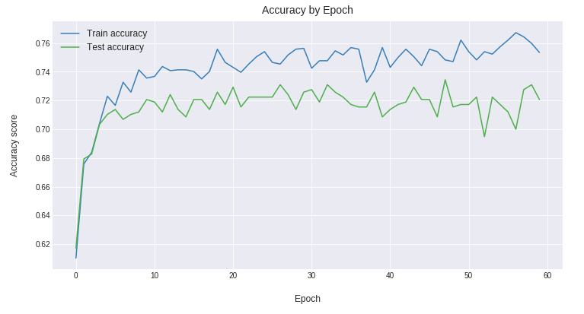
Feed forward neural network
Dense layer (64 neurons, l2 regularizer)
Dense layer (64 neurons, l2 regularizer)
Dropout (30%)
Dense layer (32 neurons)
Dense layer (32 neurons)
Dense layer (32 neurons)
Dense layer (32 neurons, l2 regularizer)
Dense layer (128 neurons, l2 regularizer)
Dropout (30%)
Dense layer (20 neurons)
Dense layer (64 neurons)
Output

Slide 13
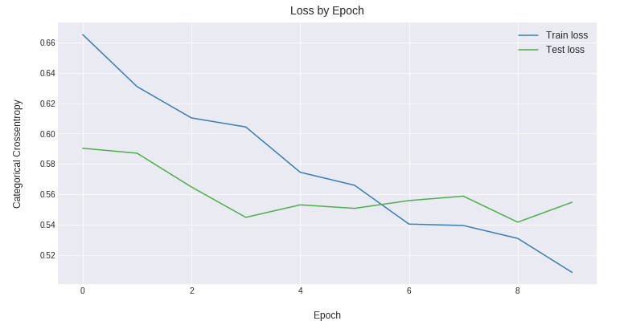
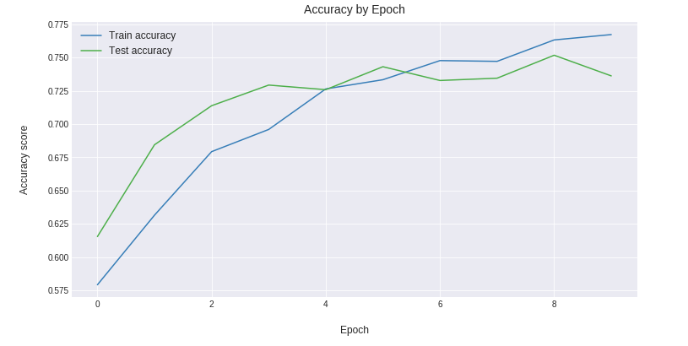
Convolutional neural network
Dense layer (64 neurons, l2 regularizer)
Dense layer (64 neurons, l2 regularizer)
Dropout (30%)
Dense layer (32 neurons)
Dense layer (32 neurons)
Dense layer (32 neurons)
Dense layer (32 neurons, l2 regularizer)
Dense layer (128 neurons, l2 regularizer)
Dropout (30%)
Dense layer (20 neurons)
Dense layer (64 neurons)
Output

Slide 14
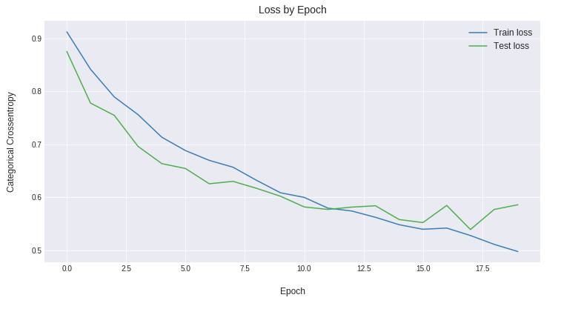
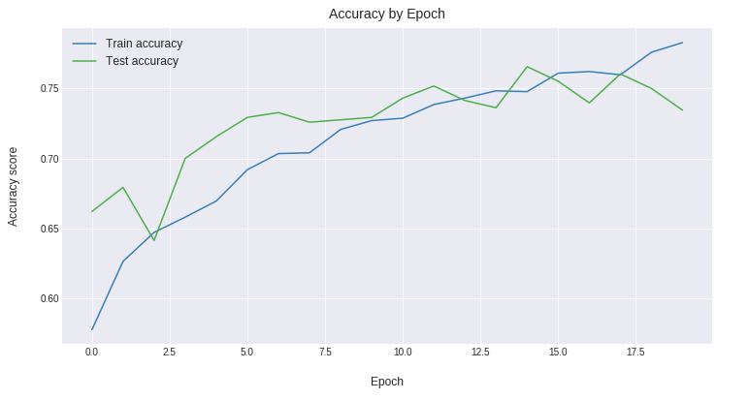
Comparative results
Model
Grid search
Train set
Test set
Random Forest
0.76
0.99
0.72
Support Vector Machine
0.72
0.73
0.71
Feed forward neural net
0.75
0.77
0.72
Convolutional neural net
0.70
0.78
0.76
Mixed input model
N.A
0.78
0.75
The use of a more complex data structure marginally increased overall accuracy.
Comparatively speaking, the proposed model pipeline performed better than optimized Random Forests and Support Vector machines.

Slide 15
Future iterations
Use more data to train the model
Use more bins/dimensions
Increase the number of locations of interest
Add and RNN to the model structure considering the same variables but seggregated by distance and categories throughout time.
There is evidence to believe that the mixed model can improve accuracy.
Next steps
The use of a more complex data structure marginally increased overall accuracy.
Comparatively speaking, the proposed model pipeline performed better than optimized Random Forests and Support Vector machines.

Slide 16
Questions?

