Slide 1
mcp-ltspice-qucs
An agentic MCP suite for RF, analog, and SMPS-EMC design
Spec → compliant deliverable in seconds.
v0.2.0 • 427 tests passing • Investor briefing

Slide 2
The problem
Hardware design today is slow, expensive, and reactive
• 3–10 days per filter design — spreadsheet math → ADS / Cadence ($30k–$200k per seat) → simulator → respin
• 60–80 % of products fail CISPR / FCC pre-compliance on first lab visit — each respin costs $20k–$80k NRE + 2–6 weeks slip
• Vendor part substitution is manual: 100-tab Excel files. Parasitics (SRF, Q, ESR) routinely ignored — silently degrade the design
• EMC compliance is reactive, not predicted — the engineer doesn't know they failed until the lab tells them
Today's flow: engineer → math → simulator → respin. We collapse the loop so an LLM agent does engineer-quality work end-to-end.

Slide 3
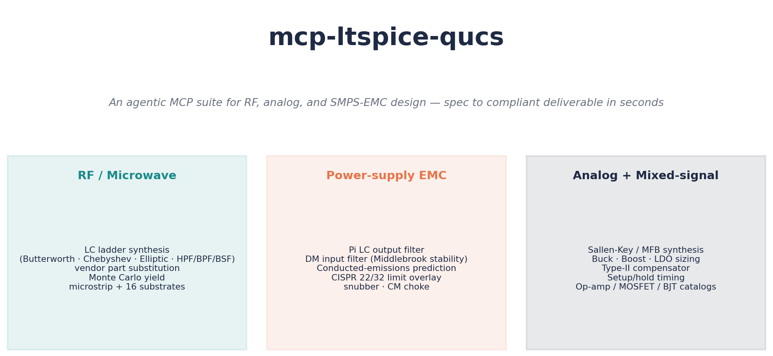
What we built
112 MCP tools across four packages, callable by any agent stack
Three categories · 56 flat tools + 56 namespaced aliases · all backed by peer-reviewed math (Pozar, Erickson, Sedra-Smith, Mancini)

Slide 4
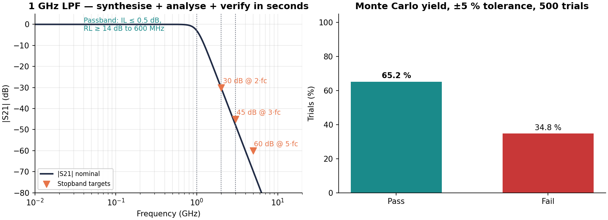
Demo 1 — RF Low-Pass Filter (1 GHz Butterworth)
Synthesise → analyse → Monte Carlo → LTspice/Touchstone deliverable in 9 seconds
• Spec: passband to 600 MHz at 0.5 dB IL; 30/45/60 dB at 2·/3·/5·fc
• Monte Carlo: 65 % yield on ideal ±5 % parts → 99 % with real Coilcraft + Murata vendor substitution (E24 snap, SRF-aware)
• Tangible output: .asc, .s2p, schematic PNG, PDF report — engineer-ready

Slide 5
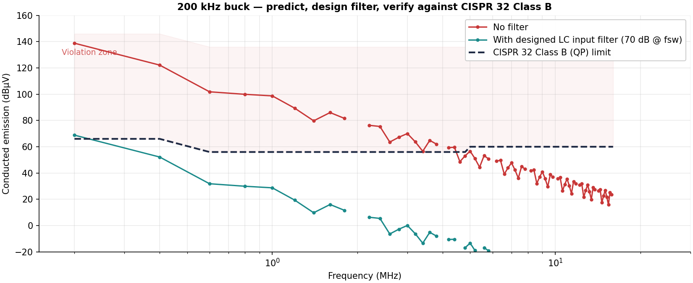
Demo 2 — SMPS Conducted Emissions vs CISPR 32 Class B
From 'I have a switching converter' to 'here's how close to compliance you are'
• Modelled the switch-node as a trapezoidal waveform, predicted all 80 harmonics across the 150 kHz – 30 MHz CISPR conducted band
• Designed a 70-dB-at-fsw LC input filter; verified Middlebrook stability against the converter's input impedance
• Worst margin: −2.8 dB — engineer immediately knows: ~3 dB more attenuation needed (taller ferrite, larger X-cap, or CM choke). No spin-the-board.

Slide 6
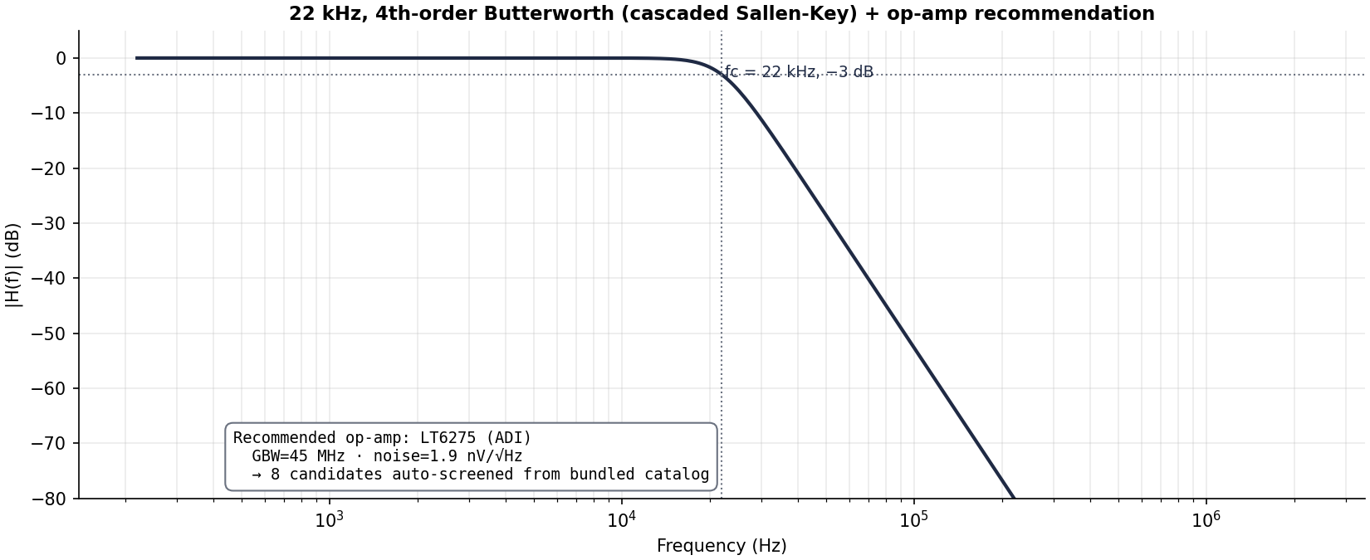
Demo 3 — Active Filter (Sallen-Key, 22 kHz, 4th order)
Anti-aliasing for a 96 kSPS audio ADC, complete with op-amp recommendation
• Decomposed into two Sallen-Key biquads with Mancini-tabulated stage Qs (0.541 / 1.307); sized R/C for 1 nF capacitors
• Required op-amp GBW: 2.87 MHz. Bundled catalogue auto-screened 8 candidates against GBW, noise (≤ 10 nV/√Hz), offset (≤ 1 mV)
• Audio-band rank (cap GBW, sort by noise): ADI LT6275 — 45 MHz · 1.9 nV/√Hz · 130 µV. Per-stage schematics + PDF report rendered.

Slide 7
What's hard to replicate
Data, math, and agent-first design
• Real vendor data baked in — Coilcraft, Johanson, TDK, Murata L/Q/SRF tables with parasitic-aware substitution. Not catalog scraping.
• Peer-reviewed math — Pozar §8.5 RF transforms, Hammerstad-Jensen microstrip, Erickson §10.4 EMI, Sedra-Smith Sallen-Key, Mancini cascade tables
• 427 unit tests guard the math, 4 simulator-gated skips, 0 failures
• Designed agent-first — every tool returns Envelope[T] with status, data, warnings, ms-timer. Exactly what an LLM needs to chain reliably.
• Composable with the rest of the engineering MCP ecosystem — antennas → nec2-antenna / openems, PCB layout → pcb-emcopilot, regulatory → emc-regulations. We sit cleanly in the middle.
• v0.2.0 shipped, tagged, GitHub Release public. Reproducible from git clone + uv run pytest.

Slide 8
Why now
• MCP standardised in late 2024 — build once, every agent stack consumes it
• LLM agents have crossed the 'useful for engineering' threshold — Claude 4.x and GPT-5 reliably orchestrate multi-step tool use
• Hardware-design tooling moat is the data + the math, not the wrapper code — and that's where we've invested
• EDA incumbents (Cadence, Synopsys, Keysight) are pricing for the Fortune-500 IDM market — the long tail of IoT / startup / consumer-electronics teams is wide open
The hardware team that ships first wins. We make every team's HW lead 5–10× faster.

Slide 9
Roadmap
Now (v0.2.0)
112 tools shipped · RF LPF/HPF/BPF/BSF · SMPS EMC · active filters · vendor catalogues · LTspice/Touchstone deliverables
Phase 6
Xyce harmonic-balance · Qucs-S noise extraction · distributed filter synthesis (hairpin, interdigital, combline) · .sch ↔ .asc conversion bridge
Phase 7
Real-simulator integration tests · async runner with heartbeat · Sobol-index sensitivity · correlated-tolerance Monte Carlo
Beyond
Persistent ngspice (10–50× MC speedup) · FilterDesign threading through pipeline · live vendor-fetch agents (Coilcraft / Murata APIs)

Slide 10
Validated. Shipped. Composable.
github.com/RFingAdam/mcp-ltspice-qucs · v0.2.0
Ready to demo live.

