Slide 1
Normalization

Slide 2
Topics to be Covered
Functional Dependency
Armstrong’s Axioms
Closure of a set of FDs
Canonical Cover
Closure of a set of attributes to decide the key
Anomaly detection
Decomposition
Normalization and Normal Forms

Slide 3

Functional Dependency (FD) and its types

Slide 4
What is Functional Dependency (FD)?
Let R be a relation schema having n attributes A1, A2, A3,…, An.
Let attributes X and Y are two subsets of attributes of relation R.
If the values of the X component of a tuple uniquely (or functionally) determine the values of the Y component, then there is a functional dependency from X to Y. This is denoted by X → Y.
(i.e RollNo → Name, SPI, BL).
It is referred as: Y is functionally dependent on the X or X functionally determines Y.
Student
RollNo | Name | SPI | BL
101 | Raju | 8 | 0
102 | Mitesh | 7 | 1
103 | Jay | 7 | 0

Slide 5
Diagrammatic representation of (FD)
Example
Consider the relation Account(account_no, balance, branch).
account_no can determine balance and branch.
So, there is a functional dependency from account_no to balance and branch.
This can be denoted by account_no → {balance, branch}.
X → Y
{X1, X2} → Y
X → {Y1, Y2}
X
Y
X1
X2
Y
X
Y1
Y2
account_no
balance
branch

Slide 6
Types of Functional Dependency (FD)
Full Functional Dependency
In a relation, the attribute B is fully functional dependent on A if B is functionally dependent on A, but not on any proper subset of A.
Eg. {Roll_No, Semester, Department_Name} → SPI
We need all three {Roll_No, Semester, Department_Name} to find SPI.

Slide 7
Types of Functional Dependency (FD)
Partial Functional Dependency
In a relation, the attribute B is partial functional dependent on A if B is functionally dependent on A as well as on any proper subset of A.
If there is some attribute that can be removed from A and the still dependency holds then it is partial functional dependency.
Eg. {Enrollment_No, Department_Name} → SPI
Enrollment_No is sufficient to find SPI, Department_Name is not required to find SPI.

Slide 8
Types of Functional Dependency (FD)
Transitive Functional Dependency
In a relation, if attribute(s) A → B and B → C, then A → C (means C is transitively depends on A via B).
Eg. Subject → Faculty & Faculty → Age then Subject → Age
Therefore as per the rule of transitive dependency: Subject → Age should hold, that makes sense because if we know the subject name we can know the faculty’s age.
Sub_Fac
Subject | Faculty | Age
DS | Shah | 35
DBMS | Patel | 32
DF | Shah | 35

Slide 9
Types of Functional Dependency (FD)
Trivial Functional Dependency
X → Y is trivial FD if Y is a subset of X
Eg. {Roll_No, Department_Name, Semester} → Roll_No
Nontrivial Functional Dependency
X → Y is nontrivial FD if Y is not a subset of X
Eg. {Roll_No, Department_Name, Semester} → Student_Name

Slide 10
Armstrong's axioms OR Inference rules
Armstrong's axioms are a set of rules used to infer (derive) all the functional dependencies on a relational database.
Reflexivity
Augmentation
Self-determination
If B is a subset of A
then A → B
If A → B
then AC → BC
If A → A
Transitivity
Pseudo Transitivity
Decomposition
If A → B and B → C
then A → C
If A → B and BD → C
then AD → C
If A → BC
then A → B and A → C
Union
Composition
If A → B and A → C
then A → BC
If A → B and C → D
then AC → BD

Slide 11
Closure of a set of FDs

Slide 12
What is closure of a set of FDs?
Given a set F set of functional dependencies, there are certain other functional dependencies that are logically implied by F.
E.g.: F = {A → B and B → C}, then we can infer that A → C (by transitivity rule)
The set of functional dependencies (FDs) that is logically implied by F is called the closure of F. It is denoted by F⁺.

Slide 13
Closure of a set of FDs [Example]
Suppose we are given a relation schema R(A,B,C,G,H,I) and the set of functional dependencies are:
F = (A → B, A → C, CG → H, CG → I, B → H)
The functional dependency A → H is logical implied.
We have
A → B
B → H
Transitivity rule
A → H

Slide 14
Closure of a set of FDs [Example]
Suppose we are given a relation schema R(A,B,C,G,H,I) and the set of functional dependencies are:
F = (A → B, A → C, CG → H, CG → I, B → H)
The functional dependency CG → HI is logical implied.
We have
CG → H
CG → I
Union rule
CG → HI

Slide 15
Closure of a set of FDs [Example]
Suppose we are given a relation schema R(A,B,C,G,H,I) and the set of functional dependencies are:
F = (A → B, A → C, CG → H, CG → I, B → H)
The functional dependency AG → I is logical implied.
We have
A → C
CG → I
Pseudo-transitivity rule
AG → I

Slide 16
Closure of a set of FDs [Example]
Suppose we are given a relation schema R(A,B,C,G,H,I) and the set of functional dependencies are:
F = (A → B, A → C, CG → H, CG → I, B → H)
The functional dependency AG → I is logical implied.
We have
A → C
Augmentation rule
AG → CG
AG → CG
CG → I
Transitivity rule
AG → I

Slide 17
Closure of a set of FDs [Example]
Suppose we are given a relation schema R(A,B,C,G,H,I) and the set of functional dependencies are:
F = (A → B, A → C, CG → H, CG → I, B → H)
Find out the closure of F.
Several members of F⁺ are
F⁺ = (A → H, CG → HI, AG → I)

Slide 18
Closure of a set of FDs [Example]
Compute the closure of the following set F of functional dependencies FDs for relational schema R = (A,B,C,D,E,F):
F = (A → B, A → C, CD → E, CD → F, B → E)
Find out the closure of F.
A → B & A → C | Union Rule | A → BC
CD → E & CD → F | Union Rule | CD → EF
A → B & B → E | Transitivity Rule | A → E
A → C & CD → E | Pseudo-transitivity Rule | AD → E
A → C & CD → F | Pseudo-transitivity Rule | AD → F
F⁺ = (A → BC, CD → EF, A → E, AD → E, AD → F)

Slide 19
Closure of a set of FDs [Example]
Compute the closure of the following set F of functional dependencies FDs for relational schema R = (A,B,C,D,E):
F = (AB → C, D → AC, D → E )
Find out the closure of F.
D → AC | Decomposition Rule | D → A & D → C
D → AC & D → E | Union Rule | D → ACE
F⁺ = (D → A, D → C, D → ACE)

Slide 20
Closure of attribute sets to decide the Key

Slide 21
What is a closure of attribute sets?
Given a set of attributes α, the closure of α under F is the set of attributes that are functionally determined by α under F.
It is denoted by α⁺.

Slide 22
What is a closure of attribute sets?
Given a set of attributes α, the closure of α under F is the set of attributes that are functionally determined by α under F.
It is denoted by α⁺.
Algorithm
Algorithm to compute α⁺, the closure of α under F
Steps
result = α
while (changes to result) do
for each β → γ in F do
begin
if β ⊆ result then result = result U γ
else result = result
end

Slide 23
Closure of attribute sets [Example]
Consider the relation schema R = (A, B, C, G, H, I).
For this relation, a set of functional dependencies F can be given as
F = {A → B, A → C, CG → H, CG → I, B → H}
Find out the closure of (AG)⁺.
Step 1.
result = α => result = AG
Algorithm
Algorithm to compute α⁺, the closure of α under F
Steps
result = α
while (changes to result) do
for each β → γ in F do
begin
if β ⊆ result then result = result U γ
else result = result
end
A → B | A ⊆ AG | result = ABG
A → C | A ⊆ ABG | result = ABCG
CG → H | CG ⊆ ABCG | result = ABCGH
CG → I | CG ⊆ ABCGH | result = ABCGHI
B → H | B ⊆ ABCGHI | result = ABCGHI
AG⁺ = ABCGHI

Slide 24
Closure of attribute sets [Exercise]
Given functional dependencies (FDs) for relational schema R = (A,B,C,D,E):
F = {A → BC, CD → E, B → D, E → A}
Find Closure for A
Find Closure for CD
Find Closure for B
Find Closure for BC
Find Closure for E
Answer
A⁺ = ABCDE
CD⁺ = ABCDE
B⁺ = BD
BC⁺ = ABCDE
E⁺ = ABCDE

Slide 25
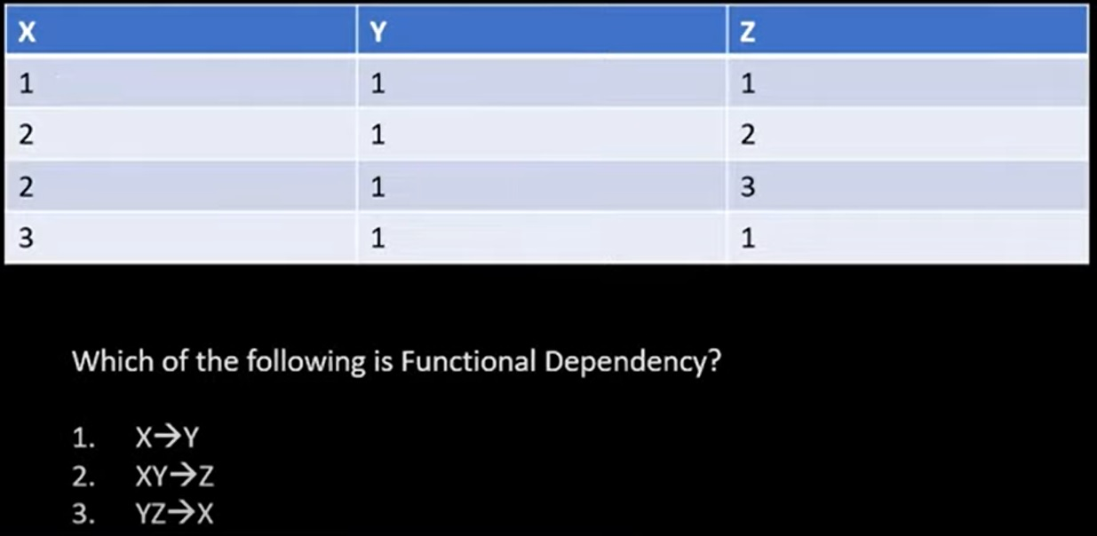
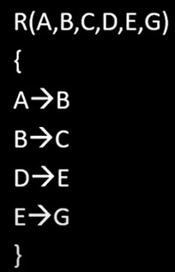
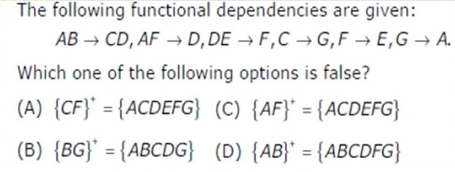

Slide 26
Canonical cover

Slide 27
What is extraneous attributes?
Let us consider a relation R with schema R = (A, B, C) and set of functional dependencies FDs F = { AB → C, A → C }.
In AB → C, B is extraneous attribute. The reason is, there is another FD A → C, which means when A alone can determine C, the use of B is unnecessary (extra).
An attribute of a functional dependency is said to be extraneous if we can remove it without changing the closure of the set of functional dependencies.

Slide 28
What is canonical cover?
A canonical cover of F is a minimal set of functional dependencies equivalent to F, having no redundant dependencies or redundant parts of dependencies.
It is denoted by F_{c}
A canonical cover for F is a set of dependencies F_{c} such that
F logically implies all dependencies in F_{c} and
F_{c} logically implies all dependencies in F and
No functional dependency in F_{c} contains an extraneous attribute and
Each left side of functional dependency in F_{c} is unique.
F = {A → B, A → C}
F_{c} = {A → BC}
Decomposition Rule
Union Rule

Slide 29
Algorithm to find canonical cover
Repeat
Use the union rule to replace any dependencies in F α1 → β1 and α1 → β2 with α1 → β1β2
Find a functional dependency α → β with an extraneous attribute either in α or in β
/* Note: test for extraneous attributes done using F_{c}, not F */
If an extraneous attribute is found, delete it from α → β
until F does not change
/* Note: Union rule may become applicable after some extraneous attributes have been deleted, so it has to be re-applied */

Slide 30
Canonical cover [Example]
Consider the relation schema R = (A, B, C) with FDs
F = {A → BC, B → C, A → B, AB → C}
Find canonical cover.
Combine A → BC and A → B into A → BC (Union Rule)
Set is {A → BC, B → C, AB → C}
A is extraneous in AB → C
Check if the result of deleting A from AB → C is implied by the other dependencies
Yes: in fact, B → C is already present
Set is {A → BC, B → C}
C is extraneous in A → BC
Check if A → C is logically implied by A → B and the other dependencies
Yes: using transitivity on A → B and B → C.
The canonical cover is: A → B, B → C

Slide 31
Canonical cover [Example]
Consider the relation schema R = (A, B, C, D, E, F) with FDs
F = {A → BC, CD → E, B → D, E → A}
Find canonical cover.
The left side of each FD in F is unique.
Also none of the attributes in the left side or right side of any of the FDs is extraneous.
Therefore the canonical cover F_{c} is equal to F.
F_{c} = {A → BC, CD → E, B → D, E → A}

Slide 32
What is an anomaly in database design?
Anomalies are problems that can occur in poorly planned, un-normalized database where all the data are stored in one table.
There are three types of anomalies that can arise in the database because of redundancy are
Insert anomaly
Delete anomaly
Update / Modification anomaly

Slide 33
Insert anomaly
Consider a relation Emp_Dept(EID, Ename, City, DID, Dname, Manager) EID as a primary key
Suppose a new department (IT) has been started by the organization but initially there is no employee appointed for that department.
We want to insert that department detail in Emp_Dept table.
But the tuple for this department cannot be inserted into this table as the EID will have NULL value, which is not allowed because EID is primary key.
This kind of problem in the relation where some tuple cannot be inserted is known as insert anomaly.
Emp_Dept
EID | Ename | City | DID | Dname | Manager
1 | Raj | Rajkot | 1 | CE | Shah
2 | Meet | Surat | 1 | CE | Shah
An insert anomaly occurs when certain attributes cannot be inserted into the database without the presence of another attribute.
NULL | NULL | NULL | 2 | IT | NULL
Want to insert new department detail (IT)

Slide 34
Delete anomaly
Consider a relation Emp_Dept(EID, Ename, City, DID, Dname, Manager) EID as a primary key
Now consider there is only one employee in some department (IT) and that employee leaves the organization.
So we need to delete tuple of that employee (Jay).
But in addition to that information about the department also deleted.
This kind of problem in the relation where deletion of some tuples can lead to loss of some other data not intended to be removed is known as delete anomaly.
Emp_Dept
EID | Ename | City | DID | Dname | Manager
1 | Raj | Rajkot | 1 | CE | Shah
2 | Meet | Surat | 1 | CE | Shah
A delete anomaly exists when certain attributes are lost because of the deletion of another attribute.
Want to delete (Jay) employee's detail
3 | Jay | Baroda | 2 | IT | Dave

Slide 35
Update anomaly
Consider a relation Emp_Dept(EID, Ename, City, Dname, Manager) EID as a primary key
Suppose the manager of a (CE) department has changed, this requires that the Manager in all the tuples corresponding to that department must be changed to reflect the new status.
If we fail to update all the tuples of given department, then two different records of employee working in the same department might show different Manager lead to inconsistency in the database.
Emp_Dept
EID | Ename | City | Dname | Manager
1 | Raj | Rajkot | CE | Sah
2 | Meet | Surat | C.E | Shah
3 | Jay | Baroda | Computer | Shaah
4 | Hari | Rajkot | IT | Dave
An update anomaly exists when one or more records (instance) of duplicated data is updated, but not all.
Want to update manager of CE department

Slide 36
How to deal with insert, delete and update anomaly
Emp_Dept
Emp
Dept
EID | Ename | City | DID | Dname | Manager
1 | Raj | Rajkot | 1 | CE | Shah
2 | Meet | Surat | 1 | C.E | Shah
EID | Ename | City | DID
1 | Raj | Rajkot | 1
2 | Meet | Surat | 1
DID | Dname | Manager
1 | CE | Shah
2 | IT | Dave
3 | Jay | Baroda | 2 | IT | Dave
3 | Jay | Baroda | 2
3 | EC | NULL
NULL | NULL | NULL | 3 | EC | NULL
Such type of anomalies in the database design can be solved by using normalization.

Slide 37
Decomposition

Slide 38
What is decomposition?
Decomposition is the process of breaking down given relation into two or more relations.
Relation R is replaced by two or more relations in such a way that:
Each new relation contains a subset of the attributes of R
Together, they all include all tuples and attributes of R
Types of decomposition
Lossy decomposition
Lossless decomposition (non-loss decomposition)

Slide 39
Lossy decomposition
The decomposition of relation R into R1 and R2 is lossy when the join of R1 and R2 does not yield the same relation as in R.
This is also referred as lossy-join decomposition.
The disadvantage of such kind of decomposition is that some information is lost during retrieval of original relation.
From practical point of view, decomposition should not be lossy decomposition.
Customer
Ano | Balance | Bname
A01 | 5000 | Rajkot
A02 | 5000 | Surat
Table-1
Table-2
Ano | Balance
A01 | 5000
A02 | 5000
Balance | Bname
5000 | Rajkot
5000 | Surat
Not Same
Customer
Ano | Balance | Bname
A01 | 5000 | Rajkot
A01 | 5000 | Surat
A02 | 5000 | Rajkot
A02 | 5000 | Surat

Slide 40
Lossless decomposition
The decomposition of relation R into R1 and R2 is lossless when the join of R1 and R2 produces the same relation as in R.
This is also referred as a non-additive (non-loss) decomposition.
All decompositions must be lossless.
Customer
Ano | Balance | Bname
A01 | 5000 | Rajkot
A02 | 5000 | Surat
Table-1
Table-2
Ano | Balance
A01 | 5000
A02 | 5000
Ano | Bname
A01 | Rajkot
A02 | Surat
Same
Customer
Ano | Balance | Bname
A01 | 5000 | Rajkot
A02 | 5000 | Surat

Slide 41
Normalization and normal forms

Slide 42
What is normalization?
Normalization is the process of removing redundant data from tables to improve data integrity, scalability and storage efficiency.
data integrity (completeness, accuracy and consistency of data)
scalability (ability of a system to continue to function well in a growing amount of work)
storage efficiency (ability to store and manage data that consumes the least amount of space)
What we do in normalization?
Normalization generally involves splitting an existing table into multiple (more than one) tables, which can be re-joined or linked each time a query is issued (executed).

Slide 43
How many normal forms are there?
Normal forms:
1NF (First normal form)
2NF (Second normal form)
3NF (Third normal form)
BCNF (Boyce–Codd normal form)
4NF (Forth normal form)
5NF (Fifth normal form)
As we move from 1NF to 5NF number of tables and complexity increases but redundancy decreases.

Slide 44
Normal forms 1NF (First Normal Form)

Slide 45
1NF (First Normal Form)
Conditions for 1NF
A relation R is in first normal form (1NF) if and only if it does not contain any composite attribute or multi-valued attributes or their combinations.
OR
A relation R is in first normal form (1NF) if and only if all underlying domains contain atomic values only.
Each cells of a table should contain a single value.

Slide 46
1NF (First Normal Form) [Example - Composite attribute]
Problem: It is difficult to retrieve the list of customers living in ’Jamnagar’ city from customer table.
The reason is that address attribute is composite attribute which contains road name as well as city name in single cell.
It is possible that city name word is also there in road name.
In our example, ’Jamnagar’ word occurs in both records, in first record it is a part of road name and in second one it is the name of city.
Customer
CID | Name | Address
C01 | Raju | Jamnagar Road, Rajkot
C02 | Mitesh | Nehru Road, Jamnagar
C03 | Jay | C.G Road, Ahmedabad
In customer relation address is composite attribute which is further divided into sub-attributes as “Road” and “City”.
So customer relation is not in 1NF.

Slide 47
1NF (First Normal Form) [Example - Composite attribute]
Solution: Divide composite attributes into number of sub-attributes and insert value in proper sub-attribute.
Customer
Customer
CID | Name | Address
C01 | Raju | Jamnagar Road, Rajkot
C02 | Mitesh | Nehru Road, Jamnagar
C03 | Jay | C.G Road, Ahmedabad
CID | Name | Road | City
C01 | Raju | Jamnagar Road | Rajkot
C02 | Mitesh | Nehru Road | Jamnagar
C03 | Jay | C.G Road | Ahmedabad
Exercise
Convert below relation into 1NF (First Normal Form)
Person
PID | Full_Name | City
P01 | Raju Maheshbhai Patel | Rajkot

Slide 48
1NF (First Normal Form) [Example - Multivalued attribute]
Problem: It is difficult to retrieve the list of students failed in ’DBMS’ as well as ’DS’ but not in other subjects from student table.
The reason is that FailedinSubjects attribute is multi-valued attribute so it contains more than one value.
Student
Rno | Name | FailedinSubjects
101 | Raju | DS, DBMs
102 | Mitesh | DBMS, DS
103 | Jay | DS, DBMS, DE
104 | Jeet | DBMS, DE, DS
105 | Harsh | DE, DBMS, DS
106 | Neel | DE, DBMS
In student relation FailedinSubjects attribute is a multi-valued attribute which can store more than one values.
So above relation is not in 1NF.

Slide 49
1NF (First Normal Form) [Example - Multivalued attribute]
Solution: Split the table into two tables in such as way that
the first table contains all attributes except multi-valued attribute with same primary key and
second table contains multi-valued attribute and place a primary key in it.
insert the primary key of first table in the second table as a foreign key.
Student
Student
Result
Rno | Name | FailedinSubjects
101 | Raju | DS, DBMs
102 | Mitesh | DBMS, DS
103 | Jay | DS, DBMS, DE
104 | Jeet | DBMS, DE, DS
105 | Harsh | DE, DBMS, DS
106 | Neel | DE, DBMS
Rno | Name
101 | Raju
102 | Mitesh
103 | Jay
104 | Jeet
105 | Harsh
106 | Neel
RID | Rno | Subject
1 | 101 | DS
2 | 101 | DBMS
3 | 102 | DBMS
4 | 102 | DS
5 | 103 | DS
… | … | …

Slide 50
Normal forms 2NF (Second Normal Form)

Slide 51
2NF (Second Normal Form)
Conditions for 2NF
A relation R is in second normal form (2NF)
if and only if it is in 1NF and
every non-primary key attribute is fully dependent on the primary key
OR
A relation R is in second normal form (2NF)
if and only if it is in 1NF and
no any non-primary key attribute is partially dependent on the primary key
It is in 1NF and each table should contain a single primary key.

Slide 52
2NF (Second Normal Form) [Example]
FD1: {CID, ANO} → {AccesssDate, Balance, BranchName}
FD2: ANO → {Balance, BranchName}
Balance and BranchName are partial dependent on primary key (CID + ANO). So customer relation is not in 2NF.
Customer
FD2
CID | ANO | AccessDate | Balance | BranchName
C01 | A01 | 01-01-2017 | 50000 | Rajkot
C02 | A01 | 01-03-2017 | 50000 | Rajkot
C01 | A02 | 01-05-2017 | 25000 | Surat
C03 | A02 | 01-07-2017 | 25000 | Surat
CID
ANO
AccesssDate
Balance
BranchName
FD1

Slide 53
2NF (Second Normal Form) [Example]
Problem: For example, in case of a joint account multiple (more than one) customers have common (one) accounts.
If an account ’A01’ is operated jointly by two customers says ’C01’ and ’C02’ then data values for attributes Balance and BranchName will be duplicated in two different tuples of customers ’C01’ and ’C02’.
Customer
FD2
CID | ANO | AccessDate | Balance | BranchName
C01 | A01 | 01-01-2017 | 50000 | Rajkot
C02 | A01 | 01-03-2017 | 50000 | Rajkot
C01 | A02 | 01-05-2017 | 25000 | Surat
C03 | A02 | 01-07-2017 | 25000 | Surat
CID
ANO
AccesssDate
Balance
BranchName
FD1

Slide 54
2NF (Second Normal Form) [Example]
Solution: Decompose relation in such a way that resultant relations do not have any partial FD.
Remove partial dependent attributes from the relation that violets 2NF.
Place them in separate relation along with the prime attribute on which they are fully dependent.
The primary key of new relation will be the attribute on which it is fully dependent.
Keep other attributes same as in that table with the same primary key.
Customer
Table-1
Table-2
CID | ANO | AccessDate | Balance | BranchName
C01 | A01 | 01-01-2017 | 50000 | Rajkot
C02 | A01 | 01-03-2017 | 50000 | Rajkot
C01 | A02 | 01-05-2017 | 25000 | Surat
C03 | A02 | 01-07-2017 | 25000 | Surat
ANO | Balance | BranchName
A01 | 50000 | Rajkot
A02 | 25000 | Surat
CID | ANO | AccessDate
C01 | A01 | 01-01-2017
C02 | A01 | 01-03-2017
C01 | A02 | 01-05-2017
C03 | A02 | 01-07-2017

Slide 55
Normal forms 3NF (Third Normal Form)

Slide 56
3NF (Third Normal Form)
Conditions for 3NF
A relation R is in third normal form (3NF)
if and only if it is in 2NF and
every non-key attribute is non-transitively dependent on the primary key
OR
A relation R is in third normal form (3NF)
if and only if it is in 2NF and
no any non-key attribute is transitively dependent on the primary key
It is in 2NF and there is no transitive dependency.
(Transitive dependency???) A → B & B → C then A → C

Slide 57
3NF (Third Normal Form) [Example]
FD1: ANO → {Balance, BranchName, BranchAddress}
FD2: BranchName → BranchAddress
So AccountNO → BranchAddress (Using Transitivity rule)
BranchAddress is transitive depend on primary key (ANO). So customer relation is not in 3NF.
Customer
FD2
ANO | Balance | BranchName | BranchAddress
A01 | 50000 | Rajkot | Kalawad road
A02 | 40000 | Rajkot | Kalawad Road
A03 | 35000 | Surat | C.G Road
A04 | 25000 | Surat | C.G Road
ANO
Balance
BranchName
BranchAddress
FD1

Slide 58
3NF (Third Normal Form) [Example]
Problem: In this relation, branch address will be stored repeatedly for each account of the same branch which occupies more space.
Customer
FD2
ANO | Balance | BranchName | BranchAddress
A01 | 50000 | Rajkot | Kalawad road
A02 | 40000 | Rajkot | Kalawad Road
A03 | 35000 | Surat | C.G Road
A04 | 25000 | Surat | C.G Road
ANO
Balance
BranchName
BranchAddress
FD1

Slide 59
3NF (Third Normal Form) [Example]
Solution: Decompose relation in such a way that resultant relations do not have any transitive FD.
Remove transitive dependent attributes from the relation that violets 3NF.
Place them in a new relation along with the non-prime attributes due to which transitive dependency occurred.
The primary key of the new relation will be non-prime attributes due to which transitive dependency occurred.
Keep other attributes same as in the table with same primary key and add prime attributes of other relation into it as a foreign key.
Customer
Table-1
Table-2
ANO | Balance | BranchName | BranchAddress
A01 | 50000 | Rajkot | Kalawad road
A02 | 40000 | Rajkot | Kalawad Road
A03 | 35000 | Surat | C.G Road
A04 | 25000 | Surat | C.G Road
BranchName | BranchAddress
Rajkot | Kalawad road
Surat | C.G Road
ANO | Balance | BranchName
A01 | 50000 | Rajkot
A02 | 40000 | Rajkot
A03 | 35000 | Surat
A04 | 25000 | Surat

Slide 60
Normal forms BCNF (Boyce-Codd Normal Form)

Slide 61
BCNF (Boyce-Codd Normal Form)
Primary Key
Determinant
Dependent
Conditions for BCNF
A relation R is in Boyce-Codd normal form (BCNF)
if and only if it is in 3NF and
for every functional dependency X → Y, X should be the primary key/candidate key of the table. OR
A relation R is in Boyce-Codd normal form (BCNF)
if and only if it is in 3NF and
every prime key attribute is non-transitively dependent on the primary key OR
A relation R is in Boyce-Codd normal form (BCNF)
if and only if it is in 3NF and
no any prime key attribute is transitively dependent on the primary key
BCNF is based on the concept of a determinant.
AccountNO → {Balance, Branch}
It is in 3NF and every determinant should be primary key.

Slide 62
BCNF (Boyce-Codd Normal Form) [Example]
Student
FD1
FD1: RNO, Subject → Faculty
FD2: Faculty → Subject
So {RNO, Subject} → Subject (Transitivity rule)
RNO | Subject | Faculty
101 | DS | Patel
102 | DBMS | Shah
103 | DS | Jadeja
104 | DBMS | Dave
105 | DBMS | Shah
102 | DS | Patel
101 | DBMS | Dave
105 | DS | Jadeja
RNO
Subject
Faculty
FD2
In FD2, determinant is Faculty which is not a primary key. So student table is not in BCNF.
Problem: In this relation one student can learn more than one subject with different faculty then records will be stored repeatedly for each student, language and faculty combination which occupies more space.
Here, one faculty teaches only one subject, but a subject may be taught by more than one faculty.
A student can learn a subject from only one faculty.

Slide 63
BCNF (Boyce-Codd Normal Form) [Example]
Student
Table-1
Table-2
Solution: Decompose relation in such a way that resultant relations do not have any transitive FD.
Remove transitive dependent prime attribute from relation that violets BCNF.
Place them in separate new relation along with the non-prime attribute due to which transitive dependency occurred.
The primary key of new relation will be this non-prime attribute due to which transitive dependency occurred.
Keep other attributes same as in that table with same primary key and add a prime attribute of other relation into it as a foreign key.
RNO | Subject | Faculty
101 | DS | Patel
102 | DBMS | Shah
103 | DS | Jadeja
104 | DBMS | Dave
105 | DBMS | Shah
102 | DS | Patel
101 | DBMS | Dave
105 | DS | Jadeja
Faculty | Subject
Patel | DS
Shah | DBMS
Jadeja | DS
Dave | DBMS
RNO | Faculty
101 | Patel
102 | Shah
103 | Jadeja
104 | Dave
105 | Shah
102 | Patel
101 | Dave
105 | Jadeja

Slide 64
Normal forms 4NF (Forth Normal Form)

Slide 65
Multivalued dependency (MVD)
For a dependency X → Y, if for a single value of X, multiple values of Y exists, then the table may have multi-valued dependency.
Multivalued dependency (MVD) is denoted by →→
Multivalued dependency (MVD) is represented as X →→ Y
Student
RNO | Subject | Faculty
101 | DS | Patel
101 | DBMS | Patel
101 | DS | Shah
101 | DBMS | Shah

Slide 66
Conditions for MVD : Any attribute say a multiple define another attribute b; if any legal relation r(R), for all pairs of tuples t1 and t2 in r, such that,
t1[a] = t2[a]
Then there exists t3 and t4 in r such that.
t1[a] = t2[a] = t3[a] = t4[a]
t1[b] = t3[b];
t2[b] = t4[b];
t1 = t4; t2 = t3
Then multivalued (MVD) dependency exists.

Slide 67
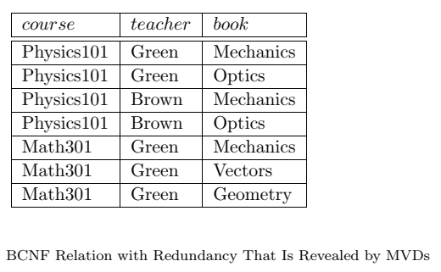
Multivalued Dependencies:
Suppose that we have a relation with attributes course, teacher, and book, which we denote as CTB. The meaning of a tuple is that teacher T can teach course C, and book B is a recommended text for the course.
There are no FDs; the key is CTB. However, the recommended texts for a course are independent of the instructor. The instance shown in Table:

Slide 68
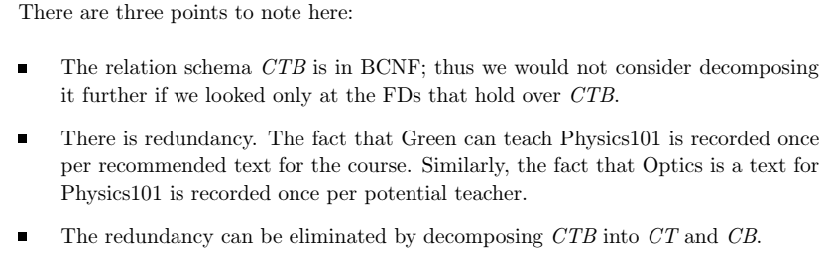
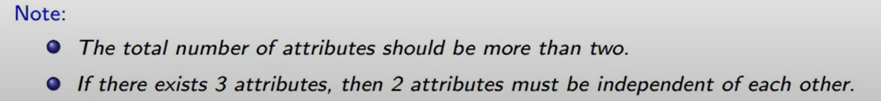
Multivalued Dependencies:
The redundancy in this example is due to the constraint that the text books for a course are independent of the instructors, which cannot be expressed in terms of FDs.
This constraint is an example of a multivalued dependency, or MVD.

Slide 69
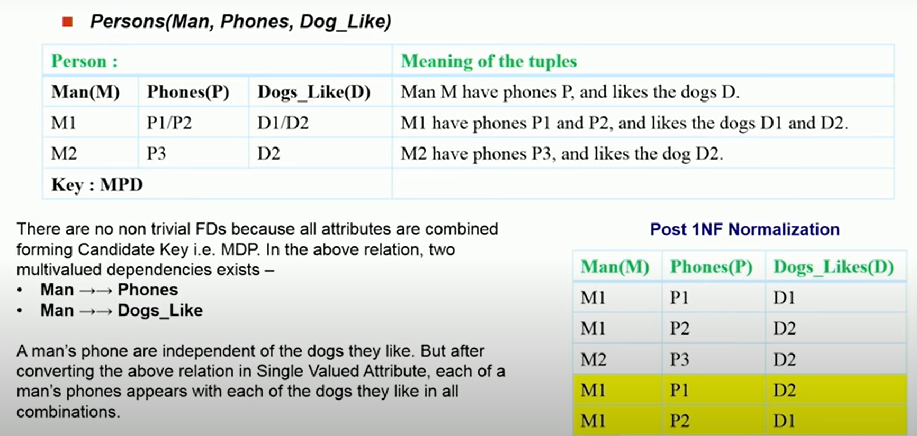
Multivalued Dependencies:

Slide 70
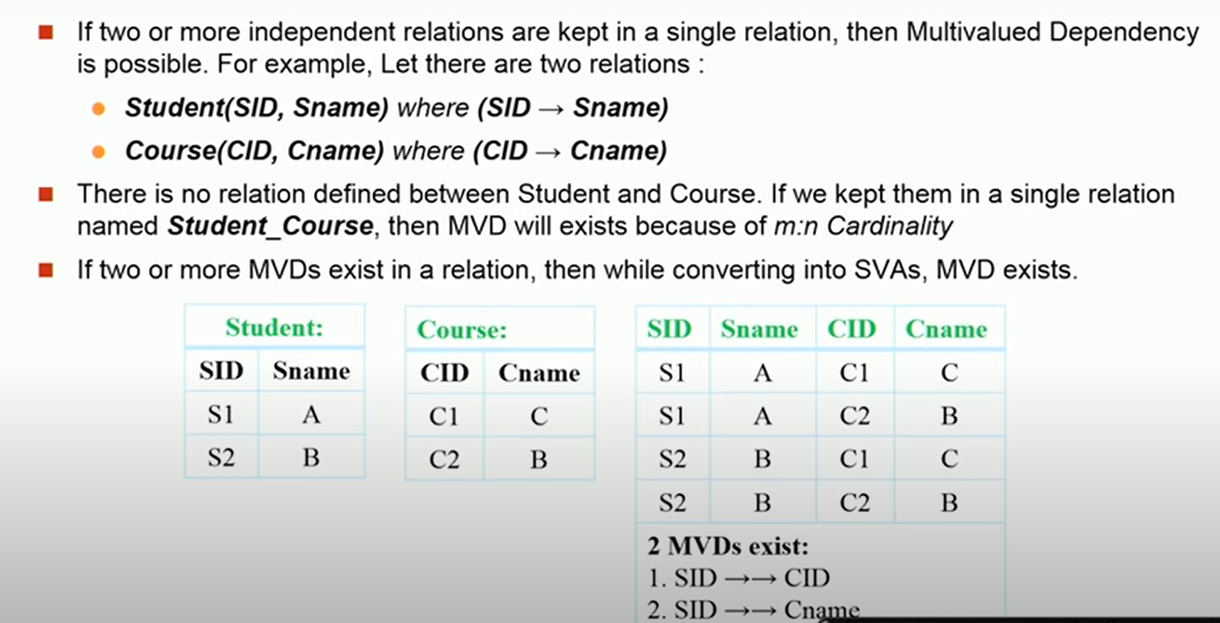
Multivalued Dependencies:

Slide 71
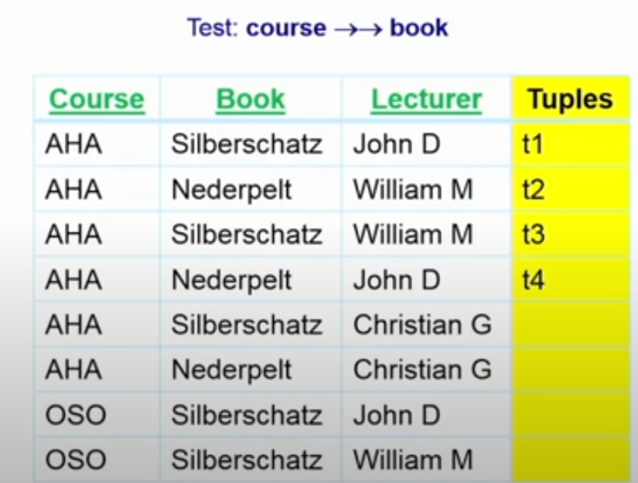
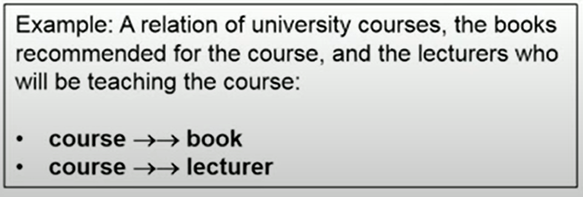
Multivalued Dependencies:
Let R be a relation schema and let α ⊆ R and β ⊆ R. The multivalued dependency
α →→ β
holds on R if in any legal relation r(R), for all pairs for tuples t₁ and t₂ in r such that t₁[α] = t₂ [α], there exist tuples t₃ and t₄ in r such that:
t₁[α] = t₂ [α] = t₃ [α] = t₄ [α] t₃[β] = t₁ [β] t₃[R – β] = t₂[R – β] t₄ [β] = t₂[β] t₄[R – β] = t₁[R – β]

Slide 72
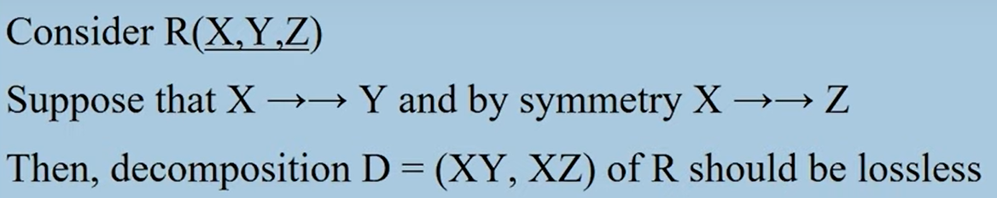
4NF (Forth Normal Form)
Conditions for 4NF
A relation R is in fourth normal form (4NF)
if and only if it is in BCNF and
has no multivalued dependencies
Above student table has multivalued dependency. So student table is not in 4NF.
Student
Subject
Faculty
RNO | Subject | Faculty
101 | DS | Patel
101 | DBMS | Patel
101 | DS | Shah
101 | DBMS | Shah
RNO | Subject
101 | DS
101 | DBMS
RNO | Faculty
101 | Patel
101 | Shah

Slide 73
Functional dependency & Multivalued dependency
A table can have both functional dependency as well as multi-valued dependency together.
RNO → Address
RNO →→ Subject
RNO →→ Faculty
Subject
Faculty
Address
RNO | Subject
101 | DS
101 | DBMS
RNO | Faculty
101 | Patel
101 | Shah
RNO | Address
101 | C. G. Road, Rajkot
Student
RNO | Address | Subject | Faculty
101 | C. G. Road, Rajkot | DS | Patel
101 | C. G. Road, Rajkot | DBMS | Patel
101 | C. G. Road, Rajkot | DS | Shah
101 | C. G. Road, Rajkot | DBMS | Shah

Slide 74
Normal forms 5NF (Fifth Normal Form)

Slide 75
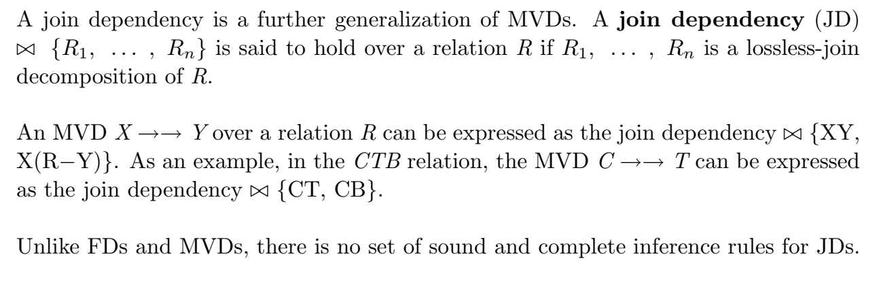
Join Dependency- 5NF

Slide 76
5NF (Fifth Normal Form)
Conditions for 5NF
A relation R is in fifth normal form (5NF)
if and only if it is in 4NF and
it cannot have a lossless decomposition in to any number of smaller tables (relations).
Student_Result
RID | RNO | Name | Subject | Result
1 | 101 | Raj | DBMS | Pass
2 | 101 | Raj | DS | Pass
3 | 101 | Raj | DF | Pass
4 | 102 | Meet | DBMS | Pass
5 | 102 | Meet | DS | Fail
6 | 102 | Meet | DF | Pass
7 | 103 | Suresh | DBMS | Fail
8 | 103 | Suresh | DS | Pass
Student_Result relation is further decomposed into sub-relations. So the above relation is not in 5NF.

Slide 77
5NF (Fifth Normal Form)
Conditions for 5NF
A relation R is in fifth normal form (5NF)
if and only if it is in 4NF and
it cannot have a lossless decomposition in to any number of smaller tables (relations).
Student_Result
Student
Subject
Result
RID | RNO | Name | Subject | Result
1 | 101 | Raj | DBMS | Pass
2 | 101 | Raj | DS | Pass
3 | 101 | Raj | DF | Pass
4 | 102 | Meet | DBMS | Pass
5 | 102 | Meet | DS | Fail
6 | 102 | Meet | DF | Pass
7 | 103 | Suresh | DBMS | Fail
8 | 103 | Suresh | DS | Pass
RNO | Name
101 | Raj
102 | Meet
103 | Suresh
SID | Name
1 | DBMS
2 | DS
3 | DF
RID | RNO | SID | Result
1 | 101 | 1 | Pass
2 | 101 | 2 | Pass
3 | 101 | 3 | Pass
4 | 102 | 1 | Pass
5 | 102 | 2 | Fail
6 | 102 | 3 | Pass
7 | 103 | 1 | Fail
8 | 103 | 2 | Pass
None of the above relations can be further decomposed into sub-relations. So the above database is in 5NF.

Slide 78
How to normalize database?
A software contract and consultancy firm maintains details of all the various projects in which its employees are currently involved. These details comprise: Employee Number, Employee Name, Date of Birth, Department Code, Department Name, Project Code, Project Description, Project Supervisor.
Assume the following:
Each employee number is unique.
Each department has a single department code.
Each project has a single code and supervisor.
Each employee may work on one or more projects.
Employee names need not necessarily be unique.
Project Code, Project Description and Project Supervisor are repeating fields.
Normalize this data to Third Normal Form.

Slide 79
How to normalize database?
A software contract and consultancy firm maintains details of all the various projects in which its employees are currently involved. These details comprise: Employee Number, Employee Name, Date of Birth, Department Code, Department Name, Project Code, Project Description, Project Supervisor.
UNF
Employee Number | Employee Name | Date of Birth | Department Code | Department Name | Project Code | Project Description | Project Supervisor
1 | Raj | 1-1-85 | 1 | CE | 1 | IOT | Patel
2 | Meet | 4-4-86 | 2 | EC | 2 | PHP | Shah
3 | Suresh | 2-2-85 | 1 | CE | 1 | IOT | Patel
1 | Raj | 1-1-85 | 1 | CE | 2 | PHP | Shah

Slide 80
How to normalize database?
UNF
Employee Number | Employee Name | Date of Birth | Department Code | Department Name | Project Code | Project Description | Project Supervisor
1 | Raj | 1-1-85 | 1 | CE | 1 | IOT | Patel
2 | Meet | 4-4-86 | 2 | EC | 2 | PHP | Shah
3 | Suresh | 2-2-85 | 1 | CE | 1 | IOT | Patel
1 | Raj | 1-1-85 | 1 | CE | 2 | PHP | Shah
1NF
Employee Number | Employee Name | Date of Birth | Department Code | Department Name
1 | Raj | 1-1-85 | 1 | CE
2 | Meet | 4-4-86 | 2 | EC
3 | Suresh | 2-2-85 | 1 | CE
Employee Number | Project Code | Project Description | Project Supervisor
1 | 1 | IOT | Patel
2 | 2 | PHP | Shah
3 | 1 | IOT | Patel
1 | 2 | PHP | Shah

Slide 81
How to normalize database?
1NF
Employee Number | Employee Name | Date of Birth | Department Code | Department Name
1 | Raj | 1-1-85 | 1 | CE
2 | Meet | 4-4-86 | 2 | EC
3 | Suresh | 2-2-85 | 1 | CE
Employee Number | Project Code | Project Description | Project Supervisor
1 | 1 | IOT | Patel
2 | 2 | PHP | Shah
3 | 1 | IOT | Patel
1 | 2 | PHP | Shah
2NF
Employee Number | Employee Name | Date of Birth | Department Code | Department Name
1 | Raj | 1-1-85 | 1 | CE
2 | Meet | 4-4-86 | 2 | EC
3 | Suresh | 2-2-85 | 1 | CE
Project Code | Project Description | Project Supervisor
1 | IOT | Patel
2 | PHP | Shah
Employee Number | Project Code
1 | 1
2 | 2
3 | 1
1 | 2

Slide 82
How to normalize database?
3NF
Employee Number | Employee Name | Date of Birth | Department Code
1 | Raj | 1-1-85 | 1
2 | Meet | 4-4-86 | 2
3 | Suresh | 2-2-85 | 1
Department Code | Department Name
1 | CE
2 | EC
Project Code | Project Description | Project Supervisor
1 | IOT | Patel
2 | PHP | Shah
Employee Number | Project Code
1 | 1
2 | 2
3 | 1
1 | 2

Slide 83
Thank You

