Slide 1
FAKEFILTER
A Fake Reviews Detector

Slide 2
PROBLEM
According to a report, in August 2017 Amazon has sold around 2.7 Billion Products in a year with a revenue of over 200 Billion Dollars.
With this huge amount of sales they also get a huge amount of data like customers reviews where a customer buys a product and then reviews it after using 2-3 months as how its been working.
But among these thousands of reviews for a single product many of them are Fake Reviews. As mentioned in the report by Livemint, sellers are buying fake reviews by paying thousand of rupees just to make their product looks good.
So there’s a need to filter out all these Fake reviews and get the most authentic reviews which will better explain the product and will further help the customers to find the best product value of their money.

Slide 3
ABSTRACT
To tackle the previously mentioned problem, I will be building a Fake Reviews Filtration software in which a user comes and enters the link to the product they are planning to buy and then my software will automatically extract all the reviews for that product and then using various NLP and ML techniques, it will filter out all the fake reviews and then performs some Data Modelling and Analytics like Topic Modelling and Sentiment Analysis on the Real reviews to provide better and authentic insights to the customer about the product.

Slide 4
FAKE REVIEWS FILTRATION
DATA COLLECTION
DATA PREPROCESSING
1
2
Filter out all the Fake reviews using Machine Learning or Deep Learning.
Will be using Research Papers available on the Topic as reference.
For Fake Review and Sentiment Analysis Amazon Reviews Dataset
Beautiful Soup for the Text Mining using the Product link
Using Python and NLTK for Data cleaning.
Removing StopWords, Lemmatizing, Stemming, POS Tagging etc.
3
6
WEB DEVELOPMENT
SENTIMENT ANALYSIS
TOPIC MODELLING
5
Based on the indivisual topic extracted,perform the sentiment analysis.
Determine which features of the product people are finding good or bad.
4
Extract all the Important topics from the filtered reviews that people have been taking about.
Will be using core NLP Techniques to extract the topics from reviews
A Website to integrate all the previously mentioned processes and visualize it.
Using HTML, CSS for Front-End
FLASK for Back-End
Notes:
© Copyright PresentationGO.com – The free PowerPoint and Google Slides template library

Slide 5
DATA COLLECTION
For the Sentiment Analysis, I’ll be using the publicly available Amazon Reviews Dataset with over 130M+ reviews dated from 1995 to 2015.
For the Fake Review Detection, I’ll be using the Yelp Restaurant Dataset which consist of around 6M+ reviews labelled as Fake and Not Fake. It has around 13.22% fake reviews and 23.91% spammers.
The use of the Yelp Dataset is mentioned in this paper
For the Topic Modelling task the same Amazon Reviews Dataset can be used.
For the scraping of the data from the website when a user inputs a product link I’ll be using the Scrapy or Beautiful Soup.

Slide 6
DATA PREPROCESSING
Before doing any classification on the dataset, it has to be cleaned first.
For the Sentiment Analysis task, Data Cleaning steps involve Tokenization, Stemming, Stop Words removal, Part of Speech tagging etc.
Similarly for Topic Modelling and Fake review detection important words has to be filtered out which will help in optimizing the Model.
Tools that will be used for Data Cleaning are NLTK for the basic NLP preprocessing steps, Matplotlib or Seaborn for Data Visualization.

Slide 7

FAKE REVIEW FILTRATION
The Yelp Dataset consist on many parameters like User Id, Date of Review, Location, Count of Review from the User, Review Text etc.
I’ll be using various Machine Learning classification algorithms like SVM, Multinomial Naïve Bayes, Logistic Regression etc. to train and classify all the product reviews into Fake or Not Fake reviews.
Some of the Papers that I will be referencing are:
https://pdfs.semanticscholar.org/4c52/1025566e6afceb9adcf27105cd33e4022fb6.pdf
https://www.aaai.org/ocs/index.php/ICWSM/ICWSM13/paper/viewFile/6006/6380
http://downloads.hindawi.com/journals/mpe/2016/4935792.pdf

Slide 8
TOPIC MODELLING
This is the method of categorizing the individual review into its topic that it’s been addressing.
It Enable consumers to quickly extract the key topics covered by the reviews without having to go through all of them.
For this process I’ll be using the Latent Dirichlet Allocation (LDA) model available in the genism library to automatically categorize each review with respect to its topic.

Slide 9
SENTIMENT ANALYSIS
After we have got all the reviews categorized with respect to their topic it will analyze how much positive, negative or neutral reviews that particular category or topic has got.
This will help the consumer to better understand the product as like which are the strong features of the product and how many people has appraised that feature.
Or what are the lack points of the product where the other users have found it unpleasing and not up to their expectations.
This whole thing will help the consumer to make a better decision before buying any product.

Slide 10
WEB DEVELOPMENT
Now after completing up with the whole analysis and segmentation part I’ll build a website where a user comes, enters the link to the product he/she is planning to buy and then will get the complete analytics of the filtered reviews and the original rating of the product.
For the Front-End part HTML and CSS will be used.
For the Back-End part I’ll be using the FLASK which is Python Based Framework used for website development and helps in connecting the Back-End codes to the Front-End part.

Slide 11
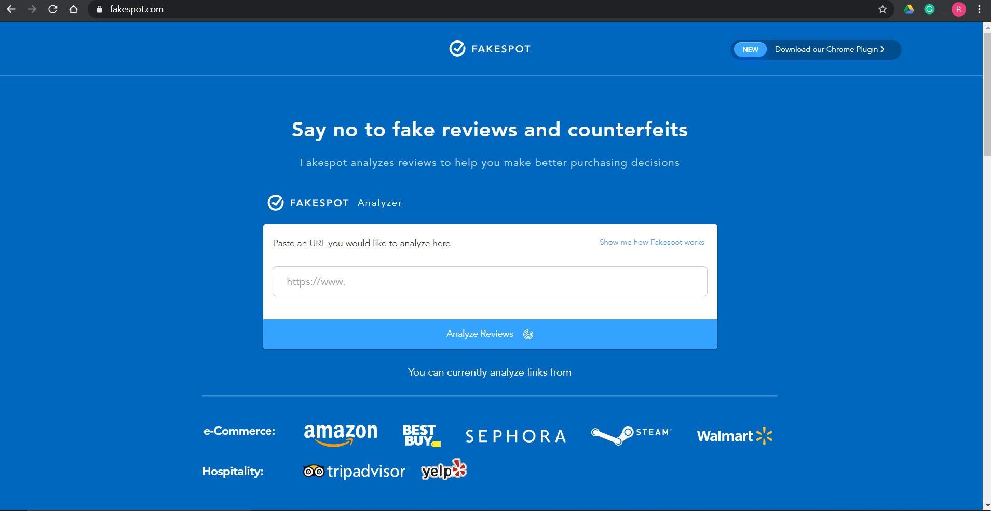
FAKESPOT.COM
This will be somewhat the final product that I’ll try to build with better features.

