Slide 1
Geometric Graphs Project
By: Robert ‘Eddie’ Bull, Thokozani Tembo

Slide 2
Project Description
Given six data files to use
Three ‘target coordinate files’ and three ‘observed data sets.’
Step 1: Create a 3D embedding for each observation.
Step 2: Create an optimal alignment transformation for each observed to each target.
Step 3: Determine which observation corresponds to which target.

Slide 3

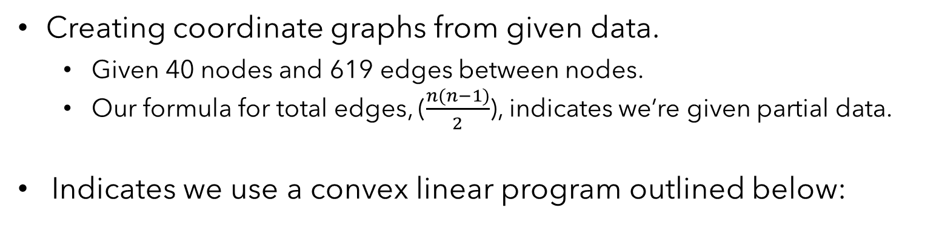
Project Description, Cont.
Creating coordinate graphs from given data.
Given 40 nodes and 619 edges between nodes.
Our formula for total edges, ($\frac{n(n−1)}{2}$), indicates we’re given partial data.
Indicates we use a convex linear program outlined below:
$$\min{ trace(G)}$$
$$G=G^{T}≥0$$
$$G∗1=0$$
$$\left|\left\langle Ge_{ij}, e_{ij}\right\rangle −\tilde{d_{ij}} \right|≤ε, \left(i,j\right)∈Θ$$

Slide 4
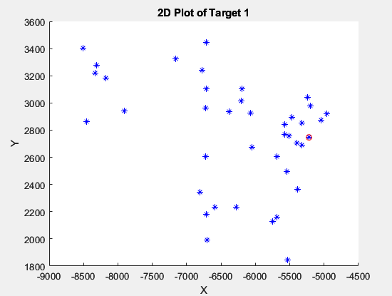
Target Graphs
Target Set 1
Red circle is Wilmington, DE
Contains cities T-Y

Slide 5
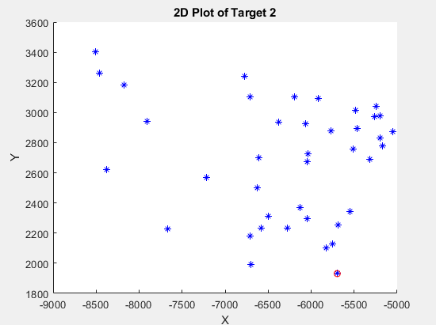
Target Graphs
Target Set 2
Red circle is Tampa, FL
Contains cities S-T

Slide 6
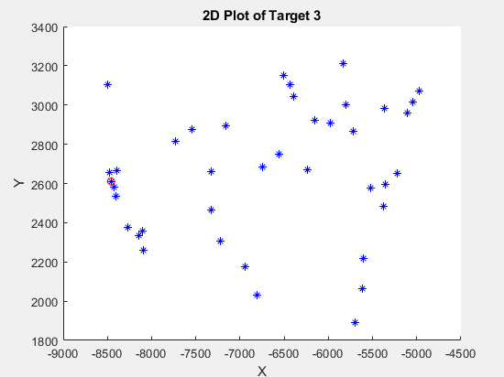
Target Graphs
Target Set 3
Red circle is San Francisco, CA
Contains cities S-R

Slide 7
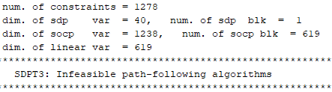
Step 1: Embeddings
Firstly, calculated Gram matrix estimates for each observed set.
A matrix representing the inner product between each pair of nodes.
Successful SDP results below:
Observed Set 1
Epsilon: 16
Observed Set 2
Epsilon: 2
Observed Set 3
Epsilon: 2

Slide 8
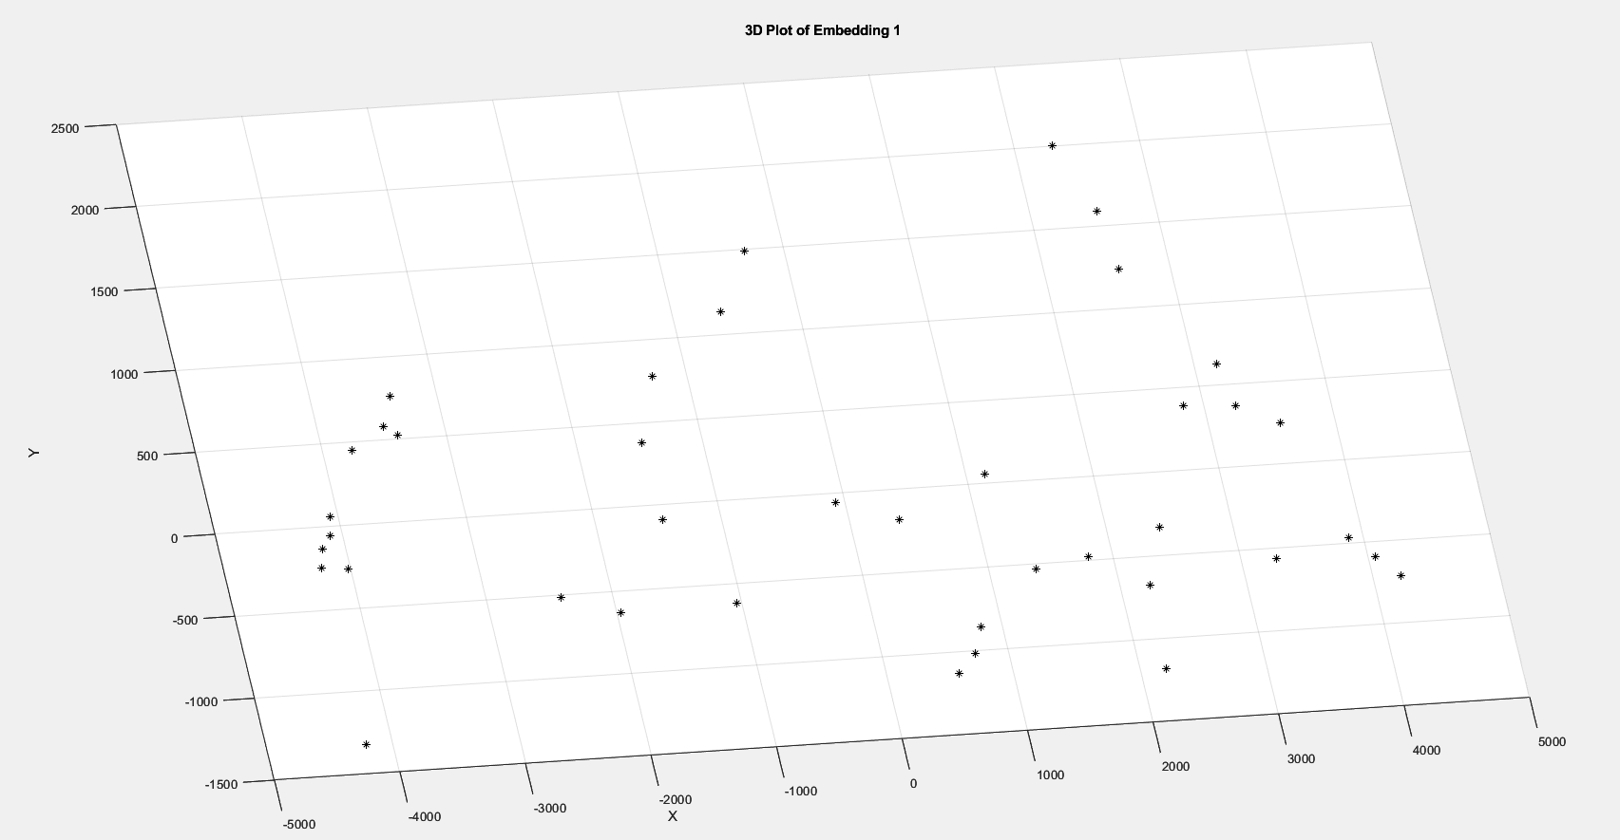
Step 1: Embeddings, Cont.
Secondly, graphed each embedding to ensure feasibility.

Slide 9
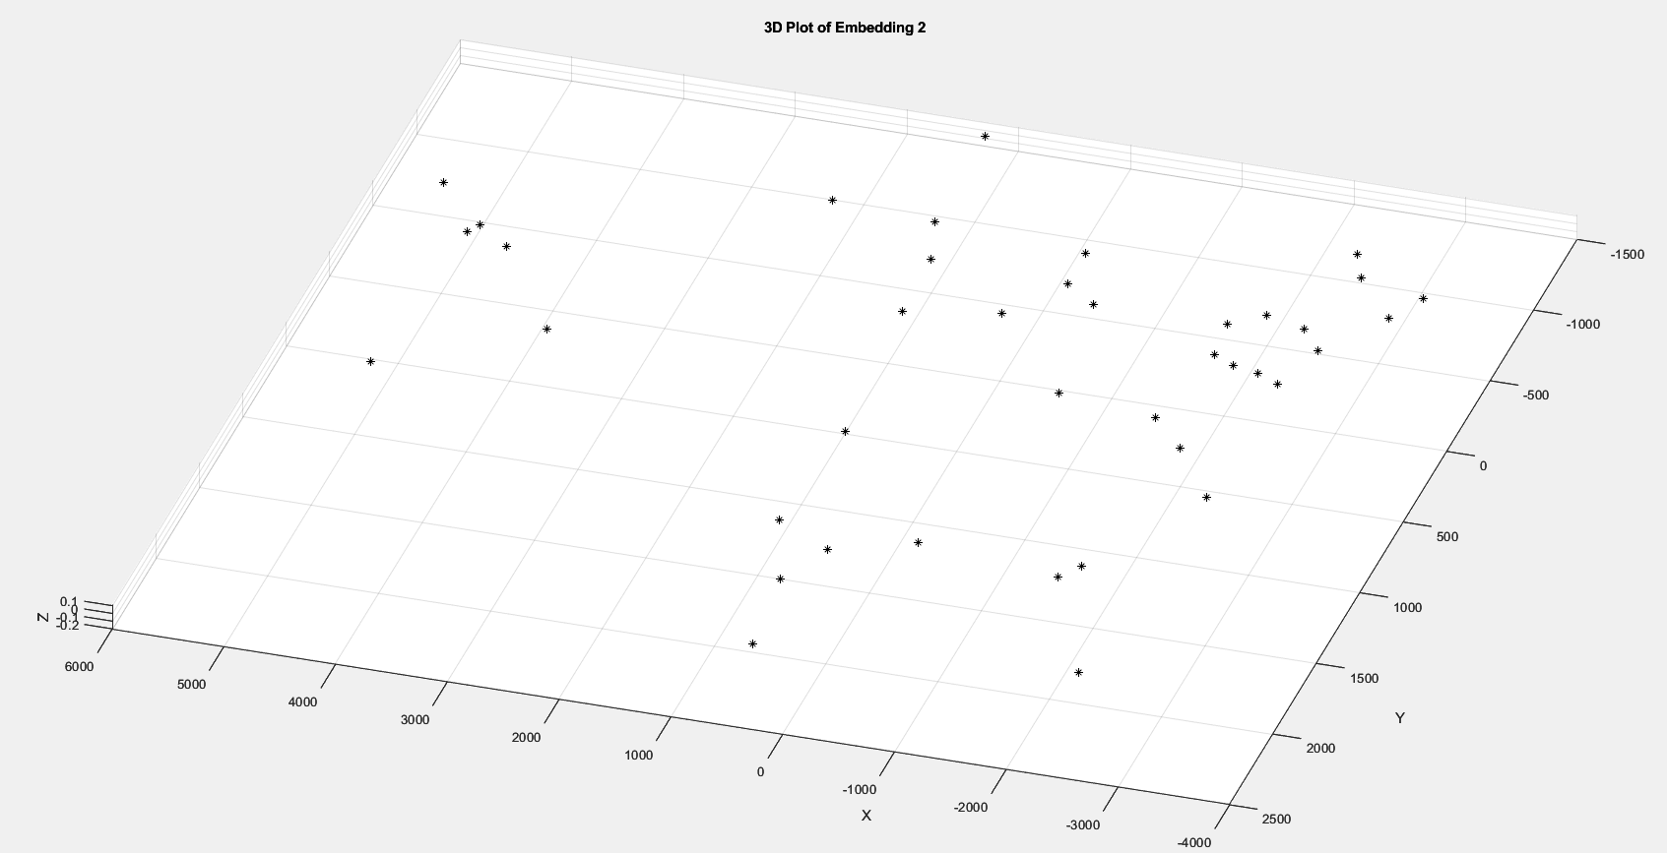
Step 1: Embeddings, Cont.
Secondly, graphed each embedding to ensure feasibility.

Slide 10
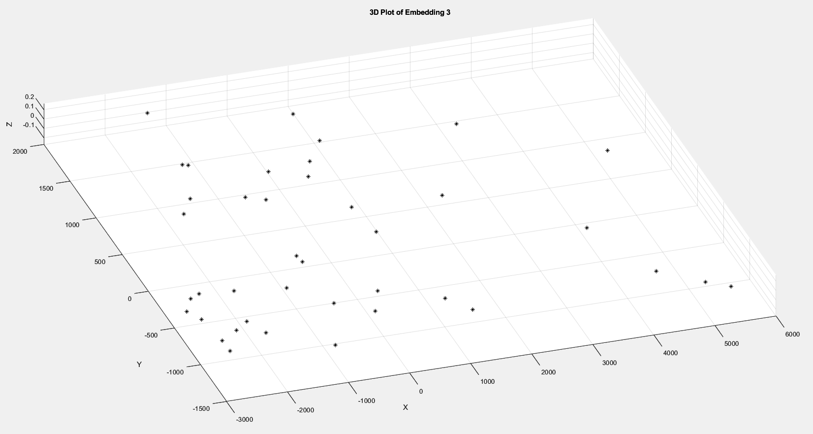
Step 1: Embeddings, Cont.
Secondly, graphed each embedding to ensure feasibility.

Slide 11
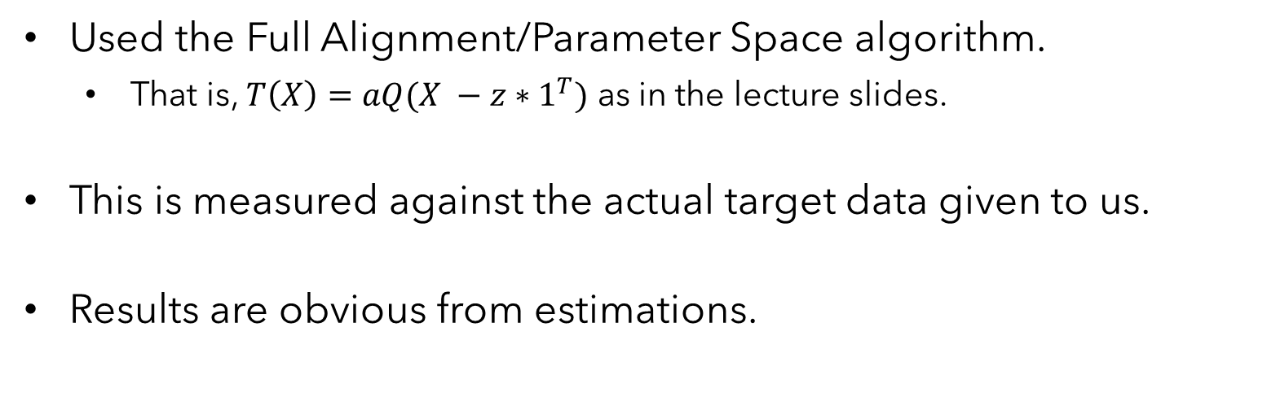
Step 2: Transformations
Used the Full Alignment/Parameter Space algorithm.
That is, $T\left(X\right)=aQ(X −z∗1^{T})$ as in the lecture slides.
This is measured against the actual target data given to us.
Results are obvious from estimations.

Slide 12

Step 3: Comparison
Below details ${\left\|T(\hat{X})−Y\right\|}_{F}^{2}$ where $T(\hat{X})$ represents the transformed embedding and $Y$, the target coordinates.
Target 1
Target 2
Target 3
45359570 | 41736965 | 0.177
0.026 | 40985441 | 55920308
45647769 | 0.061 | 57307499
Observation 1
Observation 2
Observation 3

Slide 13
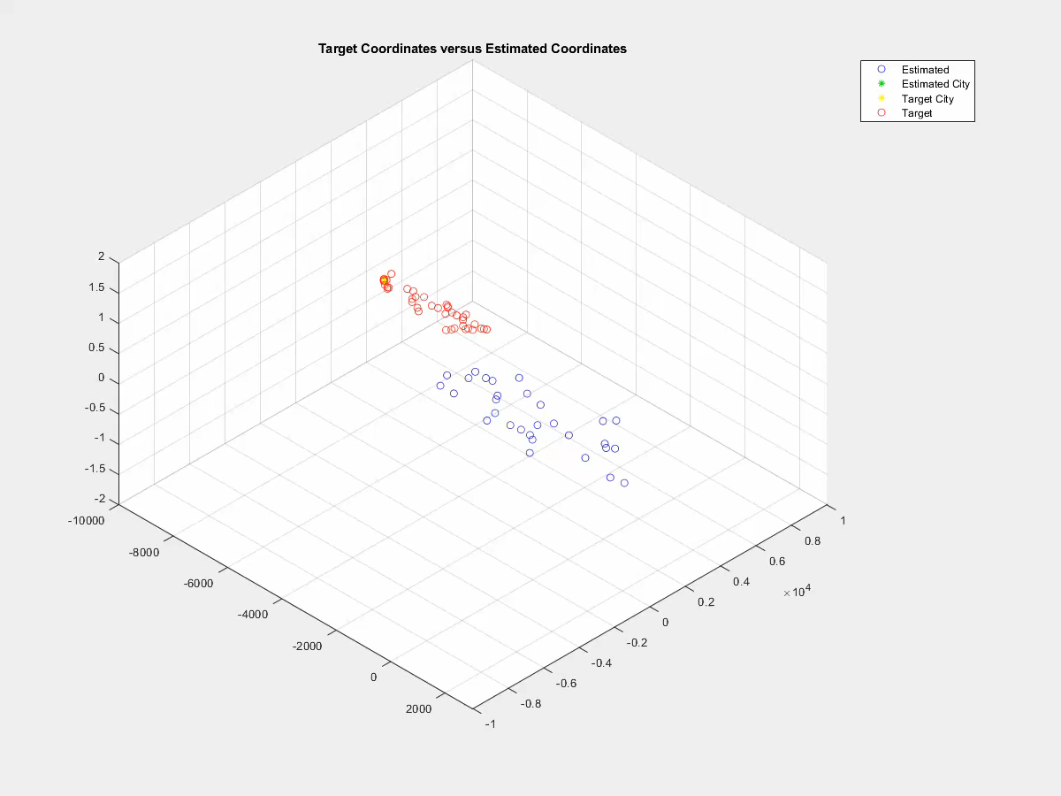
Step 3: Comparison, Cont.

Slide 14
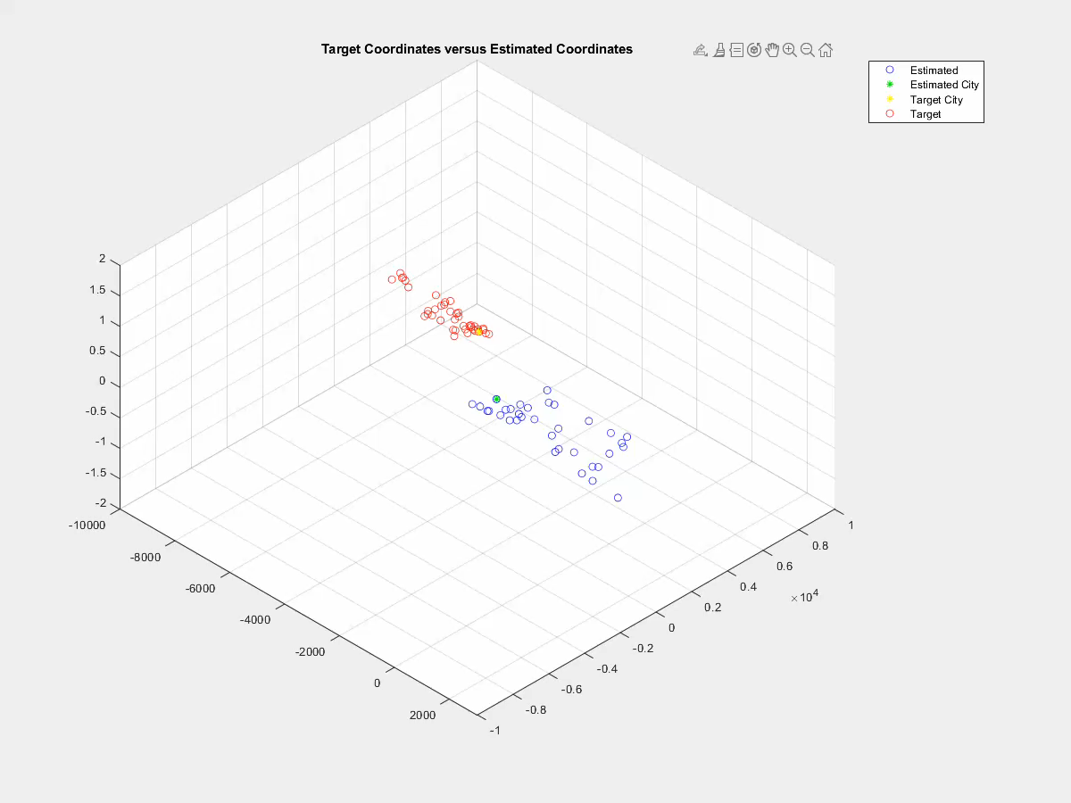
Step 3: Comparison, Cont.

Slide 15

Step 3: Comparison, Cont.

Slide 16
THANK YOU
Questions?

