Slide 1

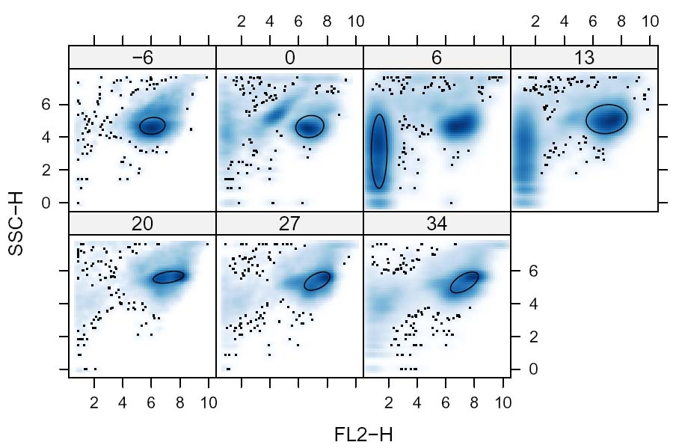
The flowCore Framework
IMPORT
STRUCTURES
METHODS
OUTPUT
flowSet
FCS 1
flowFrame 1
compensate
transform
filter
subset
...
FCS 2
flowFrame 2
flowFrame 3
FCS 3
...
phenoData
> summary(filt)‏
Pop1: 1236 of 10000 (12.36%)‏
Pop2: 6996 of 10000 (69.96%)‏
Pop3: 1768 of 10000 (17.68%)‏
Sample Meta-data
Age Sex Time
f1 41 m 1
f2 44 f 1
f3 41 m 2

