Slide 1



Slide 2
Problem Statement:
Many novels and books which were bought by students, employees and of-course general public are left unused after they read. Most number of books are left idle without any use for anyone.
What if we can generate most of it’s usage?
Solution:
We are a mobile platform where unused books by their individual owners can be kept online for renting to others.
By this we are able to provide books on rent per day basis to others and whoever made books available can earn money on the bookings..
Final Solution will be mobile interface

Slide 3
How we decided to start
So, the 1st rule we should never forget in user experience design process is truly understanding the user, then creating
a solution. As we followed the same regular design approach principle to solve
STRATEGY
01
SKELETON
04
SURFACE
05
STRUCTURE
03
SCOPE
02
User needs &
Design principles
Studying the users
& Scenarios with
the flow
User flows
Low fidelity &
and High fidelity
Wire frames
Visual design

Slide 4
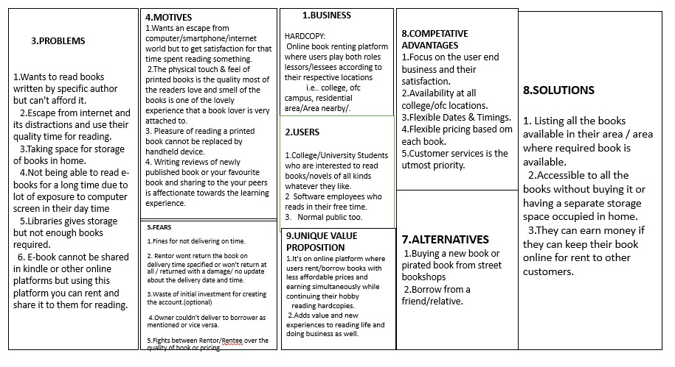
1. Strategy phase
In a strategy phase we understand
about our users, better solutions and
motives. We have created a UCD
canvas which helps us to keep in mind
with some certain elements
Users: College students,
Employees
Solutions: Affordability,
ROI on a book
Motives: Popular books,
Ease of renting
After creating UCD Canvas, we have done a google docs to get more insights

Slide 5
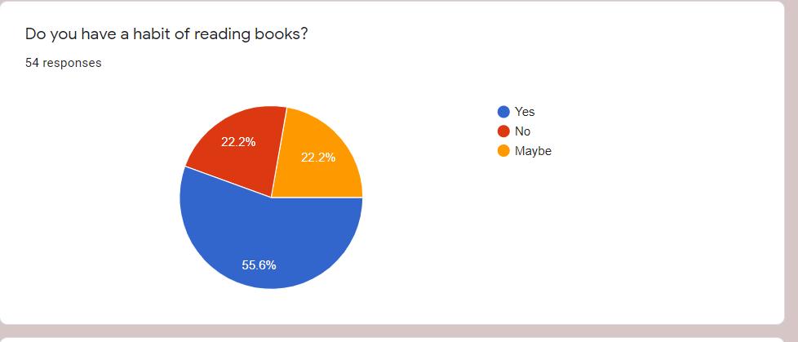
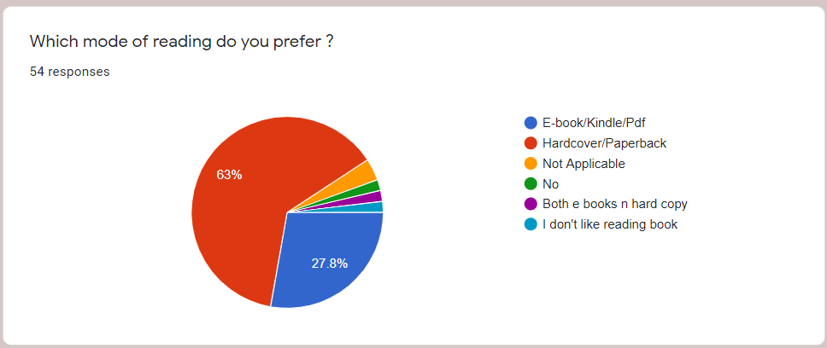
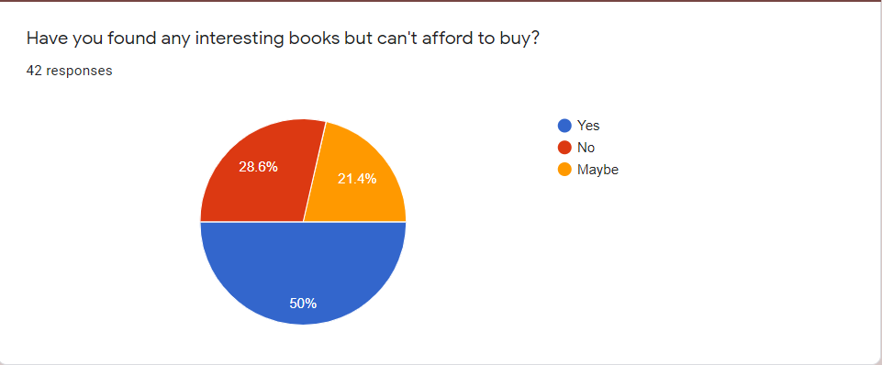
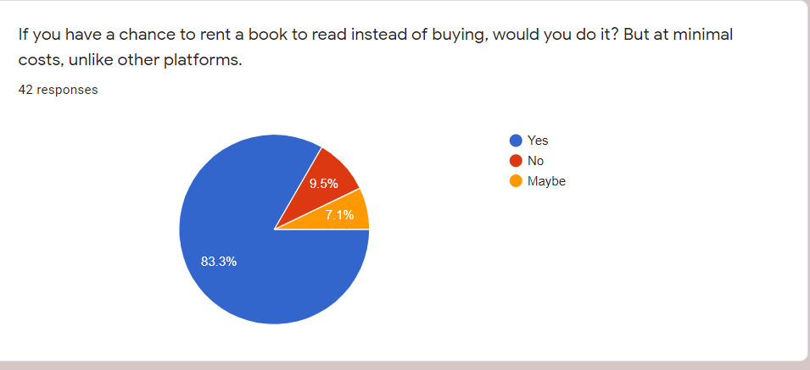
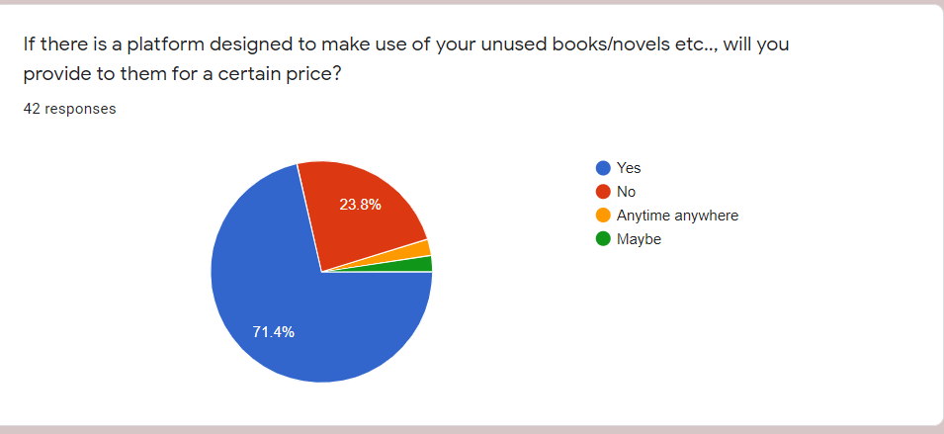
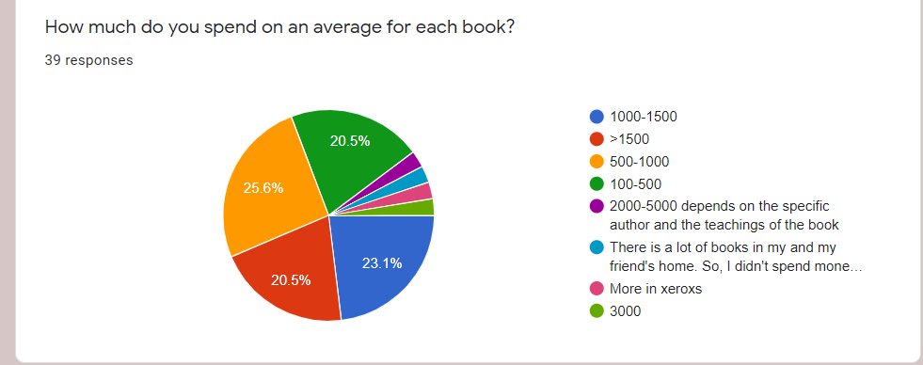
1.1 User insights
We have made a survey on 54 people by creating a google forms and here are some results

Slide 6
We found some insights in survey
55.6%have habit of reading books
63% are interested to read books via hard cover or paperback
50% people couldn’t afford to buy their desired books due to high price
83% people had showed interest to rent a book instead of buying
71.4% are interested to provide their unused books to renting purpose
And the next stage was Scope, based on user research we have created
user persons and user scenarios

Slide 7
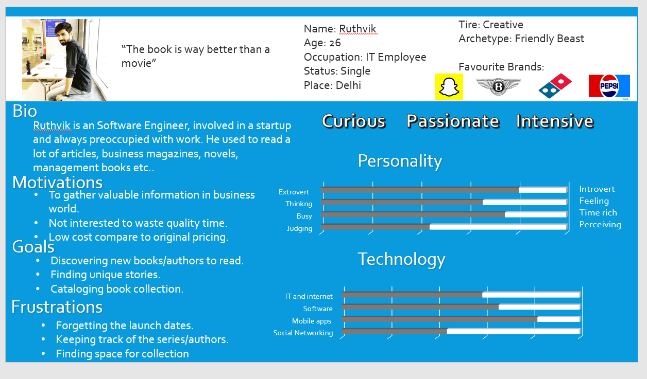
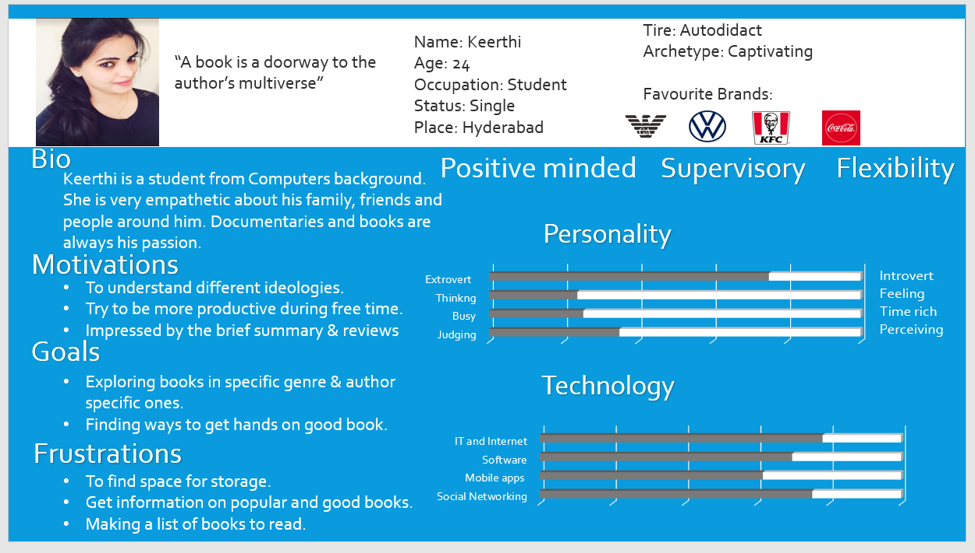
2. Scope
Users personas

Slide 8
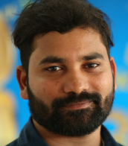


2.1 User Scenarios
Ankit Jain
30 years old from New Delhi,
Post Graduate in Computer Science
Works as Software Developer in MNC
Ananya Kaushik
Kumar
32 years old from Bangalore
A Homemaker.
25 years old from Mumbai
Pursuing MBA Technology Management
IPL Pune
He works as a Software Developer with
reputed MNC in New Delhi, Reading books is his usual habit. He wants to switch to a new technology but couldn’t find the relevant material
He spoke to Ruthvik about this and he suggested him to try HARDCOPY app to find his required material, as his collogues got benefited by finding necessary books
Today he logs in to the app, find and reads his own desired books and adds them to his library
She lives with her husband and 2 kids in Singapore township in Bangalore. Her life is busy with doing everyday chores and has no time to find best comic books for her children.
Her neighbour recommended her to use the HARDCOPY App and insisted her to find and request available comic books in her locality, She also found some of her own interest recipe books
She finds the App very useful and easy to use.
Kumar is MBA Student from IPL, he usually turn to books or mobile when in boredom. But good books are way too much price which he can't bare to purchase them
So, in search of a solution he got referral from one of his friends and found the HARDCOPY mobile app, where renting made easy and affordable. Now he can read as many books with minimal costs which he has to pay for the days he read them.
Finally he satisfied to be an user of HARDCOPY and increase the count of books in his shelf since then.

Slide 9
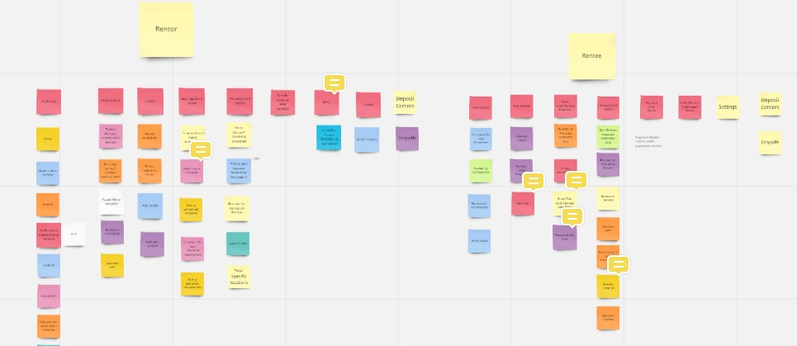
2.2 Affinity mapping
We have found few interesting things
in scope phase
1.People also like to create their own shelves
according to their genre
2. People like to know accurate status
(Rentor: Delivery/Receive,
Rentee: Pickup/Return)
Readers like to update their current status
of the book they are reading

Slide 10
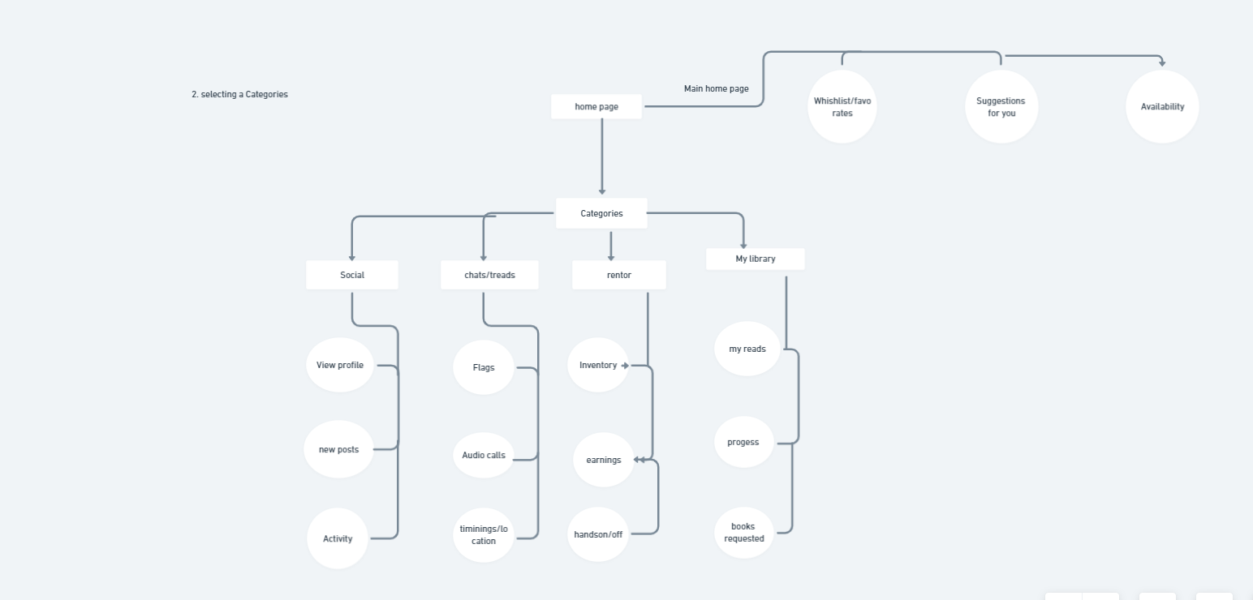
This Defines how user interact with the product, how system behave when user interact, how it’s organized, prioritized, and how much of it.
3.Structure
1. Structure is split into two components, Interaction Design & Information Architecture.
2. Interaction Design Given the functional requirements, It defines how user can interact with the product, and how the system behaves in response to the user interactions.
3. Information Architecture Given the content requirements, It defines the arrangement of content elements, how they are organized, to facilitate human understanding.

Slide 11
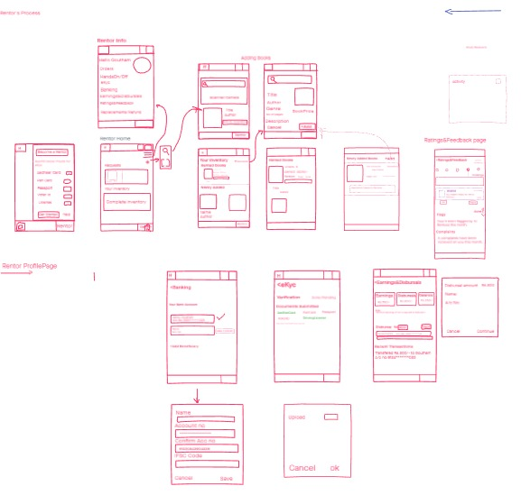
It determines the visual form on the screen, presentation and arrangement of all elements that makes us interact with the functionality of the system that exist on the interface.
4.Skeleton
4.1 Low fidelity wireframe
Wireframes are widely used to create a visual format, which is a Static diagrams that represent a visual format of the product, including content, navigation and ways for interactions. So we have used low fertility wireframes and high fertility wireframes.
https://goutham358717.invisionapp.com/freehand/Hardcopy-qgZi0gl2T?v=Tt1jbF2tS0WBqexXyFlQcA%3D%3D&linkshare=urlcopied

Slide 12
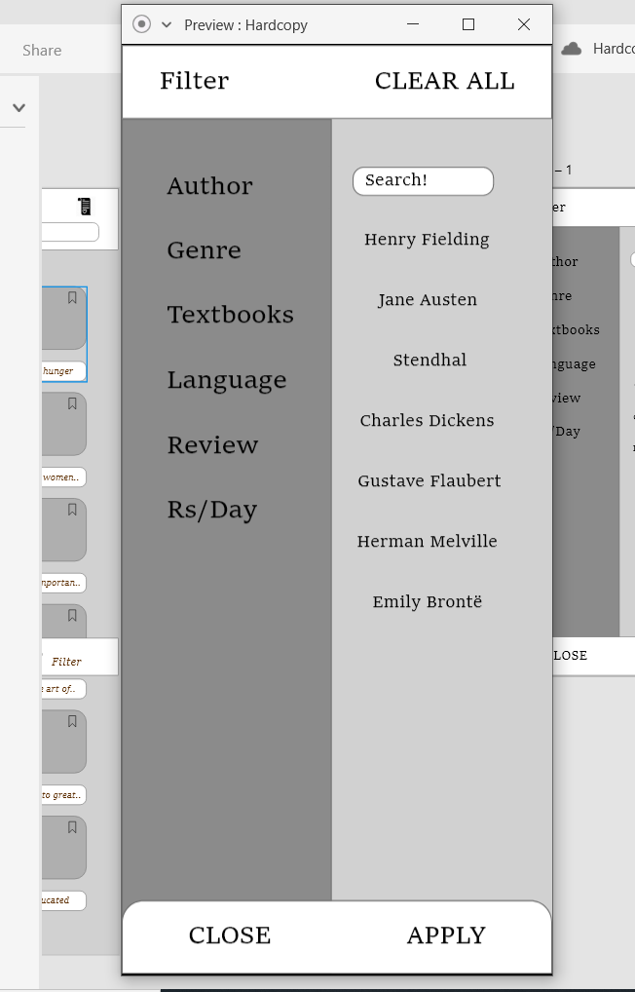
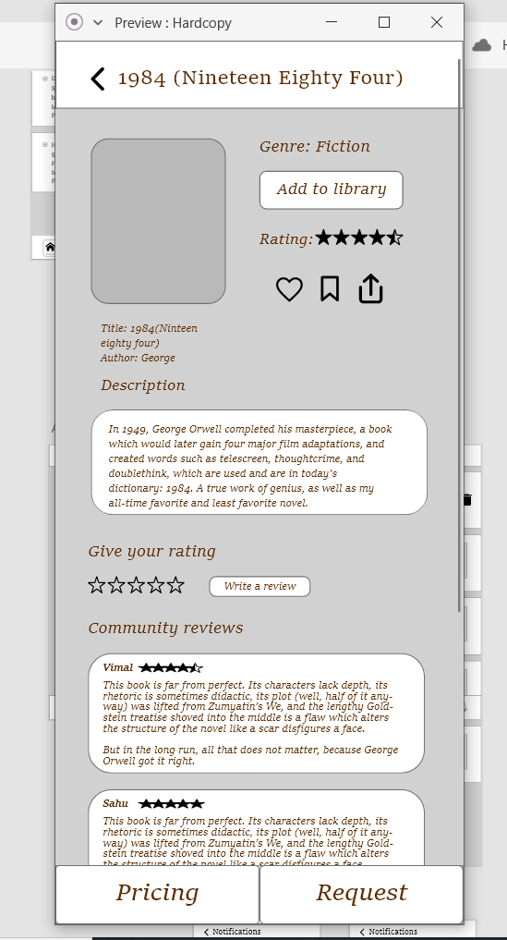
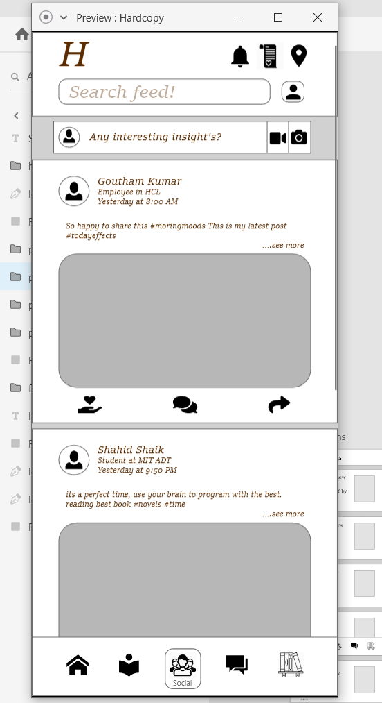
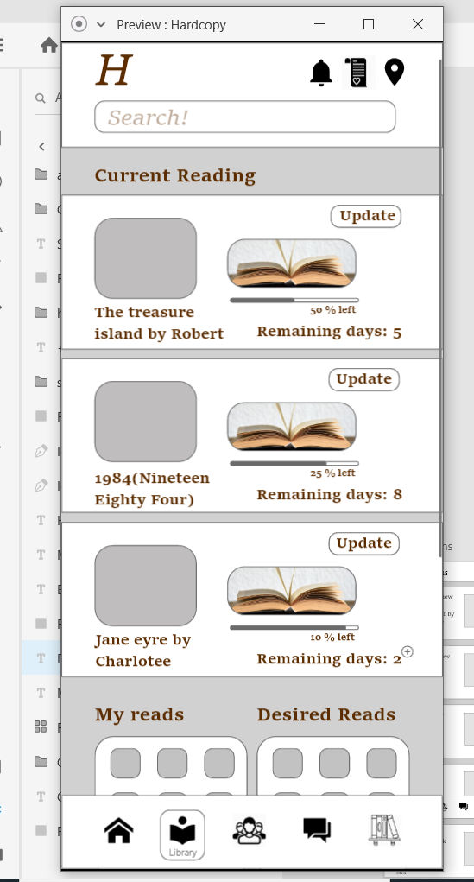
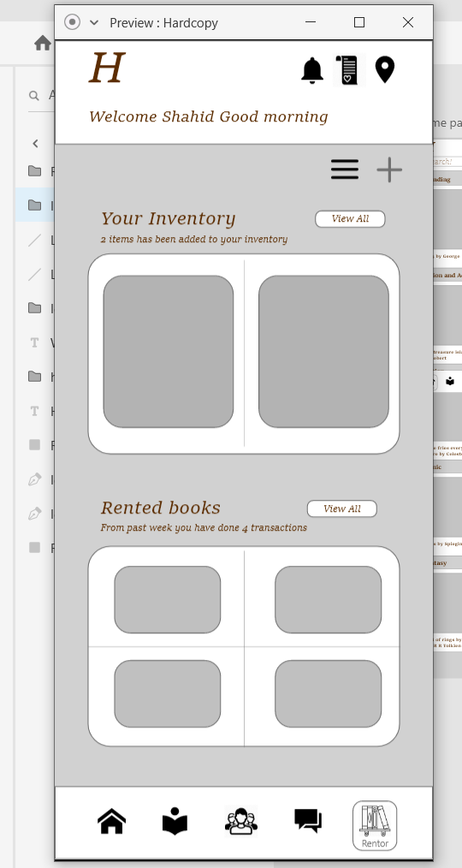
4.2High fidelity wireframes:
Filter
Book details page
Social networking
Library
Rentor page

Slide 13
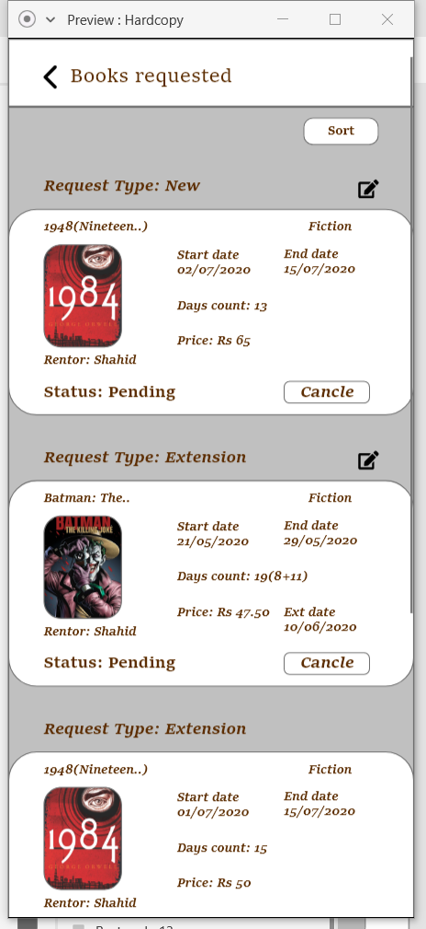
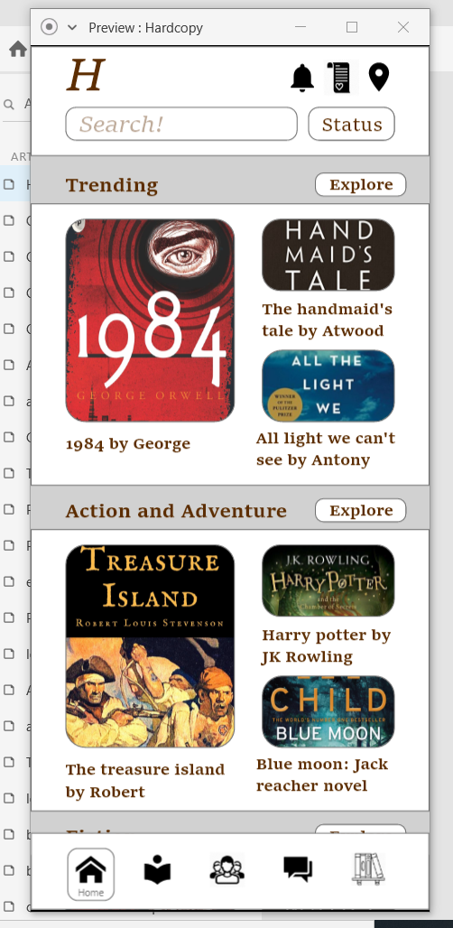
After step4 now we are dealing with Visual Design.
5.Surface
https://xd.adobe.com/view/7f94dc11-c3a2-4934-b294-89d5d3fc18c1-2ac7/
The above link shows the high fidelity wire frames.
70% of workflow has completed
This card shows the details of every genre and trending books
This card shows the details of book requested by the rentees

Slide 14
Thank you

