Slide 1

Title
Innovation
2026

Slide 2
1
2
3
4
5
6
7
FRIDA
Our Understanding
Our Proposal
Solution Architecture
Our Methodology
FRIDA Business Model
Economic Proposal

Slide 3






















Automation Demand Management
Cognitive Automation Platform
Unified Automation
Governance
Automation Opportunities Funnel
FRIDA - AI Engine
Service Orchestration
Innotek
RPA Calculator
Automated
Decision-Making
Intelligent Document Management
Conversational AI
Voice
Vision
Intelligent RPA CoE Controller
FRIDA Flight Control
RPA
Gen AI
FRIDA Admin
Password Vault
Cognitive RPA
Intelligent Assistant
FRIDA Engine
FRIDA Copilot
GenAI Analytics ​
Forms & Workflows
Exception Handling
IT
Paperless
Human In The Loop
Cognitive Testing
AIOps
Security Audit
GenAI Enterprise Platform
Cache
Memory
Guardrails​
Knowledge bases​
LLMOps​

Slide 4
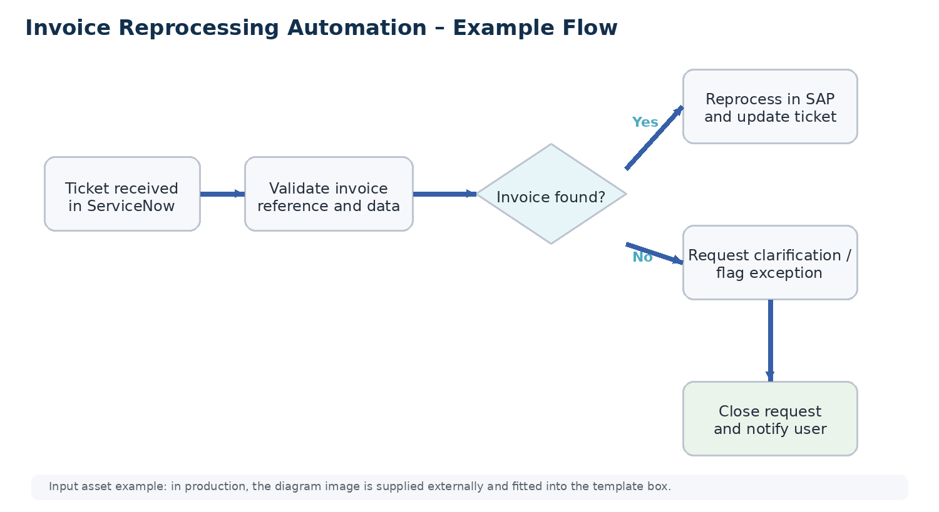
Our Understanding
Objectives
• Reduce manual work
• Improve SLA
• Reduce reprocessing errors
Systems/ Tools
• ServiceNow
• SAP VF03
• Excel

Slide 5
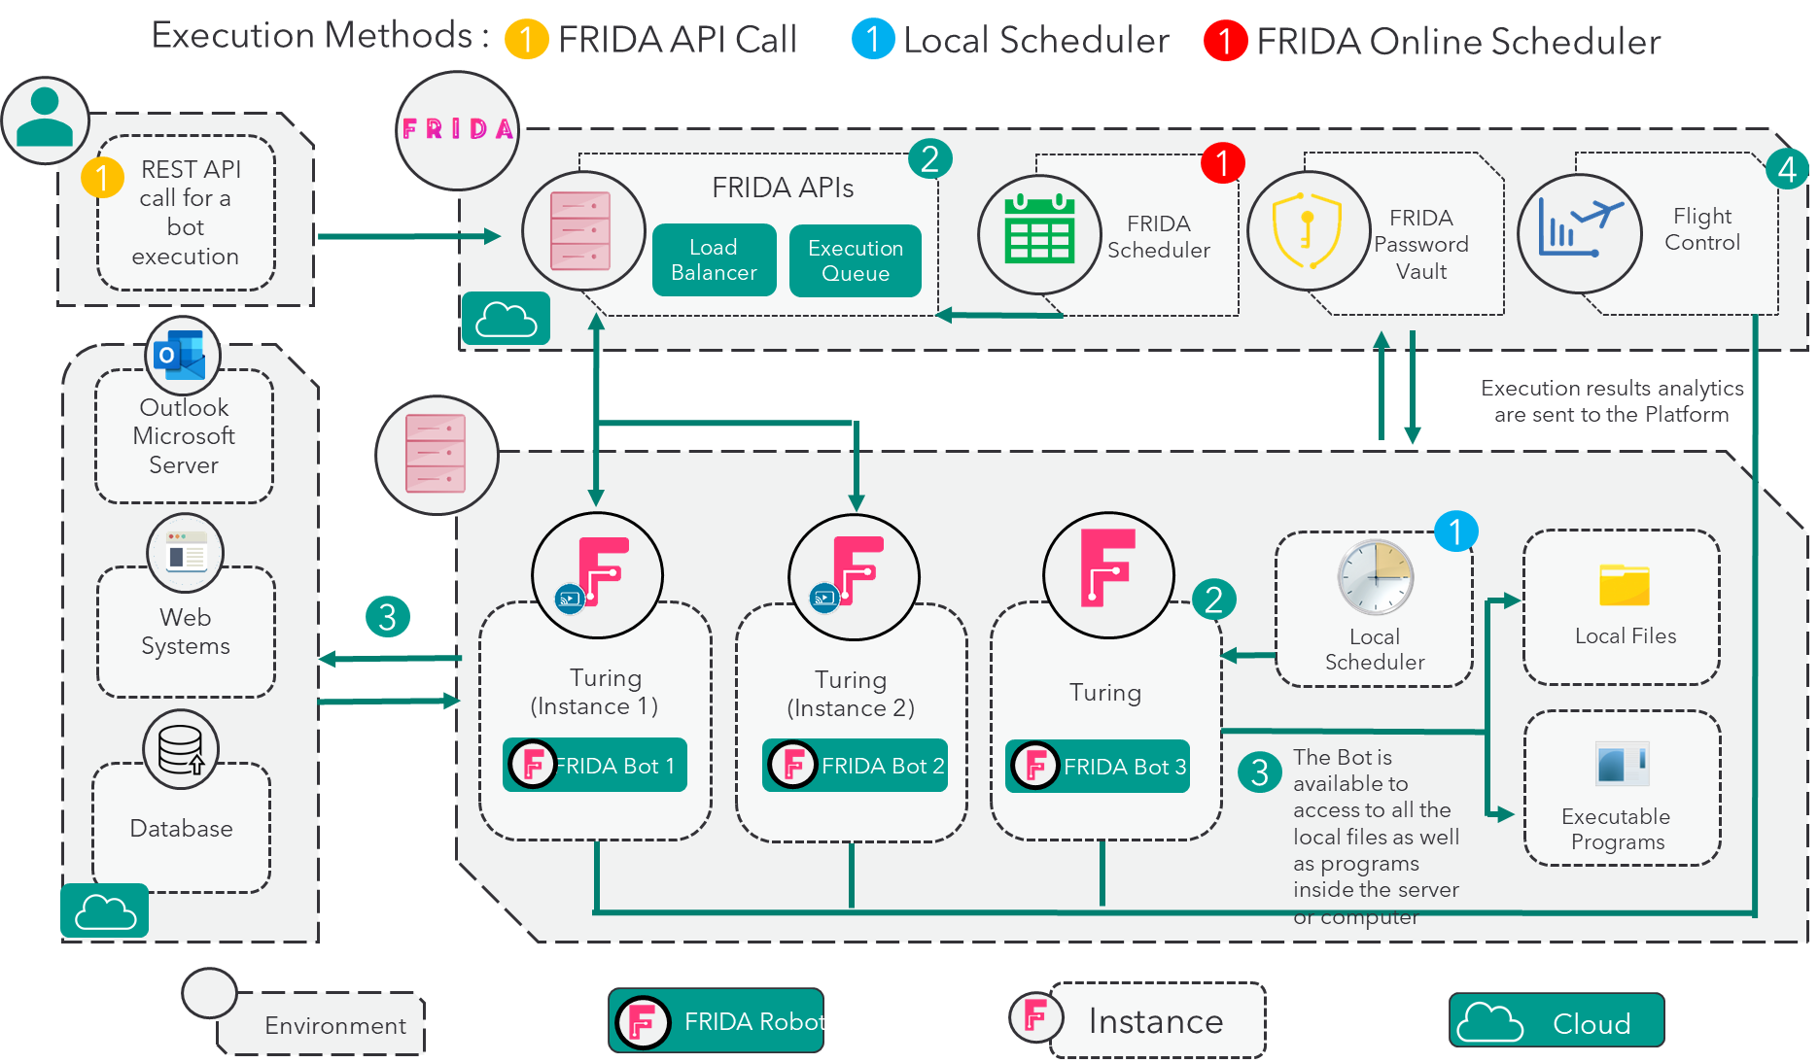
Solution Architecture
Through Turing Expo, FRIDA can execute automations centrally. This is possible under three execution architectures
Programming executions locally or remotely
On-demand execution
Through APIs, which incorporate load balancing algorithms and queue management for optimal resource management

Slide 6
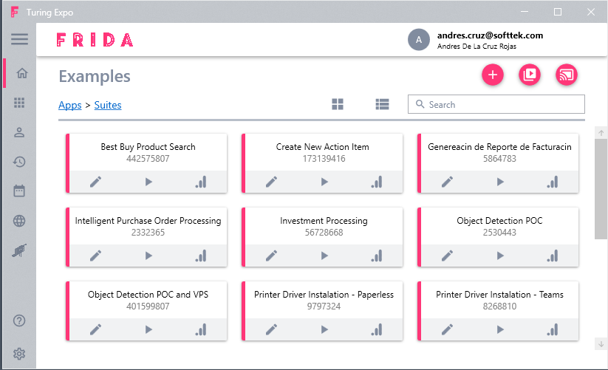
FRIDA Windows Agent Requirements
Net Framework 4.5.2
Windows 10 or 11
Windows PowerShell 3.0
8 GB in RAM
4 vCPU
Connection to
FRIDA
https://fridaplatform.online/
https://rpa.fridaplatform.online/
https://admin.fridaplatform.online/
APIs
https://frida.azure-api.net
http://automationplatform.azurewebsites.net
FRIDA Data Base
https://automation-1713b.firebaseio.com
FRIDA File Data Base
https://innotekfilestore.file.core.windows.net/
https://appsfrida.file.core.windows.net/
Turing Expo

Slide 7
Methodology
Process Analysis
Automation
Stabilization
Continuous improvement
Optimization
Analysis and documentation of processes to automate.
Construction and development of automations.
Training of AI models.
Control and analysis of areas of opportunity in automated processes.
Analysis of the behavior of automations and increase of their knowledge.
Continuous evolution. Adapting to changes in the process and refining their knowledge.
Quality door #1
Pilot
Go live
Go
Live
Quality door #2
Quality door #3
Digitized Governance
Quantitative monitoring
and control
Management of knowledge and configuration
Risk and problem management
Digitized follow up and monitoring
Organizational change management

Slide 8
Evaluation Model
When screening processes, we work according to an evaluation model that indicates whether the process is well suited for automation. We evaluate potential automation processes based on Criteria of Value and Complexity as seen in our Evaluation Matrix.
1
1
6
2
+
5
2
=
VALUE
COM-PLEXITY
5
3
4
4
3

Slide 9
Evaluation Model
1
1
6
2
VALUE
+
5
2
=
COM-PLEXITY
5
3
4
4
3
VALUE
COMPLEXITY
Value is defined through which benefits (gains) the automation could provide to the organization.
We have seven criteria’s for evaluating Value. Up to 6 points can be given for each criteria.
Cost Savings
Risk/Business Disruption
Vulnerability
Increase Quality
Employee Productivity
Time Critical / Processing Time
Complexity level have 5 evaluation criteria and are defined by how long it will take to implement the process. Usually classified within low, medium, high and very high complexity processes:
Low Complexity: Requires about 5-7 weeks to automate
Medium Complexity: Requires about 6-9 weeks to automate
High Complexity: Requires about 8-12 weeks to automate
Very High Complexity: Requires about 11-16 weeks to automate
The complexity is also closely linked to the business case that is calculated per process. A low complexity process has low implementation costs and faster return on investment compared to a high complexity process.
The value and complexity criteria's together form an evaluation matrix which is a visualization of these areas combined.

Slide 10
Bot Complexity Evaluation Criteria
COMPLEXITY MATRIX
Complexity Criteria | Simple | Medium | High | Very High
Technologies / Systems Involve | < 4 | 4 - 5 | 6 - 10 | > 10
Technologies Required | Web/Email/Excel/SAP | Web/Email/Excel/SAP/Desktop Apps/IDM/OCR | Web/Email/Excel/SAP/Desktop Apps/IDM/OCR/Databases/Custom Scripts | Web/Email/Excel/SAP/Desktop Apps/IDM/OCR/Databases/Custom Scripts
Business Rules | < 5 | 5 - 20 | 21 - 30 | > 30
Number of Screens | < 15 | 15 - 30 | 31 - 50 | > 50
Process Steps | < 10 | 10 - 25 | 25 - 40 | > 40
Number of Exceptions | 5% | 5% - 10% | 11% - 20% | > 20%
Input Data Type | Digital, structured documents, standardized data | Digital, structured and unstructured documents, standardized data | Digital, structured and unstructured documents, non-standardized and standardized data | Digital, structured and unstructured documents, non-standardized and standardized data
Data activities | Copy/Paste Retrieve and Modify | Copy/Paste Retrieve and Modify Enriched and Transform Extract from PDF documents | Copy/Paste Retrieve and Modify Enriched and Transform Extract from PDF documents Gen AI | Copy/Paste Retrieve and Modify Enriched and Transform Extract from PDF documents Apply NLP AI models Gen AI
Process Design | The process does not require redesign | The process require minimal changes | The process requires significant changes | The process require redesign
From the multiple dimension the one with the highest complexity will determine the bot complexity size. This complexity matrix can be adapted to your technology stack.

Slide 11
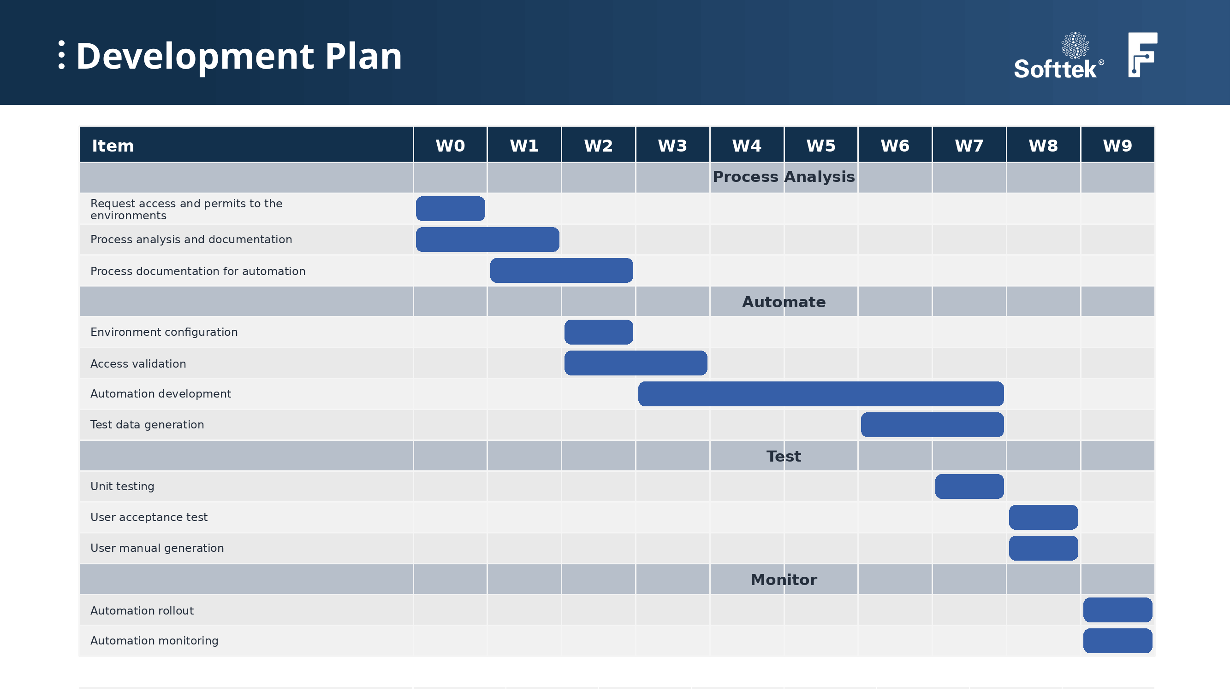

Slide 12
Pricing Model & Components – Bot Related Services Development
Bot Developmment Costs
Complexity | Cost by Process USD
Simple | $6,000
Medium | $7,500
High | $9,000
Very High | $15,000
Process | Complexity | Cost USD (One Time)
Automation |  | $,000

Slide 13
FRIDA RPA Platform Cost
Complexity | Starter Pack | Intermediate Pack | Scale Pack | Enterprise
Collaborative Bot Runners | 5 | 15 | 50 | Unlimited
Unattended Bot Runner | 5 | 12 | 27 | Unlimited
Orchestrator | Included | Included | Included | Included
AI Features | NA | Limited | Limited | Available
Monthly Pricing | 700 | 1,200 | 2,500 | 6,000
Annnual Pricing | 8,400 | 14,000 | 30,000 | 72,000

Slide 14
Economic Proposal
Process | Complexity | Cost USD (One Time) | Cost USD (Monthly)
Invoice Reprocessing Automation | High | $18,000
RPA Platform Cost |  |  | $1,200
Maintenance (Optional) |  |  | $600
Total |  | $18,000 | $1,800
Conditions
The prices shown do not include VAT or any other tax related to the provision of these services.
Prices are expressed in US dollars.

Slide 15
Q&A
2026

Slide 16
Thank you
2026

