Slide 1

Blockchain Outside Crypto Currency
RGUChaingang2022: Fraser Hobbs, Conor Howland, Fiona Mills, Daniel Pennington

Slide 2
Global E&C Challenge
Demonstrate an understanding of the principles of Blockchain
Establish a valid Blockchain, with at least two nodes, using environmental data from the National Grid as the ‘transactions’.

Slide 3

DATA
HASH of Previous Block
HASH
Unique ID dependant on contents
What is A BLOCK?
Notes:
A Block is a container of data with three key elements:
The data
The HASH of the previous block
Unique HASH of the current block, based on the content AND the previous block’s HASH- this is significant for the consensus of authentication

Slide 4




Data
Hash n
Previous Hash
Data
Hash n
Previous Hash
Data
Hash n
Hash- 0000
Data
Hash n
Previous Hash
Data
Hash n
Previous Hash
Notes:
Every block in the chain has this, effectively creates a chain of custody of data, enabling providence of the data.

Slide 5
Notes:
This chain of data, or ledger, is distributed across nodes (simplification: users): every time a block is added, a node receives a copy. This configuration if referred to as a decentralised network: no one node holds a master copy.
And this is the mechanism which allows for Consensus of Authentication…for example….

Slide 6

Block 2
Block 4
Data
Hash n
Previous Hash
Data
Hash n
Previous Hash
Block 1
Block 3
Block 5
Data
Hash n
Hash- 0000
Tampered Data
Hash x
Previous Hash
Data
Hash n
Previous Hash
Notes:
If someone decides to tamper with the data within a block this will inherently cause a change to a blocks HASH; this then no longer corresponds to the “previous hash” recorded in the next block (cascading through an subsequent blocks) breaking the chain.
This might not seem like a big deal if the hacker has the computational power to change am entire chain, however this is where the benefit of Distributed Ledger Technology come to play…

Slide 7

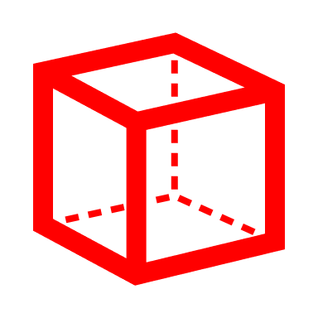
Notes:
For a block to be accepted onto the chain all the nodes on the decentralised network check that their versions of the chain (ledger) correspond with each other; should a node’s ledger not match the others, this is flagged and the block prevented from finalising/being accepted onto the chain.

Slide 8



BLOCKCHAIN
Network between computers; “Nodes”
All to verify the ‘ledger’ i.e. balance book of transactions distributed over all the ‘nodes’
Forms part of a chain of custody of information; a “Blockchain”
Notes:
So, that was what a Blockchain is in a nutshell.
Networks between nodes allowing for a Distributed Ledger
The mechanisms of the block HASH systems creating a virtual “chain of custody” between blocks of data
All working to create a system for exchanging data between parties where verification of authenticity of that data, is the paramount.
It maintains the integrity of the data
The fact that this system is being used as a legitimate mechanism in financial institutes, seems to be the ultimate proof of work of this technology.

Slide 9
benefits & applications
Every industry has some type of digital information that they’re trying to exchange in a very secure way, not just Cryptocurrencies…
Estonia – Government records/departments don’t need to ‘talk’ to each other for every transaction
Even used in the fight against Fake News – “reputation score”
Individuals have visibility and control of their own personal data – passports, medical records, driving licence – no more “proof of address” Environmentally neutral- the nodes are already running so no ‘additional’ power is required
Emergence of Smart Contracts build into Blocks
Integrity of the information
Consensus of Authentication
Track & Trace
Decentralised
Reduction of Human Error
None Back-Dateable
In-built Deterrents (Proof of Work)
Notes:
Hence, this Distributed Ledger Technology is gaining ground and being used for various purposes….

Slide 10

Carbon tracking
Competency & Training
Accounting (invoices)
Any other endorsements & approvals

Slide 11

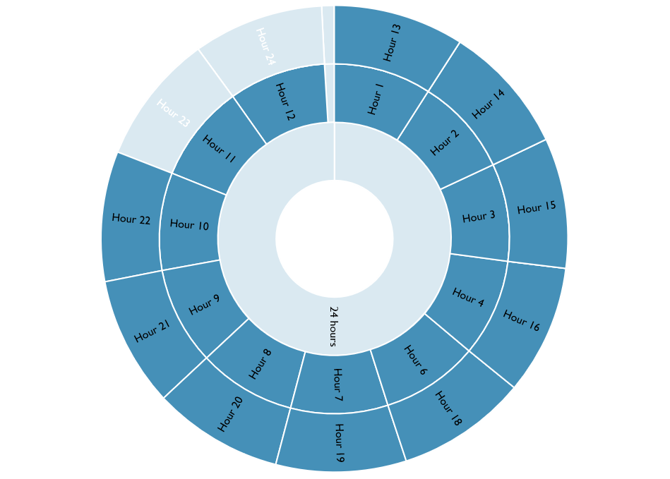
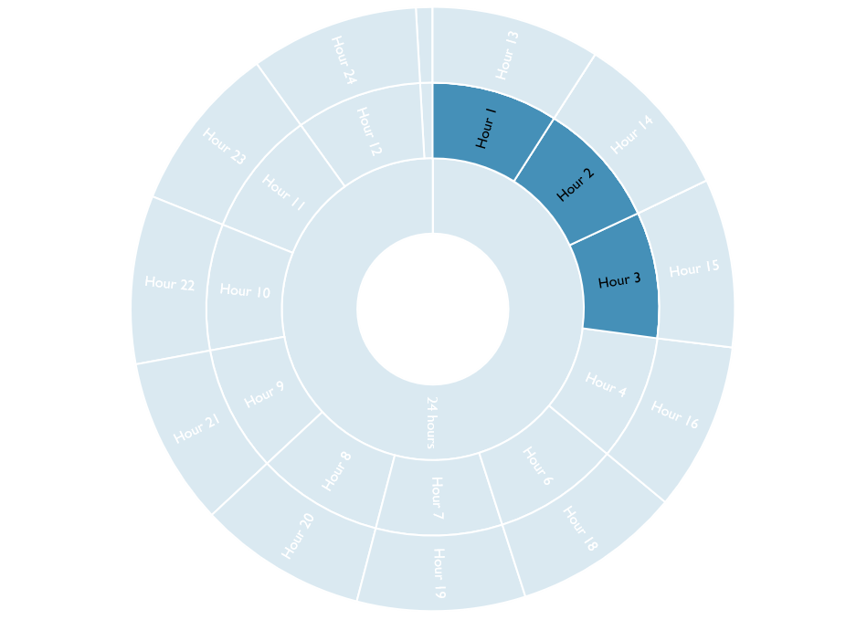
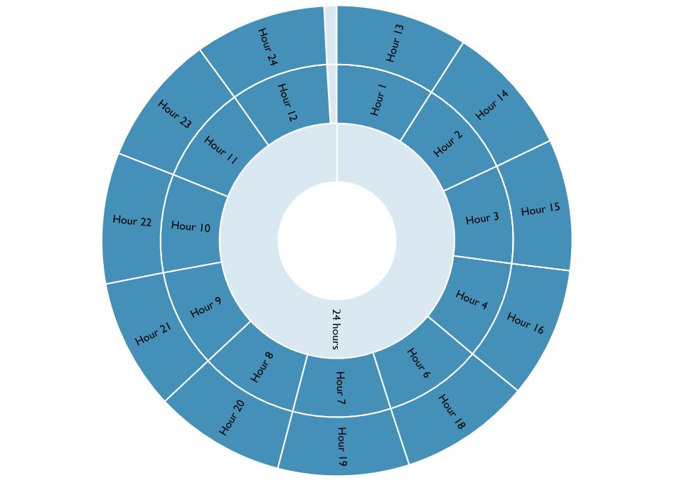
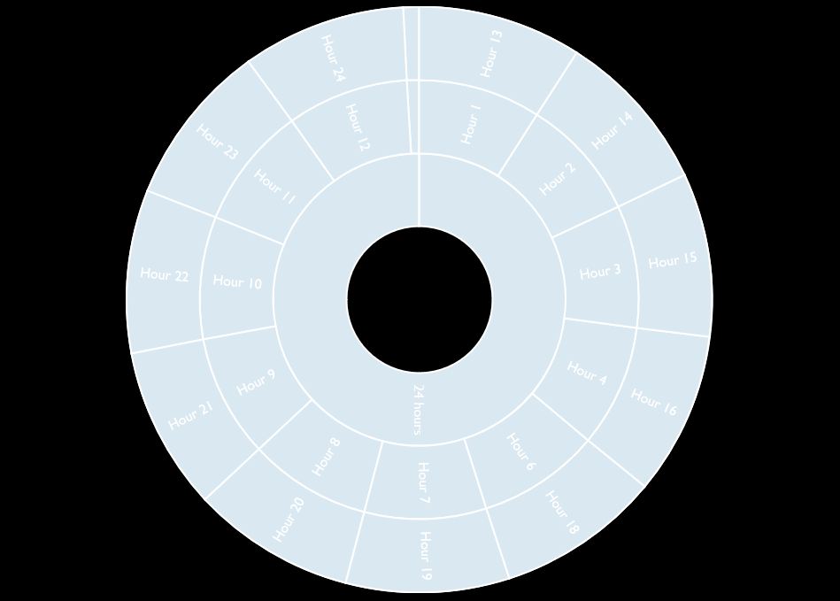
Notes:
Start 1330
Research and allocation planning – 3hrs
Development & testing – 18hrs – Clocks changed to British Summer Time
Presentation creation – 2hrs

Slide 12
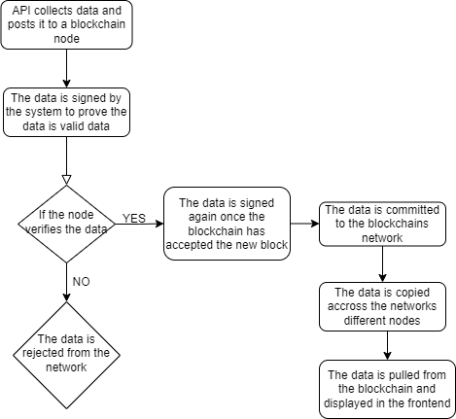
PROGRAM PLAN

Slide 13
RGU ChainGang2022 programme
National Grid API
Blockchain
UI

Slide 14
API CHALLENGES
ISSUES | SOLUTIONS
National Grid API – data retrieval
Too much raw data
API Date/Time format
48hour settlement periods
Multiple Time Zones
Data updated every half hour
More specific query to prevent excessive amounts of data pulled, increasing load times
JFGI
Unusual but makes sense because….
Moved API to a Server running BST
Efficient Storage- no point to 5 minute updates if data is the same; verification of ‘old data’ automatic, no need for ‘copies’

Slide 15
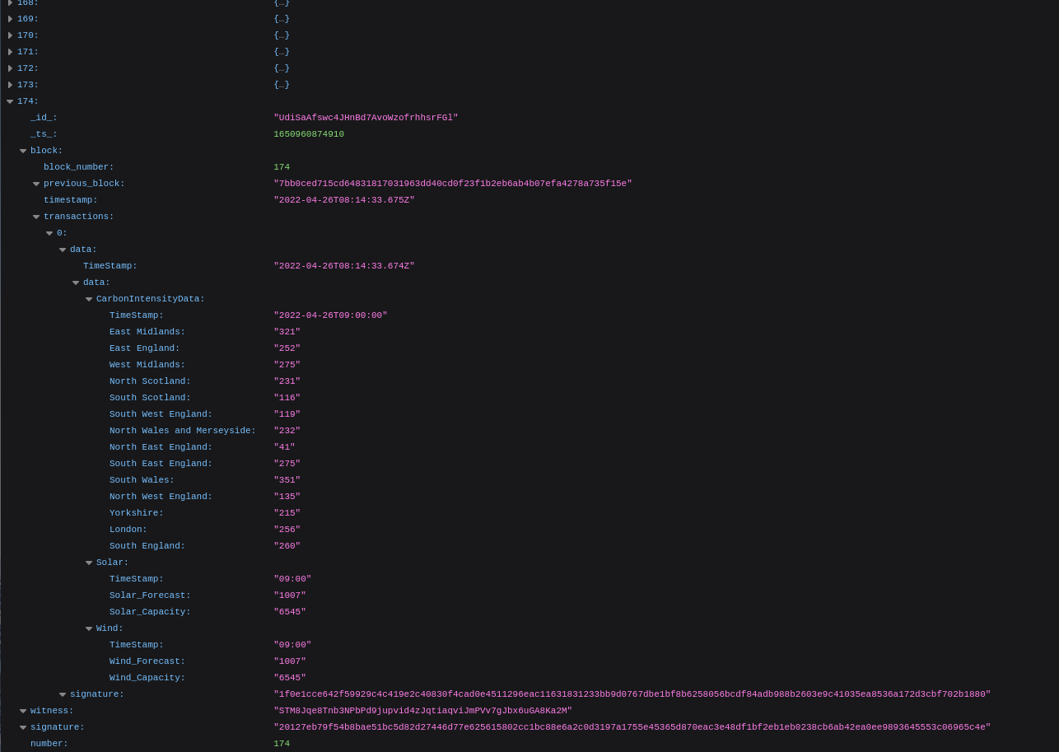

Slide 16
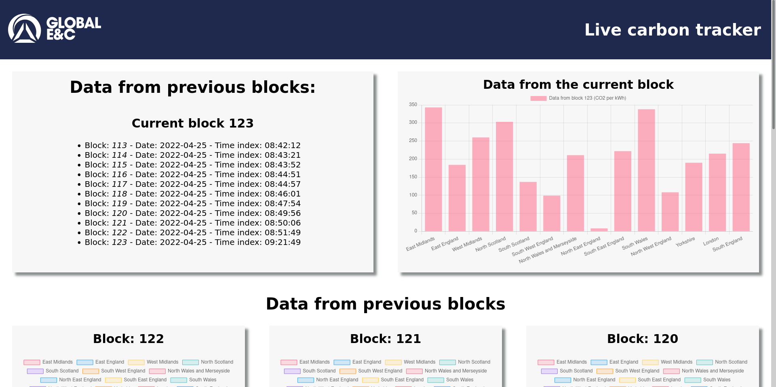
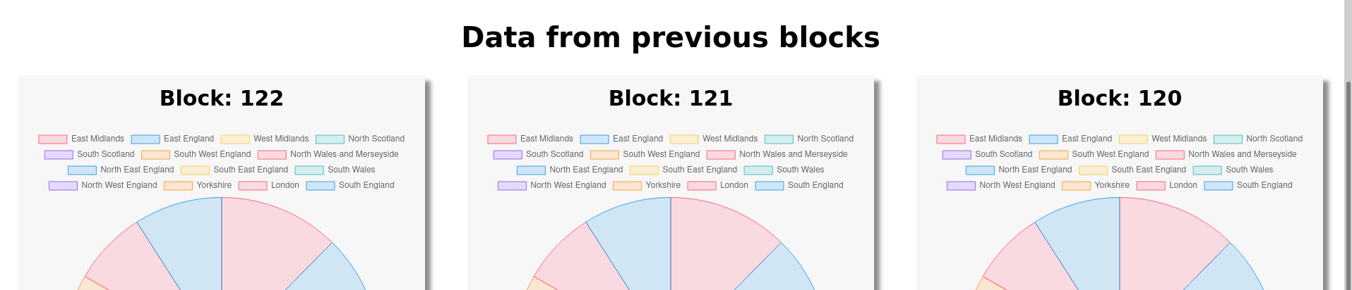

Slide 17



Thank You
RGUChaingang2022

