Slide 1

Blockchain Outside Crypto Currency
RGUChaingang2022: Fraser Hobbs, Conor Howland, Fiona Mills, Daniel Pennington

Slide 2
Global E&C ChallenGE
Demonstrate an understanding of the principles of Blockchain
Establish a valid Blockchain, with at least two nodes, using environmental data from the National Grid as the ‘transactions’.

Slide 3

DATA
HASH of Previous Block
HASH
Unique ID dependant on contents
What is A BLOCK?

Slide 4




Data
Hash n
Hast -n
Data
Hash n
Hast -n
Data
Hash n
Hast- 0000
Data
Hash n
Hast -n
Data
Hash n
Hast -n

Slide 6

Block 2
Block 4
Data
Hash n
Hast -n
Data
Hash n
Hast -n
Block 1
Block 3
Block 5
Data
Hash n
Hast- 0000
Tampered Data
Hash x
Hast -n
Data
Hash n
Hast -n

Slide 7



Slide 8



BLOCKCHAIN
Network between computers; “Nodes”
All to verify the ‘ledger’ i.e. balance book of transactions distributed over all the ‘nodes’
Forms part of a chain of custody of information; a “Blockchain”

Slide 9
benefits & applications
Every industry has some type of digital information that they’re trying to exchange in a very secure way, not just Cryptocurrencies…
Estonia – Government records/departments don’t need to ‘talk’ to each other for every transaction
Even used in the fight against Fake News – “reputation score”
Individuals have visibility and control of their own personal data – passports, medical records, driving licence – no more “proof of address” Environmentally neutral- the nodes are already running so no ‘additional’ power is required
Emergence of Smart Contracts build into Blocks
Integrity of the information
Consensus of Authentication
Track & Trace
Decentralised
Reduction of Human Error
None Back-Dateable
In-built Deterrents (Proof of Work)

Slide 10

Carbon tracking
Competency & Training
Accounting (invoices)
Any other endorsements & approvals

Slide 11

RGU ChainGang2022 programme
National Grid Data
Blockchain
UI

Slide 12
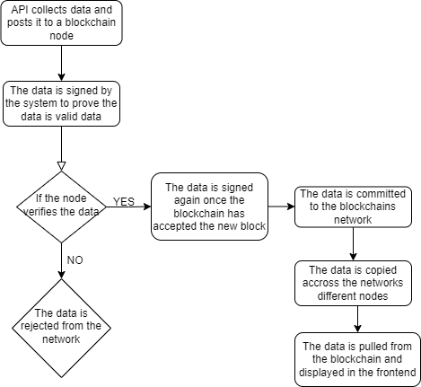

Slide 13
ISSUES | SOLUTIONS
National Grid API – data retrieval
Too much raw data
API Language format
48hour settlement periods
Data updated every half hour
Data formatted prior to entry into the block chain
Avoid any tampering
GFGI
Unusual but makes sense because….
Efficient Storage- no point to 5 minute updates if data is the same; verification of ‘old data’ automatic, no need for ‘copies’

Slide 15



Thank You
RGUChaingang2022

