Slide 1
EECS 4422 Gesture Triggered Emergency Alarming System
Yucheng Zhou
213169636

Slide 2
Project Motivation
In some situation, people encounter emergencies but have trouble asking for help (e.g. robbery at gas station, bank)
An alarm can be triggered for help without being noticed will be helpful
Gesture triggered alarm can do this

Slide 3
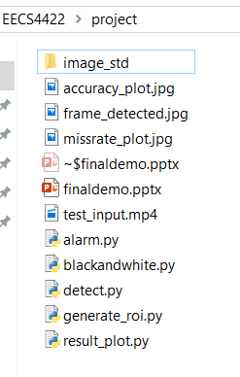
Project Overview - Structure
A program that accept video inputs, when an emergency SOS gesture is presented consistently more than 2 seconds, activate the alarm. The program includes:
Standard image library.
Main body alarm.py
External detection method detect.py

Slide 4
Project Overview - Main
The main process of the program:
Preprocess: obtain each incoming frame, perform filtering, necessary resizing and rotating, then pass to detection
Detection: use saliency method to determine the object in the frame, extract ROI, then resize to the standard size for comparison
Compare with the standard image with Euclidean Distance method, search if the object is similar to objects in the standard library.
To reassure, calculate the SSIM score as well, compare to threshold

Slide 5
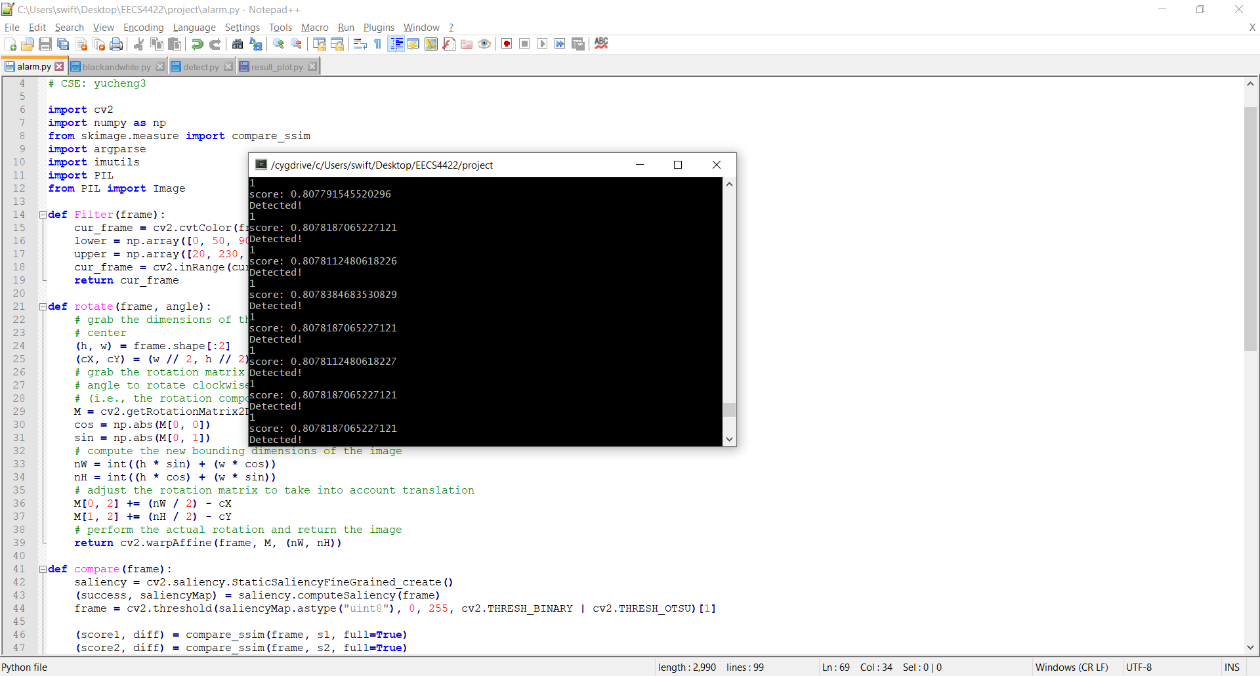

Project Overview - Main
Examine each incoming frame
A frame is detected

Slide 6
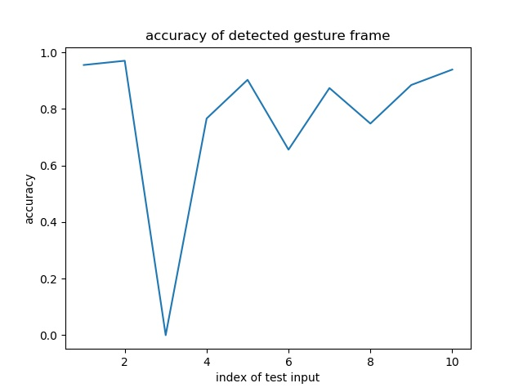
Results Analysis - Accuracy
I tested the program with 10 input videos (mp4, FPS = 30), length from 20 seconds to 50 seconds. The average accuracy of detected gesture is around 83%

Slide 7
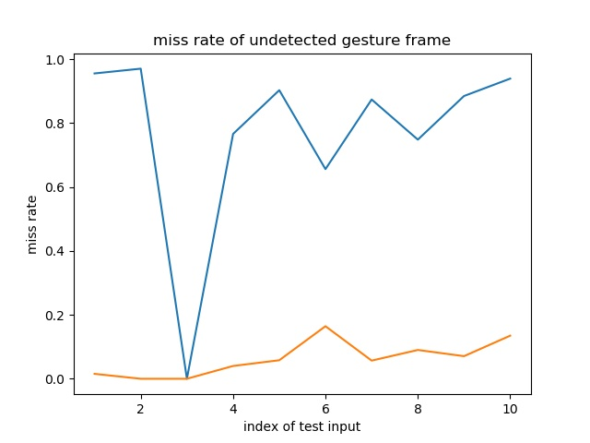
Results Analysis – Miss Rate
The average miss rate is 11%. (orange one)

Slide 8
Difficulties Encountered
When preprocessing the incoming frame, too much noise even after preprocessed, which affect the predicting accuracy
Very hard to achieve over 90% accuracy
Not real time enough. The execution time is roughly 1.8 times of the length of video

Slide 9
What Can Be Improved
Introduce training models to enhance the accuracy
Look for more efficient algorithm to save the runtime
Try use matlab instead of python to perform the task

