Slide 1
Docker and kubernetes (k8)

Slide 2
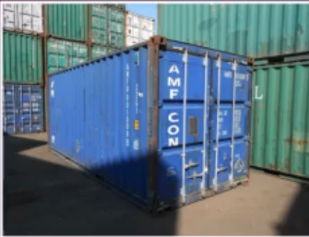
Introduction
Container is unit packing code with required libraries and runtime
Docker is tool for creating and managing containers
Always gives same result, when run anywhere

Slide 3
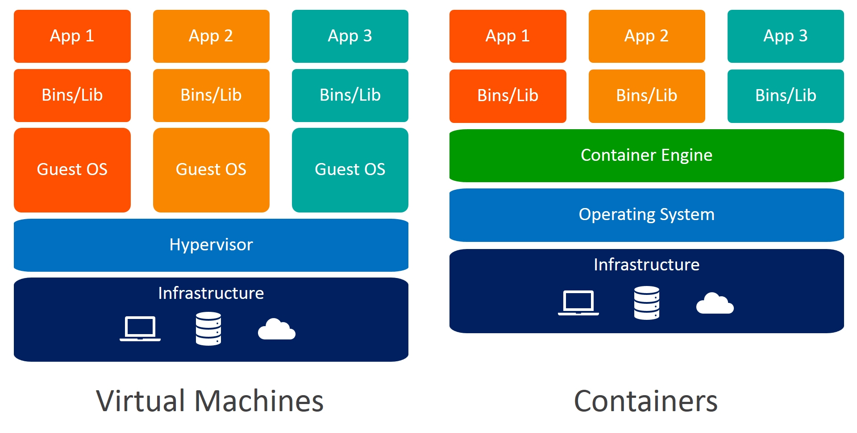
Containers vs Vms
VM, though virtual but the spinning and using VM is not that lightweight
Eats CPU and memory of underlying OS
Containers are lightweight, low impact on underlying OS
Requires minimum disk space
Sharing, Re-building and distribution is easier

Slide 4
Installation and tools
The encapsulation happens in something called as images
Storing, finding and sharing these images can be done by a service, called as Docker Hub ( A service provided by Docker)
Create an account on https://login.docker.com/, its free
For building and containerizing applications, an opensource containerization technology is used called as Docker Engine
Installation steps
sudo apt-get update
sudo apt-get upgrade
Follow - https://docs.docker.com/engine/install/ubuntu/
sudo usermod -aG docker ${USER}
sudo groupadd docker
sudo gpasswd -a $USER docker
newgrp docker
restart system
sudo docker run hello-world (If this works fine, docker is installed successfully)
Docker Engine consists of a server which runs docker (daemon), APIs to interact with docker daemon and a cli client which is docker
Docker Playground - https://labs.play-with-docker.com/

Slide 5
Demo
First docker demo –
\home\chandra\docker-kubernetes-learnings\docker_demo
There is no node or library installed on local machine
Other developer can pull and run the image, will run exactly in same manner
docker push cbagade/cl-first-prog:v1

Slide 6
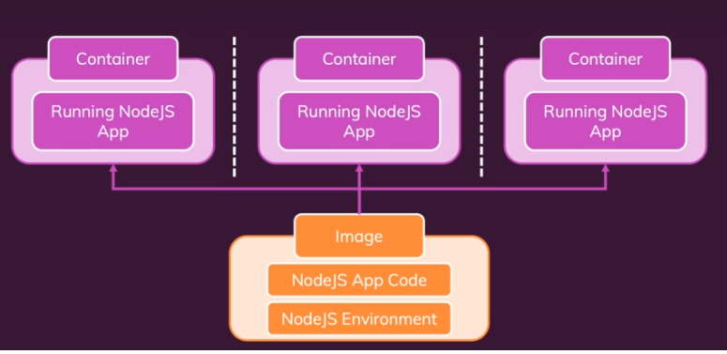
Images and containers
Images are blueprint containing code, runtime, libraries
Container is unit of software, created from image, and are running instances of image
From 1 image, multiple containers can be created on multiple machines and multiple environments
Lot of pre-built images are available like node-js , java, dotnet, ruby
Try docker run -it node and then 1+1
Try docker images, to see latest node js image

Slide 7
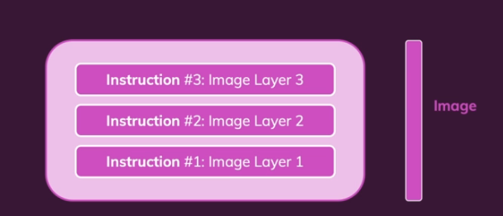
Image layers
Every instruction is represented as layer on image
After a first built, the instructions are cached
When you changes something and rebuild, the instructions are evaluation against cached ones and only changed ones are built again, super-fast
But when a layer is changed, all layers beyond that are re-built
Say in previous application, app.js is changed to have new library, then npm install instruction and all onwards instructions are re-executed
Layers are read-only

Slide 8
Demo from previous node learnings
Docker demo –
\home\chandra\docker-kubernetes-learnings\docker_demo_2
Delete image on local machine and execute demo
docker pull cbagade/cl-first-prog:v3

Slide 9
Managing data

Slide 10
Data inside container
Demo for changing data inside container
\home\chandra\docker-kubernetes-learnings\managing_data\data_till_container
The changes made in above demo, do not persist after container is recreated
The changes are happening inside container and not on host

Slide 11
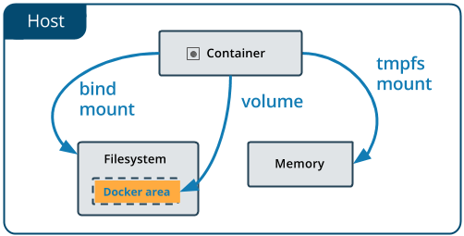
volumes
docker exec -it anonymous-vol /bin/bash
Volumes are some folders on your host which are mounted on containers
Helps to persist data
Volumes are like connection between folders, outside and inside of container
Volumes are not affected by container shutdown

Slide 12
Anonymous volumes
The volume will be a directory on local host, mounted on container
The changes made to the files inside mounted directory, will be reflected on host
The anonymous volume can be mounted inside Dockerfile as
VOLUME [ "/app/userchanges" ]
The mounted volume on container, will be available on host but the directory on host is controlled by docker system
This volume has no name and controlled by docker system, hence called as anonymous volume
\home\chandra\docker-kubernetes-learnings\managing_data\anonymous_volume
The volume is gone with container

Slide 13
Named volumes
The volume will be a directory on local host, mounted on container
The changes made to the files inside mounted directory, will be reflected on host
The named volumes can be mounted while running docker run command
The mounted volume on container, will be available on host but like anonymous volumes the directory on host is controlled by docker system
\home\chandra\docker-kubernetes-learnings\managing_data\named_volume
But this volume survives container restart

Slide 14
Bind Volumes
User specify a directly on host to be mounted on container
The changes made to the files inside mounted directory, will be reflected on host
Not to be used on production, only for local testing
\home\chandra\docker-kubernetes-learnings\managing_data\bind_volume
This volume survives container restart
Use case can be putting entire code to a bind vol so that code changes can be made inside container and tested
Only use for dev and not production

Slide 15
networking

Slide 16
Container communication
OOB container can make request to outside world
\home\chandra\docker-kubernetes-learnings\networking\www
Cross container communication
Demo shows communication with mongo container, this demo will have ip of mongo container hardcoded in app.js
\home\chandra\docker-kubernetes-learnings\networking\cross_container\ip_hardcoding
If containers are created on same network, then these can communicate with names
\home\chandra\docker-kubernetes-learnings\networking\cross_container\container_name
If mongo container mapped to named volume , data will be persisted and on mongo restart, data will be visible, since named volume will be on host
\home\chandra\docker-kubernetes-learnings\networking\cross_container\persisting_data

Slide 17
Docker compose

Slide 18
Docker compose
Till now, we created all pods, volume, networks with command line and we also deleted those with command line
This is cumbersome when there are lot many containers and artefacts
docker-compose is tool, which makes managing multi-container setup easier
docker-compose helps to replace ;docker build and docker run’ commands with one configuration file
docker-compose does not replace Dockerfile, Images or Containers
docker-compose file is composed with yaml syntax
\home\chandra\docker-kubernetes-learnings\dockercompose\mongocompose
\home\chandra\docker-kubernetes-learnings\dockercompose\app_by_compose
By default, everything inside docker-compose file will be created in one network

Slide 19
miscellaneous

Slide 20
Misc
Execute command in running container
docker exec executes command in a running container
Helpful for debugging
docker exec –it <container_id> cmd (docker exec –it <container_id> ls docker exec –it <container_id> pwd docker exec –it <container_id> /bin/bash )
CMD and ENTRYPOINT
\home\chandra\docker-kubernetes-learnings\misc
Prefer ENTRYPOINT
Try examples with ENTRYPOINT

Slide 21
kubernetes

Slide 22
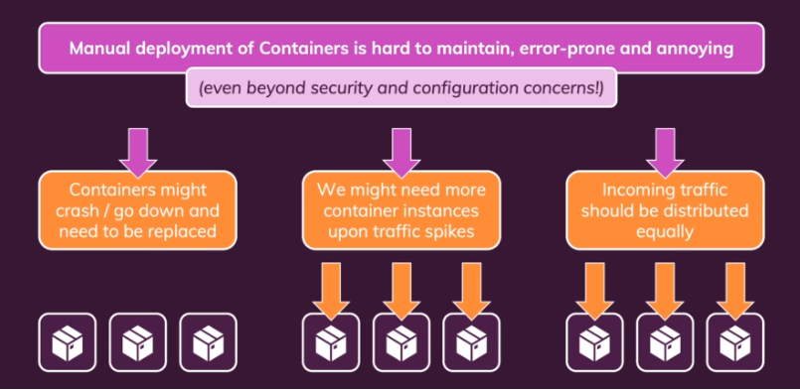
Manual deployment
A scenario for manual deployment of containers and managing those
Impossible

Slide 23
Kubernetes (k8)
Kubernetes is container orchestration tool, which facilitates large scale deployment of containers
Opensource and independent of any cloud provider
It automates deployment, scaling and management of containerized applications
It is NOT a cloud service provider, or a service provided by cloud service provider
Its is NOT restricted to any cloud
It is NOT replacement for docker but works with docker to deploy and manage containers at large scale
It’s a free service, but cloud providers also provide managed k8 services which are paid like Elastic Kubernetes Service (EKS) by AWS and Azure Kubernetes Service (AKS) by Azure

Slide 24
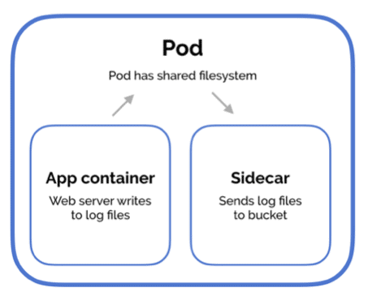
Containers and poDs
Containers consist of application and all the libraries and dependencies required to run the application, packaged as single software unit
Pod is group of one or more containers, with shared storage and network resources
Pod is smallest deployable unit of computing, that is created and managed in k8
If pod is holding multiple containers, then they can communicate with each other by localhost
Pod are ephemeral in nature, meaning stateless, K8 will stop, start replace them when needed
IP changes every time, when a pad is restarted

Slide 25
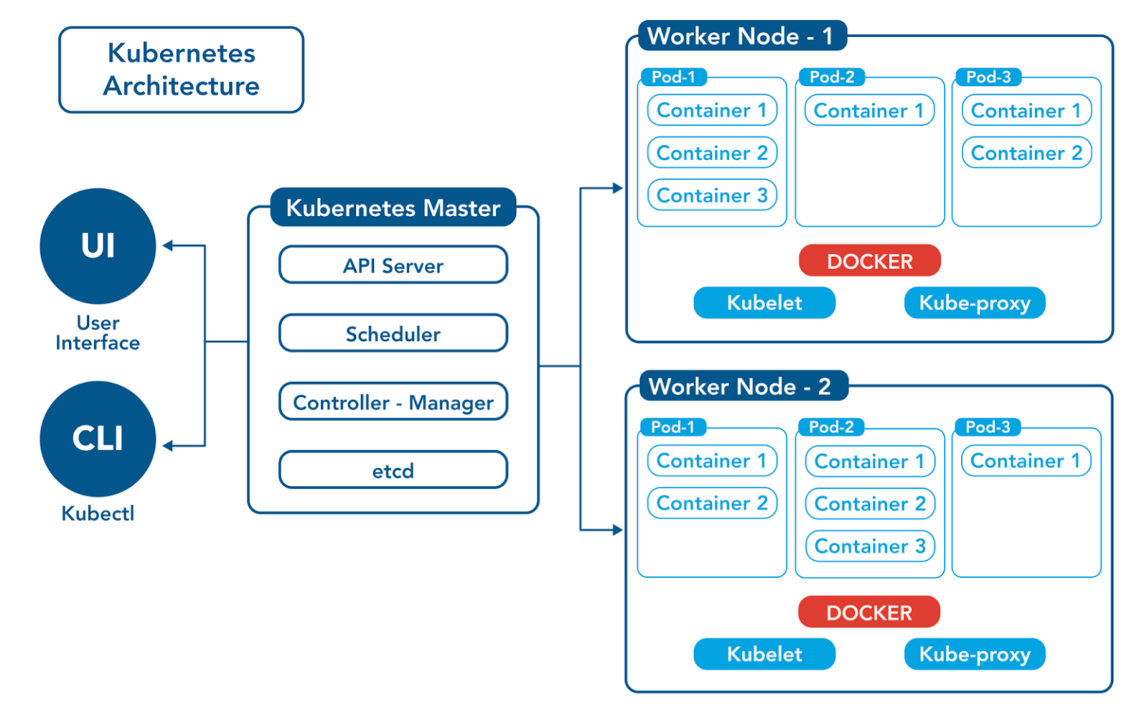
K8 Architecture
Notes:
A k8 cluster majorly consist of 2 types of machine –
Master
Worker
Master takes care of management of worker. We will come to master later on, lets first discuss worker.
When you deploy pods on to k8, those are run on worker machines, called as worker nodes. There can be many workers node based on application demand and growth.
The lifecycle of pods, like when it should be created, which worker node it should be created, when it should be taken out of service is all controlled by k8 infrastructure. K8 adds more CPU, memory to pods when require. They scale out the pods, when require.
Kube proxy on worker node, maintains network services, like traffic routing, communication between pods.
Kubelet, run on worker node and communication state and health of containers to kubernetes. Like if pod require more resources or it is failing and need to bring up.
Master is also called as Control Plane and it controls the worker nodes. It consists of –
Etcd – Stores overall configuration data of cluster (state and details of pods). We will learn about configuration data and how to make it available to Pods.
API Server – The interfaces to k8. The user and also the internal components uses these APIs to interact with k8. API Server is responsible to facilitates the communication via k8 apis.
Schedular – Schedules the pod on worker node. It decide which node to put the containers based on worker node resources, policies and other factors
Controller Manager – Responsible for bringing current state to desired state. Like say, Pods required are 4 and now are 3, so this component is responsible to trigger scheduling of one more pod. It decides what action to take when node goes down. When a new project is created, those require some default entities like Service Accounts. Controller Manager creates those.
Kubectl is CLI to interact with k8 APIs.

Slide 26
installation
For dev , setup can be done with minikube, KinD (Kubernetes in Docker)
Playground - https://killercoda.com/playgrounds/scenario/kubernetes
Cloud providers provides managed k8 services like EKS, AKS
KinD installation on Ubuntu (WSL)
sudo curl -L "https://kind.sigs.k8s.io/dl/v0.18.0/kind-$(uname)-amd64" -o /usr/local/bin/kind
sudo chmod +x /usr/local/bin/kind
kind get clusters
kubectl installation on Ubuntu (WSL)
curl -k -LO https://storage.googleapis.com/kubernetes-release/release/v1.27.1/bin/linux/amd64/kubectl
sudo chmod +x ./kubectl
sudo mv ./kubectl /usr/local/bin/kubectl
kubectl version --short

Slide 27
installation
Create kind cluster (WSL ubuntu)
cd \home\chandra\docker-kubernetes-learnings\kubernetes_demos
kind create cluster --config=cluster-config.yml --name=chandra-learnings
If there are issues like, kubelet not healthy then follow –
On ubuntu - echo -e "[boot]\nsystemd=true" | sudo tee /etc/wsl.conf
On powershell (admin) -> wsl --list –verbose
On powershell (admin) -> wsl --shutdown
wsl
exit from powershell and log onto ubuntu – and create cluster again
Restart machine will shutdown kind cluster
docker ps –a
restart container of kind image

Slide 28
Learning k8
Nodes – Display master and worker nodes
kubectl get nodes
Namespace – Mechanism to isolate groups of resources within cluster
kubectl get namespace
kubectl config view --minify | grep namespace
kubectl create namespace kube-learnings
kubectl config set-context --current --namespace=kube-learnings
Let’s build a docker image first (refer Dockerfile)
\home\chandra\docker-kubernetes-learnings\kubernetes_demo\confirm_setup
Deployment – Deployment tells kubernetes how to create and modify instances of pods that hold containerized application
kubectl create deployment kube-setup --image=cbagade/kube-setup:v1
kubectl get deployment
kubectl get pods
Kubectl describe ….. <deployment> and <pod>

Slide 29
Learning k8
Dashboard– UI View for Kubernetes artifacts
The Pod IP is reachable inside cluster only. To make it reachable outside cluster, Service need to be used.
Service – Mechanism to expose network application, running as one or more pods in cluster
Scaling – Can scale Pods ups and down to desire number
Update Deployment – to new image
Rollback Deployment – to previous image
Delete Service – to previous image
Delete Deployment – to previous image
Follow Dockerfile at \home\chandra\docker-kubernetes-learnings\kubernetes_demo\confirm_setup

Slide 30
Service
Service is used to expose the pod, outside the cluster
3 types of services –
ClusterIP – Reachable from within cluster
NodePort - A NodePort service builds on top of the ClusterIP service, exposing it to a port accessible from outside the cluster. Basically, it exposes a port onto node.
LoadBalancer - A LoadBalancer service is based on the NodePort service, and adds the ability to configure external load balancers in public and private clouds
Follow Dockerfile at \home\chandra\docker-kubernetes-learnings\kubernetes_demo\confirm_setup

Slide 31
Declarative Approach
Imperative approach got lot of commands
Same problem and docker or docker-compose
Tough to write commands for larger deployments
Kubernetes allow us to create resources inside yaml file having configuration objects
These files will have objects, which k8 can understand
\home\chandra\docker-kubernetes-learnings\kubernetes_demo\declarative_approach\pod.yaml
\home\chandra\docker-kubernetes-learnings\kubernetes_demo\declarative_approach\deployment.yaml
\home\chandra\docker-kubernetes-learnings\kubernetes_demo\declarative_approach\service.yaml
Mostly app specific resources would be incorporated in single yaml file
\home\chandra\docker-kubernetes-learnings\kubernetes_demo\declarative_approach\app_deployment.yaml

Slide 32
Liveness probe
Deployment will try to bring container from error state to running state, when pod goes in error state
The liveness probe will go one step further and explicitly makes request to a configured path to check if pod is in healthy state, if not will restart
This is useful in deadlock situation or a bug in system to keep application running
\home\chandra\docker-kubernetes-learnings\kubernetes_demo\declarative_approach\app_deployment_liveliness.yaml

Slide 33
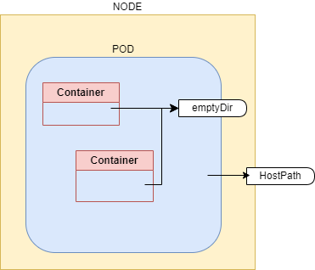
Kubernetes volumes
Changes, without Volume
This demo make temp changes to a file, but all are localized inside container.
Can’t survive container or pod restart
\home\chandra\docker-kubernetes-learnings\kubernetes_demo\k8_with_volumes\without_volume

Slide 34
Kubernetes volumes
emptyDir
Creates an empty directory on pod when pod starts and keep alive till pod is alive
Kind of temporary folder created, when pod starts
As name suggest it is initially empty
Can survive container restart, but can’t survive pod restart
\home\chandra\docker-kubernetes-learnings\kubernetes_demo\k8_with_volumes\empty_dir
hostPath
Mounts a file/directory from node’s filesystem into the pod
Can survive container restart and pod
Won’t work on multi-node cluster
\home\chandra\docker-kubernetes-learnings\kubernetes_demo\k8_with_volumes\host_path

Slide 35
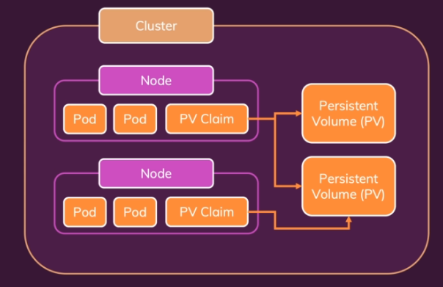
Persistent volumes (PV and PVC)
Pod and Node independent volumes are needed
Persistent volumes are kubernetes entities like pod, deployment
There are independent of pods and nodes
PV don’t store data on nodes
When pods need PVs, they need to raise a claim, called as Persistent Volume Claims (PVCs)
PVCs are then bound to PVs, making PVs available to pod

Slide 36
Persistent volumes (PV and PVC)
PV is abstract and actual storage can come from anywhere like cloud providers (aws, azure, google etc.,) or nfs
To bind PV, there should be a storage class and appropriate driver
kind provides a standard storage class to create volume of type hostPath
Go through Kubernetes Persistent Volume documentation to learn more about storage classes, drivers and various types of storages
\home\chandra\docker-kubernetes-learnings\kubernetes_demo\k8_with_volumes\persistent_volume

Slide 37
Environmental variables
ConfigMap is a kubernetes object, used to store non-confidential information
Decouple environment specific information from container images, so that application is easily portable across environment
Imagine database host value as localhost in your machine and something else on development or production environment, can be incorporated in config map
\home\chandra\docker-kubernetes-learnings\kubernetes_demo\k8_envs

Slide 38
networking

Slide 39
Pod internal communication
Containers within pod can communicate to each other by ‘localhost’
\home\chandra\docker-kubernetes-learnings\kubernetes_demo\networking\pod_internal

Slide 40
Pod 2 POD communication
Pod to Pod communication can be established either with auto generated service name or DNS
\home\chandra\docker-kubernetes-learnings\kubernetes_demo\networking\pod_2_pod

Slide 41
Secrets
Secrets can be defined as Kubernetes objects used to store sensitive data such as username and passwords with encryption
Can help to externalize authentication information of external application which pod may need to access
\home\chandra\docker-kubernetes-learnings\kubernetes_demo\k8_secret
Following example demonstrate pod-2-pod communication, with mongo db container in place.
\home\chandra\docker-kubernetes-learnings\kubernetes_demo\networking\pod_2_pod_with_mongo

Slide 42
Further learning
Kubernetes Objects like StatefulSet, Jobs , Cron Jobs, ReplicationSet, ReplicationController
Try to deploy mongo as StatefulSet
Try to read about Cloud provider kubernetes services (EKS, AKS)
Try to read about Openshift

Slide 43
SUMMARY
We learnt basic features of Kubernetes.
But there is lot to kubernetes, which users can learn. New additions keep happening to this orchestration tool and user should keep himself updated.
Openshift is a tool by RedHat and make operating Kubernetes easier. User can learn about Openshift.

