Slide 1


Slide 2
regular expressions
A pattern that strings can match

Slide 3
regular expressions
A pattern that strings can match
We have already seen examples!
'*.txt' matches filenames ending in '.txt’

Slide 4
regular expressions
A pattern that strings can match
Like '*.txt' matches filenames ending in '.txt'
Warning: notation can get ugly

Slide 5
regular expressions
A pattern that strings can match
Like '*.txt' matches filenames ending in '.txt'
Warning: notation can get ugly
Writing patterns for strings as strings...

Slide 6
regular expressions
A pattern that strings can match
Like '*.txt' matches filenames ending in '.txt'
Warning: notation can get ugly
Writing patterns for strings as strings…
...using only the symbols on the keyboard (instead
of inventing new symbols like mathematicians do)

Slide 7
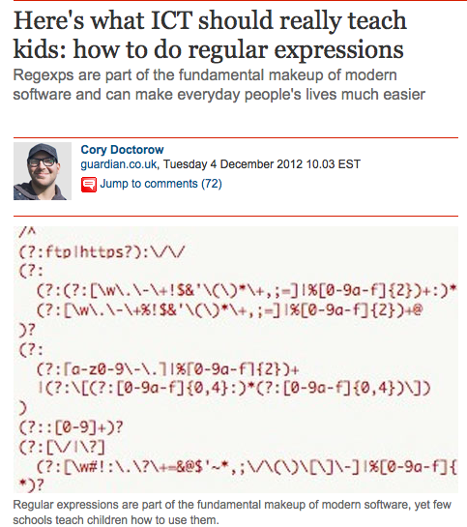

Slide 8
Why not just use “find”?
in python:
searchstring=“thing I’m lookin for”
for lin in file:
if searchstring in lin:
print lin

Slide 9
Why not just use “find”?
in python:
searchstring=“thing I’m lookin for”
for lin in file:
if searchstring in lin:
print lin
FLEXIBILITY

Slide 10
Regular Expressions are useful if you only kind of know what you are looking for.
especially if you know how it would be formatted

Slide 11
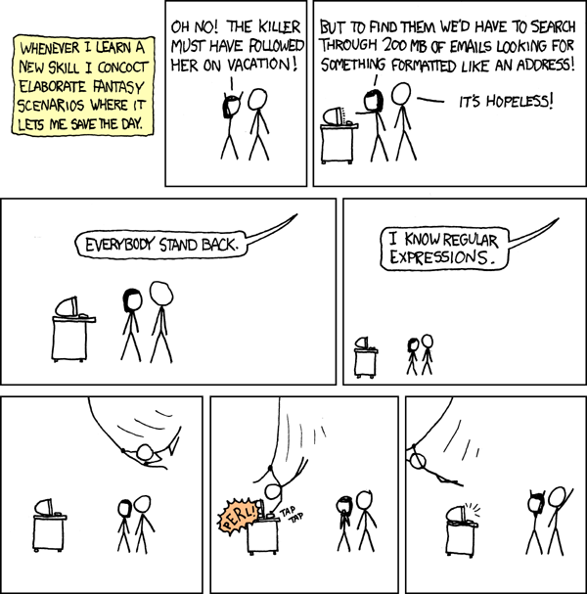

Slide 12
More common than you might think!
e.g.
pull filenames out of textfiles
find all the phone numbers in am email
search for a range of dates

Slide 13
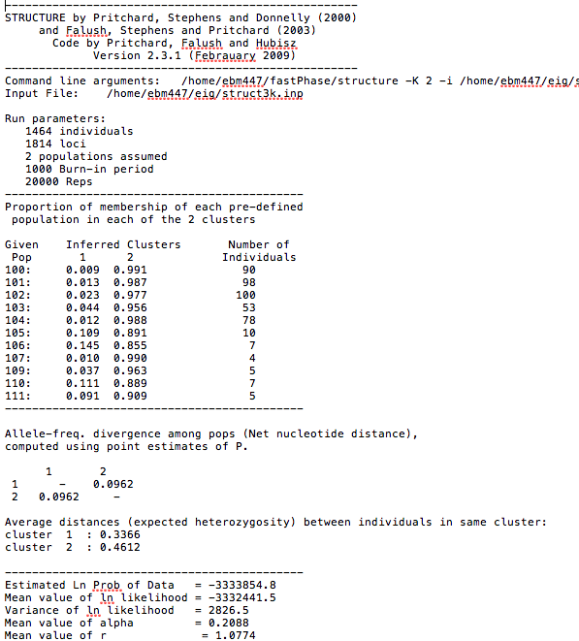

Slide 14
git clone https://github.com/snacktavish/AustinSWC.git
cd regex
open structureoutput.txt
(anyway you would like)
OR
download it as a raw file from
https://github.com/snacktavish/AustinSWC/blob/master/regex/structureoutput.txt

Slide 15

RegExPal demo
regexpal.com
structureoutput.txt

Slide 16
Cheat sheet from regexpal
Regular characters act normally
. Any character except newline.
\. A period (and so on for \*, \(, \\, etc.)
^ The start of the string.
$ The end of the string.
\d,\w,\s A digit, word character [A-Za-z0-9_], or whitespace.
\D,\W,\S Anything except a digit, word character, or whitespace.
[abc] Character a, b, or c. [a-z] a through z.
[^abc] Any character except a, b, or c.
aa|bb Either aa or bb.
? Zero or one of the preceding element.
* Zero or more of the preceding element.
+ One or more of the preceding element.
{n} Exactly n of the preceding element.
{n,} n or more of the preceding element.
{m,n} Between m and n of the preceding element. ??,*?,+?,

Slide 17
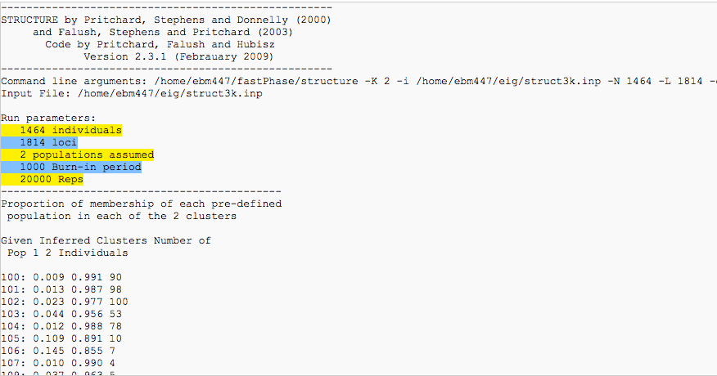
Mini-exercise!
You want to search through a bunch of different output files and get the run parameters for each one.
Write a regular expression in regexpal that will find only the five lines following “Run Parameters”

Slide 18
My answer:
^\s+\d+ \w+.+

Slide 19
ipython notebook
reg ex demo using structureoutput.txt

Slide 20

Thank you!
Instructors - Andy, Rose, Jason and Joon
Helpers - April, Nichole, Eamon, Ben, Carlos, Luke, John,
Software Carpentry – Greg Wilson
Funding – CCBB and BEACON (Hans Hoffman and Risto Mikkulainen
Logistics – Laurie Alvarez

Slide 21

too advanced sometimes
too much mixture of levels/ lack of clarity in expected skills
more real data for power of tools
nice to have prep material
thin on the inbetween material hit the high/low
some examples had booby traps
first day lacked context – WHYs +1
more explicit intro/planning
too choppy- cover things from start to finish
more file io
too many subject – more focused would be better
Needs more big picture and real data sets
Intro/setup was a pain getting everyone on board
Nice to have an exam[ple workflow
work through a project
Version compatibilty
would have liked more stats oriented stuff
Needs more problem solving
frequent test breaks / examples +1
variety of tools
ease of getting help/ great helpers
flags
loved the unix –RCK
regular expressions
fast with troubleshooting
etherpad +1
regexpal
ipython notebook + enthought
helpers +1
Powerpoint helped
Feedback interpreters!
fast answers on etherpad
PYTHON 4 LIFE
Nice to see the examples of differnet packages

