Slide 1
Fiesta ST Air Intake Headlight Proiect practica Gavrila Razvan CR2.2a

Slide 2
The Goal
My goal was to produce from design to reality a headlight air intake for rally car.
The steps that I took are the following:
Scanning and measuring
Reverse engineer and design
CFD Testing
Final product

Slide 3
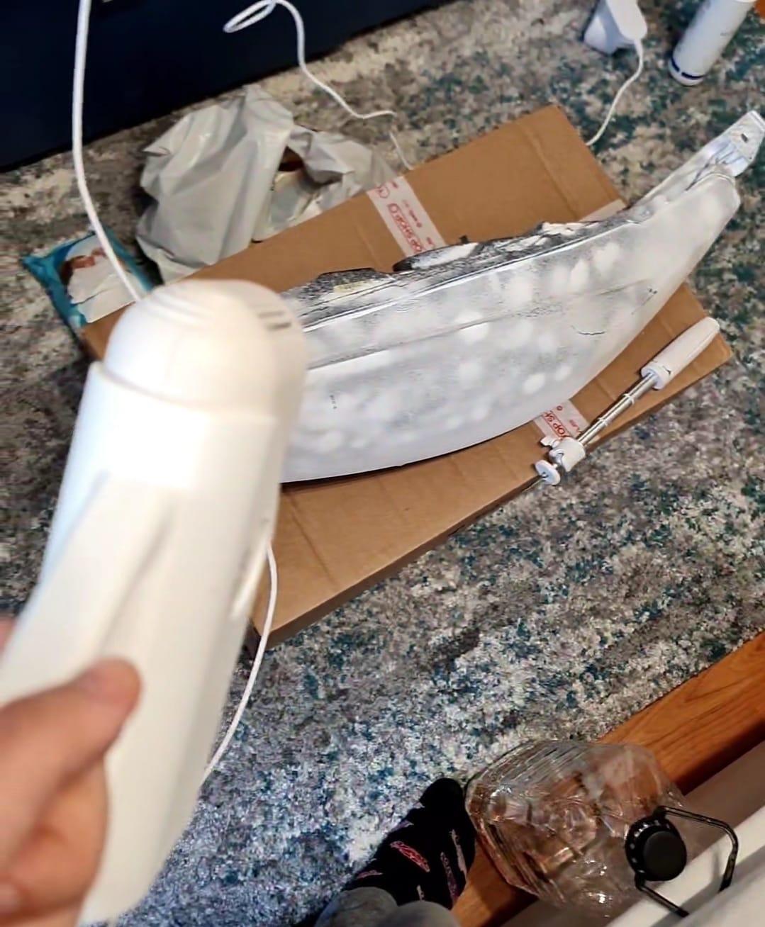
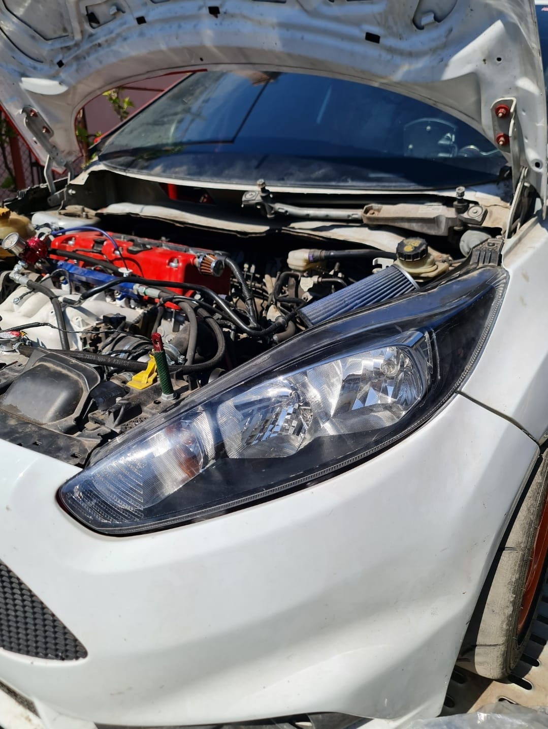
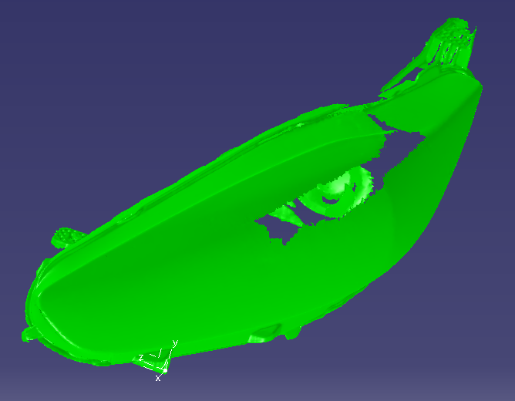
Step 1: Scanning and measuring
The first step was to measure and scan the original headlight.
We are doing this so we have a strong starting point.
I used the scan as an example on witch I based my final design.

Slide 4
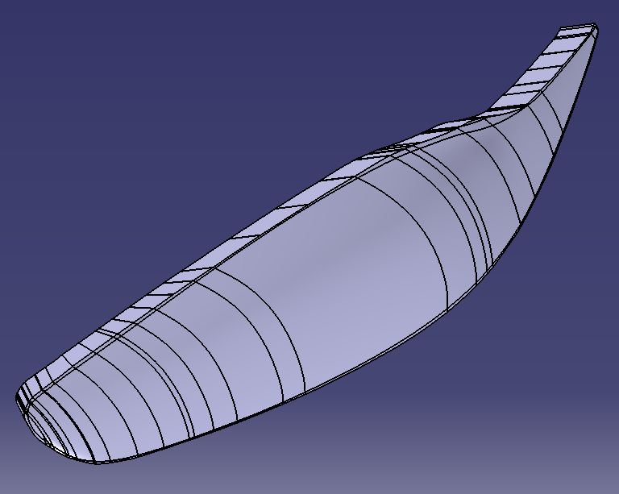
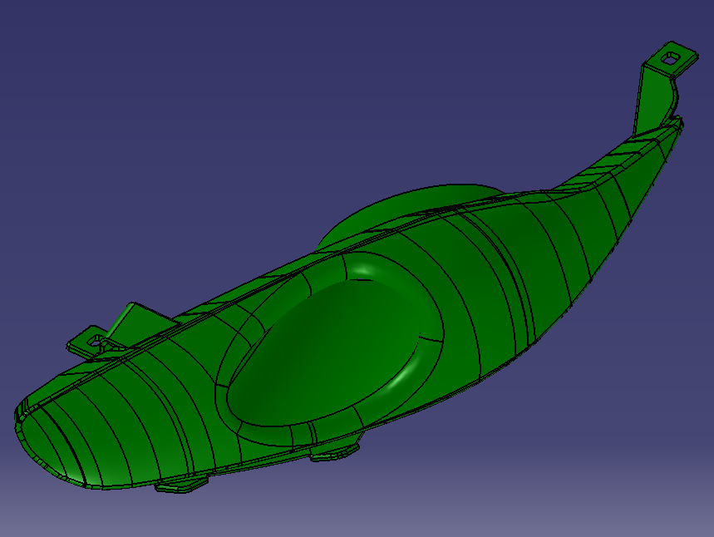
Step 2: Reverse engineer and Design
The first operation was rebuilding the shape of the original headlight(Left Picture)
After we had the shape, we moved onto making the final design that includes the factory mounting tabs and the Air Intake.

Slide 5
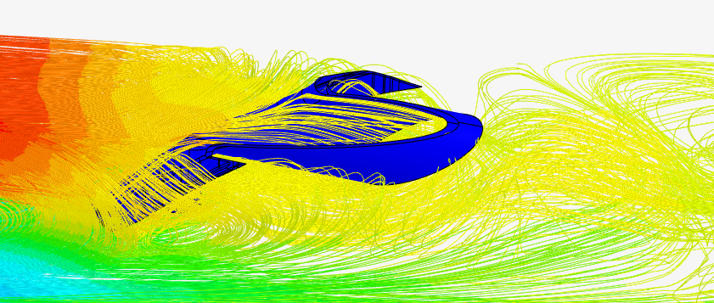
Step 3: CFD Testing
The last step before bringing the headlight to life is testing the flow of the air trough the intake
The software used for this is SimScale

Slide 6
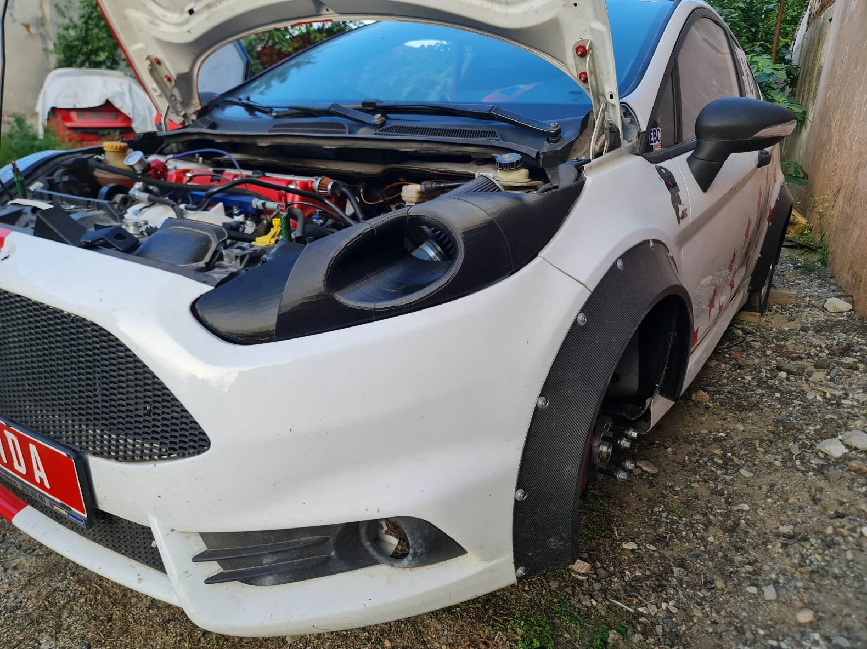
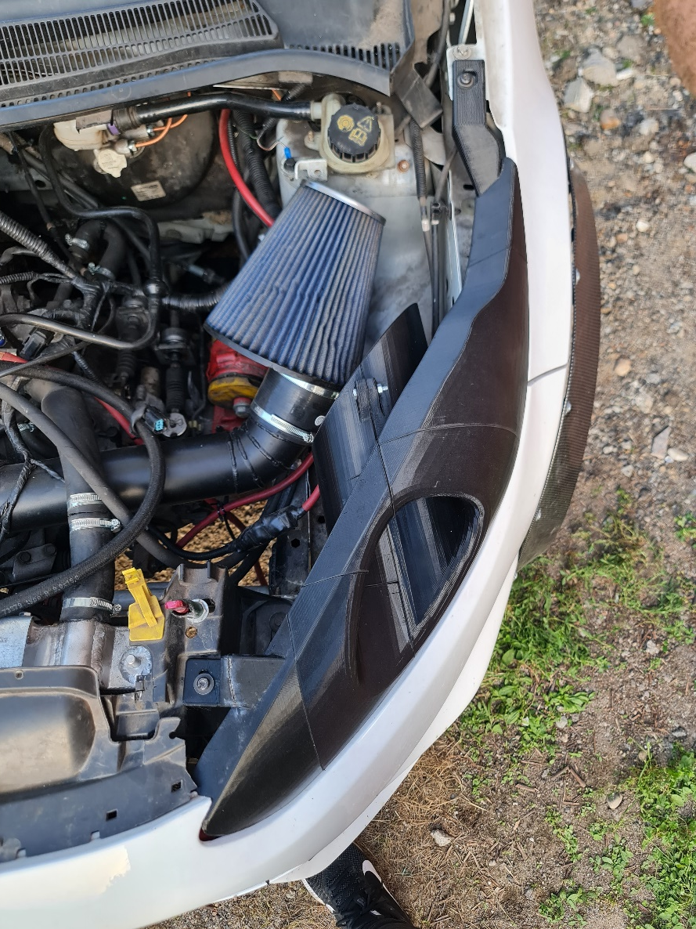
Step 4: Final Product
In the end we have the product you can see in the pictures, ready for racing!

Slide 7
Thank you for listing!

