Slide 1


Classification Using Texture Features and Machine Learning Models
Akshat(22B4513)
Vishal(22B0065)
Alvin(22B0015)

Slide 2


Introduction
Image classification is crucial in various fields such as medical imaging, remote sensing, and surveillance. Accurate classification aids in tasks like disease diagnosis, environmental monitoring, and security

Slide 3
Objective
Our main objective is to classify images using texture features extracted via Sum-Difference histogram-based and Gray-Level Co-occurrence Matrix(GLCM) methods

Slide 4
Strategy & Pseudo Code
Take an image as an input
Calculate corresponding features (contrast, dissimilarity, homogeneity, energy, correlation) using sum-difference histogram-based texture features of the image
Give these features as input to the ANN classifier and it will classify an image based on these features to which class it belongs
Do the same using the GLCM-based texture feature method.
Compare the results of the two (sum-difference histogram and GLCM).
Pseudo Code
Load the image.
Calculate texture features using Sum-Difference Histogram (SDH).
Calculate texture features using Grey Level Co-occurrence Matrix (GLCM).
Combine features from both methods.
Load dataset and corresponding labels.
Split dataset into training and testing sets.
Train the classifier using the training set.
Evaluate the classifier using the testing set.
Print the accuracy of the classifier

Slide 5
Input
https://drive.google.com/drive/folders/1TWjjQrsCVBKhvx8TEP7pBsZK9zaMsx3i?usp=sharing
It contains a Dataset named– Imagerar which has images of 8 different classes (agricultural, baseballdiamond, beach, buildings, denseresidential, forest, harbor) and approx. 500 images of each class
Using this we created two datasets (one from sum-difference histogram and one from GLCM features method) which contains image file name and corresponding five features (contrast, dissimilarity, homogeneity, energy, correlation) and at last label which class it belongs.

Slide 6
Flow
Input
We will input the image for which we want to predict the label
Classifier
We use ANN Classifier to classify the Images
Output of Labels
The Classifier outputs the label of the class to which the image belongs

Slide 7
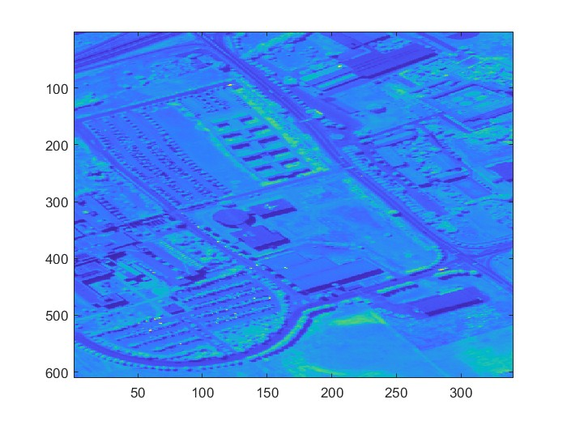
Sum-Difference Histogram based
Input
Features
Energy: 0.0016063886
Entropy: 7.2878838
Contrast: 5559679.00390631
Homogeneity: 0.05080369484937711 Correlation: 0.004462120585180015 Dissimilarity: 32639.996124267578

Slide 8
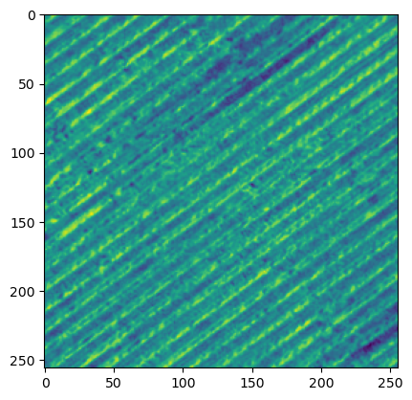
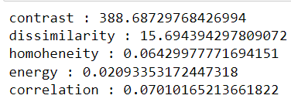
GLCM
Input
Features

Slide 9

Thank You
-----------------------------------------------------------

