Slide 1
Project 3
Employee Dashboard
Amrita Prithiani
Ben Spiegel
Lydia Glassley
Ryan Granston
Notes:
Group 3 Project 3, welcome to our final. I’m Ryan and with me today are Amrita, Ben and Lydia.

Slide 2
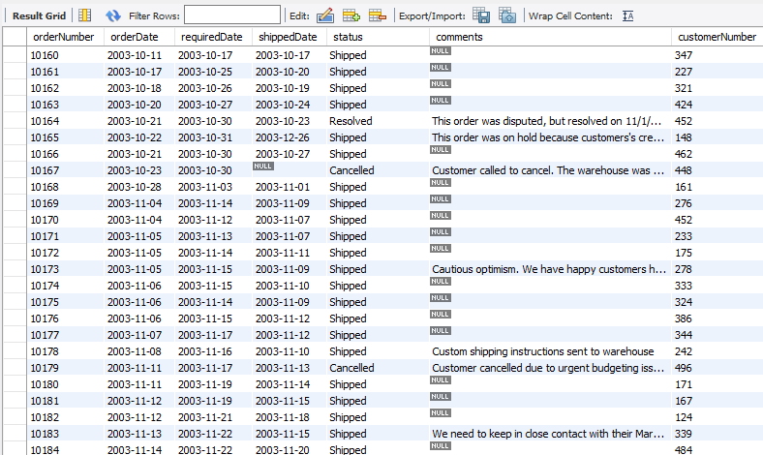
Project Summary
Employee Dashboard
Small Company
Existing database
No dedicated IT staff
Cheap
Simple to use interface
Notes:
For our final project we decided to work on a SQL database. To start we created a narrative for who our fictitious company and what they are requiring from us.
We have a small sales company of about 25 employees who need better access to their existing database.
In order to fulfill that we set out to create a browser based employee dashboard for internal use only.
Our company doesn’t have any dedicated IT staff or on prem IT infrastructure. They need this to be on the cheap.
And the interface needs to be simple enough that a non technical user will not have any issue navigating it.

Slide 3
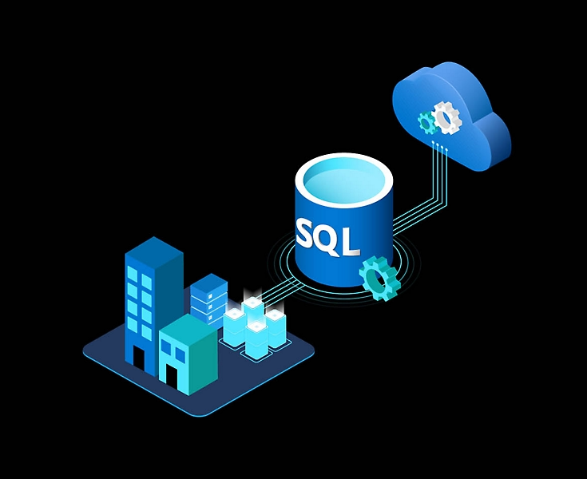
Database Host
Amazon Web Services (AWS)
Relational Databases (RDS)
Cheap
Scaleable
Easy to set up
Doesn’t require on prem infrastructure
Notes:
Our database host,
Because we don’t have on prem IT infrastructure or a dedicated IT staff,
we decided on using Amazon Web Services and their Relational Database Services for our host.
RDS obviously is very scalable, but it can be relatively cheap, with an emphasis on can and relatively.
RDS was pretty easy to set up, really only take a few minutes to get the database going.
But initially we had some issues with our connection. A lot of the tutorials and videos we found conveniently left out some security group requirements but after some infuriating hours we got it going.

Slide 4

SQL Database
MySQL
Free
Open source database
Easy to integrate into AWS
MySQL Workbench
Clean interface
Can run queries quickly
Easy to troubleshoot
Notes:
That leads us to our SQL database. Now we can’t use SQL Server cause we don’t have that Microsoft money.
So we decided on MySQL, which is the world’s most popular open source database. It’s free and easily integrates with AWS.
MySQL comes with the MySQL Workbench which is their visual database tool that integrates SQL development, administration and design.
I thought the workbench made designing our SQL queries much easier than doing it in VS code or Jupyter Lab. You can run queries quickly, it’s easy to troubleshoot and the interface helps the user understand how the database is structured.
Any of you in class interested in brushing up on SQL, I would highly recommend installing it.

Slide 5
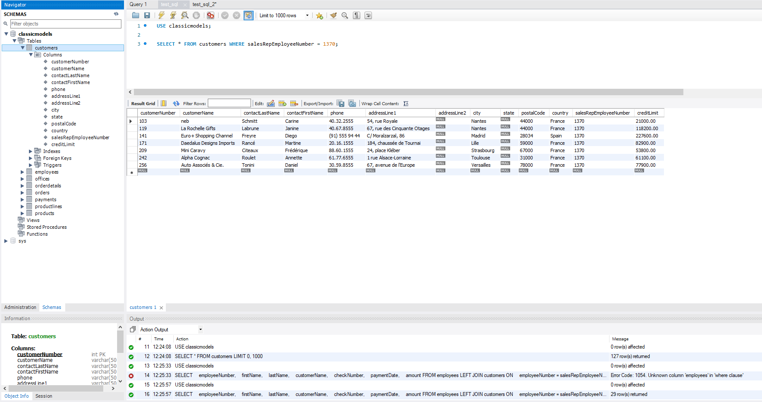
MySQL Workbench
Notes:
Here is an example of the Workbench UI.
You can see on the left our database, called classicmodels, all the different tables in the database, (customers, employees, offices, and so on) and then we break out the columns in our customer table.
This visualization makes it a lot easier to write queries. This query for example we wanted to be able to search for all the customers assigned to an employee based on their employee number.
In our database the employee number column is called different things in other tables so being able to quickly bring up the column list for individual tables really helped make the process quicker and easier.

Slide 6
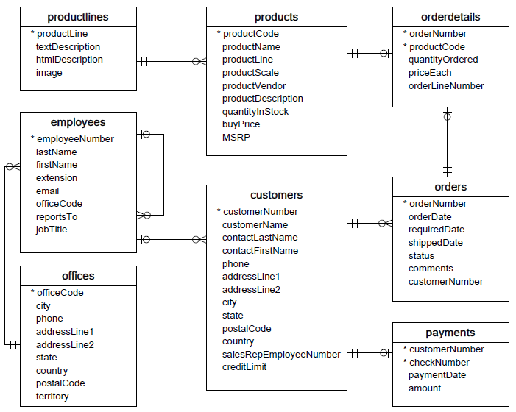
Our Database
Notes:
That brings me to our database schema.
We used an existing sample database.
As you can see, there is no center hub, the relational data is limited and the columns aren’t even named the same thing, between the different tables like i mentioned before.
The database we used was intended as a learning tool, which is probably why it’s designed like this but then again a sprawling, confusing, and poorly organized database is probably pretty common.

Slide 7
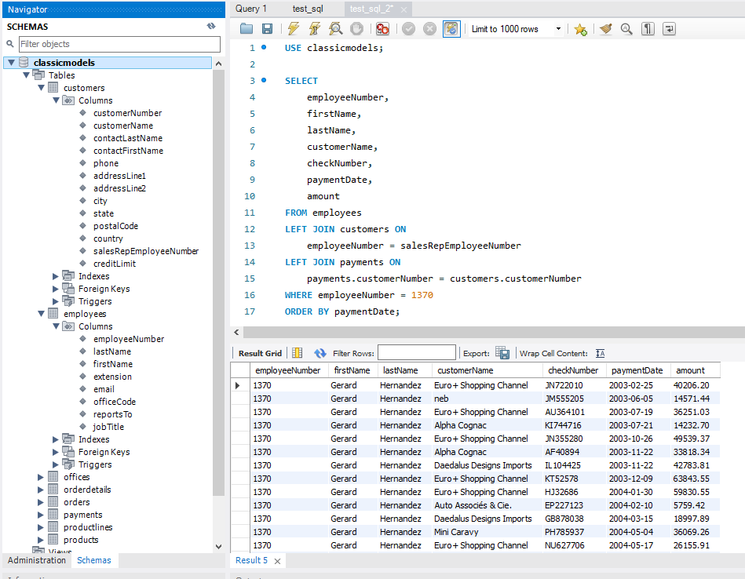
Employee Sales Query
Notes:
Here is an example of one of our queries.
We want a sales rep to be able to pull up all of their sales by their employee number. And include customer and payment information.
To do this we have to JOIN the customer table to the employee table and then the payment table to the customer table.
As there is no relation between the employee and payment table.
So if our employee is trying to figure out what he is going to be paid it takes some extra steps.

Slide 8
Building our App
Application Functionality:
Connect to database
Read data
Employee
Customer
Inventory
Add new customer
Update existing customer
Display in browser
Libraries:
PyMySQL
Config
Connector
Pandas
SQL Alchemy
Pillow
Streamlit
Notes:
With the database up and running it’s time to start designing the application.
Obviously it has to connect to the database but what do we want it to actually do.
We need the app to be clean and simple yet still cover enough relevant functions.
So we decided on an employee look up, employee sales and customer look up, shipping information, inventory information and the ability to add and update customers.
We looked at adding a delete function but decided against it.
Then of course this needs to be displayed in a browser.
Also listed here are some of the libraries we will be using to accomplish this.

Slide 9
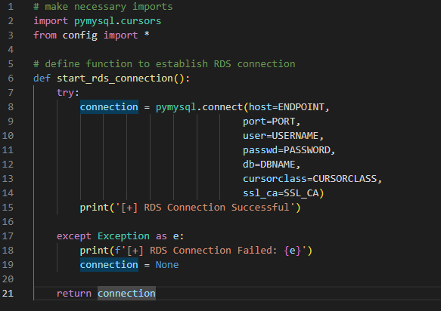
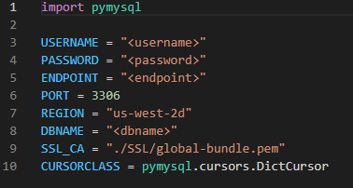

Building the connection
Notes:
Building the RDS connection was very straight forward, shown here in the example on the left.
On the right we have our dummy config file. We tried to demonstrate some amount of security by leaving the actual config off our repository.
And on the bottom right we see the connection response that gets displayed in the terminal.

Slide 10
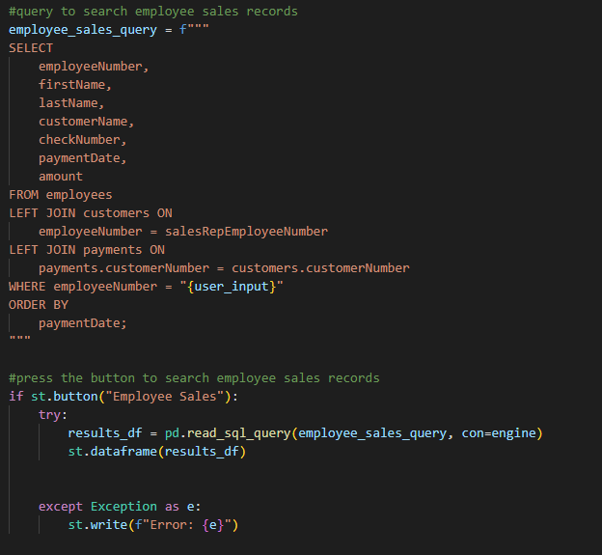
Employee Sales Query
Notes:
Here is an example of the query from before being integrated into the app, with the relevant streamlit code as well.

Slide 11
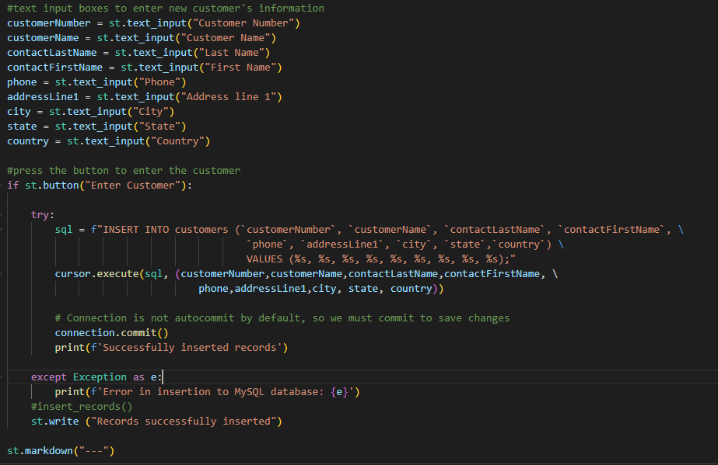
Add New Customer
Notes:
And here is an example of how we coded our add a new customer function.

Slide 12
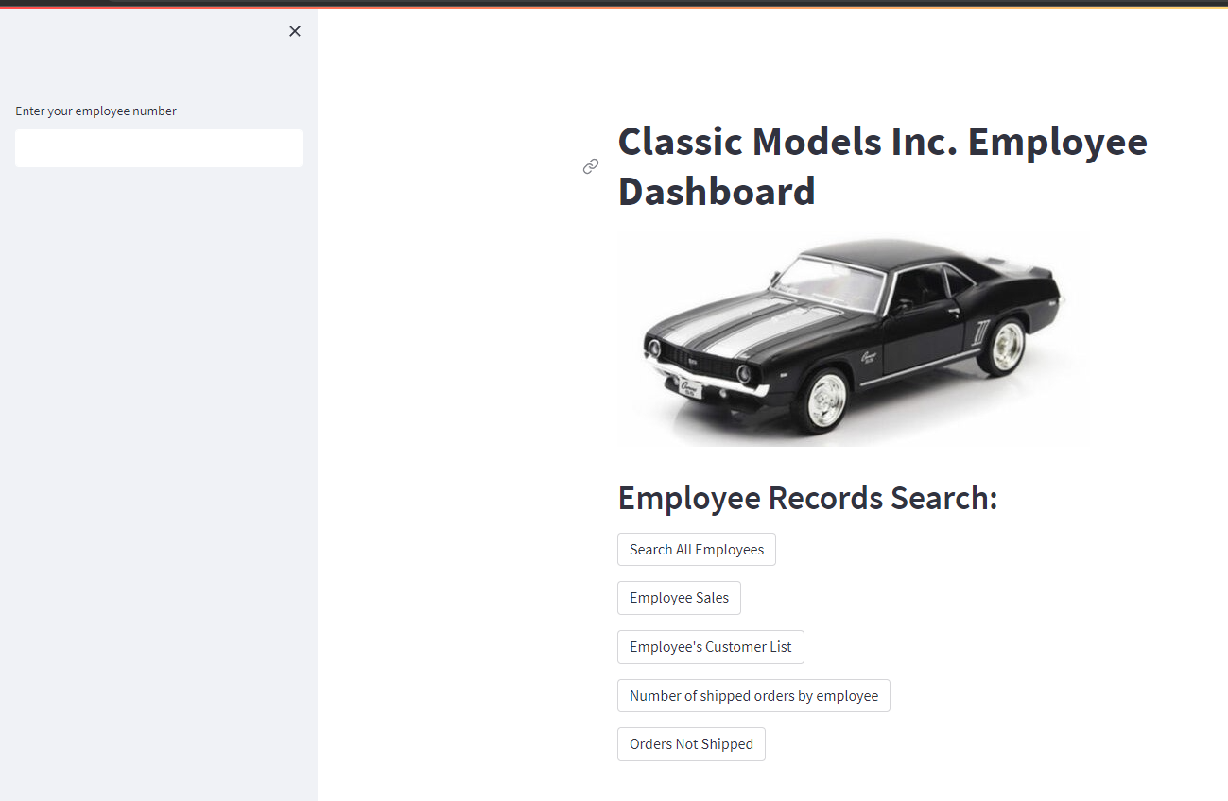
Finished Product
Notes:
Here is our finished product.
Classic Models Inc Employee Dashboard. Complete with picture of a 1969 Camaro diecast model.
The user can input their employee number on the left, and then we have a number of buttons.

Slide 13
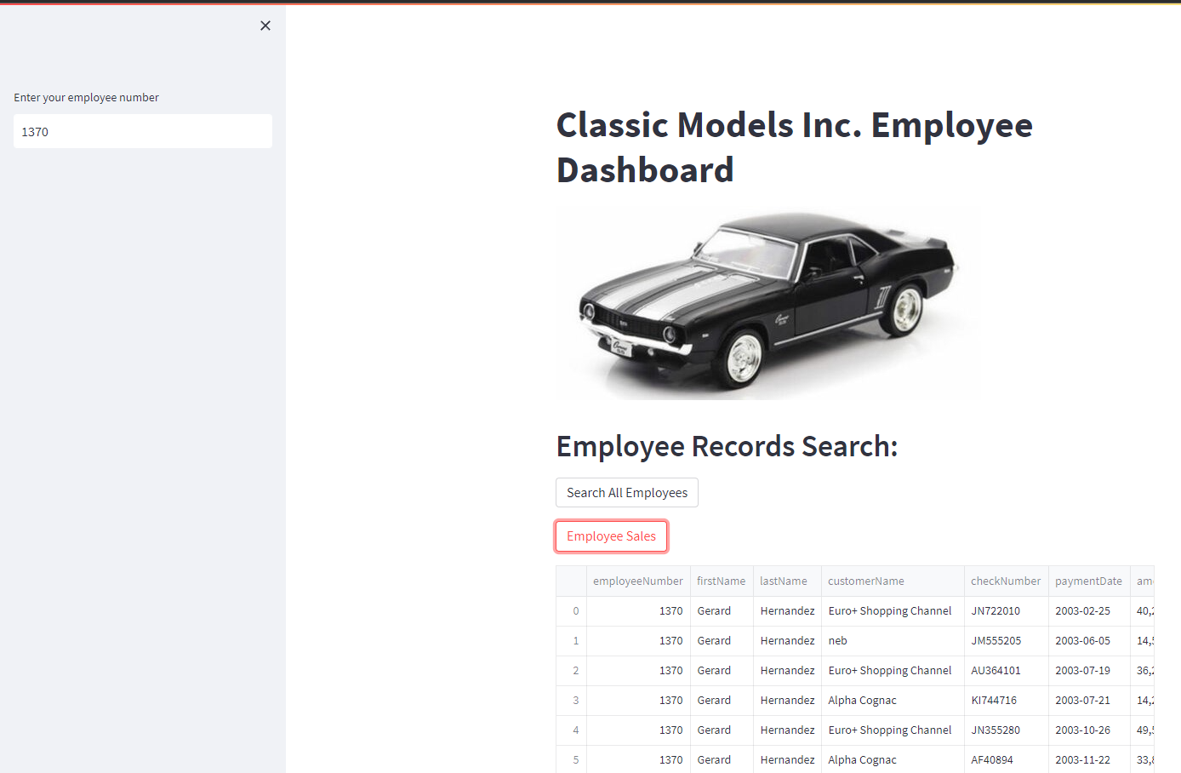
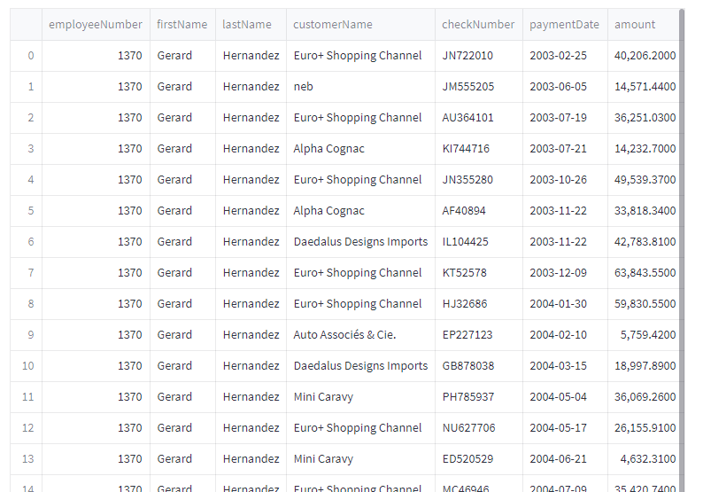
Employee Sales Query
Notes:
And here is how the employee sales query mentioned before functions in the app.

Slide 14

Next Steps
Basic Functionality:
Sales Performance Data
Customer Performance Data
More CRM Capabilities
Order Input
Opportunity Management
Notifications
Sales
Inventory
Notes:
So that leaves us with next steps.
If we are keeping the app lightweight, customer and sales performance data would be an easy include.
Or you could really build the app up and start adding more modern CRM capabilities.
Order input, notification

