Slide 1

Python for Geospatial Big Data and Data Science Using the FASRC
Robert Spang
Visiting Scholar, Centre for Geographic Analysis, Harvard University
Quality and Usability Lab, Technical University of Berlin, Germany
Devika Kakkar and Xiaokang Fu
Centre for Geographic Analysis, Harvard University

Slide 2
Chapter 1
Introduction
Python for Geospatial Big Data and Data Science Using the FASRC

Slide 3
Who we are
Robert Spang
TU Berlin, visiting scholar with the CGA
Devika Kakkar
Data Science Project Manager
Xiaokang Fu
Postdoctoral Fellow

Slide 4
Who are you?
Short round of introduction
Your name and field of research
Why are you here? What do you hope to take away from this workshop? What do you want to use HPC for?
What’s your tech / programming / data science experience level?
Have you worked with the FASRC before?
command line?

Slide 5
Files & Data for the Workshop
Files
Slides, exercises, command cheat sheet, and code files
GitHub: [TODO]
Datasets
All data we’ll work with
Publicly accessible on the cluster: /n/holyscratch01/cga/rspang/workshop_data/
Harvard’s Dataverse: [TODO]

Slide 6
Introduction to Big Data Processing & HPC
Big Data
Volume, Velocity, and Variety (3Vs)
Also: Veracity and Value
Processing
Large dataset → aggregated results → smaller datasets
Faculty of Arts and Sciences Research Cluster
Harvard’s High-Performance Cluster (HPC)
Notes:
Big Data refers to data sets that are so large, varied, or complex that they challenge the capacity and capabilities of conventional data processing systems and techniques. Key attributes often associated with Big Data are the 3Vs:
Volume: The sheer size of the data. This is the most direct attribute, referring to the massive scale of data, often in petabytes or exabytes.
Velocity: The speed at which new data is generated and collected. This could be high-frequency trading data, social media posts, sensor data, etc., that is generated every millisecond of every day.
Variety: Refers to the different types of data. This can include structured data (like databases), unstructured data (like text), and semi-structured data (like XML or JSON).
Over time, additional Vs have been proposed, like Veracity (the reliability of data) and Value (the usefulness of data), but the core challenge of Big Data revolves around storage, querying, analysis, sharing, transfer, visualization, updating, and information privacy.
It's essential to understand that the challenges of Big Data aren't just about size, but also about the infrastructure, tools, and algorithms required to handle, process, and derive insights from the data.
Processing refers to working with the data, mostly in terms of reducing it to an easier to handle subset or results that can then be further processed elsewhere (e.g. on a client side app), or for it to be communicated in texts, websites, or reports. Such analyses usually are about filtration and aggregation.
FASRC is an acronym for the Faculty of Arts and Sciences Research Cluster; Harvard's High-Performance Cluster (HPC) for scientific computation. While the FASRC is open to anyone at Harvard, you might want to use large scale computing infrastructure even after you finish your work here. Cloud Computing comes to mind, so let's briefly distinguish what an HPC offers from what cloud computing is mostly designed for. Both Cloud Computing and HPC are paradigms that leverage multiple computers to achieve specific computational goals, but they cater to different needs and have distinct characteristics.

Slide 7
Differences between a HPC & the Cloud
Purpose
Architecture
Resource Allocation
Usage and Applications
Flexibility
Economic Model
Location
Notes:
Purpose:
Cloud Computing: Primarily aimed at delivering on-demand computing resources over the internet on a pay-as-you-go basis. The primary goal is scalability, flexibility, and resource sharing.
High-Performance Clusters (HPC): Primarily focused on delivering supercomputing capabilities for intensive tasks that require significant computational power, such as simulations, scientific research, and high-frequency trading. The goal is maximum performance for specific, computationally intensive tasks.
Architecture:
Cloud Computing: Often built on distributed systems and virtualized resources. This architecture allows for dynamic resource allocation based on demand.
HPC: Typically built with a cluster of tightly-coupled, high-performance computers that work in parallel to achieve maximum computational throughput. Often, HPC environments use supercomputers or grids to achieve this.
Resource Allocation:
Cloud Computing: Resources like storage, CPU, and memory are typically virtualized, allowing them to be easily scaled up or down based on demand.
HPC: Resources are often meticulously configured and optimized for specific tasks to ensure maximum performance. There's less emphasis on dynamic scalability compared to Cloud environments.
Usage and Applications:
Cloud Computing: Used for a variety of services like Software as a Service (SaaS), Platform as a Service (PaaS), and Infrastructure as a Service (IaaS). Examples include web hosting, data storage services, and application hosting.
HPC: Predominantly used for tasks requiring intensive computational power, like fluid dynamics simulations, genomic research, or large-scale data processing and analysis.
Flexibility:
Cloud Computing: Offers high flexibility with the ability to quickly deploy, scale, or reduce resources. It can cater to a wide range of applications and services.
HPC: Generally, less flexible compared to cloud environments, as they are specifically optimized and configured for dedicated tasks.
Economic Model:
Cloud Computing: Typically employs a pay-as-you-go model, where users pay only for the resources they consume.
HPC: The economic model varies, but these systems often involve substantial upfront investment in hardware and infrastructure.
Location:
Cloud Computing: Resources can be distributed across various locations, often across different data centers and regions globally.
HPC: Systems are typically colocated in a single location or data center, optimizing for low-latency communication between nodes.
In summary, while both Cloud Computing and HPC leverage the power of multiple computers, they serve different needs and have distinct operational and architectural differences. Cloud Computing emphasizes flexibility and scalability, while HPC focuses on achieving maximum computational performance for specific tasks.

Slide 8
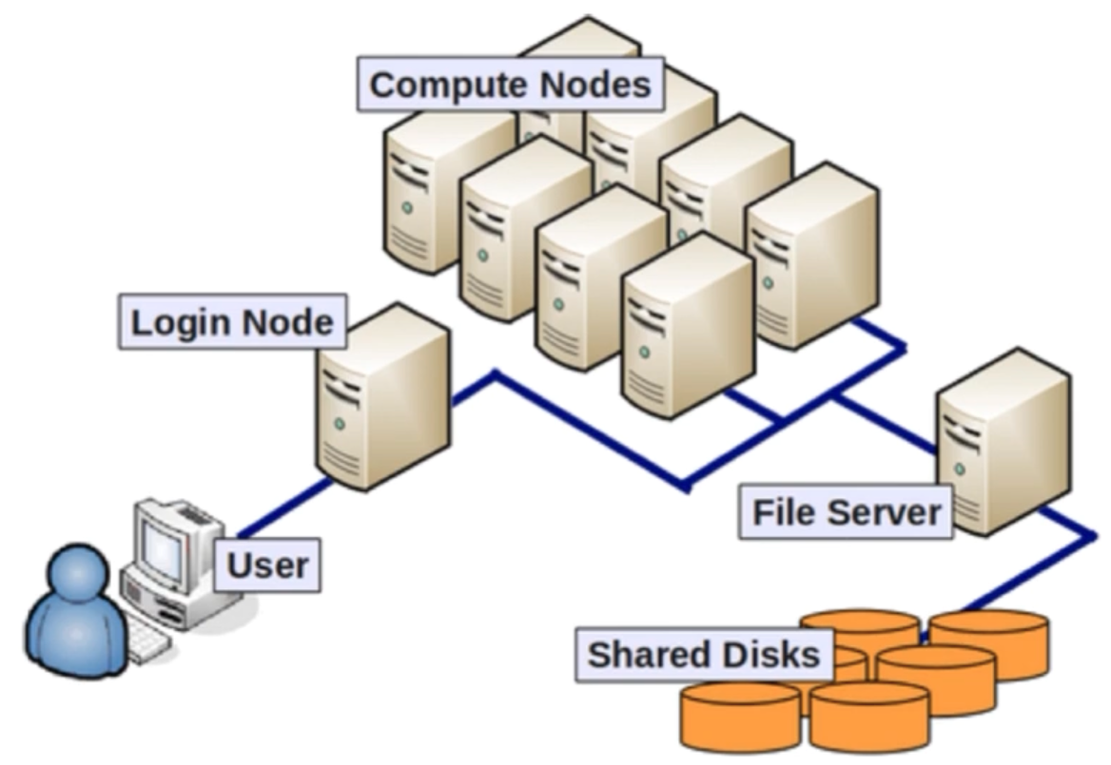
Structure of the FASRC – Structure
Access the cluster through a “login node”
ssh user@login.rc.fas.harvard.edu
From there, connect to compute nodes to run apps
Login nodes are not designed for anything compute/memory intensive
Source: https://www.youtube.com/watch?v=Ay8oR5n-yyQ

Slide 9
Structure of the FASRC – SLURM
SLURM is a job scheduler
Specify the resources needed, get a node allocated
Specify node-type, CPU cores, memory, and runtime
A job terminates after the designated time is up
SLURM ensures users do not exceed resource request
Mostly used to queue jobs, but can also run an interactive session
srun –-pty –p test –mem 100 –t 0-01:00 /bin/bash
Notes:
SLURM – Simple Linux Utility for Resource Management
Command:
srun –pty: Request an interactive session
-p test: the compute node should be of the test-class
--mem 100: request 100MB of memory
-t 0-1:00: request the session for one hour

Slide 10
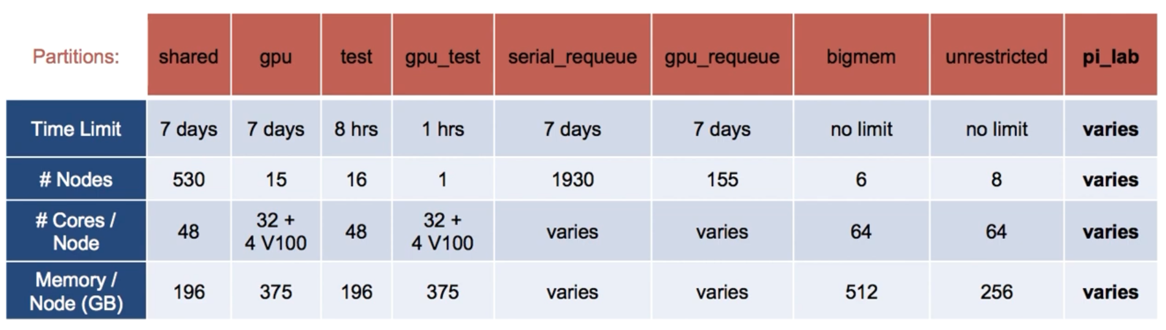
Structure of the FASRC – Partitions
Partitions are the different node-classes
Each class comes with different attributes for different use-cases
Source: https://www.youtube.com/watch?v=Ay8oR5n-yyQ

Slide 11
Structure of the FASRC – Storage
Two sites with different networks
Consider where to up-/download data
Tools e.g. rsync, scp, …
Login-nodes are are suitable for most application (10Gb/s)
For large data sets, make sure to use a cable connection (instead of e.g. EDUROAM WiFi)

Slide 12
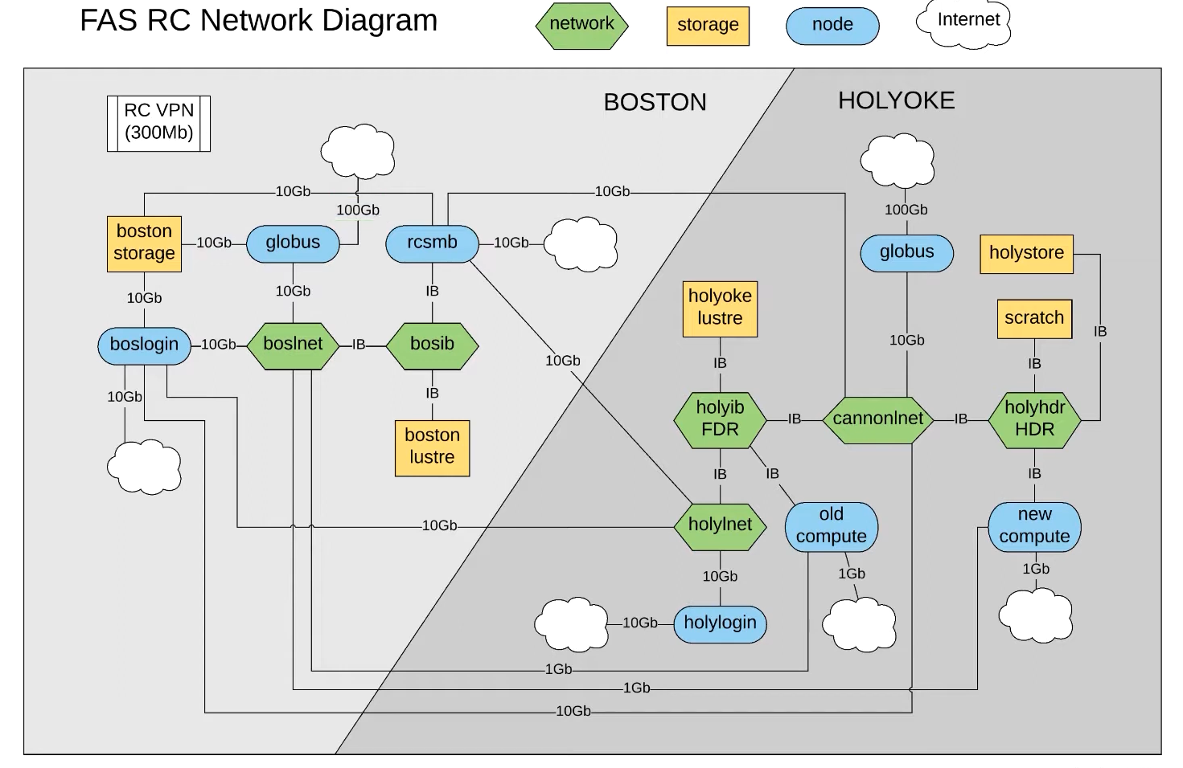
Source: https://www.youtube.com/watch?v=n1I4-4TGVP8

Slide 13
Structure of the FASRC – Storage
Home directory is your primary, private space
100GB
Moderate performance, not suitable for heavy I/O
Local (node) scratch
/scratch
200-300GB/node (shared with all users on the node!)
Lives for job duration
Global scratch
/n/$SCRATCH
2.4PB (shared with everyone on the cluser)
Lives for 90 days
Notes:
Scratches are great to work with, but copy results to your private space after your job is done

Slide 14
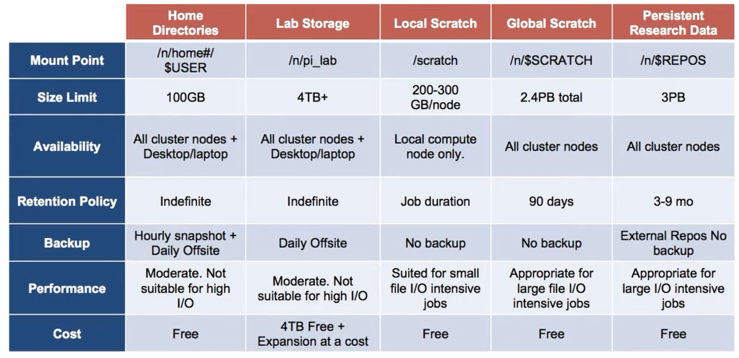
Source: https://www.youtube.com/watch?v=rGH96xVQNyM

Slide 15
Code of Conduct
Shared resources
Expect > 800 users of the RC
Your actions might influence others’ experiences
Request only the resources you need
Login nodes only to login, to submit jobs and to receive data
Consider the right storage space for each task

Slide 16
Exercise I - Web
Login to the FASRC web interface
https://rcood.rc.fas.harvard.edu/
Start an interactive Jupyter notebook session
Default settings are ok
In Jupyter, create a new Python Notebook, name it test.ipynb
Run a simple demo code (e.g. print("Hello World"))

Slide 17
Exercise II - CLI
Login to the cluster via SSH
ssh user@login.rc.fas.harvard.edu
Setup a python environment
Load the Python / mamba module
module load Mambaforge/23.3.1-fasrc01
Create a new mamba environment
mamba create -n workshop python=3.9 --file requirements.txt

Slide 18
Exercise II - CLI
Start an interactive shell on a compute node
srun --pty -p test --mem 1000 -t 0-01:00 /bin/bash
Load Python module & start environment
module load Mambaforge/23.3.1-fasrc01
mamba activate workshop
Run Python code
jupytext --to py test.ipynb # convert .ipynb to .py
python test.py

Slide 19
Chapter 1
Questions & Comments?
5min coffee break

Slide 20
Chapter 2
Basics of Big Data Software Development
Python for Geospatial Big Data and Data Science Using the FASRC

Slide 21
Chapter 2
Questions & Comments?
5min coffee break

Slide 22
Chapter 3
Introduction to the Case Study
Python for Geospatial Big Data and Data Science Using the FASRC

Slide 23
Chapter 3
Questions & Comments?
1h lunch break

Slide 24
Chapter 4
Efficient Programming
Python for Geospatial Big Data and Data Science Using the FASRC

Slide 25
Chapter 4
Questions & Comments?
5min coffee break

Slide 26
Chapter 5
Moving to the FASRC
Python for Geospatial Big Data and Data Science Using the FASRC

Slide 27
Chapter 5
Questions & Comments?
5min coffee break

Slide 28
Chapter 6
Recap, Wrap-up & Outro
Python for Geospatial Big Data and Data Science Using the FASRC

Slide 29
Chapter 6
Questions & Comments?
Thank you for joining us!

