Slide 1
Verification of BBW system

Slide 2
Outline
Build model in UPPAAL
ESAT-ADL is NOT a model checker but UPPAAL is
ESAT-ADL does NOT contain behaviors inside of function prototypes
Verify properties

Slide 3
Build model in UPPAAL
Use one template to represent one function prototype (box)
Two location
One for idle
Another one for running
Use synchronize channels to represent ports and channels (communication between boxes)
Use global variable to represent data

Slide 4
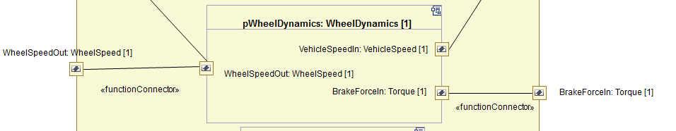
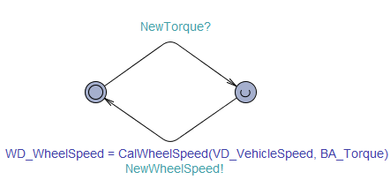
Build model in UPPAAL

Slide 5
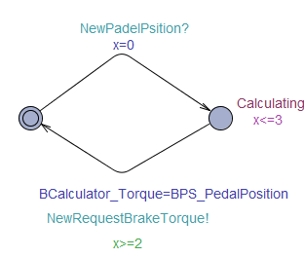
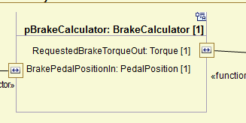
Build model in UPPAAL

Slide 6
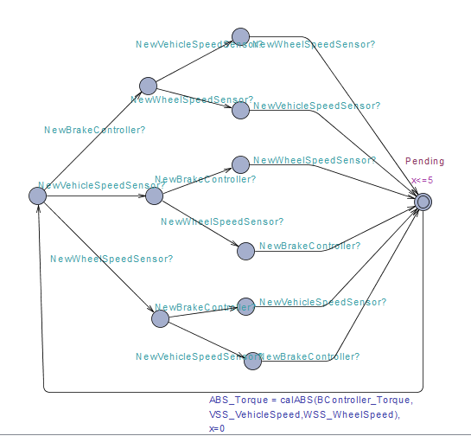
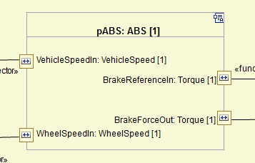
Build model in UPPAAL

Slide 7
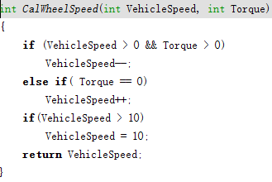
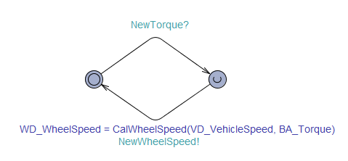
Build model in UPPAAL

Slide 8

Verify Properties
Find Properties based on your model
ABS should finish in 5 time units
Speed should be larger or equal to 0 (not negative )

Slide 9
Verify Properties
Press down pedal, vehicle should stop
Press down pedal, vehicle should stop in 61 time unit

Slide 10
Thank You!

