Slide 1
OAuth 2.0
이민형

Slide 2
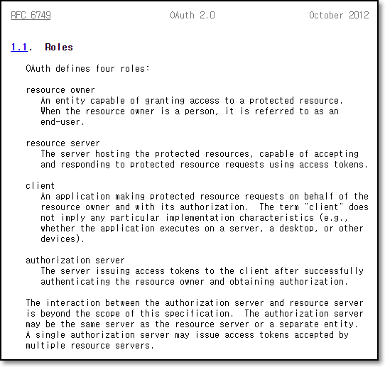

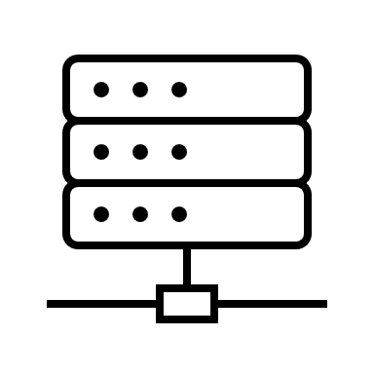








example.com
Client
google.com
Authorization Server
Bob
Resource Owner
Resource Server
A
B
C
D

Slide 3
example.com
Client
register
google.com
Authorization Server
Bob
Resource Owner
Resource Server
A
B
C
D

Slide 4
client_id : 123
client_secret : 456
example.com
Client
client_id : 123
client_secret : 456
google.com
Authorization Server
Bob
Resource Owner
Resource Server
A
B
C
D

Slide 5
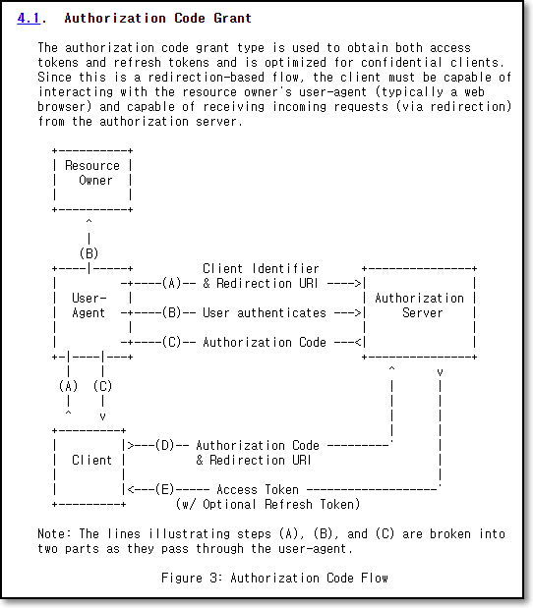
client_id : 123
client_secret : 456
example.com
Client
client_id : 123
client_secret : 456
google.com
Authorization Server
Bob
Resource Owner
Resource Server
A
B
C
D

Slide 6
client_id : 123
client_secret : 456
example.com
Client
request example.com
service
client_id : 123
client_secret : 456
google.com
Authorization Server
Bob
Resource Owner
Resource Server
A
B
C
D

Slide 7

client_id : 123
client_secret : 456
example.com
Client
client_id : 123
client_secret : 456
google.com
Authorization Server
Bob
Resource Owner
Resource Server
A
B
C
D

Slide 8
client_id : 123
client_secret : 456
example.com
Client
client_id : 123
client_secret : 456
redirection_uri : https://www.example.com/callback
google.com
https://www.google.com/oauth?
response_type=code&
client_id=123&
scope=B+C&
redirection_uri=https://www.example.com/callback&
state:xyz
Authorization Endpoint
Authorization Server
Bob
Redirection Endpoint
Resource Owner
Resource Server
A
B
C
D

Slide 9
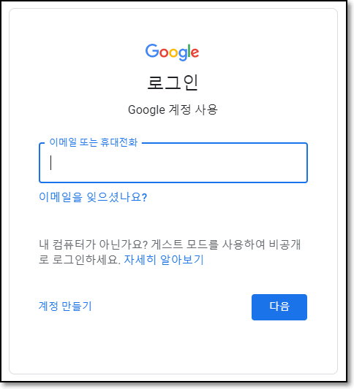
client_id : 123
client_secret : 456
example.com
Client
client_id : 123
client_secret : 456
redirection_uri : https://www.example.com/callback
google.com
Authorization Server
Bob
Resource Owner
Resource Server
A
B
C
D

Slide 10
client_id : 123
client_secret : 456
example.com
Client
client_id : 123
client_secret : 456
redirection_uri : https://www.example.com/callback
Bob: { scope:B+C, code=777 }
google.com
login success
Authorization Server
Bob
Resource Owner
Resource Server
A
B
C
D

Slide 11
client_id : 123
client_secret : 456
example.com
Client
client_id : 123
client_secret : 456
redirection_uri : https://www.example.com/callback
Bob: { scope:B+C, code=777 }
google.com
“Authorization Code Grant”
https://www.example.com/callback?
code=777&state=xyz
Authorization Server
Bob
Resource Owner
Resource Server
A
B
C
D

Slide 12
client_id : 123
client_secret : 456
example.com
Client
client_id : 123
client_secret : 456
redirection_uri : https://www.example.com/callback
Bob: { scope:B+C, code=777 }
“Authorization Code Grant”
https://www.example.com/callback?
code=777&state=xyz
google.com
Authorization Server
Bob
Resource Owner
Resource Server
A
B
C
D

Slide 13
client_id : 123
client_secret : 456
code:777
example.com
Client
client_id : 123
client_secret : 456
redirection_uri : https://www.example.com/callback
Bob: { scope:B+C, code=777 }
google.com
Authorization Server
Bob
Resource Owner
Resource Server
A
B
C
D

Slide 14
client_id : 123
client_secret : 456
code:777
“Access Token Request”
HEADER[“Authorization”] = client_secret(456)
https://www.google.com/token?
grant_type=authorization_code&
redirection_uri=https://www.example.com/callback&
code=777&client_id=123
Token Endpoint
example.com
Client
client_id : 123
client_secret : 456
redirection_uri : https://www.example.com/callback
Bob: { scope:B+C, code=777 }
google.com
Authorization Server
Bob
Resource Owner
Resource Server
A
B
C
D

Slide 15


client_id : 123
client_secret : 456
code:777
example.com
access_token
Client
client_id : 123
client_secret : 456
redirection_uri : https://www.example.com/callback
Bob: { scope:B+C, code=777 }
refresh_token
google.com
Authorization Server
Bob
Resource Owner
Resource Server
A
B
C
D

Slide 16
client_id : 123
client_secret : 456
example.com
Client
client_id : 123
client_secret : 456
redirection_uri : https://www.example.com/callback
Bob: { scope:B+C, }
google.com
Authorization Server
Bob
Resource Owner
Resource Server
A
B
C
D

Slide 17
client_id : 123
client_secret : 456
example.com
Client
client_id : 123
client_secret : 456
redirection_uri : https://www.example.com/callback
Bob: { scope:B+C, }
google.com
B
C
Authorization Server
Bob
Resource Owner
Resource Server
A
B
C
D

Slide 18
client_id : 123
client_secret : 456
example.com
Client
client_id : 123
client_secret : 456
redirection_uri : https://www.example.com/callback
Bob: { scope:B+C, }
기반 서비스 제공
B
C
google.com
Authorization Server
Bob
Resource Owner
Resource Server
A
B
C
D

Slide 19
END

