Slide 1

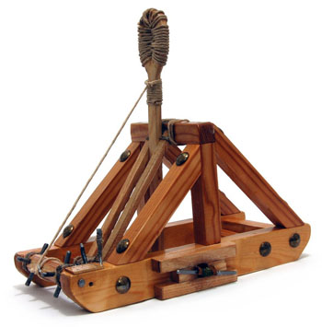
Catapult Python Programming
Session 4

Slide 2
Classes
Sometimes we have a single conceptual “thing” with several parts
For example:
3DPoints might have x y z coordinates
Students might have a name, id, and a list of grades
In many languages (including python) it’s frequent to represent an “aggregate” thing like this with a class

Slide 3
Example
class Employee:
def __init__(self, name, salary):
self.name = name
self.salary = salary
def displayEmployee(self):
print (self.name,self.salary)
Let’s take a look in Raindrops/SteveObjectExample for more details

Slide 4
A simple design for games
Make a class for each kind of thing in the game (e.g. hero, monster, powerup, etc.)
Give each class fields for position and anything else you need (e.g. speed, life points, color, etc.)
Give each class a draw method that draws the thing
Give each class a move method that moves the thing in its distinctive way
Have an overall game that has one list for each class and loops through and calls move on everything then class draw on everything

Slide 5
Activities
We’ll do some live coding of Raindrops
And then you’ll work independently on bouncing balls
If you finish bouncing balls early, make balls that grow larger over time and the “explode” into 2 smaller balls

