Slide 1
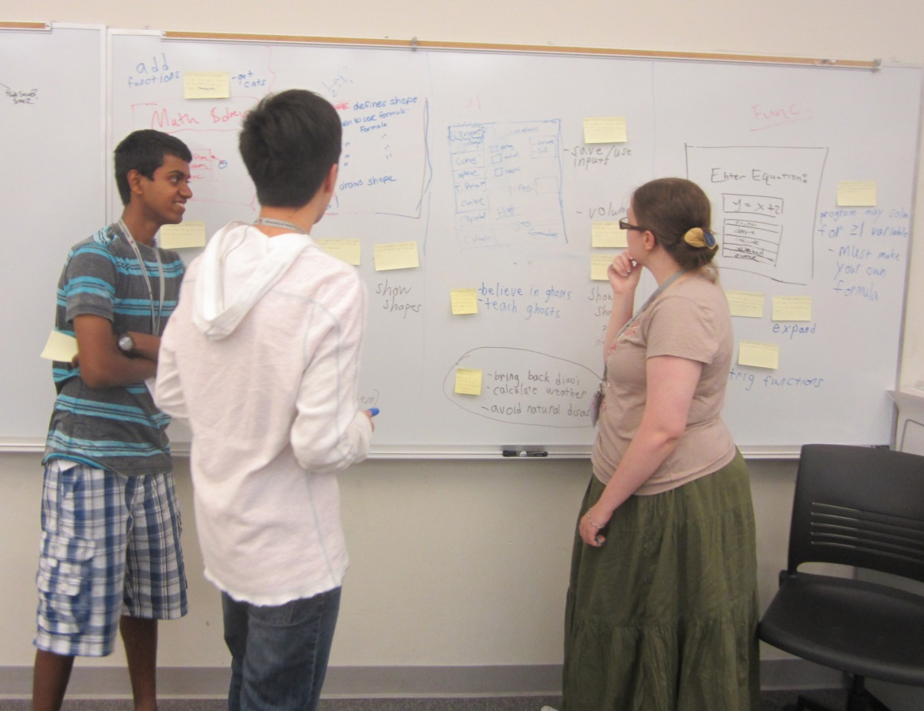
Operation Catapult Python Programming Projects – Day 1
Welcome!
Left – A past Catapult team in action. They built a system to help solve high-school geometry problems. On the way, the team invented a new design tool, seen on the board here, which combines story boards and user stories (the Post-its on the pictures).
1

Slide 2
Turn on machines now
The machines we provide are not to leave the room
Use only for projects and in-class assignments
Who has a laptop they want to use?
We’ll help you install the software that you’ll need throughout our time together
<number>

Slide 3
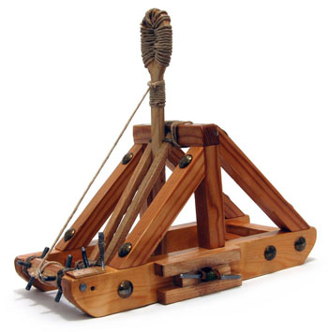
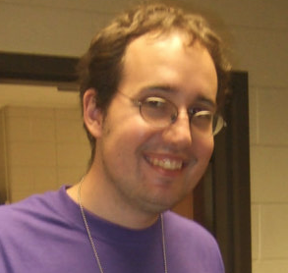
Your teaching team
Dr. Michael Hewner
Associate Professor CSSE
hewner@rose-hulman.edu
Office @ Monech Hall, D215B
Call me Buffalo!
Derek Grayless
Programming Student Assistant
CSSE
grayledw@rose-hulman.edu
Shijun Yu
Programming Student Assistant
CSSE
yus3@rose-hulman.edu
<number>
Notes:
<number>

Slide 4

Get to know each other
We will be in this room for 55+ hours over 2 weeks.
Name, hometown, and something interesting or unusual about yourself.
Why did you pick this project? What you hope to learn/do?
If you have programming experience, tell us about it.
4
Notes:
<number>

Slide 5
Website
Go to: https://rhit-csse.github.io/catapult/
There is a link with instructions about how to install the software – follow it if you’ve brought your own laptop. Myself and the teaching assistants will be going around helping folks as they need it.
If you’re using a provided laptop, poke around for a few minutes and we’ll continue shortly.
4
Notes:
<number>

Slide 6
Overall Plan 1/2
For the first 5 days
Instruction in the classroom aimed at those with no programming background
Work in the lab on programs that we assign
Start thinking about projects and who you would like to work with
6

Slide 7

Overall Plan 2/2
By the end of Friday (or so)
Finalize groups and projects
After that
Work on your group’s project
Get help from your instructors and assistants
There will be occasional “all together” classroom time
7

Slide 8
Lab Etiquette
Project time is time to focus on your project
not the time to surf the web or send email or texts
If a partner begins to get “off track”, a reminder from you may help
We will take breaks
Let’s speak to each other kindly, and only with words that our mothers would not be embarrassed to hear us say
Be very careful with drink in the labs
If you need to use the bathroom, get a drink of water, etc., it is not necessary to ask first. But if you are gone longer please sign out.
Notes:
<number>

Slide 9
What if you already know something (or lots!) about programming?
You’ll still probably learn some new and important things in the next couple of days
If you find a concept or assignment to be easy, please put that to good use by patiently helping others around you to understand it
Also feel free to go above and beyond and add features to the projects. I can also provide suggestions at a variety of difficulty levels.
Notes:
<number>

Slide 10


Catapult Python Programming
Notes:
<number>

Slide 11
Agenda
Python’s interactive console
Basic computations
Data types
Variables
Our first “game” - Moving Smile, narrated by me
Notes:
<number>

Slide 12
Python Console
The python console is a great place to try out stuff before you code it “formally”
Please play along with me as I take you through the basics and feel free to try stuff out.
If you get confused or your system is not doing what mine does, please get a assistant to help.

Slide 13
Python Basics
1) numbers and arithmetic:
8 / 3 8 // 3 8 % 3
2) variables and assignment:
width = 5 width = 2 * height width = width + 2
4) Use a function
abs(-3) math.sin(2.18)
5) Strings of characters:
my_name = 'Buffalo' you = "your" + "mother's child"
Pick out parts: you[5] you[5:13] you[-5]
Notes:
<number>

Slide 14
Variables
my_total = 17
...
my_total = my_total + 3
print(my_total + 3); # prints 23
print(my_total); # prints 20
Useful to accumulate values
Or just clarify what some particular value means
Use descriptive names with _ in between words

Slide 15
Some Python data types - numeric
int: whole numbers
Arbitrarily large whole numbers.
6 44389654908498902
float
Real numbers (there can be roundoff errors)
4.72 1.7e4 1.0/3.0
conversion
int (14.5 / 6.2)
float(a + 7)
Complex (probably not used in Catapult)
3.7 + 2.8j
Notes:
<number>

Slide 16
Operations on numeric types
x + y
x – y
x * y
x / y
x // y integer division
x % y remainder (modulo)
x**y
-x
abs(x)
x == y True if x equals y, False otherwise.
x != y are x and y unequal?
x < y
x <= y
x > y
x >= y
Other numeric operations, such as sin, cos, tan, sqrt, log, can be imported from the math module.
Notes:
<number>

Slide 17
More Python data types 1/2
Boolean
values: True False
>>> 3 < 5 True
String – a sequence of characters.
Examples: ″abc ″ ′abc ′ ′a\nc′ ′a\\c′
print (abc) vs print (′abc′)
Notes:
<number>

Slide 18
More Python data types 2/2
String concatenation: >>> s = "abc" >>> s + "def" 'abcdef' >>> 'abc' 'def' 'abcdef' >>> s 'def' SyntaxError: invalid syntax

Slide 19
Live Coding: Moving Smile
I’m going to ask you to code along with me, and I’ll explain things as I go
If you get stuck – immediately raise your hand and an assistant will be happy to help you
We’re going to see tons of features I’m going to explain on subsequent days, so try to the recall the gist of what the various parts do – and don’t get hung up on the details

Slide 20
"I have no idea what you are talking about!"
I am serious about this. Say it, don't just think it!
If I go too fast, or for any other reason you are not getting something, don’t let me go on.
Stop me, ask a question! I don't want anyone to get lost.
During "all together" demo times, if you are stuck, raise your hand and look at us; one of us will come to help you.
Or perhaps someone near you can help.
Notes:
<number>

Slide 21
Live Coding: Dog Bark
Images, text, and sounds

Slide 22
Expanding Moving Smile
Add sounds, text, images, new features

