Slide 1

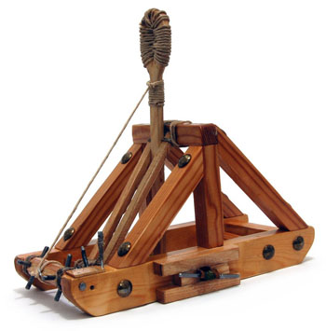
Computer Science Project Intro
Dr. Hewner
But as always call me Buffalo
Notes:
1

Slide 2
Designing Electric Devices in General
Semiconductor Physics
Chip Fabrication
Microprocessor Design
Assembly Language
Compilers
Programming Language Design
Software Engineering
Databases
Computer Graphics
Algorithms/Data Structures
Artificial Intelligence/Computer Vision
Cryptography
Theory of Computation
Really mathy stuff...
Computer Engineering
Computer Science
Discrete Math
Notes:
2

Slide 3
What Programming Language?
My latest languages:
C#
Java
Python
x86 assembly
Rust
*Erlang
*Smalltalk
*Haskell
*Prolog
C
Java
Javascript
Lisp
Ruby

Slide 4
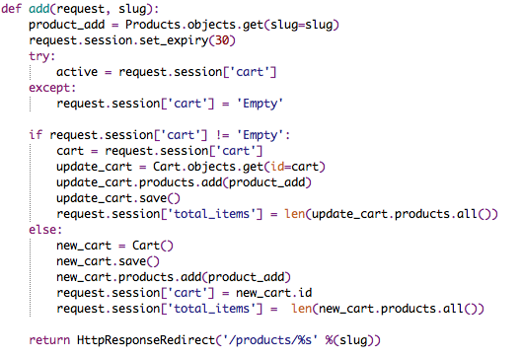
We'll teach you python
General purpose, easy-to-learn programming language

Slide 5
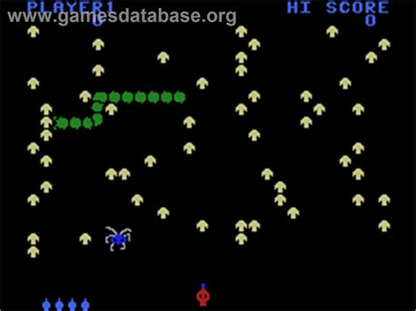
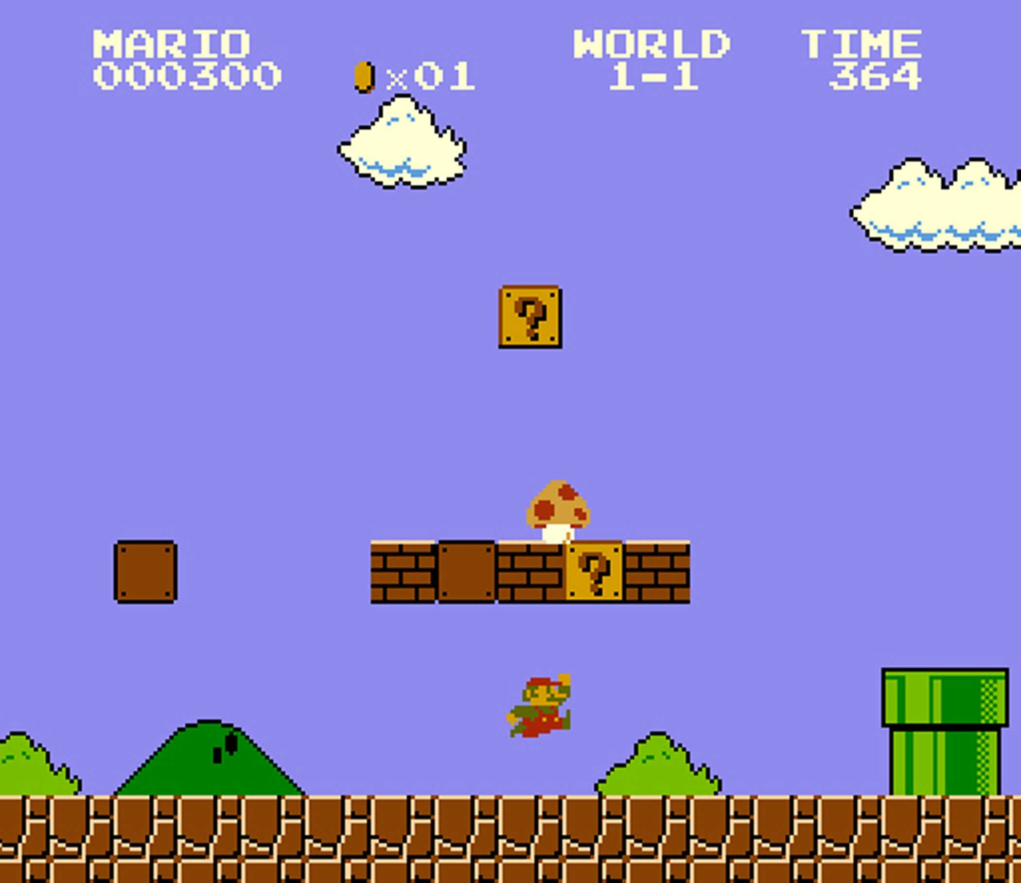
You'll design and make your own game. Most naturally classic arcade-type games:
But also puzzle games, menu RPGs etc are possible...we'll decide exactly what the individual groups a doing as we go.

Slide 6
No experience necessary!
We'll start from the absolute basics
And go into more advanced topics as there's interest and time
At the end, everybody will have something to play that can be a jumping off point into future explorations at home....

