Slide 1

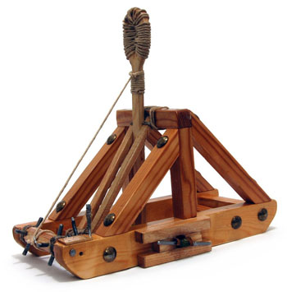
Catapult Python Programming
Session 2

Slide 2
Functions
def triangle_area(base, altitude):
return base * altitude / 2
my_area1 = triangle_area(5, 8)
my_area2 = triangle_area(4, 3)

Slide 3
Moodle surveys
Do them

Slide 4
Functions in Python
Functions help us when we need to repeat certain actions (like the PB&J example from the previous slide)
A function will always have:
  A name
  Inputs (called parameters or arguments)
  Output (called a return value)
Note that while there may be “nothing” in the inputs or output this still has to be indicated by the programmer.
In the case where no return is specified Python will return a special value of None by default.

Slide 5
Structure of a Function
General form:
def functionName(arguments):
statements
return expression (common but optional)
NB: blocks of code are indicated by indentation in Python. Indentation can include spaces, so be careful!
Examples:
def printHello():
print(“Hello”)
No arguments, no return
def printThis(this):
print(this)
One argument, no return
def slope(x1, y1, x2, y2):
return (y2-y1)/(x2-x1)
4 arguments, return

Slide 6
A little more live coding
Interacting with the Python shell
vs
Writing a program in a file
  3 vs, print (3).
How do we call a function?
How do we store the returns of a function?

Slide 7

Practice
In python interactive mode:
1. Write a function to compute the area of a trapezoid (we’ll do this one together)
2. Define and test a function that takes the x and y coordinates of a point and prints its distance from (0,0) (hint: val**0.5 is square root)

Slide 8
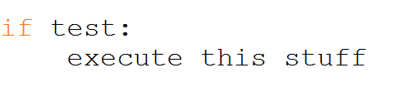
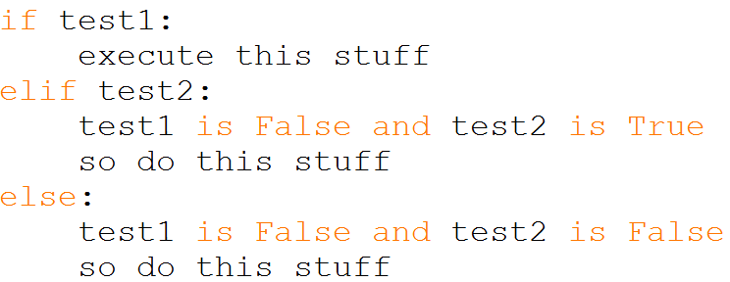
Conditional Statements
We can change the behavior of the program based off the value of a logical test. Commonly this is done with if statements although you will see other ways we can change things soon.
An if statement will look like this—
You can also add other statements for behaviors that happen when the first test is not true--
Exercise to do together:
A function that takes a score as input and returns a letter grade, assuming a 90-80-70- … scale

Slide 9
Practice
Go here
https://codingbat.com/python/Warmup-1
And in groups of 2 solve at least 3 problems

Slide 10
Work on ClickInTheCircle
Groups of 2
I’m going to ask you to code this one on your own, but please ask as you get stuck.
Borrow stuff from your previous programs as you need.
Don’t try to do it all at once – run and test each individual step as you go

