Slide 1
Operation Catapult
Python Programming Projects– Day 1
Welcome!
If you have little/no programming experience, sit in one of front 6 tables, 1 per computer
If you have lots of experience, sit in the back 6 tables, 2 per computer

Slide 2
Operation Catapult
Python Programming Projects– Day 1
Matt Boutell - Assistant Professor
  Office: Moench F203 (east end of CSSE hallway around corner; moving soon to F224 on west side)
  Phone extension: 8534 (812-877-8534)
  email: boutell@rose-hulman.edu
Michael Boland – Programming student assistant.
  Software Engineering major
  e-mail: bolandmg@rose-hulman.edu
  Here during most group project times

Slide 3
Introductions – you first
Name, hometown, and something interesting or unusual about yourself.
Why did you pick this project? What you hope to learn/do?
Programming students:
  Programming experience?

Slide 4
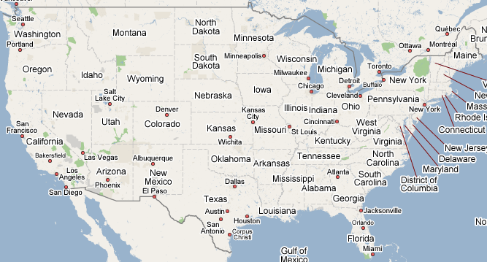
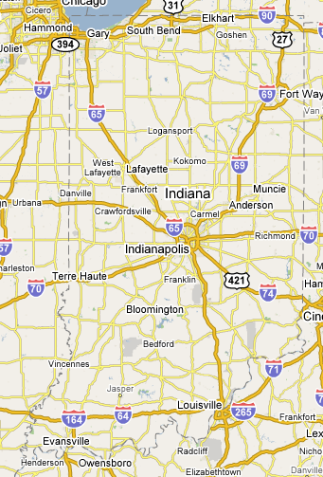
Where are we from?

Slide 5
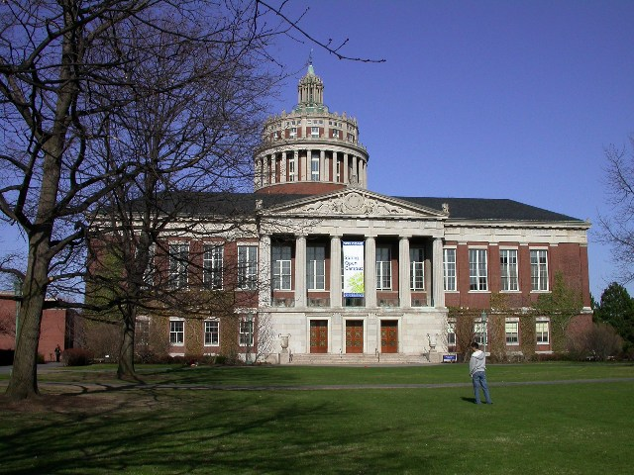
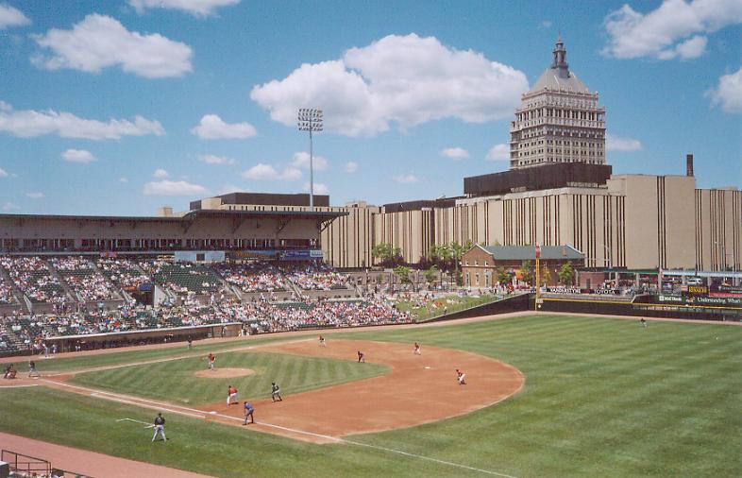
Templeton → WPI → UMass@Amherst →
Norton High / Stonehill Coll.→ U. Rochester/Kodak → Rose!

Slide 6
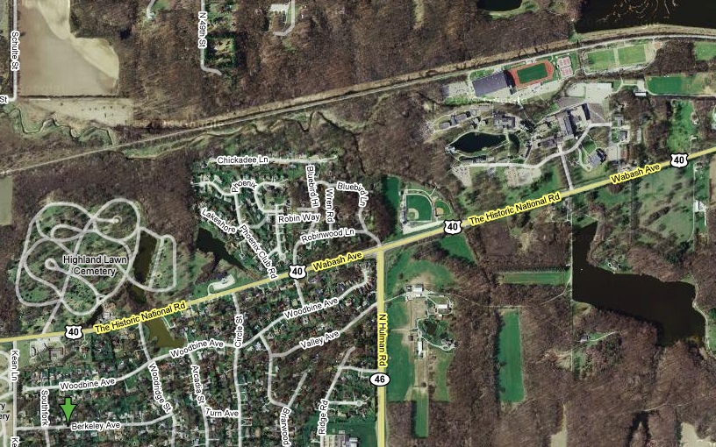
My background
Home

Slide 7
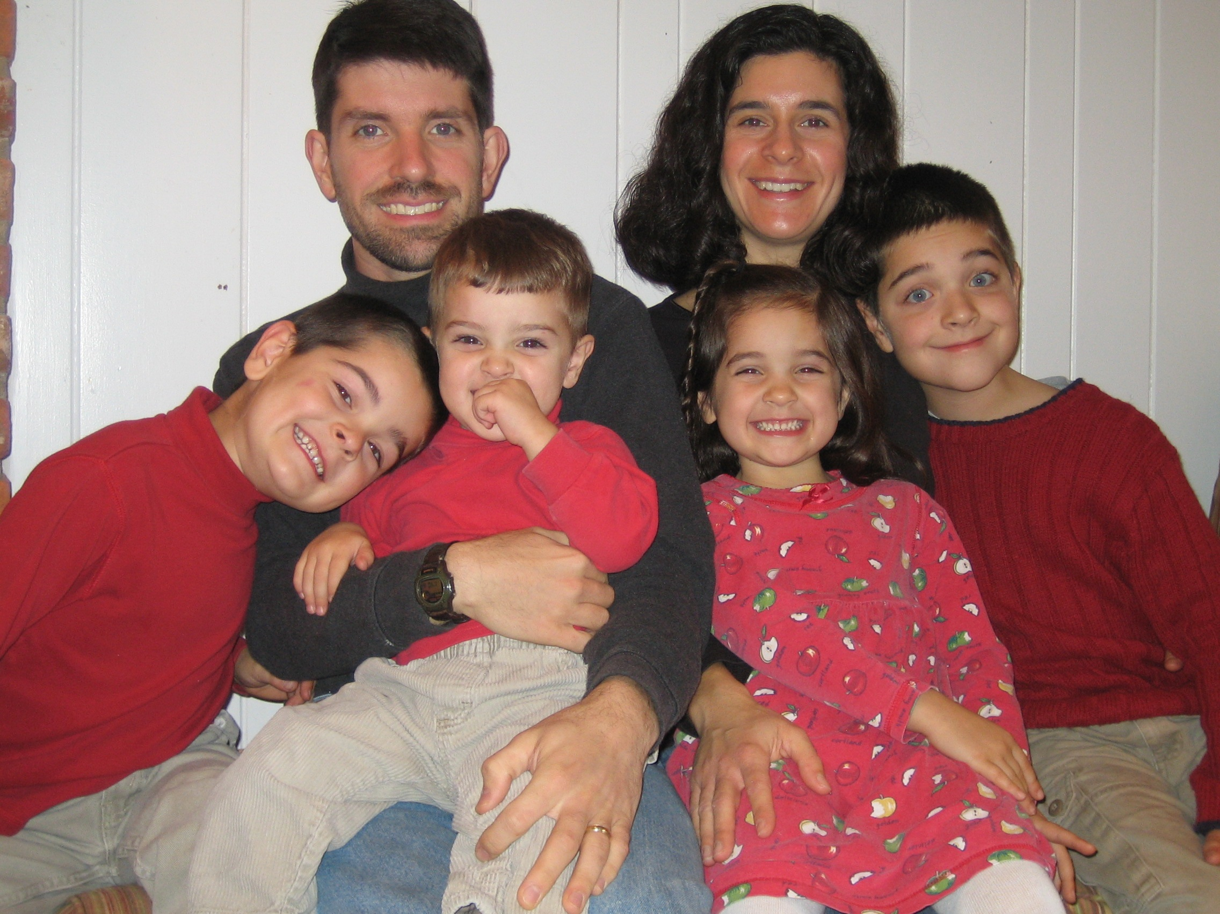

Slide 8
Current activities
Homeschooling
Reading The Irresistible Revolution
Gardening
Mosaic (http://mymosaic.org)

Slide 9
Administrative stuff
Michael will demonstrate
  AFS
  The under-construction website:
  http://www.rose-hulman.edu/class/csse/catapult
Notes:
Time out with the other project students

Slide 10
Class Discussion-Time Etiquette
Goal: learn Python quickly, so can get to projects
Do ask me questions
(including “are you sure that what you said is right?” questions) at any time.
Do interact with your neighbors about the things we are discussing, exercises you are doing.
Don’t do things that will distract us from the learning process (such as …)
  IM, email, …
  using the speakers on your computer or other audio device.

Slide 11
Lab Etiquette
The lab is near the offices of many professors, so let’s not be so noisy that they can’t get their work done.
My office is in F-203, around corner.
    If I am not in the lab with you, I will very likely be there.
      Or helping my other project teams (if any).
      Or in F224, my new office
    Feel free to find me, in that case.

Slide 12
Lab Etiquette (continued)
The lab during project time is not the place for you to browse the internet for things unrelated to Python programming, to send unrelated email or instant messages, listen to your Ipod, etc.
  You are welcome to do these things at other times, in our lab, in the Public computer lab (in Logan Library) or the Dynamics lab (O-203).
  If one of your partners begins to get “off track”, a reminder from you may help.
Let’s speak to each other kindly, and only with words that your mother (and my mother) would not be embarrassed to hear us say.
If you need to use the bathroom, get a drink of water, etc., it is not necessary to ask first.

Slide 13
Format
Today
  More talk and less hands-on computer activities.
After today
  More hands-on time and less talk.

Slide 14
Computer programming
Python Programming
A lot of fun. You should have a great sense of accomplishment by the end.
A lot of learning. About programming, about Python, about using pre-defined packages to handle many of the details.
  I expect to learn a lot also.
A lot of work. Some of the things you will accomplish will not come easily. But you’ll feel great when you have done them!
  Programming projects have been some of the most intense in Catapult.

Slide 15
Sometimes you may feel like you are in the dark for a while
But when the light comes on, it will be bright and beautiful!
Sometimes you will need help in finding a path through the dark.
  Don’t be afraid
  to ask …
    Me
    Michael
    other students

Slide 16
Learning and Doing
The first 4-5 days we’ll focus on learning about Python and its various libraries.
Repeat
  There will be a little bit of discussion time, followed by time for you to learn by doing.
  Until you have mastered the basic concepts.
Everyone will be doing the same small programs. Students with more programming experience may want to add extra features or they may want to work ahead.
After that, groups will choose and work on their specific projects.

Slide 17
How to fail at learning Python and OOP!
Don’t stay on-task. Browse the internet or do instant messaging instead.
Don't bother learning the terminology.
Be satisfied with (only) getting the assignments done, even if you don’t understand them.
Let someone else take over your keyboard and move too fast for you. She knows more than you do about programming, and you wouldn’t want to slow her down!
Even if you are totally confused, don't ask for help. That might show your classmates or professor what you don't know!

Slide 18
How to fail at this project (continued)
When you don’t understand something, believe that you’re the only one who is so stupid, so don’t ask any questions!
When you don’t understand something, assume that it will come to you eventually; move on (and wait for your lack of understanding to trip you up later).
Don’t bother Dr. B., Michael, or fellow-Catapulters with your problems and questions; you can probably figure things out yourself

Slide 19
Ask questions!
Participate!
Get involved!
Don’t sit passively and let things roll by you.
They may roll over you!

Slide 20
What if you already know something (or lots!) about programming?
You’ll still probably learn some new and important things in the next couple of days.
If you find a concept or assignment to be easy, please put that to good use by patiently helping others around you to understand it.
And think of “extra” features to add to the assigned programs.

Slide 21
Algorithms, Languages, Translators
What is an algorithm?
How do we communicate an algorithm to another person?
  Depends on the person. Has to be in a language they can understand.
  Baking a cake. Telling my mother vs telling my 3-year old son.

Slide 22
Language Barriers
What if we want to have Pierre perform an algorithm for us, but we do not know his language?
  We could hire a translator (a.k.a. compiler) to translate all of the instructions into French, and give them to Pierre.
  We could instead hire an interpreter. We read the next instruction to be done, the interpreter translates it into French, and Pierre does it.
  In the first case, it takes longer before Pierre can get started; in the second case, execution of each instruction is a little bit slower.
  Python is more like that interpreter.

Slide 23
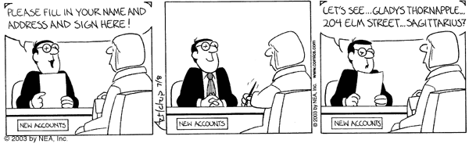
Understanding terminology and using it properly can enhance communication
Some important terms you will learn:
  function
  argument
  module
  string
  list
  class
  method

Slide 24
Python
Invented in 1990 by Guido van Rossum.
Named for “Monty Python’s Flying Circus”
Now has a huge worldwide following.
“Official” web site is python.org .
Makes it simple to do simple things.
Has the power to do complex things.
I think you will like it!

Slide 25
The Big Secret!
We are using Python at Rose for the first time this Fall
…so I don’t know everything about Python or its class libraries.
  There are dozens of packages, containing hundreds of classes with thousands of methods.
But:
  I am enjoying learning Python and will enjoy working with you as well.
  We used it successfully last session
  The projects took 30-50% less time than they did with Java

Slide 26
Schedule
For the first few days
  Instruction in the classroom.
    Aimed at those with no programming background.
  Work in the lab on programs that I assign.
Monday (or so)
  Finalize groups and projects.
After that (probably beginning Tuesday morning).
  Work on your group’s project.
  Get help from Michael and me as needed.
  There will be occasional “all together” classroom time when there is something that I think most groups need to know about

Slide 27
I have no idea what you are talking about, Dr. B.!
If I go to fast, or for any other reason you are not getting it, don’t let me go on.
Stop me, ask a question!
During demo times, if you are stuck, raise your hand and look at Michael; he will come to help you.

Slide 28
Python Demo
Open up the IDLE program from your desktop and follow along.
Ask questions as they come up.
  If your questions are “advanced programming” questions, I may defer the answer so as not to confuse the beginning programmers.
Help
Demo of some Python features.
  Enjoy the ride.
  We will do more detail on many of these features tomorrow.
  I will post most everything I show you to the website

