Slide 1
Operation Catapult
Python Programming Projects– Day 1
Welcome!

Slide 2
Turn on tablet PCs now
They are not to leave the room
Username:
Password:
Ignore the DropBox message for today.
We will need to double up on tablets for today.
Who has a laptop they’d be willing to use in the lab?
  Ideally, about 10 of you can do so
  Please bring it tomorrow
  We’ll help you install the software

Slide 3
Multitasking for a few minutes
Answer a quick survey on Moodle
  www.rose-hulman.edu/moodle
  Catapult Brief Survey
Whatever you want to do

Slide 4
Operation Catapult
Python Programming Projects– Day 1
Claude Anderson - Professor
  Office: F210 (east end of CSSE hallway)
  Phone extension: 8331 (812-877-8331)
  email: anderson@rose-hulman.edu
Trevor Burch and Austin Fahsl– Programming student assistanta.
  Sophomore CS majors
  burchtm@rose-hulman.edu
  fahslaj@rose-hulman.edu
  Here during most group project times

Slide 5
Format
Today.
  More talk and less hands-on computer activities.
After today
  More hands-on time and less talk.

Slide 6
Introductions
Get to know each other. We’ll be in this room for ~60 hours in the next 2.5 weeks.
Tell us
  Name, hometown, and something interesting or unusual about yourself
  These are a few of my favorite things …
  Why did you pick this project?
  What you hope to learn/do?
  If you have any programming experience, tell us about it.

Slide 7
Instructor Professional Background
Formal Education:
  BS Caltech, Mathematics 1975
  Ph.D. Illinois, Mathematics 1981
  MS Indiana, Computer Science 1987
Teaching:
  TA at Illinois, Indiana 1975-1981, 1986-87
  Wilkes College (now Wilkes University) 1981-88
  RHIT 1988 – 2022?
Major Consulting Gigs:
  Pennsylvania Funeral Directors Assn 1983-88
  Navistar International 1994-95
  Beckman Coulter 1996-98
  ANGEL Learning 2005-2008
  Operation Catapult History:
  First taught Catapult in 1999; this is my 13th session
  Introduced Python in 2007
Notes:
I knew within a month at Rose that this is where I wanted to spend the rest of my career.
Why am I likely to graduate in 2022? (Hat’s proba bly when Bekah will graduate) Maybe I should stick around until 2023 so I can have 35 years!
Tell them the 7 – 14- 28- 56 story (July-October, 2009)
What to call me?
I taught ToC 3 times. Once at Wilkes University, once to grad students at IU, and once at Rose.
“Theory of Computation teacher.” Now that’s a name I haven’t heard for a long time.

Slide 8
Instructor Personal Background
Married 37 years
9 children, ages 12-33
Two of our children graduated from Rose
Five grandsons, ages 1-7
I live really close to campus
  The house immediately west of the Rose soccer field
The most important thing in my life
  Loved/forgiven by Jesus Christ
  Not because I deserve it
  Relationship, not religion
  Other things I enjoy
  Reading (history, especially), volleyball, disk golf (there is a very nice course in Terre Haute), playing with my kids, vegetable gardening, music

Slide 9

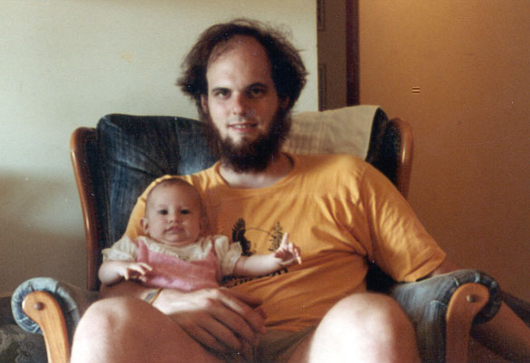
A couple of pictures

Slide 10
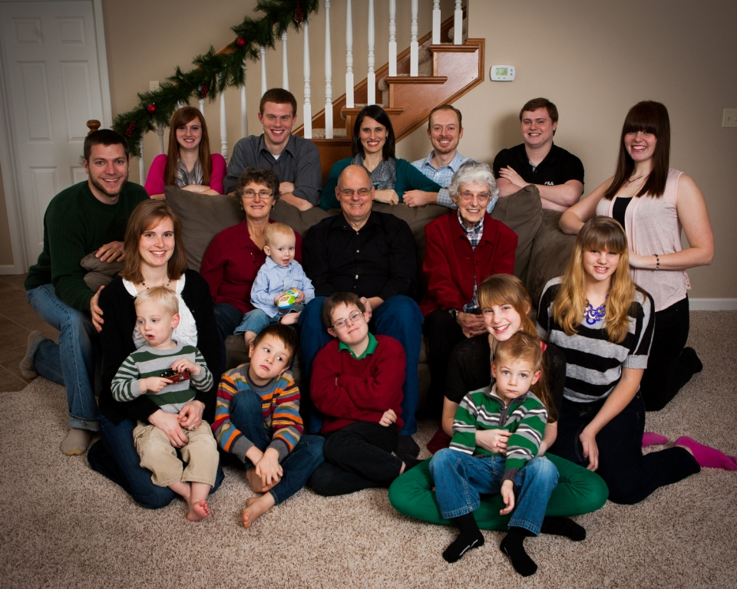

Slide 11
Schedule
For the first few days
  Instruction in the classroom, aimed mostly at those with no programming background.
  Work in the lab on programs that I assign.
  Start thinking about projects.
Friday (or so)
  Determine groups and projects.
After that
  Work on your group’s project.
    Get help from Nathan and me as needed.
    There may still be occasional “all together” classroom time as needed.

Slide 12
Other preliminaries
What to call Claude &
What to call Trevor and Austin
  See “Other preliminaries”
Feel free to interrupt and ask questions at any time.
Who this is aimed at
  But if you know more …
Not intended to go over your head
  Slow me down if you are lost
  Ask questions if you don't "get it":
  Get help from Nathan or me if something does not work for you

Slide 13
Class Discussion-Time Etiquette
Goal: learn Python basics, so we can get to actual projects
Do ask questions at any time
  No question is too dumb
  (except the one you don’t ask)
Do interact with your neighbors about the things we are discussing, exercises you are doing, etc.
Don’t do things that will distract others from the learning process. (such as …)

Slide 14
Lab Etiquette
The lab is near the offices of other CSSE professors, so let’s not be so noisy that they can’t get their work done.

Slide 15
Lab Etiquette (continued)
The lab during project time is not the place for you to browse the internet for things unrelated to Python programming, to send unrelated email or instant messages, listen to your Ipod, etc.
  You are welcome to do these things at other times, in this lab or in the Public computer lab (in Logan Library).
  If one of your partners begins to get "off track", a reminder from you may help.
Let’s speak to each other kindly, and only with words that your mother (and my wife's mother) would not be embarrassed to hear us say.
If you need to use the bathroom, get a drink of water, etc., it is not necessary to ask first.
If your program uses sound, please use headphones, not speakers, to test it.

Slide 16
Computer Programming
Python Programming
A lot of fun. You should have a great sense of accomplishment by the end.
A lot of learning. About programming, about Python, about using pre-defined packages to handle many of the details.
  I expect to learn a lot also.
A lot of work. Some of the things you will accomplish will not come easily. But you’ll feel great when you have done them!
IMHO, in terms of learning and sense of accomplishment, most other Catapult projects are wimpy when compared to the programming projects.

Slide 17
Learning and Doing
For about a week we’ll focus on learning about Python and its various libraries.
Repeat
  There will be a little bit of discussion time, followed by time for you to learn by doing.
  Until you have mastered the basic concepts.
Everyone will be doing the same small programs. Students with more programming experience may want to add extra features or they may want to work ahead.
After that, groups will choose and work on their specific projects.

Slide 18
How to fail at learning Python and OOP!
Don’t stay on-task. Browse the internet or do instant messaging instead.
Don't bother learning the terminology.
Be satisfied with (only) getting the assignments working, even if you don’t understand them.
Let someone else take over your keyboard and move too fast for you. She knows more than you do about programming, and you wouldn’t want to slow her down!
Even if you are totally confused, don't ask for help. That might show your classmates or professor what you don't know!

Slide 19
How to fail at this project (continued)
When you don’t understand something, believe that you’re the only one who is so stupid, so don’t ask any questions
When you don’t understand something, assume that it will come to you eventually; move on to the next thing (and wait for your lack of understanding to trip you up later)
Don’t bother Claude, Austin, Trevor, or fellow-Catapulters with your problems and questions; you can probably figure things out yourself
  (in about 3 months!)

Slide 20
Ask questions!
Participate!
Get involved!
Don’t sit passively and let things roll by you.
They may roll over you!

Slide 21
What if you already know something (or even a lot) about programming?
You’ll still probably learn some new and important things in the next few days.
If you find a concept or assignment to be easy, please put that to good use by patiently helping others around you to understand it.
Feel free to think of “extra” features to add to the assigned programs.

Slide 22
Working with a partner on some of this week’s assignments
Remember that the main goal is for both of you to learn, not just to complete the assignment.
Discuss what you are doing, to make sure that both of you understand it.
Let the person with the least computer background do the “driving” most of the time
  This makes it easier for that person to “put on the brakes” when he/she does not understand something.

Slide 23
Sometimes you may feel like you are in the dark for a while
But when the light comes on, it will be bright and beautiful!
Sometimes you will need help in finding a path through the dark.
  Don’t be afraid
  to ask …

Slide 24
Working with a partner
For some learning assignments this week, you will work with another person (preferably someone whose programming experience is similar to yours).
Take turns "driving" the computer. If one of you spends more time in control, it should be the person who feels least comfortable.
Each of you should be responsible for making sure that both you and your partner understand what’s going on.
  Ask each other "understanding" questions.
  If neither of you is sure of the answer, ask someone else.

Slide 25
Algorithms, Languages, Translators
What is an algorithm?
How do we communicate an algorithm to another person?
  Depends on the person. Has to be in a language they can understand.
  Baking a cake. Telling my wife vs telling my 7-year-old grandson.

Slide 26
Language Barriers
What if we want to have Pierre perform an algorithm for us, but we do not know his language?
  We could hire a translator (a.k.a. compiler) to translate all of the instructions into French, and give them to Pierre.
  We could instead hire an interpreter. We read the next instruction to be done, the interpreter translates it into French, and Pierre does it.
  In the first case, it takes longer before Pierre can get started; in the second case, execution of each instruction is a little bit slower.
  Python is more like that interpreter.

Slide 27
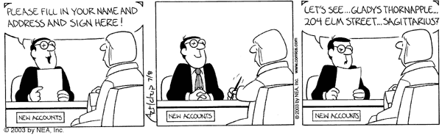
Understanding terminology and using it properly can enhance communication
Some important terms you will learn:
  function
  argument
  module
  string
  list
  class
  method

Slide 28
Python
Invented in 1990 by Guido van Rossum.
Named for "Monty Python’s Flying Circus"
Now has a huge worldwide following.
"Official" web site is python.org .
Makes it simple to do simple things.
Has the power to do complex things.
I think you will like it!

Slide 29
I have no idea what you are talking about, Claude!
If I go too fast, or for any other reason you are not getting it, don’t let me go on.
Stop me, ask a question!
During "all together" demo times, if you are stuck, raise your hand and look at Trevor or Austin; one of them will come to help you.
Or perhaps someone near you can help.

Slide 30
Login and Website
http://www.rose- hulman.edu/class/csse/catapult/
Most of the material that is there now is from last session; it will be updated as we go along, but I wanted to have something for experienced students who want to work ahead to look at.

Slide 31
Python Demo
Open up the IDLE program from your desktop and follow along (look on with someone else if you do not have a computer to use).
Ask questions as they come up.
  If your questions are “advanced programming” questions, I may defer the answer so as not to confuse the beginning programmers.
Demo of some Python features.
  Enjoy the ride.
  We will see more detail on some of these features tomorrow, and you will get practice using them.
  I will post most everything form class demos to the website so you can look them up later
Notes:
Demo tic tac toe and circle programs.
Variables, calculations. If time allows, do loops and strings.
See transcript

