Slide 1
Operation Catapult
Python Programming Projects– Day 1
Welcome!
If you have little/no programming experience, sit in one of front 6 tables
If you have lots of experience, sit in the back tables, 1-2 per computer

Slide 2
Turn on machines now
They are not to leave the room
Use only for projects
Bring up a web browser
Who has a laptop they want to use?
  Please bring them when we start the project
  We’ll help install the software for you

Slide 3
Operation Catapult
Python Programming Projects– Day 1
Matt Boutell - Associate Professor
  Moench F222 (diagonally across hall)
  boutell@rose-hulman.edu
Katie Dion – CS major, Programming Student Assistant
  F204 (around corner)
  dionkm@rose-hulman.edu
Brian Bowmaster – CS minor, Programming Student Assistant
  F204 (around corner)
  bowmasbt@rose-hulman.edu

Slide 4
Introductions
Get to know each other. We’ll be in this room for 70+ hours over 3 weeks.
Name, hometown, and something interesting or unusual about yourself.
Why did you pick this project? What you hope to learn/do?
If you have programming experience, tell us about it.

Slide 5
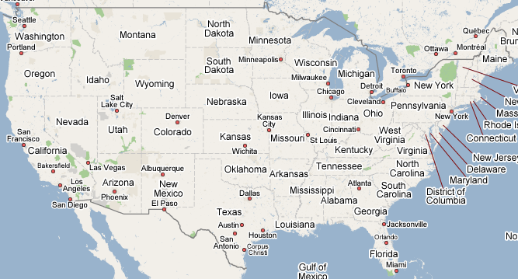
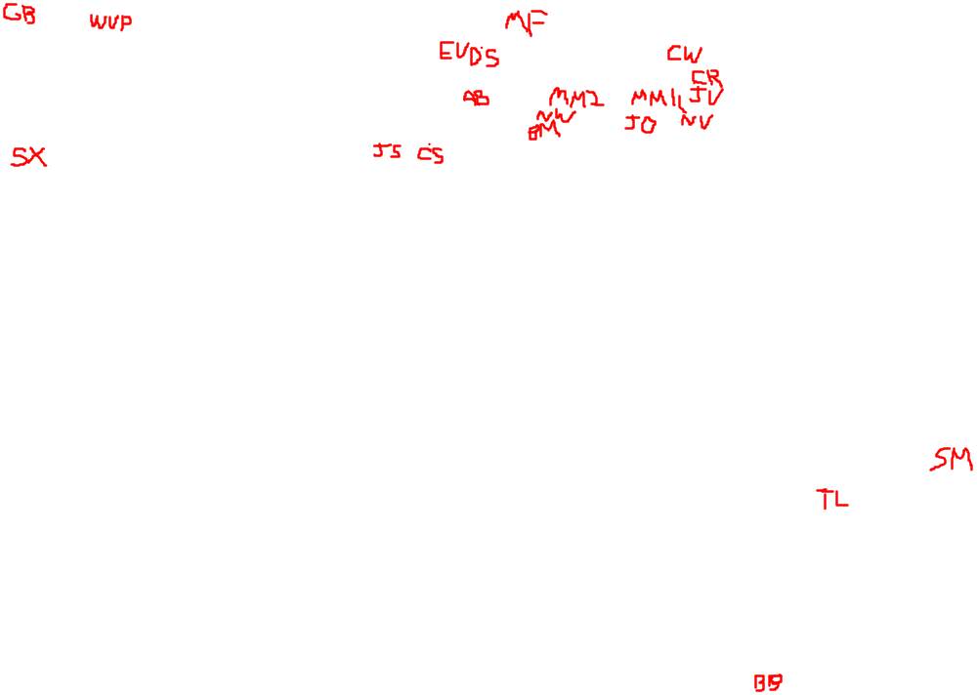
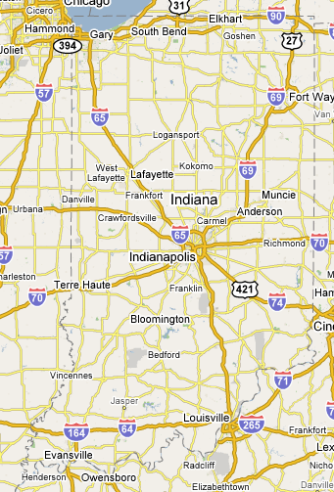
Where are we from?

Slide 6
Me: Templeton → WPI → UMass@Amherst →
Norton High / Stonehill Coll.→ U. Rochester/Kodak → Rose!

Slide 7
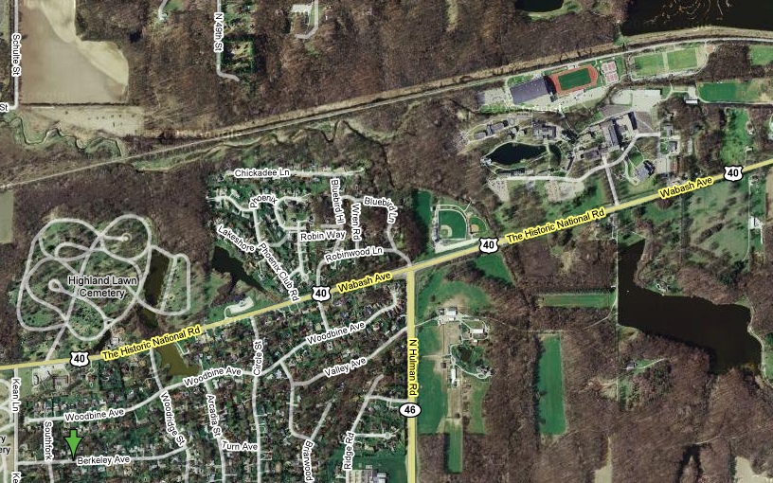
My background
Home

Slide 8
See “intro to me” slide

Slide 9
Website
Go to:
  http://www.rose-hulman.edu/class/csse/catapult/2013-S2
  This should be the browser homepage
Take 5 mins and explore what’s there.
Notes:
Time out with the other project students

Slide 10
Schedule
For the first few days
  Instruction in the classroom.
    Aimed at those with no programming background.
  Work in the lab on programs that I assign.
  Start thinking about projects.
Monday (or so)
  Finalize groups and projects.
After that
  Work on your group’s project.
  Get help from Katie, Brian, and me as needed.
  There will be occasional “all together” classroom time.

Slide 11
Class Discussion-Time Etiquette
Goal: learn Python quickly, so can get to projects
Do ask me questions at any time.
Do interact with your neighbors about the things we are discussing, exercises you are doing.
Don’t do things that will distract us from the learning process (such as …)
  IM, email, …
  using the speakers on your computer or other audio device.

Slide 12
Lab Etiquette
The lab is near the offices of many professors, so let’s not be so noisy that they can’t get their work done.
My office is in F-222, across the hall.
    When I’m not helping you, I may have to work in there briefly
    If so, feel free to find me

Slide 13
Lab Etiquette (continued)
Project time is not the time for you to surf the web, to send unrelated email or texts, listen to your iPod, etc.
  You may at other times, here, in the library, or the Dynamics lab (O-203).
  If one of your partners begins to get “off track”, a reminder from you may help.
Let’s speak to each other kindly, and only with words that our mothers would not be embarrassed to hear us say.
Be very careful with drink in the labs.
If you need to use the bathroom, get a drink of water, etc., it is not necessary to ask first.

Slide 14
Computer programming
Python Programming
A lot of fun. You should have a great sense of accomplishment by the end.
A lot of learning. About programming, about Python, about using pre-defined packages to handle many of the details.
  I expect to learn a lot also.
A lot of work. Some of the things you will accomplish will not come easily. But you’ll feel great when you have done them!
  Programming projects have been some of the most intense in Catapult.

Slide 15
Learning and Doing
The first 4-5 days we’ll focus on learning about Python and its various libraries.
Repeat
  There will be a little bit of discussion time, followed by time for you to learn by doing.
  Until you have mastered the basic concepts.
Everyone will be doing the same small programs. Students with more programming experience may want to add extra features or they may want to work ahead.
After that, groups will choose and work on their specific projects.

Slide 16
How to fail at learning Python and OOP!
Don’t stay on-task. Browse the internet or do instant messaging instead.
Don't bother learning the terminology.
Be satisfied with (only) getting the assignments done, even if you don’t understand them.
Let someone else take over your keyboard and move too fast for you. She knows more than you do about programming, and you wouldn’t want to slow her down!
Even if you are totally confused, don't ask for help. That might show your classmates or professor what you don't know!

Slide 17
How to fail at this project (continued)
When you don’t understand something, believe that you’re the only one who is so stupid, so don’t ask any questions!
When you don’t understand something, assume that it will come to you eventually; move on (and wait for your lack of understanding to trip you up later).
Don’t bother Dr. B., the assistants, or fellow-Catapulters with your problems and questions; you can probably figure things out yourself

Slide 18
What if you already know something (or lots!) about programming?
You’ll still probably learn some new and important things in the next couple of days.
If you find a concept or assignment to be easy, please put that to good use by patiently helping others around you to understand it.
And think of “extra” features to add to the assigned programs.

Slide 19
Algorithms, Languages, Translators
What is an algorithm?
How do we communicate an algorithm to another person?
  Depends on the person. Has to be in a language they can understand.
  Baking a cake. Telling my mother vs. telling my 5-year old son.

Slide 20
Language Barriers
What if we want to have Pierre perform an algorithm for us, but we do not know his language?
  We could hire a translator (a.k.a. compiler) to translate all of the instructions into French, and give them to Pierre.
  We could instead hire an interpreter. We read the next instruction to be done, the interpreter translates it into French, and Pierre does it.
  In the first case, it takes longer before Pierre can get started; in the second case, execution of each instruction is a little bit slower.
  Python is more like that interpreter.

Slide 21
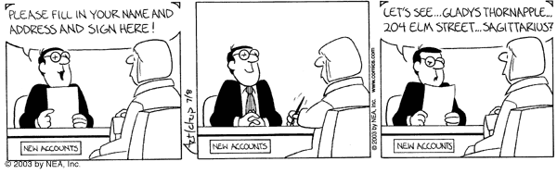
Understanding terminology and using it properly can enhance communication
Some important terms you will learn:
  function
  argument
  parameter
  string
  list
  class
  method

Slide 22
Python
Invented in 1990 by Guido van Rossum.
Named for “Monty Python’s Flying Circus”
Now has a huge worldwide following.
“Official” web site is python.org .
Makes it simple to do simple things.
Has the power to do complex things.
I think you will like it!

Slide 23
I have no idea what you are talking about, Dr. B.!
If I go too fast, or for any other reason you are not getting it, don’t let me go on.
Stop me, ask a question!
During demo times, if you are stuck, raise your hand and look at Brian or Katie; they will come to help you.

Slide 24
Python Demo
Open up the IDLE program from your desktop and follow along.
Ask questions as they come up.
  If your questions are “advanced programming” questions, I may defer the answer so as not to confuse the beginning programmers.
Help
Demo of some Python features.
  Enjoy the ride.
  We will do more detail on many of these features tomorrow.
  I will post most everything I show you to the website
Notes:
Demo tic tac toe and circle programs.
Variables, calculations. If time allows, do loops and strings.
See transcript

Slide 25
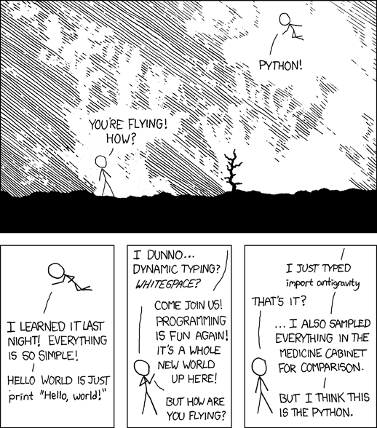
http://xkcd.com/353/
Notes:
Demo tic tac toe and circle programs.
Variables, calculations. If time allows, do loops and strings.
See transcript

