Slide 1

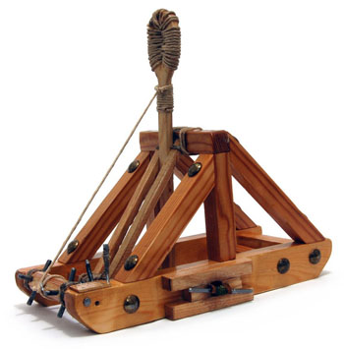
Catapult Python Programming
Session 2

Slide 2
Agenda for AM and early PM
Google Drive
Review the Zellegraphics library
Review, Loops, exercises for you to do
Review list, tuples

Slide 3
Email List
If you didn’t email me—please fill out the email survey that is under the “Other” tab on the website.

Slide 4
"I have no idea what you are talking about!"
Say it, don't just think it!
If I go too fast, or for any other reason you are not getting it, don’t let me go on.
Stop me, ask a question!
During "all together" demo times, if you are stuck, raise your hand and look at us; one of us will come to help you.
Or perhaps someone near you can help.

Slide 5
Questions from yesterday?
Remember: Yesterday's slides and transcript are posted on website

Slide 6
Install Python
For those of you who didn’t install Python, this is the time to do it.
There is a link to the installation instructions on the course webpage under the “Other” tab.

Slide 7
Ideas from yesterday
Practice: Try out the following operations in the interactive console in IDLE. What do you think they do? (No cheating with Google!)
1) // vs /
2) %
Challenge:
3) | ←should be on the same key as \
4) &
Try using numbers as well as True and False (for logical expressions)
Experiment and see what happens!

Slide 8
Some Python data types
Numeric types
  int: whole numbers
    Arbitrarily large whole numbers.
    Examples 6, 44389654908498902
  float
    Real numbers (there can be roundoff errors)
    Examples 4.72 1.7e4 1.0/3.0

Slide 9
Operations on numeric types
x + y
x – y
x * y
x / y
x // y integer division
x % y remainder (modulo)
x**y
-x
abs(x)
x == y True if x equals y,
False otherwise.
x != y not equal
x < y
x <= y
x > y
x >= y
Other numeric operations, such as sin, cos, tan, sqrt, log, can be imported from the math module.

Slide 10
More Python data types 1/2
Boolean
  values: True False
  >>> 3 < 5
  True
String – a sequence of characters.
  Examples: ″abc ″ ′abc ′ ′a\nc′ ′a\\c′
  print abc vs print ′abc′

Slide 11
More Python data types 2/2
String concatenation:
>>> s = "abc"
>>> s + "def"
'abcdef'
>>> 'abc' 'def'
'abcdef'
>>> s 'def'
SyntaxError: invalid syntax

Slide 12

Stretch Break

Slide 13
General Structure of Solutions
Steps are done in a certain order.
Some sets of steps may repeat.
We may have certain actions that we repeat with different things (e.g., when making a PB&J sandwich we spread peanut butter on the bread, then spread jelly on the bread).
We usually need some things (inputs) and produce some things (outputs).
Python has several structures that support including these concepts in any code you write!

Slide 14
Aspects of “Good” Code
Commented
  Can share with other people
  When you edit later, you can understand what you wrote
  Shows thought process, so easier to debug
Informative variable names
Encapsulation: each process is only in one place
  Instead of copying code over and over, you encapsulate it in a function that you call with different inputs over and over
  This makes it easier to change your code as you only change it in one place
Every line brings you closer to your goal—no useless lines of code

Slide 15
Functions in Python
Functions help us when we need to repeat certain actions (like the PB&J example from the previous slide)
A function will always have:
  A name
  Inputs (called parameters or arguments)
  Output (called a return)
Note that while there may be “nothing” in the inputs or output this will still have to be indicated by the programmer.
In the case where no return is specified Python will return a special value of None by default.

Slide 16
Structure of a Function
General form:
def functionName(arguments):
statements
return expression (common but optional)
NB: blocks of code are indicated by indentation in Python. Indentation can include spaces, so be careful!
Examples:
def printHello():
print(“Hello”)
No arguments, no return
def printThis(this):
print(this)
One argument, no return
def slope(x1, y1, x2, y2):
return (y2-y1)/(x2-x1)
4 arguments, return

Slide 17
A little more live coding
Interacting with the Python shell
vs
Writing a program in a file
  3 vs, print (3).
How do we call a function?
How do we store the returns of a function?

Slide 18
Practice
Do this yourself (with help from neighbors and us)
  Define a function that takes the x and y coordinates of a point and prints its distance from (0,0)
  Define a function that takes the side length of a square and returns its area.
  Challenge
  Define a function that takes as input a day, month, and year and prints what season it is. For more fun try detecting if it is a holiday and printing out a special message in that case.

Slide 19
Stretch Break

Slide 20
Logical Expressions
We often want to test whether a statement is true and change what we do based off of that.
To perform logical tests we use logical expressions.
The basic ones include:
and
or
not
<
>
Did anyone try the challenge from the first practice? Which operation do you think | and & were?

Slide 21
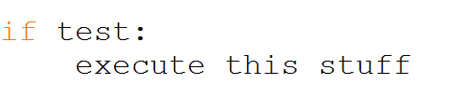
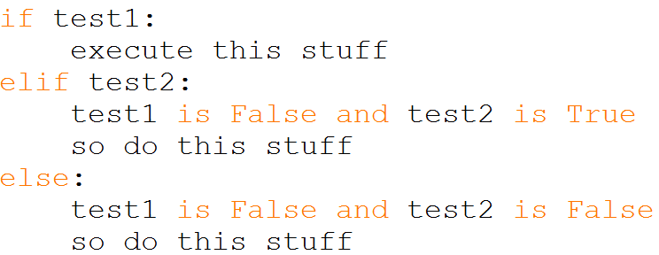
Conditional Statements
We can change the behavior of the program based off the value of a logical test. Commonly this is done with if statements although you will see other ways we can change things soon.
An if statement will look like this—
You can also add other statements for behaviors that happen when the first test is not true--

Slide 22
Repeating Behavior in Python
Another common feature of solutions is that we may want to repeat behavior over and over.
We can do this with “loops”. There are two types of loops: for loops and while loops. We will start with for loops.
The code indented under the loop statement will be run repeatedly until you “break” out of the loop.
For loops will run (or iterate) a set number of times depending on the number you place where x is in this statement-- for i in range(x):
This number could also be a variable.
We will try a few examples together.

Slide 23
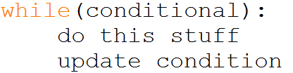
While Loops
While loops repeat the code inside of them until the conditional statement that controls them becomes False.
A while loop will have these things:
1) A controlling conditional statement
2) A change that occurs to factors involved in the conditional statement inside the loop
While loops look like this:

Slide 24
Practice
.
Do this yourself (with help from neighbors and us)
  Define a function that takes an input number and determines whether it is between -5 and 5. If it is inside the range it should print “Good”, otherwise it prints “Bad”. Challenge: also print “Zero” if it is between -1 and 1. Try to make this happen with the fewest number of statements possible.
  Define a function that takes a number (itself) and prints out itself + 0, itself + 1, itself + 2, … , itself + itself.
  Define a function that takes a number (itself) and does the same thing as the previous function but this time stops when the number that would be printed is divisible by 7.
  Challenge
  Create a function that calls another function within a loop.
  Create a loop that changes based on the output of a function.

Slide 25
Stretch Break

Slide 26
A Simple Graphics Module 1/2
This module is not part of the standard Python distribution. We added it. It’s called zellegraphics.py
It comes from http://mcsp.wartburg.edu/zelle/python/, but we enhanced it.
Documentation is in the file zellegraphics.pdf.

Slide 27
Getting Help From IDLE

Slide 28
A Simple Graphics Module 2/2
We’ll do an example, then you’ll get a chance to play.
  Another example of writing a program in a separate file. (do it now!)
  Draw lines and a circle, fill a rectangle and move it.
  Notice that a window, a line, and a circle, are all examples of objects. We’ll see that as we write the code.
  Later we’ll see how to create our own object types.

Slide 29
Your turn
Use the graphics module to draw a picture of a house. Make it as simple or fancy as you want. Draw and/or fill rectangles, circles, lines, ovals, polygons, individual points.
See if you can use a loop to create some part of your drawing.
Perhaps you will want to make something move.
Try to be artistic, as well as to learn about programming.

Slide 30
String Operations (do live)
>>> alpha = 'abcdefghjklm'
>>> alpha[1]
'b'
>>> alpha [3:5]
'de'
>>> alpha[6:]
'ghjklm'
>>> len(alpha)
12
>>> alpha[0:12:2]
'acegjl‘
>>> alpha[1] = 'X‘
# are strings immutable
Traceback (most recent call last):
File "<pyshell#32>", line 1, in <module>
alpha[1] = 'X'
TypeError: 'str' object does not support item assignment
>>> 'def' in alpha
True
>>> 'df' in alpha
False
>>> alpha.find('def')
3
>>> alpha.find('deg')
-1
>>> >>> alpha.upper()
'ABCDEFGHJKLM'
>>> alpha.islower()
True
>>> '***' + alpha.center(20) + '***'
'*** abcdefghjklm ***'
>>> '***' + alpha.rjust(20) + '***'
'*** abcdefghjklm***‘
>>> '***' + alpha.ljust(20) + '***'
'***abcdefghjklm ***‘
>>> sent = "This sentence has 5 words"
>>> sent.split()
['This', 'sentence', 'has', ‘5', 'words']
>>> sent.split('e')
['This s', 'nt', 'nc', ' has 5 words']
>>> sent.count('en')
2

Slide 31
Tuples and Lists
Tuples (immutable)
>>> tup1 = ('coke', 'sprite', 'dr pepper')
>>> tup1[1]
'sprite'
>>> tup1[1:]
('sprite', 'dr pepper')
>>> for drink in tup1:
print 'I like ' + drink
I like coke
I like sprite
I like dr pepper
>>> tup1[2] = 'pepsi'
Traceback (most recent call last):
File "<pyshell#10>", line 1, in <module>
tup1[2] = 'pepsi'
TypeError: 'tuple' object does not support item assignment
lists (mutable)
>>> list2 = ['coke', 'sprite', 'dr pepper'] # all one line
>>> list2[1:]
['sprite', 'dr pepper']
>>> list2[2] = 'pepsi'
>>> list2
['coke', 'sprite', 'pepsi']
>>> numList = [2, 3, 6, 7, 3, 4, 7, 5, 3, 4, 2, 1, 8, 3];
>>> numList.count(3)
4
>>> numList.remove(4)
>>> numList
[2, 3, 6, 7, 3, 7, 5, 3, 4, 2, 1, 8, 3]
>>> numList.reverse()
>>> numList
[3, 8, 1, 2, 4, 3, 5, 7, 3, 7, 6, 3, 2]
>>> numList.sort()
>>> numList
[1, 2, 2, 3, 3, 3, 3, 4, 5, 6, 7, 7, 8]
>>> len(numList)
13
Notice the difference in the form of the use of the sort method and the len function. A list is an Object. Objects know things and do things.

Slide 32
Getting help from IDLE
How could we find the names of all list operations?
Try
  dir(list)
  help(list)
  help(list.append)
Notes:
– what is that self argument.

Slide 33
Programs that help you write programs
IDLE: great for quick experimentation
Eclipse: great for organizing bigger programs
Soon we'll install Eclipse, pydev, and pygame on student-owned laptops.

