Slide 1

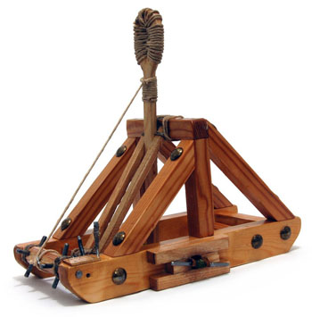
Catapult Python Programming
Session 4

Slide 2
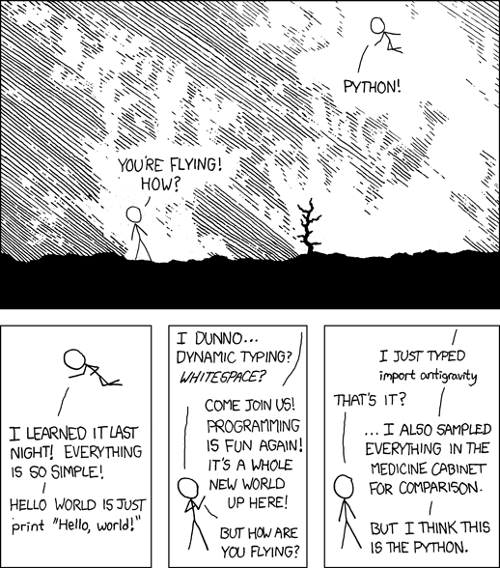
http://xkcd.com/353/
Notes:
Demo tic tac toe and circle programs.
Variables, calculations. If time allows, do loops and strings.
See transcript

Slide 3
Announcements
Continue thinking about project ideas and who you want to work with

Slide 4
Today’s schedule
Equilateral triangle
  Finish miscGraphics
  New pic posted
Use VS Code
Programs:
  How long does it take for me to save up for a car?
        Say, $5000 saving $200/month, earning 5% interest?
  Interactive graphics (if time)

Slide 5
Programs that help you write programs
IDLE: great for quick experimentation
VS Code: great for organizing bigger programs

