Slide 1

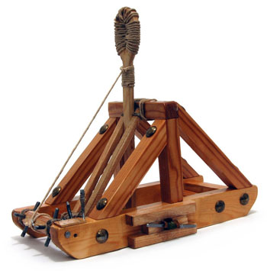
Catapult Python Programming
Session 4

Slide 2
Lists and Tuples
Lists
  Ordered sequence of items
  Types of items can be mixed
  Can be accessed with indexes
  Can be changed (mutated)
  Indicated with square brackets, e.g., [1,”hello”,3.5]
Tuples
  Like lists, but CANNOT be changed
  Indicated with parenthesis, e.g., (1,”hello”,3.5)
  People mess up and return tuples a lot of times!

Slide 3
Libraries
We can get functions from other code files by using import
Python needs to know where those files are
  By default your interactive shell will open wherever you installed python
  If you want the shell to change location, run a code file from that location—then it will know about any files that are there
  If you are writing code in a file Python will be able to find other code in that file as well as code in the Python installation location’s Lib/site-packages file
There are other more complicated ways to import files—if you find you need more complex functionality during the project time ask me then

Slide 4
Practice
Write a fun graphical program that combines a loop and a circle (or other shape).
  Example: Move a circle from the upper left corner of the window to the lower right corner. Encapsulate this in a function. Challenge: Handle rectangular windows.
Write a graphical program that combines a list of shapes and a loop.
  Example: Write a function that, given a list of circles, changes the color of all the circles to a color of your choice. Challenge: Make the color an input to your function or incorporate moving the circles.

Slide 5

Stretch Break: Find Objects Outside

Slide 6
Classes
Classes are used in programming to package together data and functions
  Only functions that need to know about a variable will know about it
  This lets us have chunks of code that behave as “black boxes”—very useful for a group project!
  This also lets us express ideas about the function of something—e.g., the class may be called ‘GUI’ for your Graphical User Interface or ‘Circle’ for a circular shape in your graphics library
Make a class that would express the object that you chose
  What aspects could be used to describe it? Those should be variables.
  How does it change or effect others? Those should be functions. For instance, does it need to grow? If it is rained on, would it change to something else?

Slide 7
Practice
Create your own class that makes a graphical object.
  Make a car class. The car can consist of a rectangle with two circles for wheels. The car should be centered on a point given to the constructor. Make a function that moves the car on the screen and a function that changes the color of the car.
Challenge
  Make a face class that has a face, eyes, nose, and mouth. Make your class methods include ones that give expressions (e.g., smile, nose wiggle, nod)

