Slide 1

Catapult 2014 Session 10

Slide 2
Pygame
Pygame is a library designed for programming games using 2D graphics.
Compared to zellegraphics, it has:
much better mouse and keyboard input
much faster drawing commands
better image support
collision-detection
Sound
For documentation, see pygame.org/docs (bright green box at the top of window)

Slide 3
Surfaces
In Pygame many drawn objects are Surfaces
Pygame draws the Surfaces as layers on top of each other.
Different surfaces are able to detect collisions with one another based on a “rectangle” that bounds it
Pygame.draw draws things ON TOP of a given surface, it does not create a new surface.

Slide 4
Moving objects on screen is much different
With zellegraphics, you could do things like circle.move(dx, dy)
In pygame, you repeatedly:
Change the coordinates of your object
Blank out the screen
Redraw your item(s) in the new location
cause them to display
This is done in the event loop (next slide)

Slide 5
Event loop
In an infinite loop,
get input from the user, using it to change the state of your object (like the location)
other code that affects objects (like collisions)
blank out the screen
redraw your item(s) in the new location
cause everything to display

Slide 6
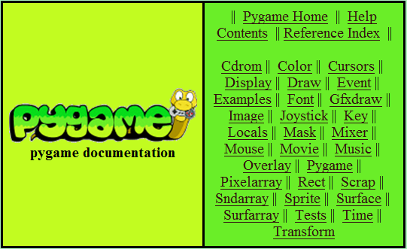
Pygame Documentation
http://www.pygame.org/docs

Slide 7
Caution
At the end of your project, you’ll be given an opportunity to make a standalone (.exe) version of your project. For this to work, all pygame fonts that you use should be SysFonts (created using pygame.font.SysFont) and the pygame default font should not be used [i.e. don’t use pygame.font.SysFont(None, 12)]
pyame.time keeps time in milliseconds not seconds

Slide 8
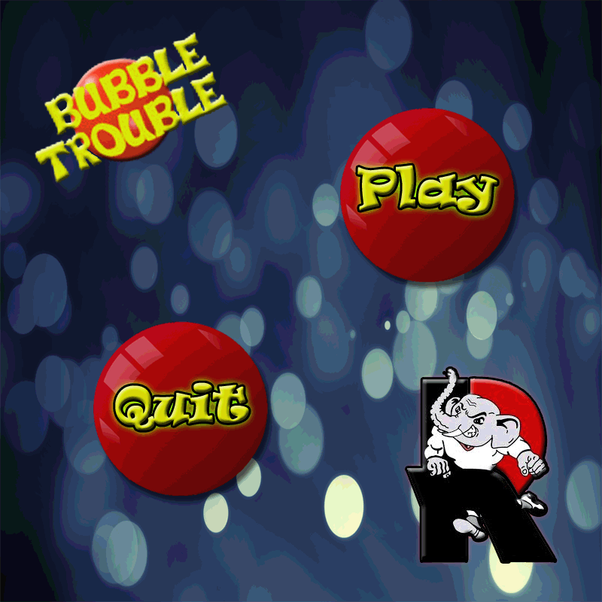
Demos
Controllable Ball (With Instructor)
Paddle Ball
Moving Smilies (Take 2)
Bubble Trouble

