Slide 1

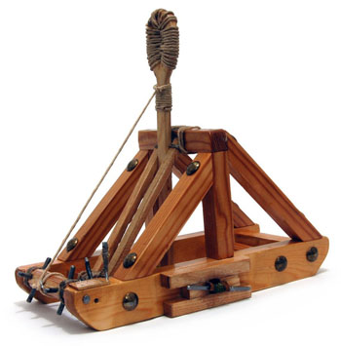
Catapult Python Programming
Session 2

Slide 2
Agenda for AM and early PM
Make sure that everyone has Software Installed
Python basics
Review loops and functions and try some exercises
Review lists and tuples

Slide 3
Install Software
For any of you who didn’t finish software installation this morning, this is the time to do it.
There is a link to the installation instructions on the course webpage under the “Other” tab.

Slide 4
"I have no idea what you are talking about!"
I am serious about this. Say it, don't just think it!
If I go too fast, or for any other reason you are not getting something, don’t let me go on.
Stop me, ask a question! I don't want anyone to get lost.
During "all together" demo times, if you are stuck, raise your hand and look at us; one of us will come to help you.
Or perhaps someone near you can help.

Slide 5
Python Basics
1) numbers and arithmetic:
  8 / 3 8 // 3 8 % 3
2) variables and assignment:
  width = 5 width = 2 * height width = width + 2
3) define a function:
  def triangle_area(base, altitude):
  return base * altitude / 2
4) Use a function
  triangle_area(5, 8) abs(-3) math.sin(2.18)
5) Strings of characters:
  my_name = 'Chandan' you = "your" + "mother's child"
  Pick out parts: you[5] you[5:13] you[-5]

Slide 6
Some Python data types - numeric
  int: whole numbers
    Arbitrarily large whole numbers.
    6 44389654908498902
  float
    Real numbers (there can be roundoff errors)
    4.72 1.7e4 1.0/3.0
  conversion
    int (14.5 / 6.2)
    float(a + 7)
  Complex (probably not used in Catapult)
    3.7 + 2.8j

Slide 7
Operations on numeric types
x + y
x – y
x * y
x / y
x // y integer division
x % y remainder (modulo)
x**y
-x
abs(x)
x == y True if x equals y,
False otherwise.
x != y are x and y unequal?
x < y
x <= y
x > y
x >= y
Other numeric operations, such as sin, cos, tan, sqrt, log, can be imported from the math module.

Slide 8
More Python data types 1/2
Boolean
  values: True False
  >>> 3 < 5
  True
String – a sequence of characters.
  Examples: ″abc ″ ′abc ′ ′a\nc′ ′a\\c′
  print (abc) vs print (′abc′)

Slide 9
More Python data types 2/2
String concatenation:
>>> s = "abc"
>>> s + "def"
'abcdef'
>>> 'abc' 'def'
'abcdef'
>>> s 'def'
SyntaxError: invalid syntax

Slide 10
Decide Where to Keep Your Files
Make a folder where you will save your Python programs
When it is time to save files, save them there
(Windows: set "start in" for the IDLE shortcut)

Slide 11
General Structure of Programs
Steps are done in a certain order.
Some sets of steps may repeat.
We may have certain actions that we repeat with different things (e.g., when making a PB&J sandwich, we spread peanut butter on the bread, then spread jelly on the bread).
We usually need to use some things (inputs) and produce some things (outputs).
Python has several structures that support these concepts in code that you write!

Slide 12
Aspects of “Good” Code
Commented
  Can share with other people
  When you edit later, you can understand what you wrote
  Shows thought process, so easier to debug
Informative variable names
Encapsulation: each process is only in one place
  Instead of copying code over and over, you encapsulate it in a function that you call with different inputs over and over
  This makes it easier to change your code as you only change it in one place
Every line of code brings you closer to your goal—no useless code

Slide 13
Functions in Python
Functions help us when we need to repeat certain actions (like the PB&J example from the previous slide)
A function will always have:
  A name
  Inputs (called parameters or arguments)
  Output (called a return value)
Note that while there may be “nothing” in the inputs or output this still has to be indicated by the programmer.
In the case where no return is specified Python will return a special value of None by default.

Slide 14
Structure of a Function
General form:
def functionName(arguments):
statements
return expression (common but optional)
NB: blocks of code are indicated by indentation in Python. Indentation can include spaces, so be careful!
Examples:
def printHello():
print(“Hello”)
No arguments, no return
def printThis(this):
print(this)
One argument, no return
def slope(x1, y1, x2, y2):
return (y2-y1)/(x2-x1)
4 arguments, return

Slide 15
A little more live coding
Interacting with the Python shell
vs
Writing a program in a file
  3 vs, print (3).
How do we call a function?
How do we store the returns of a function?

Slide 16
Practice
Do this yourself (with help from neighbors and us)
  Define and test a function that takes the x and y coordinates of a point and prints its distance from (0,0)
  Define and test a function that takes the side length of a square and returns its area.
  Challenge
  Define a function that takes as input a day, month, and year and prints what season it is. For more fun try detecting if it is a holiday and printing out a special message in that case.

Slide 17
Logical Expressions
We often want to test whether a statement is true and change what we do based off of that.
To perform logical tests we use logical expressions.
The basic ones include:
and
or
not
<
>

Slide 18
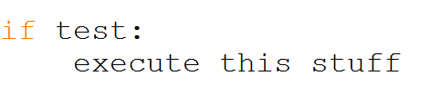
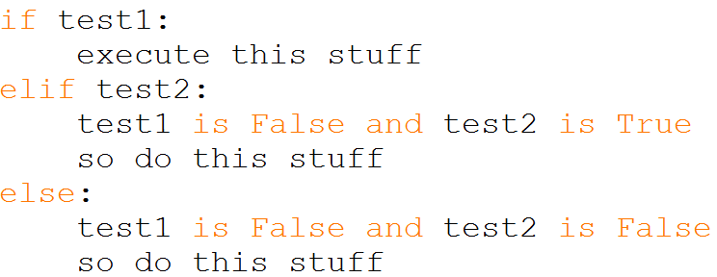
Conditional Statements
We can change the behavior of the program based off the value of a logical test. Commonly this is done with if statements although you will see other ways we can change things soon.
An if statement will look like this—
You can also add other statements for behaviors that happen when the first test is not true--
Exercise to do together:
A function that takes a score as input and returns a letter grade, assuming a 90-80-70- … scale

Slide 19
Repeating Behavior in Python
We may want to repeat behavior over and over.
We can do this with “loops”. There are two types of loops: for loops and while loops. We start with for loops.
The code indented under the loop statement will be run repeatedly until you “break” out of the loop.
For loops will run (or iterate) a set number of times depending on the number you place where x is in this statement–
for i in range(x):
This number could also be a variable.
We did a few examples together. What about a loop inside a loop?

Slide 20
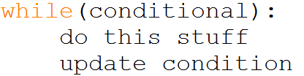
While Loops
While loops repeat the code inside of them until the conditional statement that controls them becomes False.
A while loop will have these things:
1) A controlling conditional statement
2) A change that occurs to factors involved in the conditional statement inside the loop
While loops look like this:

Slide 21
Practice
.
Do this yourself (with help from neighbors and us)
  Define a function that takes an input number and determines whether it is between -5 and 5. If it is inside the range it should print “Good”, otherwise it prints “Bad”. Challenge: also print “Zero” if it is between -1 and 1. Try to make this happen with the fewest number of statements possible.
  Define a function that takes a number (itself) and prints out itself + 0, itself + 1, itself + 2, … , itself + itself.
  Define a function that takes a number (itself) and does the same thing as the previous function but this time stops when the number that would be printed is divisible by 7.
  Challenge
  Create a function that calls another function within a loop.
  Create a loop that changes based on the output of a function.

Slide 22
String Operations (do live)
>>> alpha = 'abcdefghjklm'
>>> alpha[1]
'b'
>>> alpha [3:5]
'de'
>>> alpha[6:]
'ghjklm'
>>> len(alpha)
12
>>> alpha[0:12:2]
'acegjl‘
>>> alpha[1] = 'X‘
# are strings immutable
Traceback (most recent call last):
File "<pyshell#32>", line 1, in <module>
alpha[1] = 'X'
TypeError: 'str' object does not support item assignment
>>> 'def' in alpha
True
>>> 'df' in alpha
False
>>> alpha.find('def')
3
>>> alpha.find('deg')
-1
>>> >>> alpha.upper()
'ABCDEFGHJKLM'
>>> alpha.islower()
True
>>> '***' + alpha.center(20) + '***'
'*** abcdefghjklm ***'
>>> '***' + alpha.rjust(20) + '***'
'*** abcdefghjklm***‘
>>> '***' + alpha.ljust(20) + '***'
'***abcdefghjklm ***‘
>>> sent = "This sentence has 5 words"
>>> sent.split()
['This', 'sentence', 'has', ‘5', 'words']
>>> sent.split('e')
['This s', 'nt', 'nc', ' has 5 words']
>>> sent.count('en')
2

Slide 23
Tuples and Lists
Tuples (immutable)
>>> tup1 = ('coke', 'sprite', 'dr pepper')
>>> tup1[1]
'sprite'
>>> tup1[1:]
('sprite', 'dr pepper')
>>> for drink in tup1:
print 'I like ' + drink
I like coke
I like sprite
I like dr pepper
>>> tup1[2] = 'pepsi'
Traceback (most recent call last):
File "<pyshell#10>", line 1, in <module>
tup1[2] = 'pepsi'
TypeError: 'tuple' object does not support item assignment
lists (mutable)
>>> list2 = ['coke', 'sprite', 'dr pepper'] # all one line
>>> list2[1:]
['sprite', 'dr pepper']
>>> list2[2] = 'pepsi'
>>> list2
['coke', 'sprite', 'pepsi']
>>> numList = [2, 3, 6, 7, 3, 4, 7, 5, 3, 4, 2, 1, 8, 3];
>>> numList.count(3)
4
>>> numList.remove(4)
>>> numList
[2, 3, 6, 7, 3, 7, 5, 3, 4, 2, 1, 8, 3]
>>> numList.reverse()
>>> numList
[3, 8, 1, 2, 4, 3, 5, 7, 3, 7, 6, 3, 2]
>>> numList.sort()
>>> numList
[1, 2, 2, 3, 3, 3, 3, 4, 5, 6, 7, 7, 8]
>>> len(numList)
13
Notice the difference in the form of the use of the sort method and the len function. A list is an Object. Objects know things and do things.

Slide 24
Getting help from IDLE
How could we find the names of all list operations?
Try
  dir(list)
  help(list)
  help(list.append)
Notes:
– what is that self argument.

Slide 25
Programs that help you write programs
IDLE: great for quick experimentation
PyCharm: great for organizing bigger programs
You should have PyCharm already installed by now on student-owned laptops.

