Slide 1

Catapult 2019

Slide 2
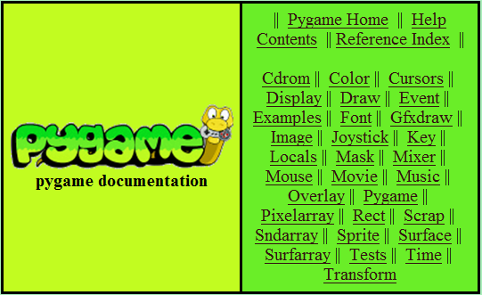
Pygame Documentation
PyGame is a library designed for programming games using 2D graphics.
http://www.pygame.org/docs
Everything you need to know about PyGame can be found here!

Slide 3
Surfaces
In Pygame many drawn objects are Surfaces
Pygame draws the Surfaces as layers on top of each other.
Different surfaces are able to detect collisions with one another based on a “rectangle” that bounds it
Pygame.draw draws things ON TOP of a given surface, it does not create a new surface.

Slide 4
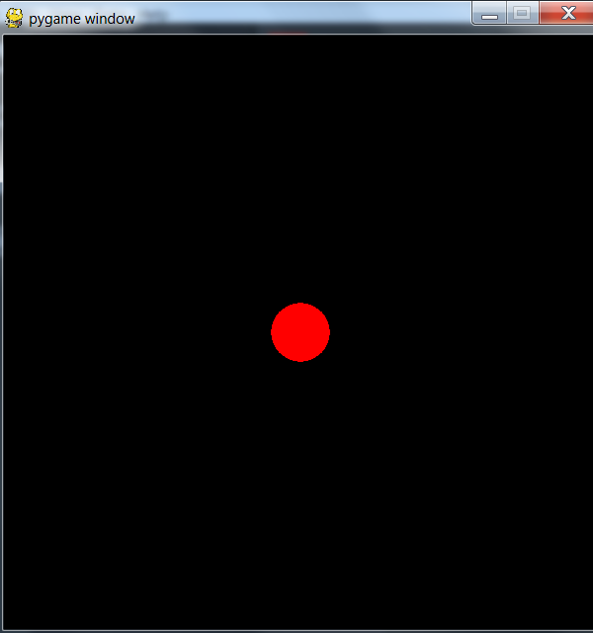

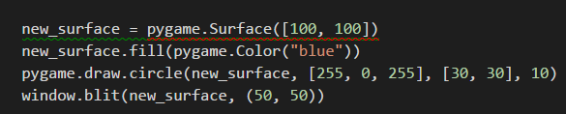
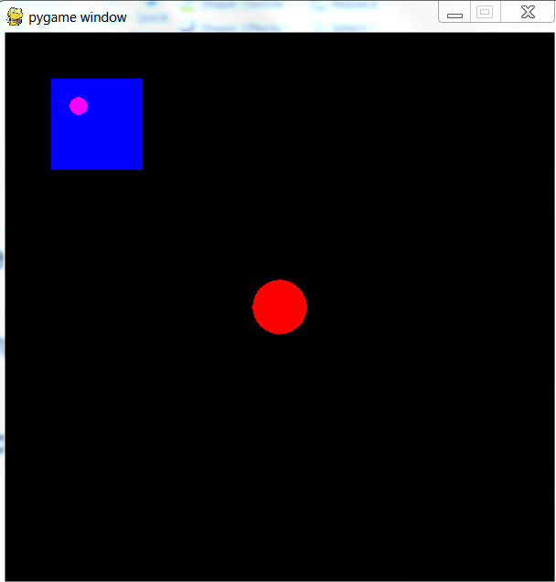
Surfaces (cont.)

Slide 5
Moving objects on screen in PyGame
To move an object Pygame, you repeatedly:
Change the coordinates of your object
Blank out the screen
Redraw your item(s) in the new location – Like
calling draw()/blit() (draw() for built-in PyGame graphics and blit() for Surfaces)
Update your display
This is done in your program’s event loop (next slide)

Slide 6
Event Loop
In an while loop,
Get input from the user, using it to change the state of your object (like the location)
Other code that affects objects (like collisions between multiple objects)
Blank out the screen
Redraw your item(s) in the new location
Update the display

Slide 7
Event Loop - Example
while True:
events = pygame.event.get()
for event in events:
if event.type = QUIT:
…
// collision detection, other event handling code
// blank out screen
// redraw objects
// update display

Slide 8
Colors
pygame.Color(color_name)
color_name is an RGB tuple - (R, G, B) – each value represents the red, green, and blue values of a specific color
Red = [255, 0, 0]
Blue = [0, 0, 255]
Lime Green = [50, 205, 50]
color_name can also be a string like “green” or “gray”

Slide 9
Caution
At the end of your project, you’ll be given an opportunity to take your project home with you. For this to work, all pygame fonts that you use should be SysFonts (created using pygame.font.SysFont) and the pygame default font should not be used [i.e. don’t use pygame.font.SysFont(None, 12)]
pygame.time keeps time in milliseconds not seconds vs python’s time library which keeps track of time in seconds

Slide 10
Things to Remember
import pygame
pygame.init()
Must have event loop
pygame.display.update()
pygame.display.flip()
pygame.quit()
Notes:
Flip – updates full display Surface to the screen
Update – updates portions of the display

Slide 11
Demos
Bubble Trouble
Rainfall
Racing

