Slide 1

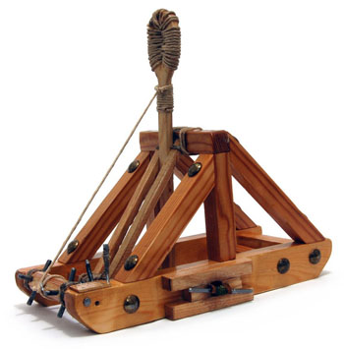
Catapult Python Programming
Session 4

Slide 2
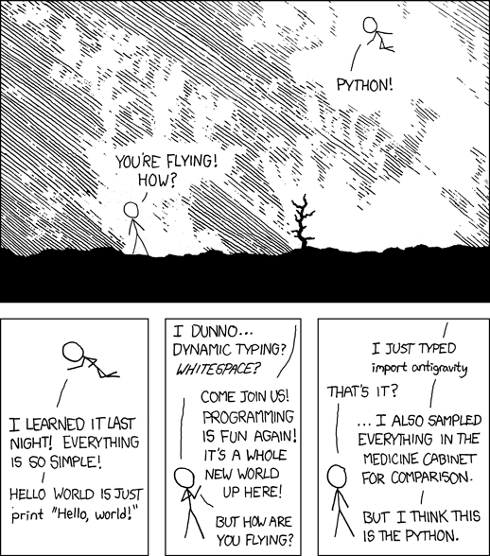
http://xkcd.com/353/
Notes:
Finish work on Houses Assignment
Introduce Miscellaneous PyGame Graphics Assignment
Begin work on Miscellaneous PyGame Graphics Assignment

Slide 3
Announcements
Continue thinking about project ideas and who you want to work with

Slide 4
Today’s schedule
- Finish work on Houses Assignment
- Introduce Miscellaneous PyGame Graphics Assignment
- Begin work on Miscellaneous PyGame Graphics Assignment
Other programs to write if you have time:
  How long does it take for me to save up for a car?
        Say, $5000 saving $200/month, earning 5% interest?

