Slide 1

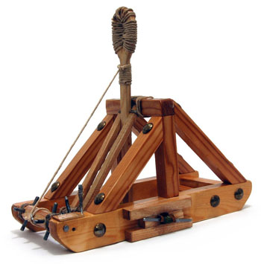
Catapult Python Programming
Session 3

Slide 2
Let’s talk about lists
Live coding

Slide 3
String Operations (do live)
>>> alpha = 'abcdefghjklm'
>>> alpha[1]
'b'
>>> alpha [3:5]
'de'
>>> alpha[6:]
'ghjklm'
>>> len(alpha)
12
>>> alpha[0:12:2]
'acegjl‘
>>> alpha[1] = 'X‘
# are strings immutable
Traceback (most recent call last):
File "<pyshell#32>", line 1, in <module>
alpha[1] = 'X'
TypeError: 'str' object does not support item assignment
>>> 'def' in alpha
True
>>> 'df' in alpha
False
>>> alpha.find('def')
3
>>> alpha.find('deg')
-1
>>> >>> alpha.upper()
'ABCDEFGHJKLM'
>>> alpha.islower()
True
>>> '***' + alpha.center(20) + '***'
'*** abcdefghjklm ***'
>>> '***' + alpha.rjust(20) + '***'
'*** abcdefghjklm***‘
>>> '***' + alpha.ljust(20) + '***'
'***abcdefghjklm ***‘
>>> sent = "This sentence has 5 words"
>>> sent.split()
['This', 'sentence', 'has', ‘5', 'words']
>>> sent.split('e')
['This s', 'nt', 'nc', ' has 5 words']
>>> sent.count('en')
2

Slide 4
Tuples and Lists
Tuples (immutable)
>>> tup1 = ('coke', 'sprite', 'dr pepper')
>>> tup1[1]
'sprite'
>>> tup1[1:]
('sprite', 'dr pepper')
>>> for drink in tup1:
print 'I like ' + drink
I like coke
I like sprite
I like dr pepper
>>> tup1[2] = 'pepsi'
Traceback (most recent call last):
File "<pyshell#10>", line 1, in <module>
tup1[2] = 'pepsi'
TypeError: 'tuple' object does not support item assignment
lists (mutable)
>>> list2 = ['coke', 'sprite', 'dr pepper'] # all one line
>>> list2[1:]
['sprite', 'dr pepper']
>>> list2[2] = 'pepsi'
>>> list2
['coke', 'sprite', 'pepsi']
>>> numList = [2, 3, 6, 7, 3, 4, 7, 5, 3, 4, 2, 1, 8, 3];
>>> numList.count(3)
4
>>> numList.remove(4)
>>> numList
[2, 3, 6, 7, 3, 7, 5, 3, 4, 2, 1, 8, 3]
>>> numList.reverse()
>>> numList
[3, 8, 1, 2, 4, 3, 5, 7, 3, 7, 6, 3, 2]
>>> numList.sort()
>>> numList
[1, 2, 2, 3, 3, 3, 3, 4, 5, 6, 7, 7, 8]
>>> len(numList)
13
Notice the difference in the form of the use of the sort method and the len function. A list is an Object. Objects know things and do things.

Slide 5
Repeating Behavior in Python
For loops will run (or iterate) a set number of times depending on the numbers you use:
# starts at 0
for i in range(3):
print "Welcome",i,"times."
# starts at one
for i in range(1,4):
print "Welcome",i,"times."
# loops across a list
for name in [‘alice’, ‘bob’]:
print "Welcome",name,"!"

Slide 6
Practice
Let’s write a basic integer sum together
Then go here:
https://codingbat.com/python/Warmup-2
I recommend string_times and array_count9
Then take a look at string_splosion. I’ll probably talk about the solution to that one.

Slide 7
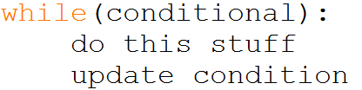
While Loops
While loops repeat the code inside of them until the conditional statement that controls them becomes False.
A while loop will have these things:
1) A controlling conditional statement
2) A change that occurs to factors involved in the conditional statement inside the loop
While loops look like this:

Slide 8
Code Exercise: TicTacToe
This one is more challenging, so be sure to get plenty of help as you need it!

