Slide 1
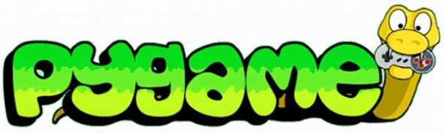
Catapult 2018

Slide 2
Pygame
Pygame is a library designed for programming games using 2D graphics.
Compared to zellegraphics, it has:
much better mouse and keyboard input
much faster drawing commands
better image support
collision-detection
sound

Slide 3
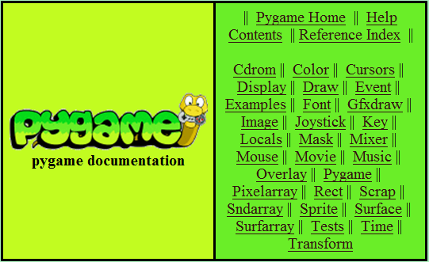
Pygame Documentation
http://www.pygame.org/docs
Everything you need to know about PyGame can be found here!

Slide 4
Surfaces
In Pygame many drawn objects are Surfaces
Pygame draws the Surfaces as layers on top of each other.
Different surfaces are able to detect collisions with one another based on a “rectangle” that bounds it
Pygame.draw draws things ON TOP of a given surface, it does not create a new surface.

Slide 5
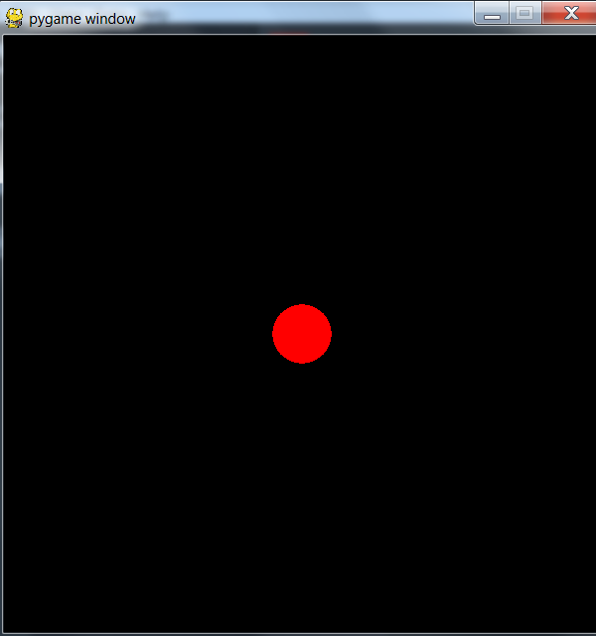

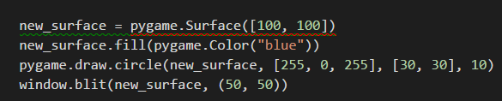
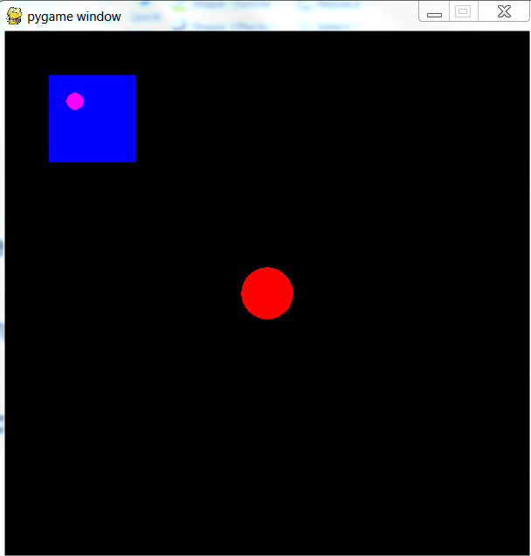
Surfaces (cont.)

Slide 6
Moving objects on screen is much different
With zellegraphics, you could do things like circle. Move(dx, dy)
In Pygame, you repeatedly:
Change the coordinates of your object – Like calling move()
Blank out the screen – Like calling fill()
Redraw your item(s) in the new location – Like
calling draw()/blit() (draw() for built-in PyGame graphics and blit() for Surfaces)
Update your display
This is done in the event loop (next slide)

Slide 7
Event Loop
In an infinite loop,
get input from the user, using it to change the state of your object (like the location)
other code that affects objects (like collisions)
blank out the screen
redraw your item(s) in the new location
cause everything to display

Slide 8
Event Loop (cont.)
while True:
events = pygame.event.get()
for event in events:
if event.type = QUIT:
…
// collision detection, other event handling code
// blank out screen
// redraw objects
// update display

Slide 9
Colors
Zellegraphics had built in colors: “red”, “blue”, etc.
pygame.Color(color_name)
color_name is an RGB tuple - (R, G, B) – each value represents the red, green, and blue values of a specific color
Red = [255, 0, 0]
Blue = [0, 0, 255]
Lime Green = [50, 205, 50]

Slide 10
Caution
At the end of your project, you’ll be given an opportunity to make a standalone (.exe) version of your project. For this to work, all pygame fonts that you use should be SysFonts (created using pygame.font.SysFont) and the pygame default font should not be used [i.e. don’t use pygame.font.SysFont(None, 12)]
pygame.time keeps time in milliseconds not seconds

Slide 11
Demos
Rainfall
Racing

Slide 12
Things to Remember
import pygame
from pygame.locals import *
pygame.init()
Must have event loop
pygame.display.update()
pygame.display.flip()
pygame.quit()
Notes:
Flip – updates full display Surface to the screen
Update – updates portions of the display

