Slide 1
Defining Classes in python
Catapult—Rose Hulman Institute of Technology

Slide 2
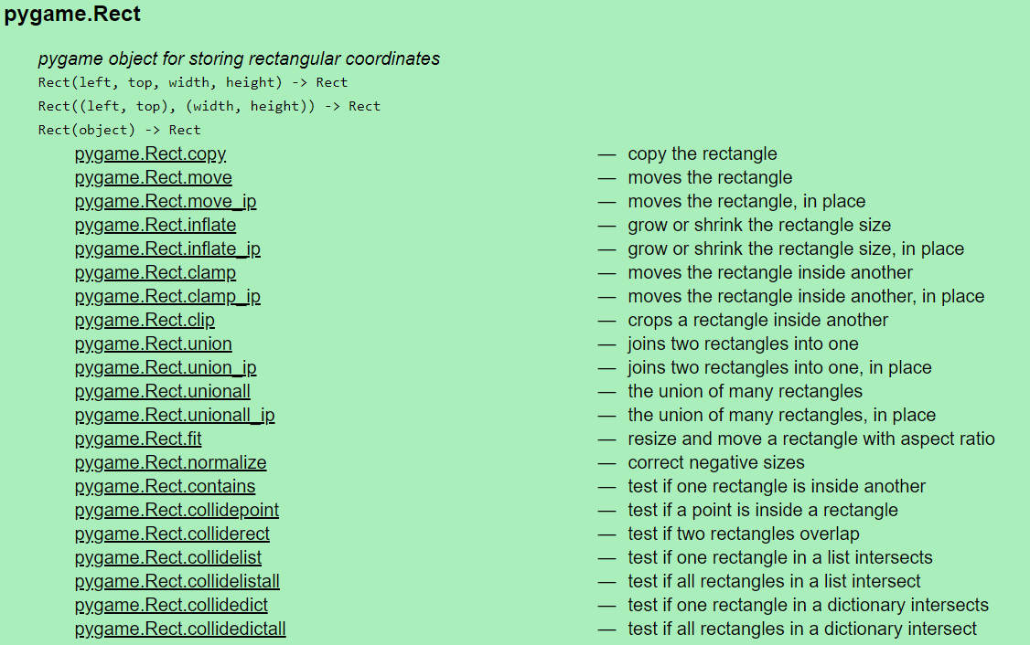
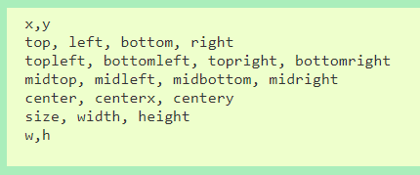
We’ve Actually Been Using Objects All Along
As you’ve worked on the assignments we’ve given you, we’ve added links in the files to PyGame documentation that we thought may be helpful to you. A lot of them have looked something like this:
You’ve been working with PyGame Rect Objects along. You’ve been calling methods on the Rect objects to make them do something like move and accessing instance variables which tell you something about the object like width

Slide 3
Object Terminology
Objects are “active data types”
They know stuff — instance variables
They can do stuff — methods
Objects are instances of some class
Objects created by calling constructors
Notes:
[Animate this slide to reveal by major bullets]
On board:
UML is Unified Modeling Language
Draw together the UML class diagram for Line on the board

Slide 4
Key Concept!
A class is like an "object factory"
Calling the constructor tells the classes to make a new object
Parameters to constructor are like "factory options", used to set instance variables
Or think of class like a "rubber stamp"
Calling the constructor stamps out a new object shaped like the class
Parameters to constructor "fill in the blanks". That is, they are used to set instance variables.
Notes:
This slide has two different analogies. Reveal and discuss each.

Slide 5
Example
Consider: p = Point(200, 100) t = Text(p, 'Go Giants!')
p
t
Point x _______
y _______
fill _______
outline _______
getX() …
getY() …
…
Text anchor _______
text _______
getAnchor() …
getText() …
setText(text)
setStyle(style)
…
Point x _______
y _______
fill _______
outline _______
getX() …
getY() …
…
200
100
'black'
'black'
200
100
'black'
'black'
'Go Giants'
This is a clone of p
Notes:
[Includes animated builds of objects]
-Python stamps out a point object in memory, using the Point class as a template
-Point's constructor fills in the slots, using parameters and default values
-Python attaches the 'p' variable to the point object
-Python stamps out a text object in memory, using the Text class as a template
-Text's constructor fills in the slots…
-…making a clone of the point object in the process (Why? So if we do p.move() the text stays put, and if we do t.move() the point stays put.)
- …finishing Text object slots
-Python attaches the 't' variable to the text object

Slide 6
Creating Custom Objects: Defining Your Own Classes
Custom objects:
Hide complexity
Provide another way to break problems into pieces
Make it easier to pass information around
Notes:
Develop together on board, class diagrams for Card, Deck. Steer them toward class diagram for Card that goes with code on the next slide. Can be more creative with Deck.
Questions to ask:
What data do we need to store inside a card object? (card name, suit)
What kinds of operations do we need to do on a card? (print it, get its value for BlackJack)
Ask the same questions for Deck and for Hand.
Is Hand different then Deck? Maybe just CardCollection for both?

Slide 7
Code to Define a Class
Declares a class named Card
class Card:
"""This class represents a card from a standard deck."""
docstring describes class, used by help() function
Notes:
Animate call-outs

Slide 8
Code to Define a Class
Special name, __init__ declares a constructor
class Card:
"""This class represents a card from a standard deck."""
def __init__(self, card, suit):
self.cardName = card
self.suitName = suit
Special self parameter is the first formal parameter of each method in a class. self always refers to the current object
Create instance variables just by assigning to them
c
Card
def __init__(self,card,suit):
self.cardName = card
self.suitName = suit
A sample constructor call:
c = Card('Ace', 'Hearts')
cardName ______
suitName ______
'Ace'
'Hearts'
Notes:
Animate call-outs.
special name
self parameter
show calling code (multi-step animation of object creation and initialization)
create instance variables just by assigning to them

Slide 9
Code to Define a Class
class Card:
"""This class represents a card from a standard deck."""
def __init__(self, card, suit):
self.cardName = card
self.suitName = suit
def getValue(self):
"""Returns the value of this card in BlackJack.
Aces always count as one, so hands need to adjust
to count aces as 11."""
pos = cardNames.index(self.cardName)
if pos < 10:
return pos + 1
return 10
self parameter again, no other formal parameters
docstring for method
use self.<varName> to read instance variable
A sample method call:
c.getValue()
Card…
Notes:
Animate call-outs.
add accessor:
docstring again
self argument again
show calling code
reading instance variable
Q5

Slide 10
Code to Define a Class
class Card:
"""This class represents a card from a standard deck."""
def __init__(self, card, suit):
self.cardName = card
self.suitName = suit
def getValue(self):
"""Returns the value of this card in BlackJack.
Aces always count as one, so hands need to adjust
to count aces as 11."""
pos = cardNames.index(self.cardName)
if pos < 10:
return pos + 1
return 10
def __str__(self):
return self.cardName + " of " + self.suitName
Sample uses of __str__ method:
print (c)
msg = "Card is " + str(c)
Special __str__ method returns a string representation of an object
Notes:
Animate call-outs.
add __str__:
another special name
Ask what the self.cardName and self.suitName expressions do. (read instance variable values)
show calling code, both `print card` and "First card is " + str(card)

Slide 11
Stepping Through Some Code
Sample use:
card = Card('7','Clubs')
print (card.getValue())
print (card)
class Card:
"""This class represents a card from a standard deck."""
def __init__(self, card, suit):
self.cardName = card
self.suitName = suit
def getValue(self):
"""Returns the value of this card in BlackJack.
Aces always count as one, so hands need to adjust
to count aces as 11."""
pos = cardNames.index(self.cardName)
if pos < 10:
return pos + 1
return 10
def __str__(self):
return self.cardName + " of " + self.suitName
Notes:
Add the given code to the end of backjackWithClasses (in EclipseProjects/BallSim Eclipse project, because we give it to students as a reference for writing ballSim)
Comment out the call to main(), step through the code using "Step Into" and showing:
self in the debugger as we step into the constructor, note that the instance variables aren't there
step through the constructor, see instance variables appear
step into getValue, show values of instance variables inside self
step into the print statement, show that control jumps to the special __str__ method
Also while in Eclipse, show how the docstrings show up by putting the insertion point after a constructor call to Card and hitting control-space.

Slide 12
Key Ideas
Constructor:
Defined with special name __init__
Called like ClassName()
Instance variables (a.k.a fields):
Created when we assign to them
Live as long as the object lives
self formal parameter:
Implicitly get the value before the dot in the call
Allows method of an object to "talk about itself"

Slide 13
Let's look at an example!
An employee class and some uses of it
http://www.tutorialspoint.com/python/python_classes_objects.htm

