Slide 1
Design Problem – Card Game
On the next slide is another story problem
To be successful at solving these types of problems you must first read the story problem and do the following “To Do”s
To Do #1 Identify all the primary nouns
A primary noun is a noun in the problem that has attributes (other nouns)
Nouns that designate actors of the system (i.e. The user can click…) can be excluded
To Do #2 Write down the attributes (other nouns) associated with the primary nouns
To Do #3 Identify all the verbs
To Do #4 Identify which primary nouns are worked on by the verbs
To Do #5 Design a system using UML to handle this problem

Slide 2
In a particular card game, players have hands of cards. Each card is worth some points and also has a color (red, blue, green). During play, players accrue bonuses that mean cards of a particular color are worth bonus points. During play, sometimes a random card is selected from one player's hand and moved to another player's hand. At the end of game, it is necessary to compute the total points for each player's hand.
To Do #1 Identify all the primary nouns
A primary noun is a noun in the problem that has attributes (other nouns)
Nouns that designate actors of the system (i.e. The user can click…) can be excluded
To Do #2 Write down the attributes (other nouns) associated with the primary nouns
To Do #3 Identify all the verbs
To Do #4 Identify which primary nouns are worked on by the verbs
To Do #5 Design a system using UML to handle this problem

Slide 3
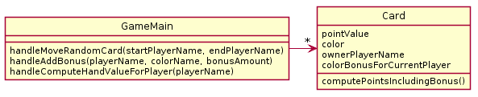
In a particular card game, players have hands of cards. Each card is worth some points and also has a color (red, blue, green). During play, players accrue bonuses that mean cards of a particular color are worth bonus points. During play, sometimes a random card is selected from one player's hand and moved to another player's hand. At the end of game, it is necessary to compute the total points for each player's hand.
What is wrong with this design? (Hint: look at and refer to your design principles by number). I see at least 2 separate categories violated.
PAUSE HERE for a couple minutes!
Try to see what you can think might be wrong
When you have an idea, then continue

Slide 4
My answer (in order of importance)
1a. The design does not function correctly
The player’s color bonus cannot be preserved if he/she loses all their cards of a particular color
It requires iterating over all objects to get the full set of cards in the players hands to move cards or compute final total
1c. Playername & player color bonus are duplicated across cards
2a. Player (common noun from problem) not represented
Notes:
Note for 1a – obviously you try to use nouns from the description. But its not required

Slide 5
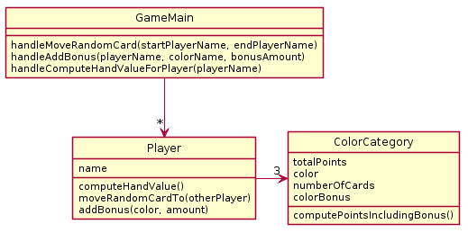
In a particular card game, players have hands of cards. Each card is worth some points and has a color (red, blue, green). During play, players accrue bonuses that mean cards of a particular color are worth bonus points. During play, sometimes a random card is selected from one player's hand and moved to another player's hand. At the end of game, it is necessary to compute the total points for each player's hand.
What is wrong with this design? (Hint: look at and refer to your design guidelines). I see at least 2 separate categories violated.
PAUSE HERE for a couple minutes!
Try to see what you can think might be wrong
When you have an idea, then continue

Slide 6
Some design flaws noticed (in order of importance)
1a. The design does not function correctly
Once a card is added to a player's hand, its specific point value is lost so the card cannot be randomly moved to another player's hand
2a. Card (common noun from problem) is not represented

Slide 7
In a particular card game, players have hands of cards. Each card is worth some points and has a color (red, blue, green). During play, players accrue bonuses that mean cards of a particular color are worth bonus points. During play, sometimes a random card is selected from one player's hand and moved to another player's hand. At the end of game, it is necessary to compute the total points for each player's hand.
Now design your solution that solves all problems.
PAUSE HERE for 5-10 minutes!
Try to make your own improved design
Either paper or using plantuml is OK!

Slide 8
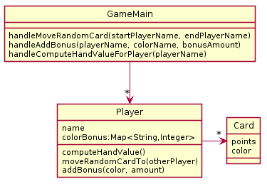
A Potential Solution
Reminder:
We implicitly assume there exists:
constructors as needed
getters and setters as needed
getPoints(), getColor() too
Notes:
Since UML is meant to be a simple way to communicate, we often omit simple methods like getters and setters.
If we want you to show all methods, we will tell you to do so

