Slide 1
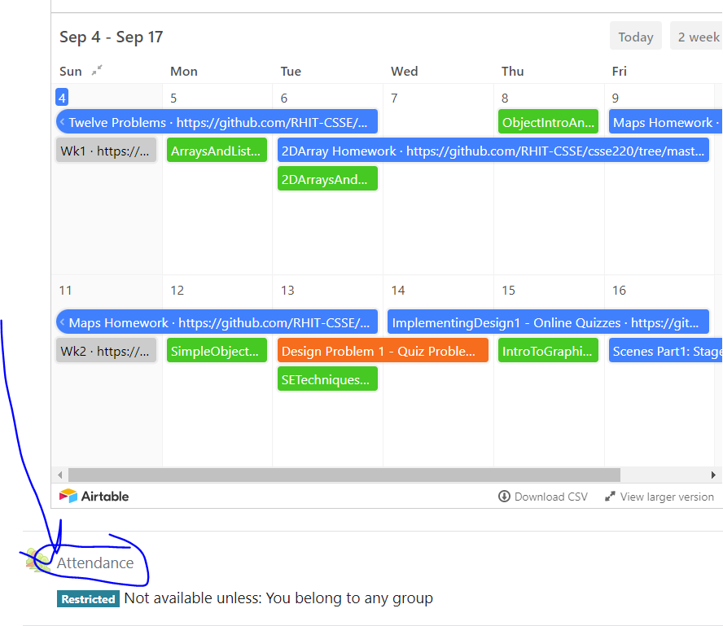
CSSE 220
Today’s Attendance password
__________
Maps
Check out PracticeMapsAndObjectIntro from Git

Slide 2
Maps – What, When, Why, How?
What:
Collection of key-value pairs
Key is the identifier
i.e. A word in a dictionary, or a student ID number, something that uniquely identifies an item
Value is the data for that identifier
i.e. The definition of a word in a dictionary, a Student object for an ID, the value associated with an unique ID
Think of this like a dictionary (in some programming languages they’re even called dictionaries)
Key: word
Value: definition
Notes:
Example: counting the words in constitution, keep track of the occurrences of each word in the document
Each String should map to some integer!

Slide 3
Maps – What, When, Why, How?
When:
We use maps when a unique piece of data is used to retrieve additional information
Why:
Fast access to information based on a unique key
Example:
HashMap<String, Student>
usernameToStudent =
new HashMap<String, Student>();
Notes:
Draw table on the board showing username to students and attempt to look a student up by their username… if we had an ArrayList of students we’d have to loop through each and compare the username to find the student we wanted, but if we have them in a HashMap, we just have to look them up by their username. Makes the code simpler and faster
Angle brackets similar to?? ArrayList
HashMap very common. Has TWO TYPES? Why?

Slide 4

Another Example
HashMap<String, Dog> nameToDogMap = new HashMap<String, Dog>();
Key | Value
Ally
Buddy
Doug
Pickles
Yolanda
Can be created all at once
nameToDogMap = {
("Ally", new Dog("Ally"),
("Buddy", new Dog("Buddy"),
("Doug", new Dog("Doug"),
("Pickles", new Dog("Pickles "),
("Yolanda", new Dog("Yolanda")
}
OR (more commonly) one at a time via “put"
nameToDogMap.put("Ally", new Dog("Ally") );
nameToDogMap.put("Buddy", new Dog("Buddy") );
nameToDogMap.put(“Doug", new Dog(“Doug") );
nameToDogMap.put("Pickles", new Dog("Pickles") );
nameToDogMap.put("Yolanda", new Dog("Yolanda") );

Slide 5
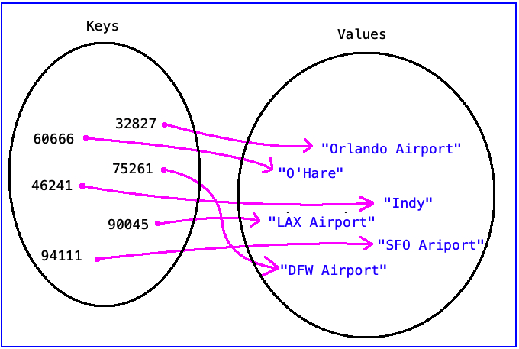
Another Example
HashMap<Integer, String>
airportMap = new HashMap<Integer, String>();
Represented with a mathematical diagram:
Could we reverse the key-value relationship?
Which way is better?
Notes:
This might create a problem if there are two airports in the same zip code.
Q: How could we fix that issue and store information if there are two airports in one zipcode?
A: We could reverse the order so that the key is the String (Airport) and the value is the zipcode
Q: What if there is also Airport that is in two zipcodes?
A: We need to store information in a non one-to-one correspondence. This means the value needs to be a collection. We will look at an example late of this. (Social Media example)

Slide 6
Another Example
HashMap<Integer, String>
zipcodeToAirport = new HashMap<Integer, String>();
Represented with a mathematical set:
zipcodeToAirport = {
(46241, "Indy"),
(60666, "O'Hare"),
(32827, "Orlando Airport"),
(90045, "LAX Airport"),
(75261, "DFW Airport"),
(94111, "SFO Airport")
}

Slide 7
Maps
Sometimes, it’s difficult to fully understand maps.
Let’s do an example together:
Implement an int array using a map
Then we will make a word to square map
Key | Value
0 | 0
1 | 1
2 | 4
3 | 9
4 | 16
Key | Value
“zero” | 0
“one” | 1
“two” | 4
“three” | 9
“four” | 16
Notes:
For good measure, I will start this one from scratch just so they will see it from the ground up (I like them to see it from scratch sometimes, but it appears in the solution set).

Slide 8
Maps
Sometimes, it’s difficult to fully understand maps.
Let’s work with MapExampleV1 from Team's channel for Hollingsworth Sections
Notes:
For good measure, I will start this one from scratch just so they will see it from the ground up (I like them to see it from scratch sometimes, but it appears in the solution set).

Slide 9
Maps
Read through the 3 Map sample problems found in MapsSamples.pdf and make sure you understand how they work
Then use the code as an example to answer the Map quiz questions
Then solve the map problems in today’s code
Post ANY questions to Piazza even including code since this is purely collaborative exercise and the solution code is available to you
Please look to help answer questions other students post
Notes:
Once groups are finished, ask them to work on the array problems from SVN
Once enough groups are finished, review the quiz questions and pint class to the cheat sheet

Slide 10
HashMap with collections as values
What if we wanted to make a mini-social network…
Keep track of each student’s username and friend list?
How could we store that information?
HashMap?
Data Type of key?
Type of value?
Code?

Slide 11
HashMap with collections as values
HashMap<String, ArrayList<String>> friendMap;
friendMap.put("Jason", new ArrayList<String>() );
friendMap = new HashMap<String, ArrayList<String>>();
friendMap.put("Jason", new ArrayList<String>() );
ArrayList<String> jasonsFriends = friendMap.get("Jason");
jasonsFriends.add("Aaron");
friendMap.get("Jason").add("Sriram");
friendMap.get("Sriram").add("Jason");
NULL POINTER EXCEPTION: friendMap.get("Sriram") is null
Keys (String) | Values (ArrayList<String> )
Keys (String) | Values (ArrayList<String> )
Jason | []
Keys (String) | Values (ArrayList<String> )
Jason | [Aaron]
Keys (String) | Values (ArrayList<String> )
Jason | [Aaron, Sriram]
friendMap->

Slide 12
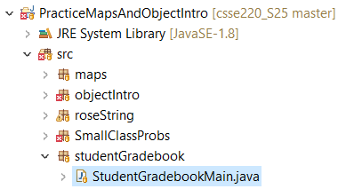

Now code the StudentGradebook class yourself
Uncomment the code found in StudentGradebookMain to see what the class should do
Then create the class and add the constructors and methods you need
If you finish early, add a function to compute the student’s average grade
Notes:
Do not spend too much time on this since students will need time outside of class to complete this. Be sure to reserve time for the rest of the material and for students to complete the quiz.

Slide 13


Terminology Review
client – uses the services of a primitive type or class by declaring variables from these types and then calling operations to manipulate these variables
object – a variable that stores a reference to an object instance
primitive type – boolean, byte, character, short, int, float, double variables of these these types are not objects in Java
variable – stores either primitive data (e.g., from type int) or reference data (i.e., a reference to an object instance)
wrapper class – a built-in Java class that turns a Java primitive type into an object version of the primitive type, e.g., Integer wrapper class is an object version of the primitive type int

Slide 14
Reminder: Questions from Today
Collaborative Exercises
PracticeMapsAndObjectIntro
MapsAndObjectIntroQuiz
Post ANY questions to Piazza even including code since this is purely collaborative exercise and the solution code is available to you
Please help! Post answers to questions posted by other students

