Slide 1
CSSE 220
Linked List Implementation
The git projects for today are:
PracticeLinkedListSimple
PracticeLinkedListSimpleSolution
Notes:
Doing everything in LinkedListSimple today
Quiz given in next slide

Slide 2
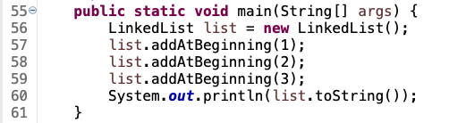
Quiz
Get into pairs
Look at/run the code in LinkedList.java main
Draw a box-and-pointer diagram of what’s happening in the main code.
To figure it out, you’ll have to look at the LinkedList constructor and addAtBeginning.
If you’ve forgotten how to do box-and-pointer diagrams, checkout the handout on Day 5 of the schedule
Q1
Notes:
This diagram is their quiz for the day

Slide 3
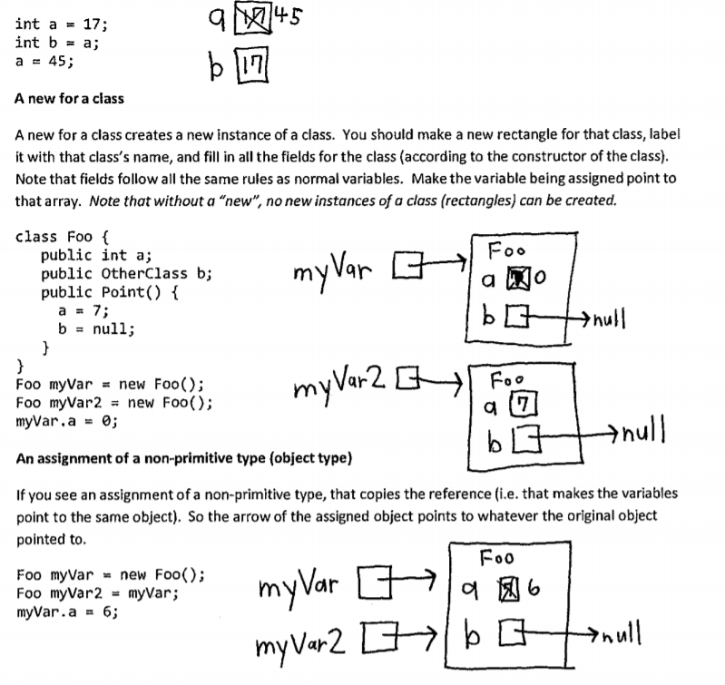

Slide 4
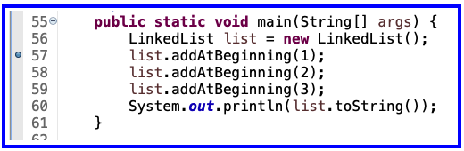
Optional - Now Walk Through Together
Set a breakpoint at first addAtBeginning
Execute in the debugger

Slide 5
Debugger's Variables Tab
Set a breakpoint at first addAtBeginning
Execute in the debugger

Slide 6
Solve the Other Problems in LinkedListSimple
Look at toString to get an idea of how to do size, then go from there
They are in approximate difficulty order
Get help if you get stuck!
Hold on to your quiz today, we will finish it next class period.

Slide 7
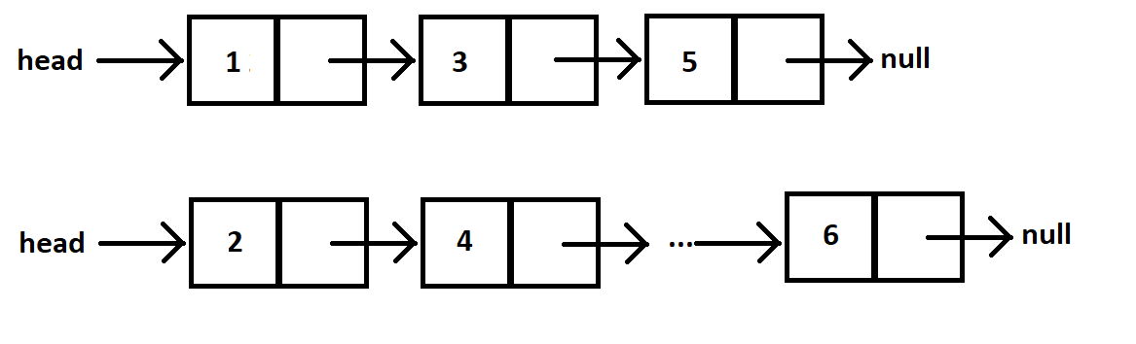
Shorthand Notation
Using pictures will be extremely helpful
Can use System.out.println( this ) to see what the current list looks like (does it match diagram?)

Slide 8
Solve the Other Problems in LinkedListSimple
Look at toString to get an idea of how to do size, then go from there
They are in approximate difficulty order
Get help if you get stuck!
size()
add…
remove…

Slide 9
Loops in Arrays vs. LinkedLists
int[] nums = ……
for (int k = 0; k < nums.length; k++) {
// do stuff with
// arbitrary element nums[k]
}
Equivalent in while loop
int k = 0;
while ( k < nums.length ) {
// do stuff with
// arbitrary element nums[k]
k++;
}
LinkedList list = ……
//Another Day!
Node current = this.head;
while ( ? ) {
//do stuff with
//arbitrary element
?
}
Use a ‘for’ because we know exact length of array at outset
This is known as a definite loop

Slide 10
Loops in Arrays vs. LinkedLists
int[] nums = ……
for (int k = 0; k < nums.length; k++) {
// do stuff with
// arbitrary element nums[k]
}
LinkedList list = ……
Node current = this.head;
while ( current != null ) {
// do stuff with
// arbitrary element
current.value++;
current = current.next;
}
Use a ‘while’ because we do not
know exact length of linked list at outset
This is known as an indefinite loop

Slide 11
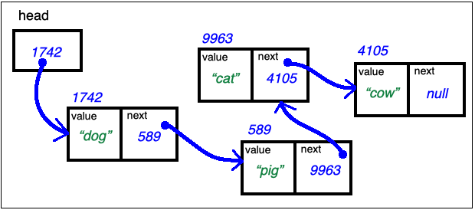
Traverse Linked List Past the End
LinkedList list = …… current's values:
_______________
Node current = this.head; _______________
while ( current != null ) { ___________
// do stuff with __________
// arbitrary element ____________
current = current.next; ___________
} // end while
// current = null here

Slide 12
Traverse Linked List Stop at the End
LinkedList list = …… current's values:
_______________
Node current = this.head; _______________
while ( current.next != null ) { _____________
// do stuff with ______________
// arbitrary element __________
current = current.next; _______________
} // end while
current.next = new Node(vToAdd, null); // adds new node at end

Slide 13
Traverse Linked List With Trailer
LinkedList list = …… current trailer:
Node trailer = null; ____________ ____________
Node current = this.head; ____________ ____________
while ( current != null ) { ____________ ____________
// do stuff w/ node values ____________ ____________
trailer = current; ____________ ____________
current = current.next; ____________ ____________
} // end while

Slide 14
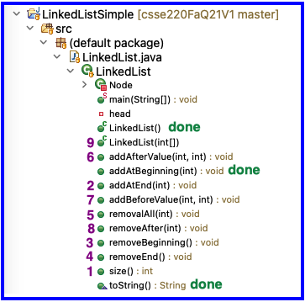
Solve the Other Problems in LinkedListSimple
Look at toString to get an idea of how to do size, then go from there
Recommended order
Get help if you get stuck!

Slide 15
Homework
SinglyLinkedList
Requires you to implement a SinglyLinkedList
Additional algorithm questions which make use of the SinglyLinkedList
Will give time in next class to work on it

Slide 16
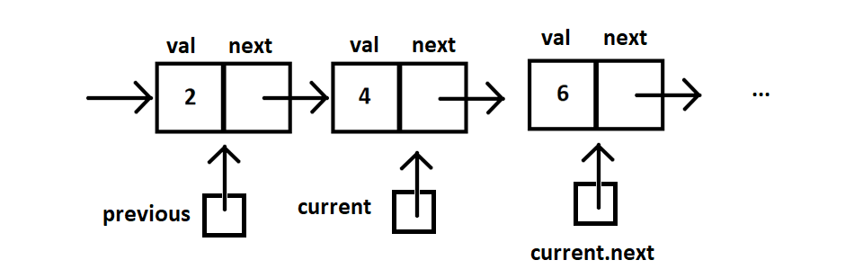
Shorthand Notation

Slide 17
Team Project Work TiMe
Move into your groups if not already
Review comments from Milestone 0 feedback
Be prepared to ask question of the grader
You will have ~5 minutes, so use it well
Notes:
This is the end of Monday’s class, pick up from here on Wednesday to complete quiz

Slide 18
Project advice
When done with MIlestone1 (or beyond)
Add “final Milestone1 Commit”
To your commit message so graders will know to check out that version
Build an end-to-end solution
Build the next thing you can TEST
Don’t focus on cool graphics and other extra items early in the project, focus on basic functionality
Complete the milestone and keep moving forward!
Notes:
This is the end of Monday’s class, pick up from here on Wednesday to complete quiz

Slide 19
FINAL SLIDE FOR TODAY

Slide 20
FRIDAYs material

Slide 21
Data Structures + BiG-O Notation
CSSE 220
Understanding the engineering trade-offs when storing data
The git projects for today are:
PracticeLinkedListSimple
PracticeLinkedListSimpleSolution
Notes:
If students get through things quickly we can move into this material in the first hour, but if not- that is OK, we have the next class period to go through it and give them time to work on the rest of the quiz and the homework problems.

Slide 22
Data Structures
We need efficient ways to store data based on how we’ll use it
"How we'll use it" = algorithms used to access/update data stored in the data structure
The main theme for the rest of the course
Notes:
Q: Have to move all the other elements up or down to make/use room. O(n)

Slide 23
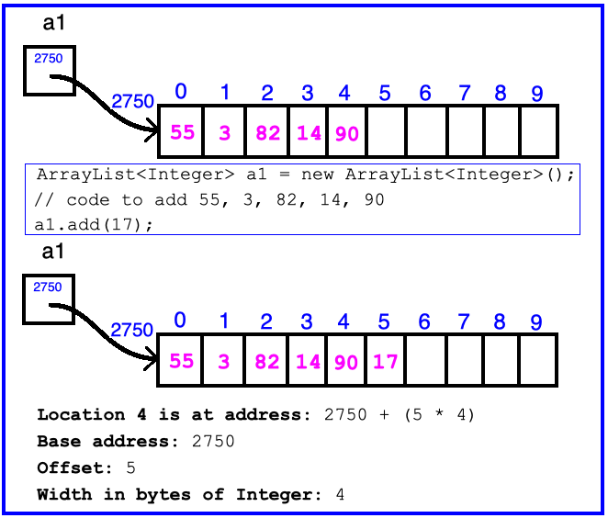
ArrayList Data Structure in Java
Fast addition to end of list Requires 1 multiplication and 1 addition to compute address
Notes:
Q: Have to move all the other elements up or down to make/use room. O(n)

Slide 24
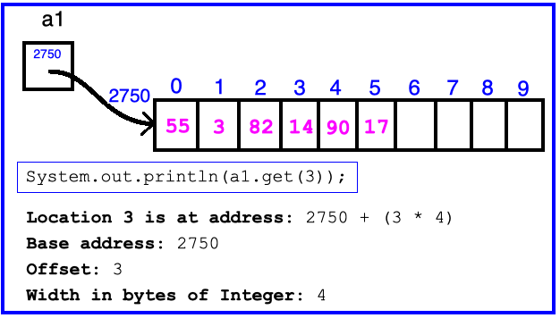
ArrayList Data Structure in Java
Fast access to any existing position Requires 1 multiplication and 1 addition to compute address
Notes:
Q: Have to move all the other elements up or down to make/use room. O(n)

Slide 25
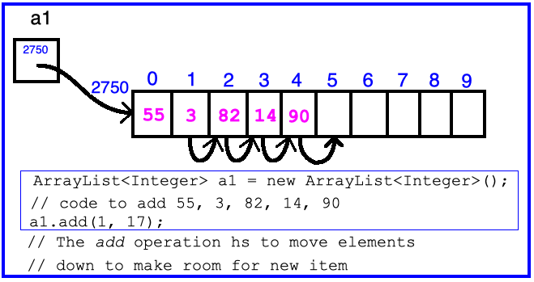
ArrayList Data Structure in Java
Slow inserts to and deletes from middle of list
Notes:
Q: Have to move all the other elements up or down to make/use room. O(n)

Slide 26
Big-O Notation
Describes the limiting behavior
How slow it can possibly run?
Describes the worst case
Used for Classifying Algorithm Efficiency
“O” for “Order”
O(n) → said as “Order n”
O(n^2) → said as “Order n-squared”

Slide 27
Big-O Notation (continued)
Don’t Care About Constants
O(2n + 7) → O(n)
Don’t Care About Smaller Powers
O(6n^2 + 7n) →O(n^2)
Algorithm grows asymptotically no faster than n^2
If constant value, we say O(1) → “Order 1”
O(48) → O(1)
Q2
Notes:
We care about which part of the expression grows the fastest as n, the input size, grows.

Slide 28
ArrayList Performance (Revisited)
Fast addition to end of list:
Fast access to any existing position – O(1) (like array)
Keep extra capacity for list growth
Fast access includes items in capacity not yet filled – O(1)
Capacity management is best left for CSSE230
Slow inserts to and deletes from middle of list
Can get to insert/delete location quickly
For insert, shift all items right to accommodate - O(n)
For delete, shift all items left to fill gap – O(n)
Q3

Slide 29
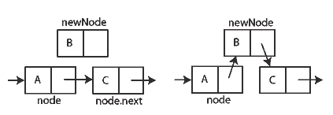
Another List Data Structure
What if we have to add/remove data from a list frequently?
LinkedLists support this:
Fast insertion and removal of elements
Once we know where they go
Slow access to arbitrary elements
data
data
data
data
null
data
Insertion, per Wikipedia
Q4-5
Notes:
- Examples: employee list, music play list
Sketch a linked list on the board for “two more weeks” (quiz #3)
Then show insertion and deletion.

Slide 30
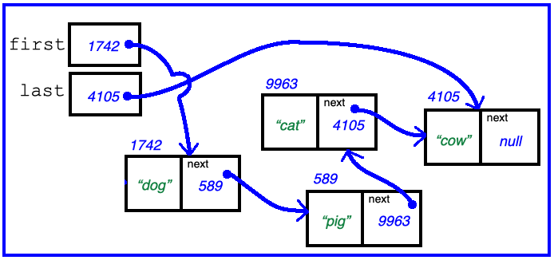
Big-O LinkedList<E> Methods?
void addFirst(E element) _____________
void addLast(E element) _____________
E getFirst() _____________
E getLast() _____________
E removeFirst() _____________
E removeLast() _____________
Notes:
Big-Oh of each?
All of the operations perform as could be expected for a doubly-linked list.
Thus, these operations all take O(1) time.

Slide 31
Homework
SinglyLinkedList
Requires you to implement a SinglyLinkedList
Additional algorithm questions which make use of the SinglyLinkedList
Will give you remaining class time to work on it
If you complete it, work on the project!

Slide 32
Optional Homework: Genetic Algorithm
https://moodle.rose-hulman.edu/mod/assign/view.php?id=1711587
https://rednuht.org/genetic_cars_2/
https://www.tutorialspoint.com/genetic_algorithms/genetic_algorithms_introduction.htm
Can replace a homework assignment grade
A more open-ended assignment
Room to explore ideas
Grade based on completion, design and creativity

